Slide 1
Polling Location Change for Ward 2 Precinct 1 #234-23
From
Albemarle Field House
To
Scandinavian Living Center
Notes:
Thank you Chairman, and the members of the committing for having us at tonight’s meeting. I will now talk about (say docket number) the temporary polling location change for W2P3

Slide 2
#234-23 Request to move Ward 2, Precinct 1 Polling Location
THE CITY CLERK is requesting that the Ward 2, Precinct 1 polling location, currently located at Albemarle Field House at 250 Albemarle Road, be temporarily relocated to Scandinavian Living Center at 206 Waltham Street, as Albemarle is under construction.
The Election Commission Voted 4-0 to recommend this change.
Notes:
The Senior Center will be under construction until Summer/Fall 2024
We propose that that W2P3 temporarily vote in the Gymnasium of Cabot elementary as Cabot has enough space, and resources (tables, chairs, outlets) to accommodate two precincts

Slide 3
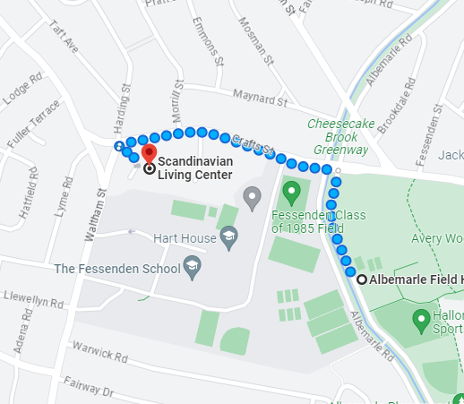
Location
Notes:
If you drive to voting, it is an additional 3-5 minute ride (.6 miles)
If you walk it is an additional 10 minute walk at most (.4 miles)
If you take the 59 bus you still can get off at the Senior Center stop, and then you just have that additional 10 minute walk as well. But it does not chance what transportation you need to take

Slide 4
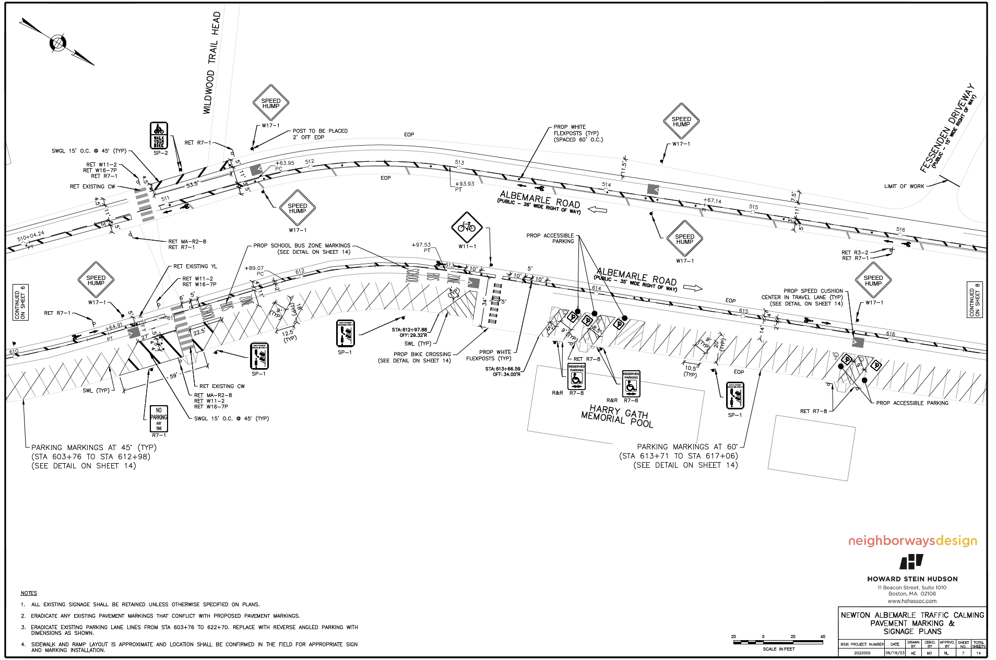
Construction Happening at Albemarle
According to the Planning Department, construction is slated to begin in August, but there is a potential that the project is delayed into September.
Parking spots will be limited (as can be seen in the picture below). And during construction there will be temporary street closures.
Notes:
The Senior Center will be under construction until Summer/Fall 2024
We propose that that W2P3 temporarily vote in the Gymnasium of Cabot elementary as Cabot has enough space, and resources (tables, chairs, outlets) to accommodate two precincts

Slide 5
Construction Happening at Albemarle (ctd)
Due to the potential for conflict with construction occurring on Election day, and with the potential of limited parking, it is suggested that 2-1 be moved to Scandinavian Living Center just for the September and November Elections this year.
Notes:
The Senior Center will be under construction until Summer/Fall 2024
We propose that that W2P3 temporarily vote in the Gymnasium of Cabot elementary as Cabot has enough space, and resources (tables, chairs, outlets) to accommodate two precincts

Slide 6
Any Questions?
Notes:
Yes it can, the gym is quite spacious and offers enough resources

