Slide 1
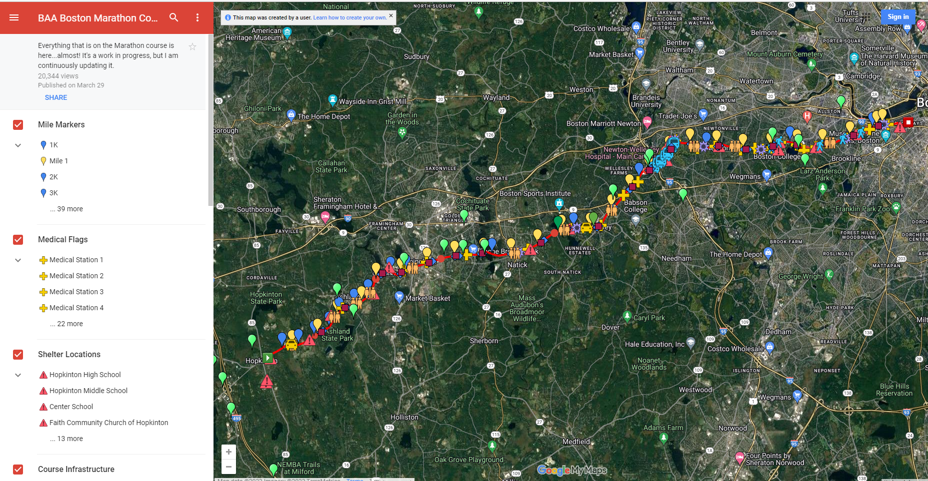
Detailed Boston Marathon Course Map

Slide 2
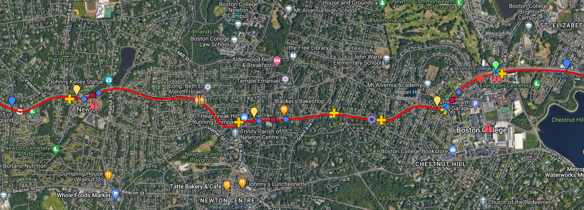
Newton City Hall to Boston College Details
Location of Incident

Slide 3
Sumner Street to Grant Ave Section Map with Hydration Station Location
“Vault”
Supply Depot
Hydration Station

Slide 4
Dispatch From BAA

Slide 5
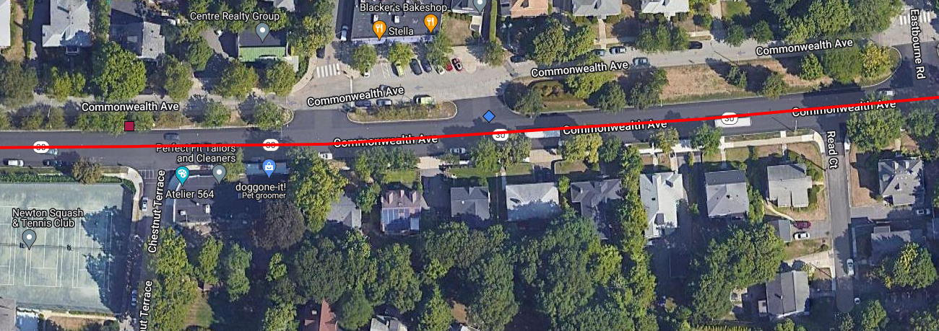
Detail Map of 530-534 Comm Ave Area
Hydration Station
530 Comm Ave
534 Comm Ave

