Slide 1

TODAY’S GOALS
Brief stormwater compliance program review
Accomplishments to date
Clean Charles River Initiative: Phosphorus Control Plan update
What’s next?
Newton’s Municipal Stormwater (MS4) Permit Program Updates
Presentation to Public Facilities Committee

Slide 2
Why Are We Here?
Municipal Separate Storm Sewer (MS4) General Permit reissued by EPA in 2016 and became effective July 1, 2018
This federal Clean Water Act permit requires multi-faceted municipal implementation – Utilities, Planning, Operations, Engineering, GIS-Information Technology, Communications – It Takes a Community!
Requirements are very challenging and we need everyone to understand the implications and needs.

Slide 3
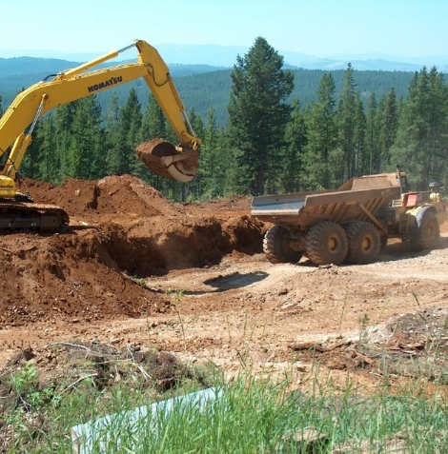
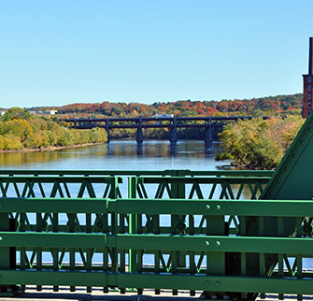
Nationwide Stormwater Permitting Programs
Construction General Permit (CGP):
Runoff from >1 acre soil disturbance
Industrial Multi-Sector General Permit (MSGP):
Runoff from Industrial Facility per SIC Code
Municipal MS4 General Permit

Slide 4
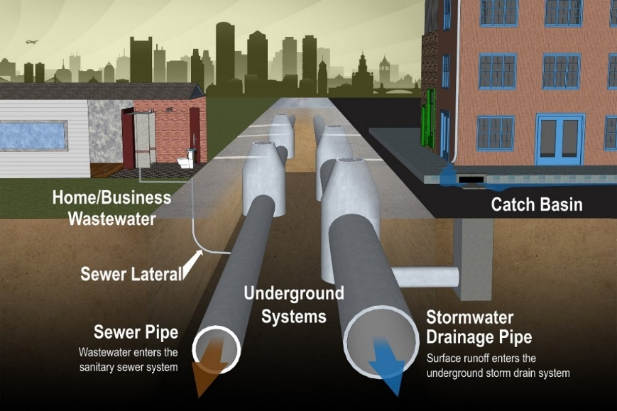
What is an MS4?
A Municipal Separate Storm Sewer System is:
A conveyance or system of conveyances owned by a state, city, town, or other public entity that discharges to waters of the U.S and is:
  Designed or used for collecting or
  conveying stormwater
  Not a combined sewer
  Not part of a publicly-owned
  treatment works

Slide 5
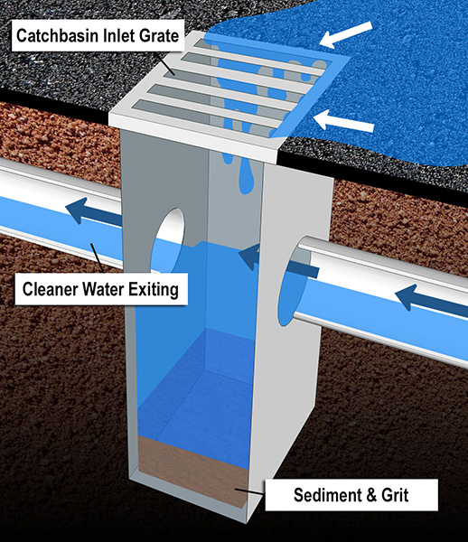
Newton’s MS4
Drainage System Facts:
320 miles of stormwater drainage pipe
12,750 catch basins
5,852 of Manholes
2 pump stations
183 exterior outfalls/interconnections
201 Interior outfalls
14 miles of streams
Ditches and Swales as well…

Slide 6
What is the MS4 General Permit?
Clean Water Act requires EPA to regulate
any discharges from the MS4 based on
1987 Amendments to the Act
The MS4 general permit is based on
development density and population
~260 Municipalities Covered in MA
In most states, the state administers this permit
– MA is EPA regulated
Every five years a new permit is drafted
and issued (in theory)
Each permittee is required to develop
a 5-Year Stormwater Management Plan
consistent with the general permit
Currently in “Permit Year 5”
EPA administers NPDES permits in Massachusetts

Slide 7






Municipal Stormwater Compliance
Six Primary Control Measures
1) Public Education
2) Public Involvement
3) Illicit Discharge Detection and Elimination
4) Construction Site
Runoff Control
5) Post-Construction Stormwater Management
6) Good Housekeeping and Pollution Prevention

Slide 8
Newton’s Accomplishments to Date
MS4 Program Highlights
On-going social media, Green Cart, stormwater webpage, pet licensing, and paper flier educational materials developed and disseminated.
Over 80% of the City’s stormwater drainage system investigated for illicit discharges.
Hundreds of site plans reviewed annually for compliance with construction erosion control and stormwater control policies.
Thousands of construction site inspections annually.
Ongoing street sweeping, leaf litter and catchbasin cleaning programs. Over 1500 tons of material swept from streets annually!

Slide 9
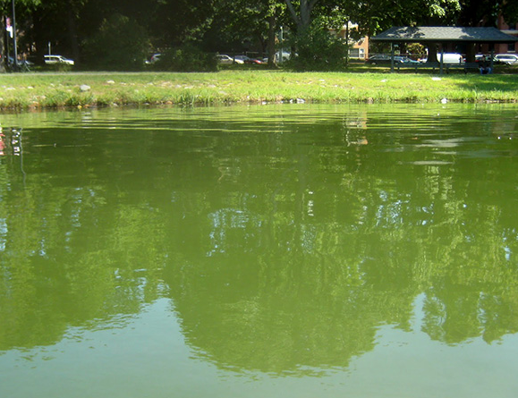
Nutrients as a Pollutant
Health Officials Warn
Of Blue-Green Algae Bloom in Charles River
Increased Nutrients
Increased Biological Activity
Reduced Dissolved Oxygen & Changing pH Levels
August 31, 2016 2:45 PM
BIOLOGICAL &
ECOLOGICAL STRESS

Slide 10

Clean Charles River Initiative
Medium Density Residential
3,578 kg/yr
Reduce Phosphorus in discharges through strategic planning and implementation
1995: EPA New England launched the Clean Charles initiative.
The EPA and MassDEP established Total Maximum Daily Load (TMDL) for all discharges
  2007, Final TMDL for Nutrients in the Lower Charles River Basin
  (Lower TMDL)
  2011, TMDL for Nutrients in the Upper/Middle Charles River (Upper TMDL)
TMDL Requirements:
  Phosphorus WWTF discharge limits for summer/winter at 0.1/0.3 mg/L
  Stormwater phosphorus reductions are significant!
High Density Residential
3,876 kg/yr
Commercial / Industrial
4,091 kg/yr
~12,000 kg/yr reduction from stormwater
sources

Slide 11
Nutrient Load Reduction Requirements
The MS4 General Permit defines stormwater load reduction targets for individual communities
34 regulated communities will be required to meet the Load Reduction Requirement by 20% in the first eight years of the permit term (2026)…and by 25% in the first ten years (2028)
Newton
- 1303 lbs/yr
Dedham
- 222 lbs/yr
Lexington
- 133 lbs/yr
Wayland
- 11 lbs/yr
Communities Shown Here for Example Only – 30 others included in discharge requirements

Slide 12
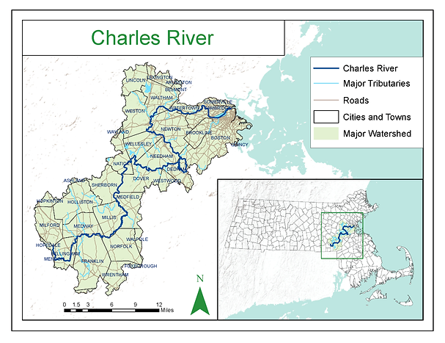
Newton’s Phosphorus Control Plan Obligations
Priority ranking of areas and infrastructure for the implementation of stormwater quality control facilities
Establish O&M program for those structural controls
Identify non-structural stormwater controls that will support the reduction of phosphorus loading
Legal and Funding
Assessment
Control Plan
Implementation
Reduce TP by 25%
By 50%
2018
2020
2023
2026
2028
2033
Notes:
Charles River Watershed
308 square miles
Population: 1.2 million
35% impervious area

Slide 13
Phosphorus Control Planning Schedule
Developing a multi-phase plan to achieve TMDL goal.
Reduce Total Phosphorus from stormwater discharges by 61% or 5,214 lbs by 2038 (Phase 1, 2 and 3 PCP).
Years 1-5
July 2018-2023
  Create Phase 1 PCP Plan by June 2023
Years 5-10
July 2023-2028
  Implement Phase 1 PCP Plan
  Create Phase 2 PCP Plan
Years 10-15
July 2028-2033
  Implement Phase 2 PCP Plan
  Create Phase 3 PCP Plan
Years 15-20
July 2033-2038

Slide 14
Phosphorus Control Plan Status
Year 5 (2023)
Description of Phase 1 Planned Controls
Implementation Schedule & Cost
Description of Structural Control O&M Program
Written Phase 1 PCP
Full Implementation of Non-Structural
Currently accounting for anticipated benefits of non-structural controls (street sweeping and leaf litter clean up)
Identifying potential opportunities to account for existing public and private stormwater controls
Current projections are that existing “controls” only account for about 1/3 of Permit Year 8 target and 1/4 of Permit Year 10 target
In Progress

Slide 15
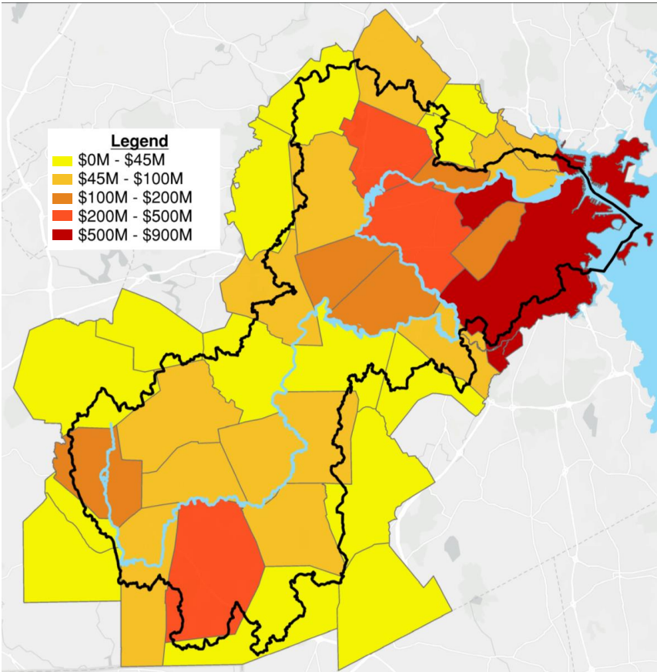

Phosphorus Control Needs?
About 1,000 lbs of phosphorus will still need to be targeted for removal through new stormwater control retrofits and non-structural pollution prevention programs on public and private properties to meet Year 10 requirements.
Close to 4,750 lbs to meet Year 20 requirements.
So…What Does this Mean to the City?

Slide 16
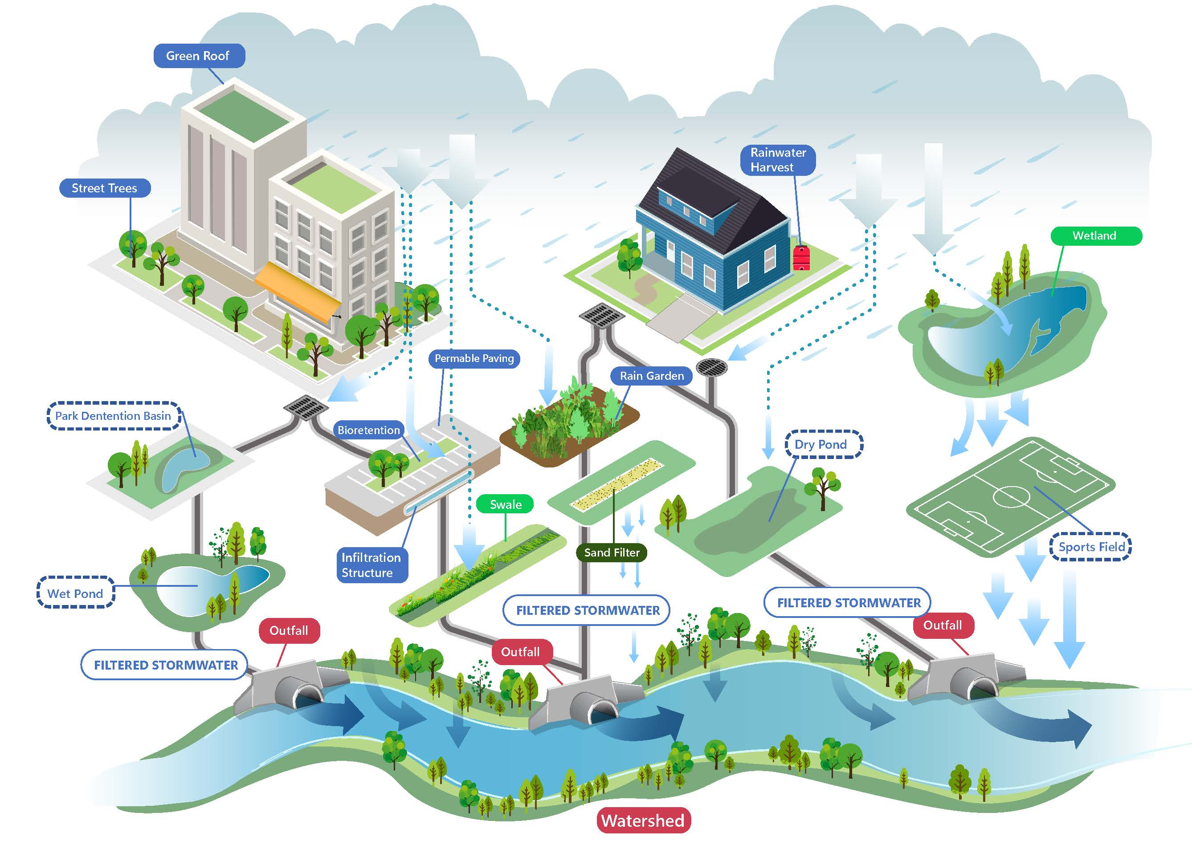
What Does Comprehensive Stormwater Retrofitting Look Like?

Slide 17
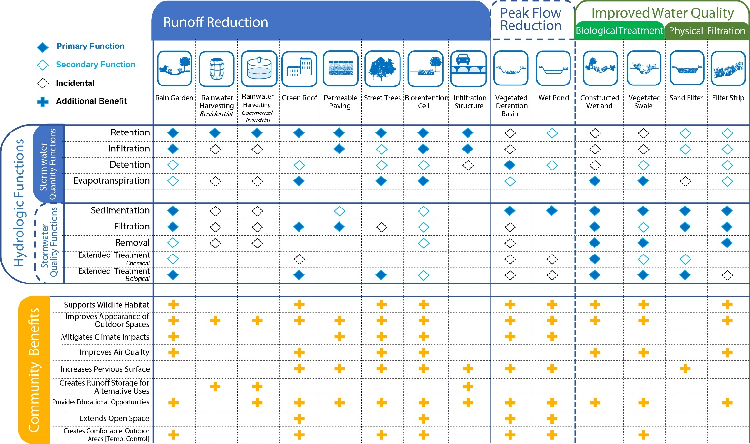
What are the Benefits of Comprehensive Stormwater Retrofitting?

Slide 18
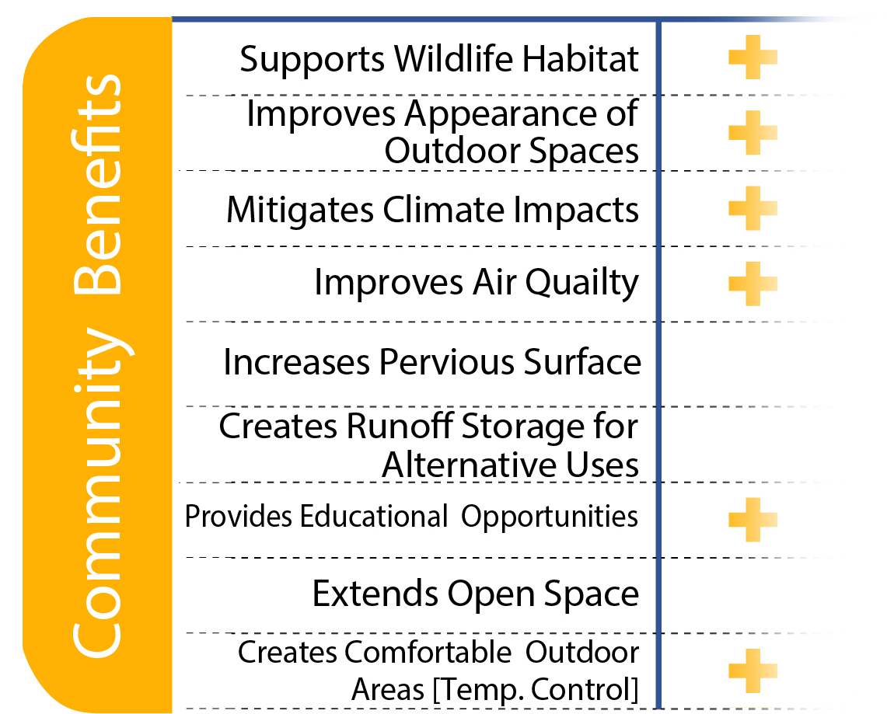
What are the Benefits of Comprehensive Stormwater Retrofitting?
Supports
Improves
Mitigates
Increases
Creates
Provides
Extends
Creates

Slide 19
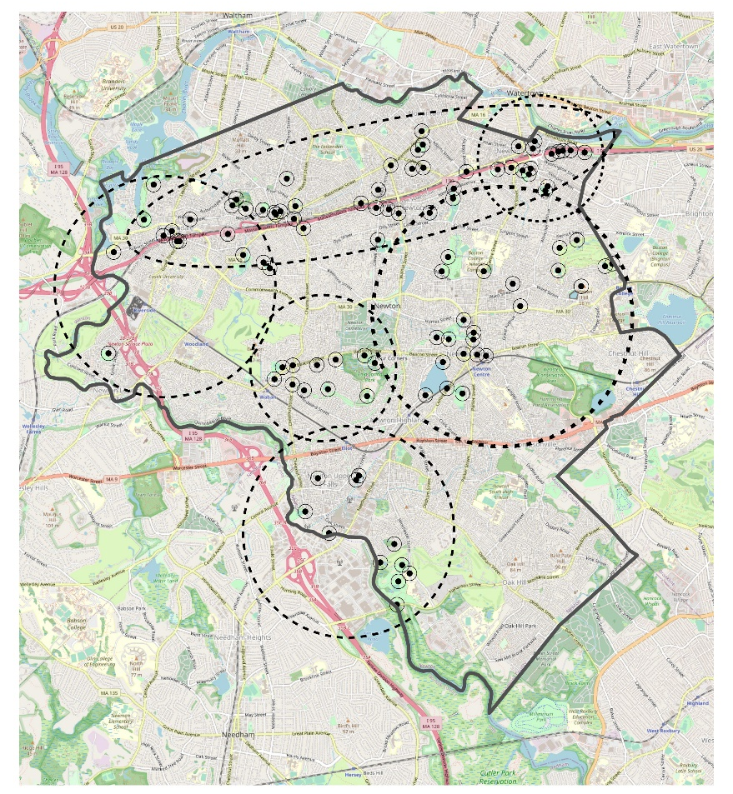
Where Are We Looking for Retrofit Opportunities?
Municipal Facilities/Properties
  School Projects
High Benefit to Cost
Anticipated and Upcoming Facility Improvements
Streetscape Improvements
Alignment with Community Needs and Vision
  Village Enhancement Projects
Washington Street Vision Plan
Newton Business Development Corridor
California Street Redevelopment
Climate Adaption Improvements
Newton Comprehensive Plan
Riverside Vision Plan
Needham Street Vision Plan
Charles River Mill Development
Four Corners Redevelopment Plan
Cochituate Aquaduct Management
Upper Falls Greenway Development
Newton Comprehensive Plan
Open Space and Recreation Plan
Newton Centre Redevelopment
Newton Square Enhancements
Walnut Street Enhancements
Wells Ave. & Business Park Redevelopment
  Public/Private Partnerships?

Slide 20
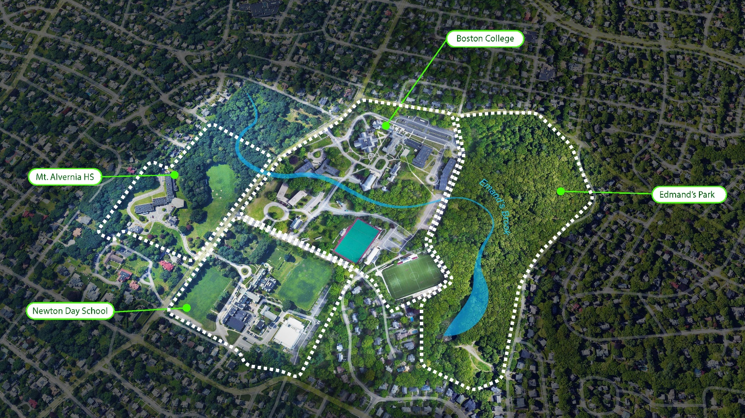
What Does Comprehensive Stormwater Retrofitting look like in a Newton watershed?
Residential Raingarden Community Programs
University Green Infrastructure Collaboration
High School Raingarden Demonstration and Educational Programming
Urban Pond Restoration and Park Improvements
Park and Ballfield Nutrient Best Management

Slide 21
Creating a Holistic Urban Clean Water Strategy
Identification of Issues and Opportunities
Goal Setting
Participatory Community Planning
Revitalization Ideas
Economic Development Target Areas
Identification and Vetting of Pipeline Projects
Weaving in of Other Business Expertise
Aligning Stormwater Infrastructure Needs to Vision
VISIONING
Funding Identification and Grant Support
Incentive Programs
District/Tax Based Financing
Public-Private Partnerships and Partner Identification
Bid Documentation
Contractor Procurement
Construction Administration
Resident Project Representation
Operations and Maintenance
Daylighting Waterways
Parks and Signature Open Spaces
Streets
Conservation
Urban Pond Renewal
Integration of Green Systems
Design Infrastructure/Resiliency
Character/Brand Strategy
Highest and Best Use Partnerships
Clean Water
Equity
Resiliency
Environmental
Stewardship
Cost-Saving
FUNDING & IMPLEMENTATION
PLACE
MAKING
Highest and Best Use Analysis
Low Impact Development Strategy
Operations and Maintenance Strategy
Pollution Prevention and Source Control Strategy
Innovative Ideas and Regulatory Advocacy
Partnering Ideas
Site Development Scenarios (Public or Private)
Hydraulics, Hydrology, Water Quality Modeling
Cost-Benefit Analysis
Roadmap to Implementation
Policy Auditing- Are we set up to succeed?
Streamlining of processes to encourage (re)investment
Zoning and Land Use
Policy Recommendations
Political Navigation and Strategy
Sustainability/ Resiliency Goals & Recommendations
POLICY ALIGNMENT
STRATEGY

Slide 22
In Summary
Excellent progress on most stormwater permit obligations!
PCP Phase 1 Completion June 2023
Continued financial support for operations, program and capital investment
Integration of community economic and community development vision with clean water programs will reduce costs and accelerate progress on Clean Charles Initiatives

Slide 23
Questions / Discussion
THANK YOU!
Newton’s Municipal Stormwater (MS4) Permit Program Updates
Presentation to Public Facilities Committee

