Slide 1
Thoughts on How Key Partnerships Could Accelerate Newton Residents’ Adoption of 4OurFuture Actions
A discussion document for the NCCE
Jon Slote
7/5/23 version
Player | Personal Plan | Find Vendors | Apply for Rebates
HVAC inspector | With checklist? Train coaches? | Conflict | Not appropriate
Energy coaches | With checklist? | Informal only | Could be good fit, maybe for specialist?
Endless Energy | Good fit with audits | Conflict of interest | Possible
Abode |  | Conflict? | Potential
New third party | Could City endorse rather than pay? | Best fit - follow Solar Sage model? Could be fee-based. | Potential - could be fee-based

Slide 2
Starting point: The NCCE’s Residential Recommendations review with the City
On 5/8/23 Halina and a subset of the NCCE reviewed the 5-point residential plan with the Mayor and others from her Sustainability team. This included a review of recommendation #5.
Proposal
5. Create an Electric HVAC Inspector role
As the number of heat pump installations as increased in Newton, so has and will the number of citizen complaints. At least some of these problems could have been avoided with better homework before the contract’s signing, and better verification of delivered quality after project completion.
We recommend that the City create an Electric HVAC Inspector role to assist Newton’s residents’ efforts to electrify their homes. This role would review all permit applications for electric heating systems, inspect contractor workmanship on-premises, and issue certificates of compliance for completed projects. This could be accomplished by retraining one of the current inspectors or serving as the basis for a hire in the near future. In addition, such a capability-enhancing effort could provide career-and-grade professional development opportunities for City personnel.
Should the functions of Electric HVAC Inspector be outside the purview of the Inspectional Service Department, it may make more sense to locate it in a different executive administrative unit.
Discussion Summary
Halina described the many visits from her heat pump installer and Inspectional Services that her own heat pump installation required, however the Mayor took this as an example demonstrating that the needed inspectional services were provided.
Jonathan pointed out that fulfilling Newton’s CAP goals would demand many more heat pump installations than our current volume, and this could stretch our electric HVAC inspectional services capacity. The Mayor understood, but didn’t feel we were needing to yet consider expanding this service capacity beyond a single individual.
After hearing many comments supporting this recommendation, the Mayor was clearly unconvinced, and pointedly asked the group “What problem are we solving for?”
Follow Up
Jonathan and Asa volunteered to be the NCCE contact persons to work with Ann Berwick and with the ISD Commissioner when he/she comes aboard about what an Electric HVAC Inspector/Advocate role should look like.
Phil is also potentially interested in contributing.
Jon mentioned that in California has a service similar to the one we recommended as #5. He will send out more detailed information shortly.

Slide 3
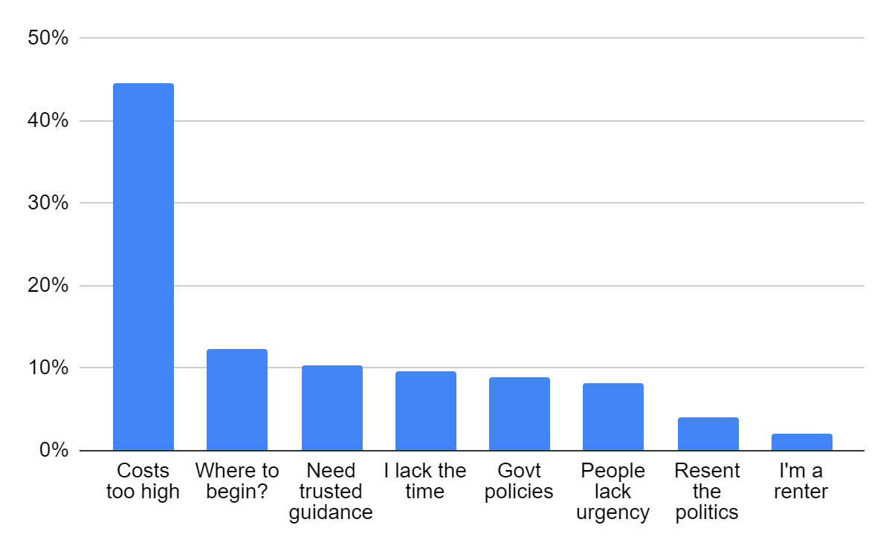
Stepping back: Identifying the key barriers to residents taking action
Is there a better answer to the question “What problem are we solving for?”
Barriers Identified in Newton’s Listening Project: (Independent research project by Slote et al)
Barriers Identified from QuitCarbon’s Research: (West coast startup supporting decarbonization)
Residents' lack of a sufficiently detailed plan to know the complete scope and costs of their project
Concerns about finding an honest, reliable contractor
Lack of understanding about available incentives, and/or a perception that obtaining them will be very onerous
% Of Respondents Mentioning
These two different sources show striking agreement on the primary barriers, i.e.:
Specific Plan
Trusted Contractors
Available Incentives
Link to Newton Listening Project Report:
https://drive.google.com/file/d/1jwaau7dWOT3O4df6vZUSQuf7MDAXWvxk/view?usp=drive_link
Link to QuitCarbon’s Website:
https://www.quitcarbon.com/

Slide 4
The Inspector’s role and primary barriers
What barriers do the proposed Inspector’s roles address?
Barrier Addressed
Electric HVAC
Inspector’s Responsibilities
Responsibility Services Other Value
Specific Plan
Trusted Contractors
Available Incentives
Permit applications review
On-site inspections
Certificates of compliance
While permit reviews should have some impact on resident’s plans, the Electric HVAC Inspector role doesn’t generally address the primary barriers.
So, what can we do to better address these primary barriers?

Slide 5
What markets usually want: For each barrier, a specific response
Informational responses are easy to implement, assistance is harder to do but can have a much bigger effect
Barrier Category
Specific Plan
Trusted Contractors
Available Incentives
Response Depth
Potential Responses
Information that makes it easier for me to know what I need to do
Providing a checklist of how to properly electrify
Finding available local heat pump contractors
Providing access to a comprehensive list of available incentives
Assistance that removes friction to getting the result I want
Creating personalized home electrification plans
Recommending a specific heat pump contractor
Creating a personalized plan to facilitate filing for available incentives

Slide 6
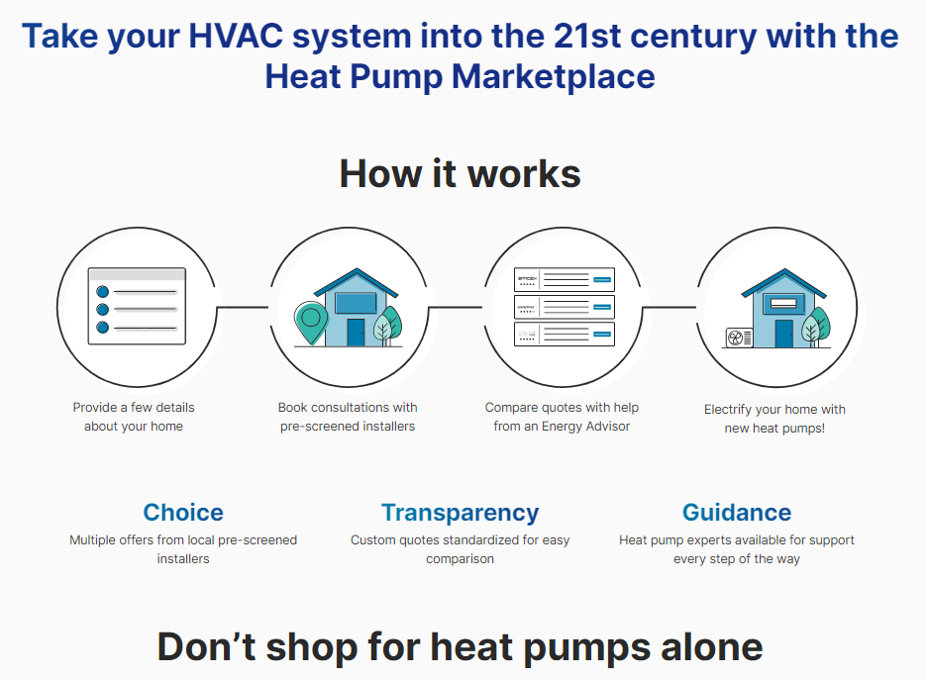
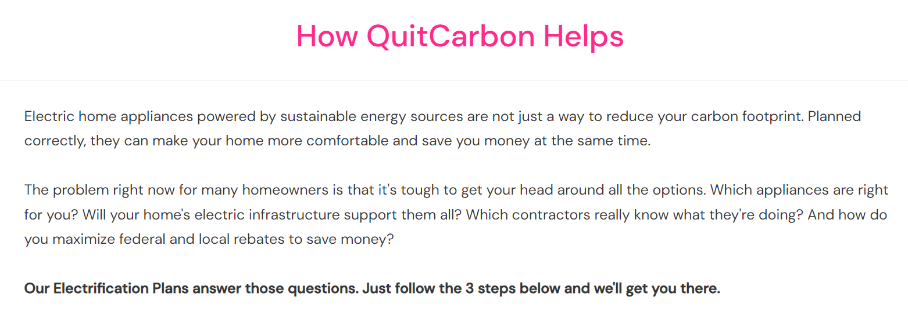
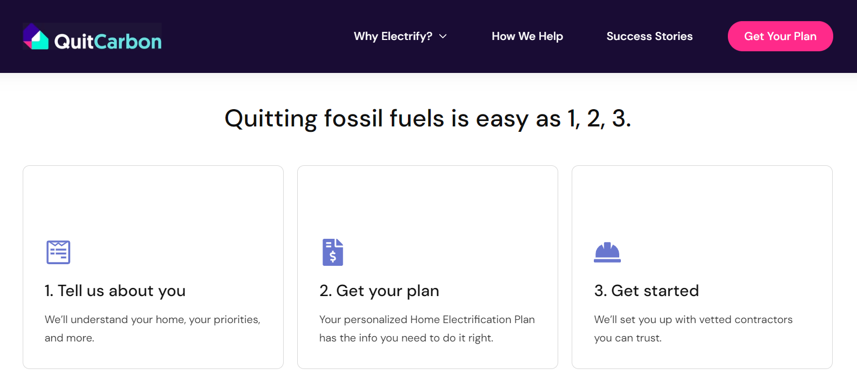
Market Scan: Some other company’s approaches to address inertia
QuitCarbon
EnergySage
Bay Area startup QuitCarbon explicitly focuses on resident’s top barriers in their service descriptions:
EnergySage provides our residents with access to solar installers…
The centerpiece of their pitch is a free electrification plan; revenue flows via referral payments from contractors.
…and has very aggressive plans to expand their services:
The company provides an online
marketplace that has helped homeowners
find solar installers for the past decade. With the financial backing of France-based Schneider, EnergySage last fall launched a residential heat pump marketplace. Next up: adding related business lines such as EV chargers.
“Now that we have the money and the resources from Schneider, I want to go global,’’ CEO Vikram Aggarwal said. “I want to build this company into the next Amazon of energy.’’

Slide 7
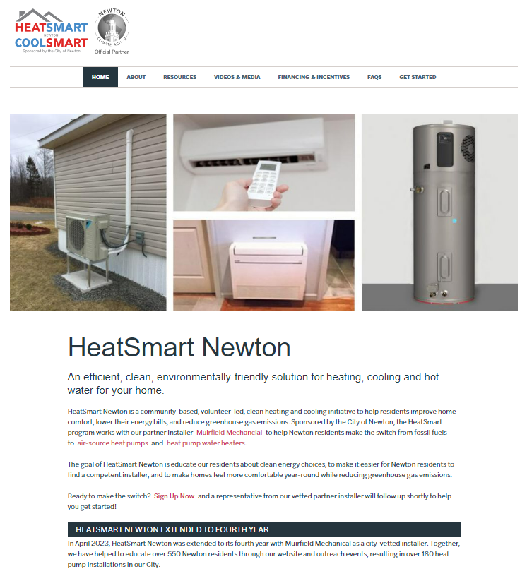
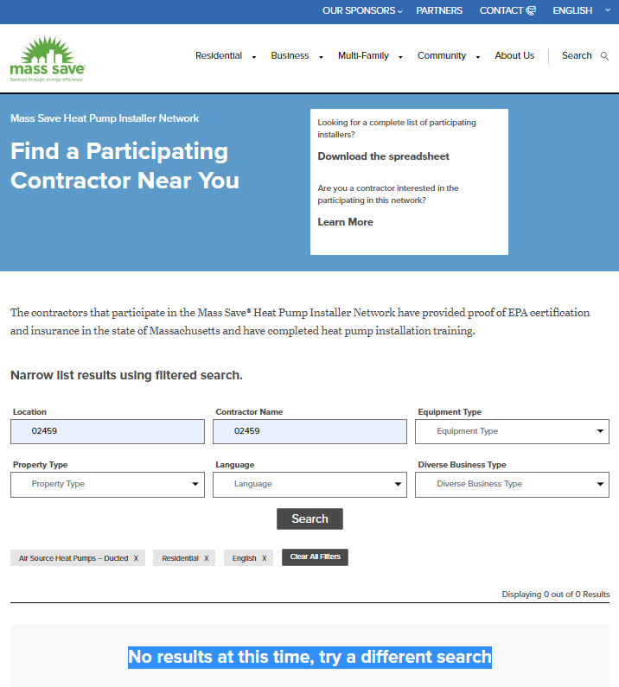
Market Scan: Likely options for marketable heat pump installer search capabilities
Present entities in this space each bring some strengths and questions
HeatSmart
The City’s current heat pump expert partner organization focuses on promoting our one vetted vendor… it’s simple but may not be scalable or appealing to everyone.
Mass Clean Energy Center
MassCEC’s newly redesigned consumer website makes going green look easy… but most consumers would conclude that their heat pump installer searches don’t work.
EnergySage
The City’s current solar marketplace platform generally gets high marks… will their more recent expansion into heat pumps continue this trend?

Slide 8
Implementation possibilities for each response
A comprehensive approach depends on partnerships between multiple public and private entities
Provide a checklist of how to properly electrify
Find available local heat pump contractors
Provide a comprehensive list of available incentives
Checklist generated by Energy Coach with expert input.
Checklist to be approved by Electric HVAC Inspector.
Distributed by Energy Coaches, through Newton website, etc.
Deepen Newton’s relationship with whichever vendor can produce the best heat pump contractor search capabilities.
Similar to current heat pump installer campaigns, the City, Green Newton, Mothers Out Front, etc. should aggressively promoting availability of incentives more widely.
Information
Create personalized home electrification plans
Recommend a specific heat pump contractor
Create personalized plans to facilitate filing for incentives
Selected Energy Coaches (or contractor) to expand role to include creating plans residents can shop with.
Electric HVAC Inspector to train or coach on how to create plans that follow checklist.
Inspector distributes checklist with relevant permits.
All parties step up promotion of Newton’s vetted contractor.
Explore EnergySage’s willingness to broker specific recommen-dations (while retaining Muirfield’s prominent placement).
EnergySage service could charge a fee or be paid by referral.
Explore GreenNewton’s willingness to provide bespoke assistance as a service.
Service could have a fee, or a discounted fee with a GN membership, or just require a membership.
Assistance
$
$
$ = Revenue opportunities

Slide 9
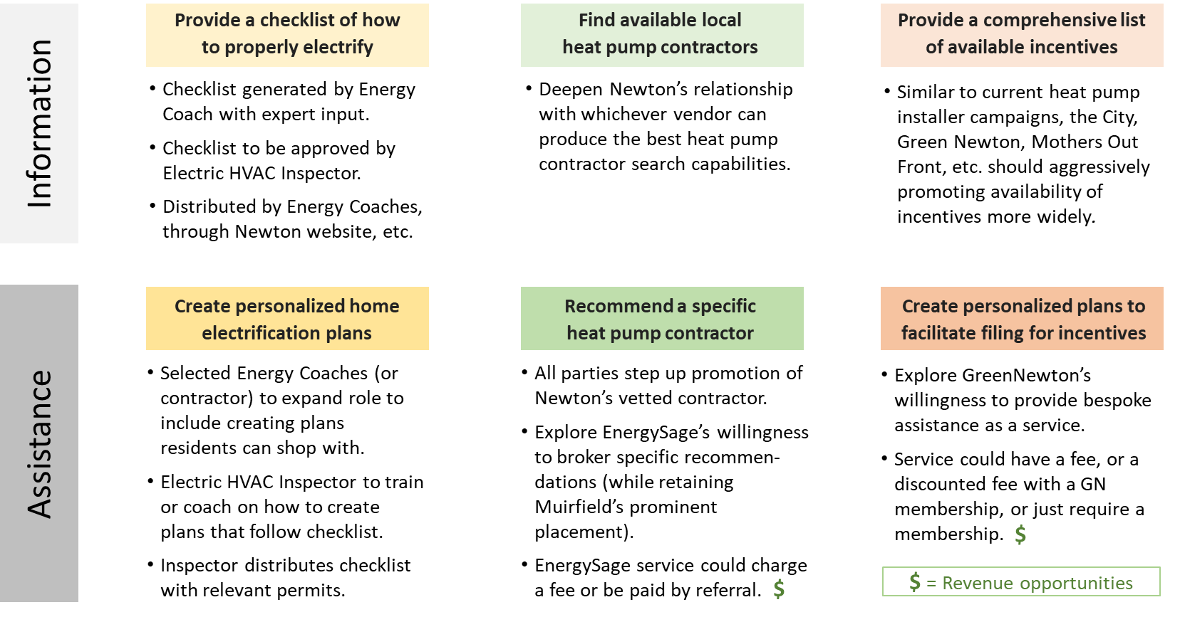
Consider: Might we adjust the NCCE’s residential recommendations?
There seem to be opportunities to add to our original plan in the interest of responding more directly to key barriers.
Which of the items shown might the NCCE want to adopt, reject, amend, etc.?
What other ideas haven’t we yet considered?
Next steps?

