Slide 1
Accessory Apartment Amendments
Docket #192-22
Zoning and Planning Committee
July 18, 2022

Slide 2
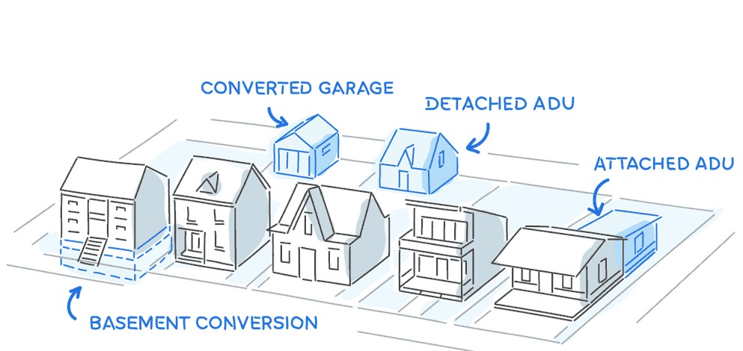
Overview
Recap of April Meeting
Proposed Amendments
Examples of Recent Projects
Next Steps

Slide 3
Recap of April Meeting

Slide 4
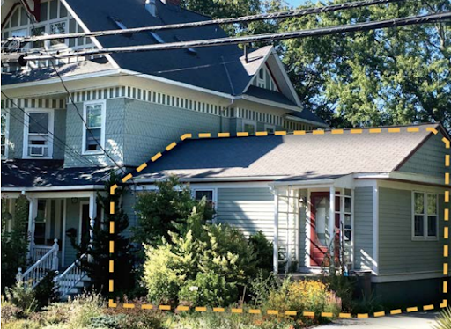
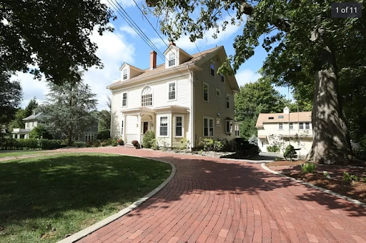
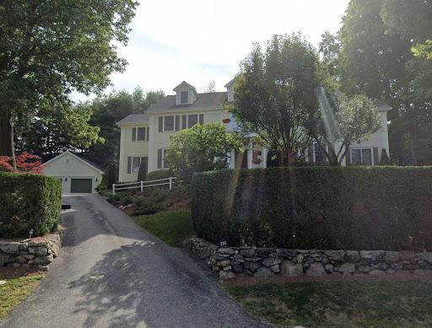
Interior & Detached ADUs
Image Source: Google Earth

Slide 5
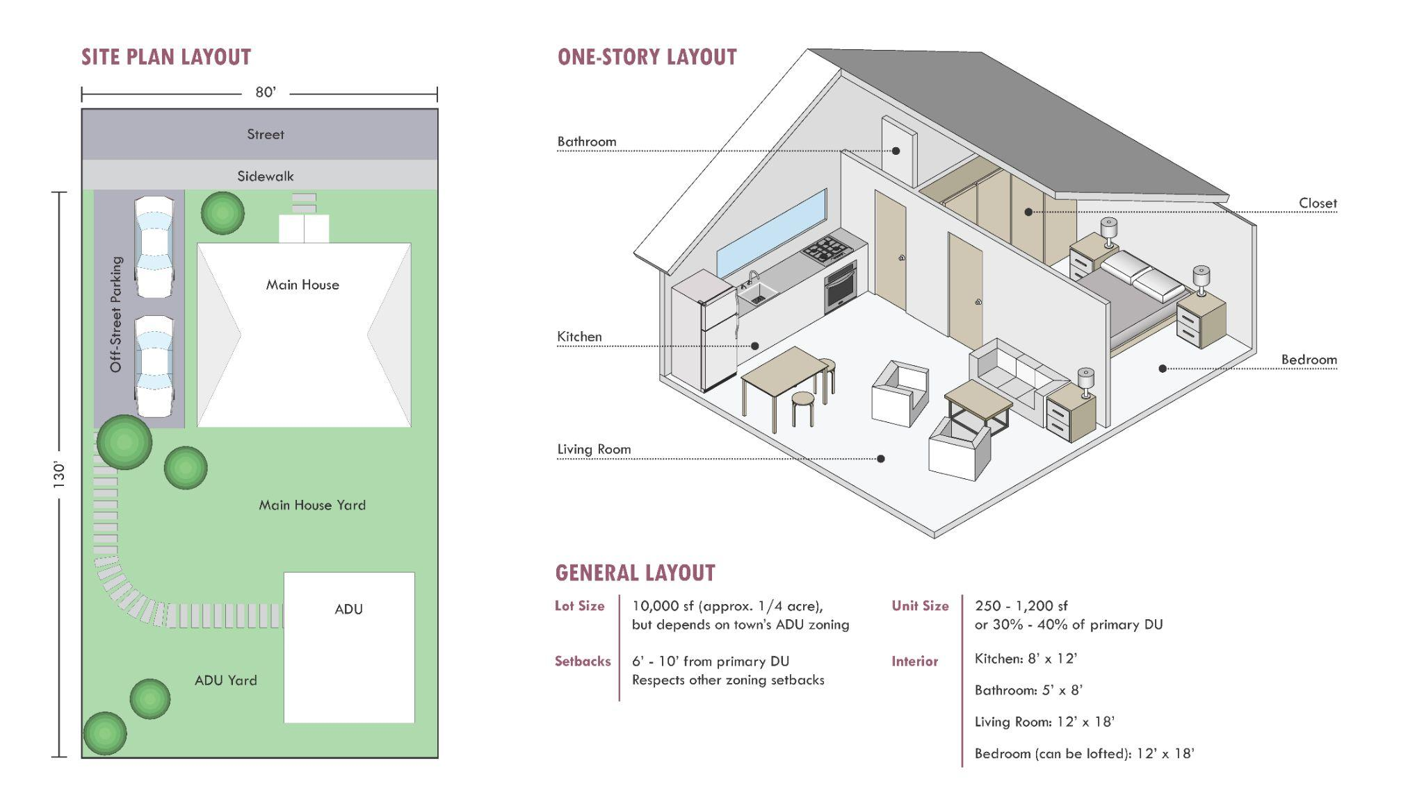
Benefits of ADUs
Diversify housing options
Flexibility for homeowners
Allow for new housing without adding new buildings
Support for aging in place & needs of a dynamic, changing community
Image Source: “Living Little,” MAPC

Slide 6
Proposed Amendments:
Remove the 4-year lookback period for ADUs
Allow small detached ADUs by-right
Maximum size allowed by-right
Updated setback requirements

Slide 7
1. Remove 4-year lookback
Why?
A primary residence must be at least 4 years old to get a permit for an ADU, except by special permit
Allowing ADUs to be part of a building process from the beginning can enable the owner to intentionally fold in accessibility features and egress in the design stage
ADUs are not a bonus on top of the allowed by right FAR, so the square footage can be distributed

Slide 8
1. Remove 4-year lookback
Proposed change - remove Sec. 6.7.1.C.5 (below)
Current | Proposed
The principal dwelling unit must have been constructed 4 or more years prior to the date of application for a permit to construct an accessory apartment as evidenced by a certificate of occupancy for the original construction of the dwelling or, where no certificate is available, the owner provides other evidence of lawful occupancy of the existing dwelling on or before a date at least 4 years prior to the date of application, except by special permit; | The principal dwelling unit must have been constructed 4 or more years prior to the date of application for a permit to construct an accessory apartment as evidenced by a certificate of occupancy for the original construction of the dwelling or, where no certificate is available, the owner provides other evidence of lawful occupancy of the existing dwelling on or before a date at least 4 years prior to the date of application, except by special permit;

Slide 9
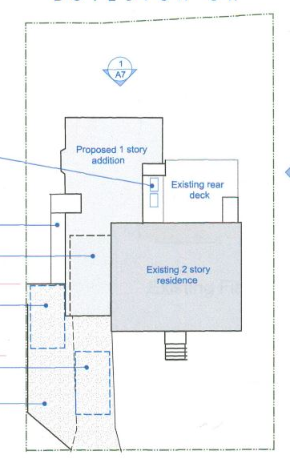
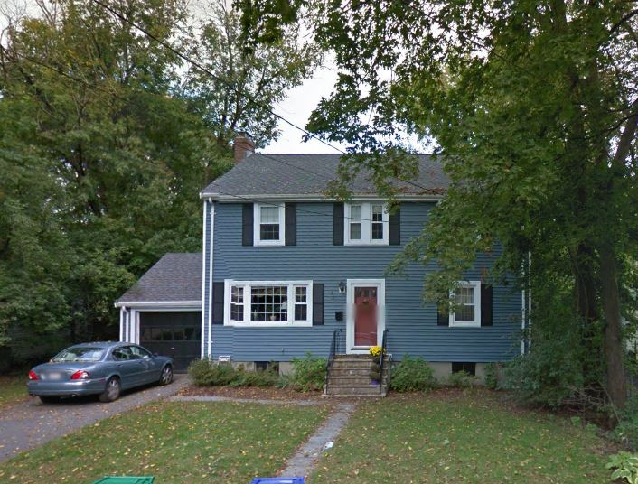
1. Remove 4-year lookback
Case Study - 17 Walnut Place
Primary dwelling unit: 2,425 sf
Internal ADU addition: 948 sf
Actual FAR=2425+948 =3,373 sf
Allowable FAR= 3,448 sf
FAR calculation: SR3, lot size 7,335 sq ft=FAR of .47 = 3,448 sq ft
Note: ADU cannot be seen from the street
Image Source: Google Earth

Slide 10
2. Allow small detached ADUs by-right - max. size
Why?
Except for some historic carriage houses, all detached ADUs require a special permit
Very few homeowners pursue detached ADUs in new structures, or non-historic ones
Special permit requirement has deterred some from pursuing an ADU

Slide 11
2. Allow small detached ADUs by-right - max. size
Proposed change - Amend Sec.6.7.1.E.1
 | Current | Proposed
Allowed by-right | Not allowed (except historic carriage houses in non-historic districts) | 250 sf- 900 sf or 50% of total Habitable Space, whichever is less
Allowed by Special Permit | 250 sf- 1200 sf or 40% of total Habitable Space, whichever is less Or up to 1,500 sq. ft. | Up to 1,500 sq. ft.

Slide 12
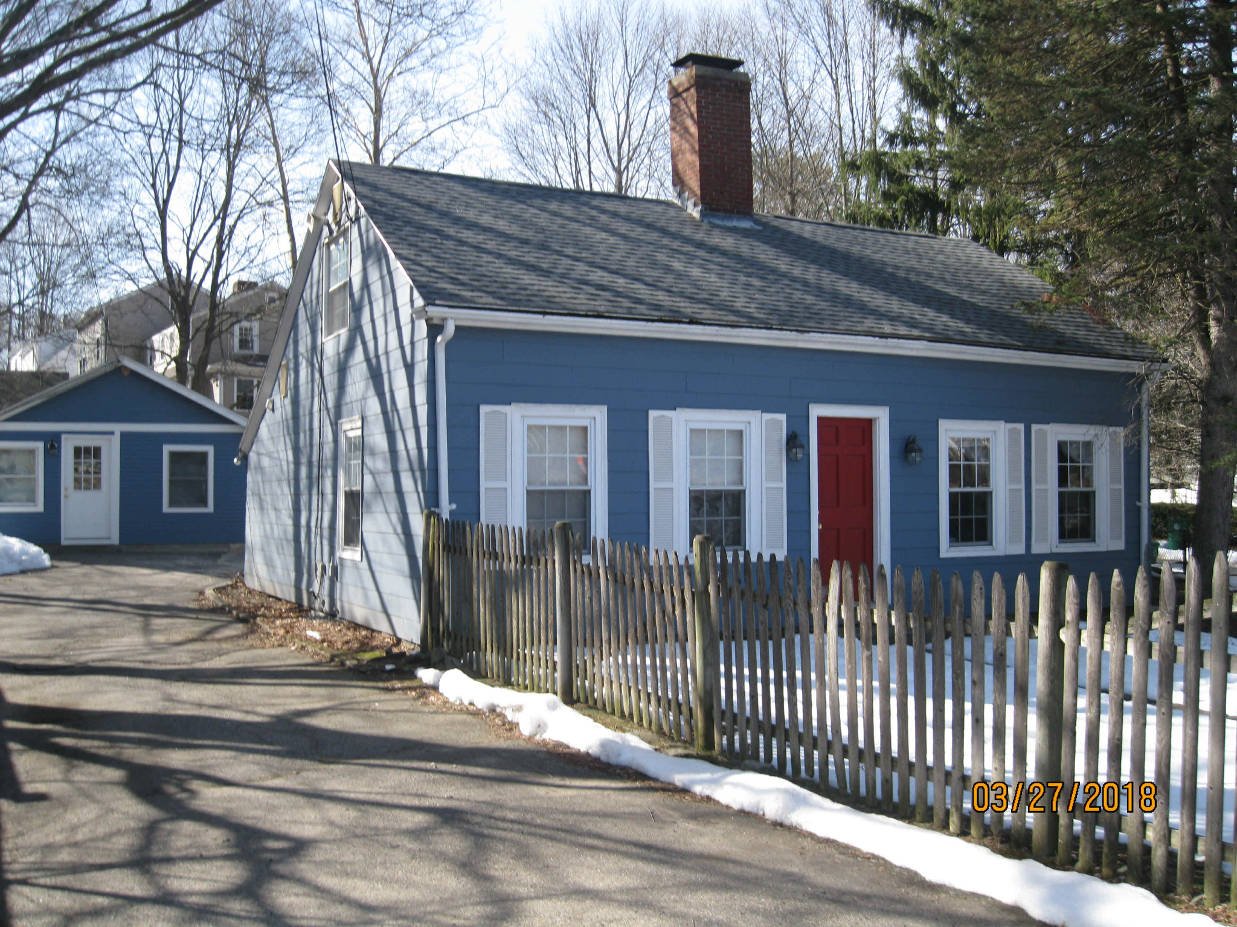
2. Allow small detached ADUs by-right - max. size
Case Study - 1224 Boylston
Pre-existing accessory building
Meets all dimensional requirements
No changes proposed to interior or exterior of accessory building
Needed Special Permit to become ADU regardless
Image Source: Newton Inspectional Services Department

Slide 13
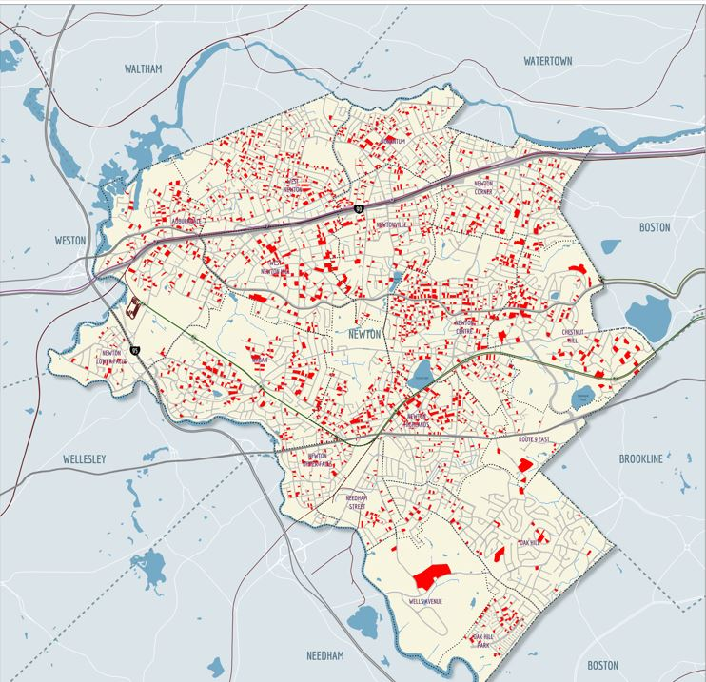
2. Allow small detached ADUs by-right - reduce setbacks
Why?
Lots with Accessory Buildings
Significant amount of existing accessory buildings do not meet the setback requirements of the principal dwelling
Common setback relief granted by special permit for detached ADUs
Image Source: Newton Pattern Book

Slide 14
2. Allow small detached ADUs by-right - reduced setbacks
Proposed change - Amend Sec.6.7.1.E.5
Current | Proposed
A detached ADU must meet the setback requirements of the principal dwelling unit, except by special permit | A detached ADU must meet the setback requirements for Accessory Buildings (5 ft rear and side yard setbacks) Additional screening requirements if detached ADU setbacks are less than the principal dwelling unit requirements Dense planting Fencing

Slide 15
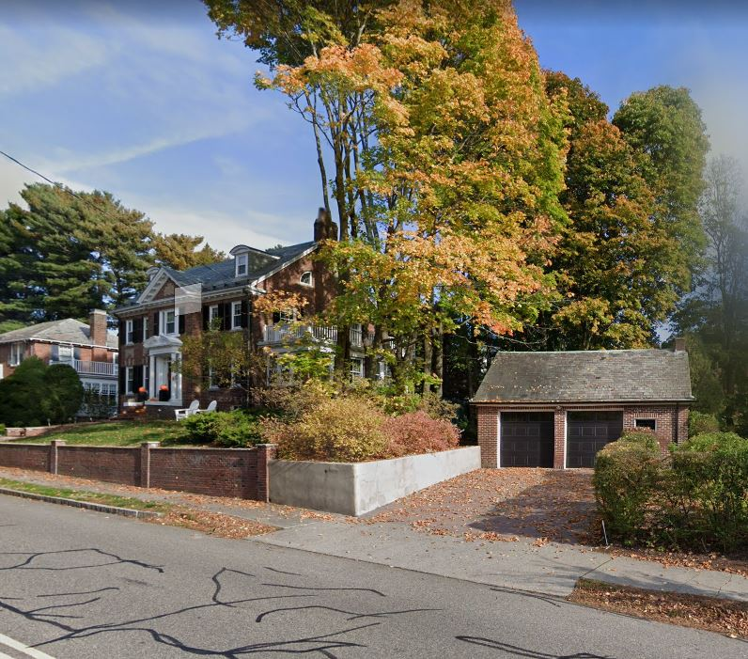
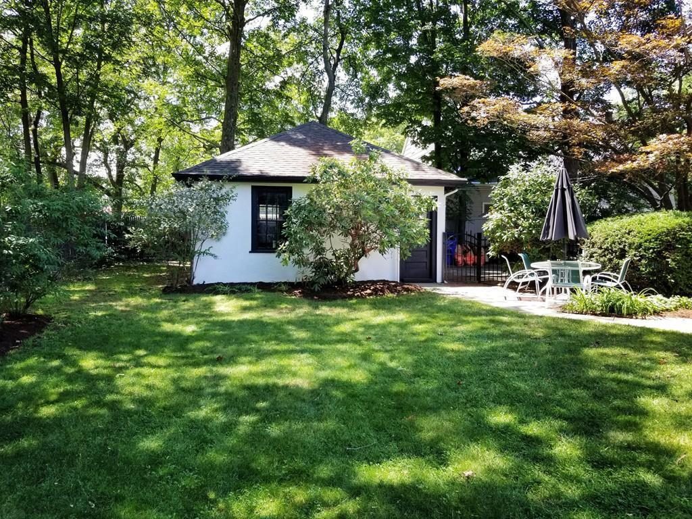
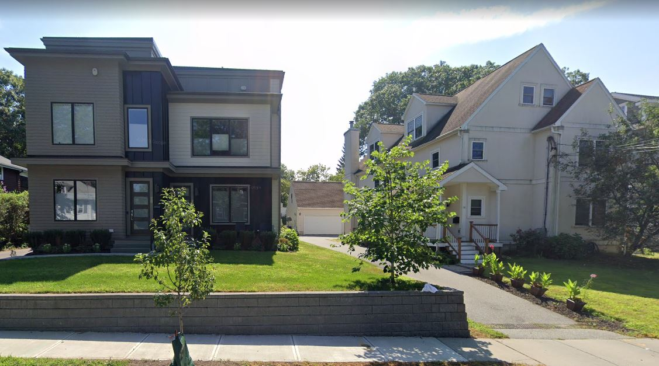
Case Study - Existing accessory building setbacks

Slide 16
Looking Ahead:
Thank you!
Refine proposals based on Committee feedback
Set public hearing date

