Slide 1
Embodied CARBON draft language
zoning & Planning public hearing
April 24, 2023
Climate & Sustainability Team
Embodied Carbon Working Group

Slide 2
What is embodied carbon in the built environment?
Embodied carbon refers to the greenhouse gas (GHG) emissions associated with the manufacturing, transportation, installation, maintenance, and disposal of building materials.
Upfront embodied carbon focuses on the GHG emissions released before a building is constructed. These can also be thought of as supply chain emissions.
Image Source: Carbon Leadership Forum, 2020
Cradle-to-Gate
(Module D)
Cradle-to-Grave
Note: some content courtesy of Rebecca Esau of RMI

Slide 3
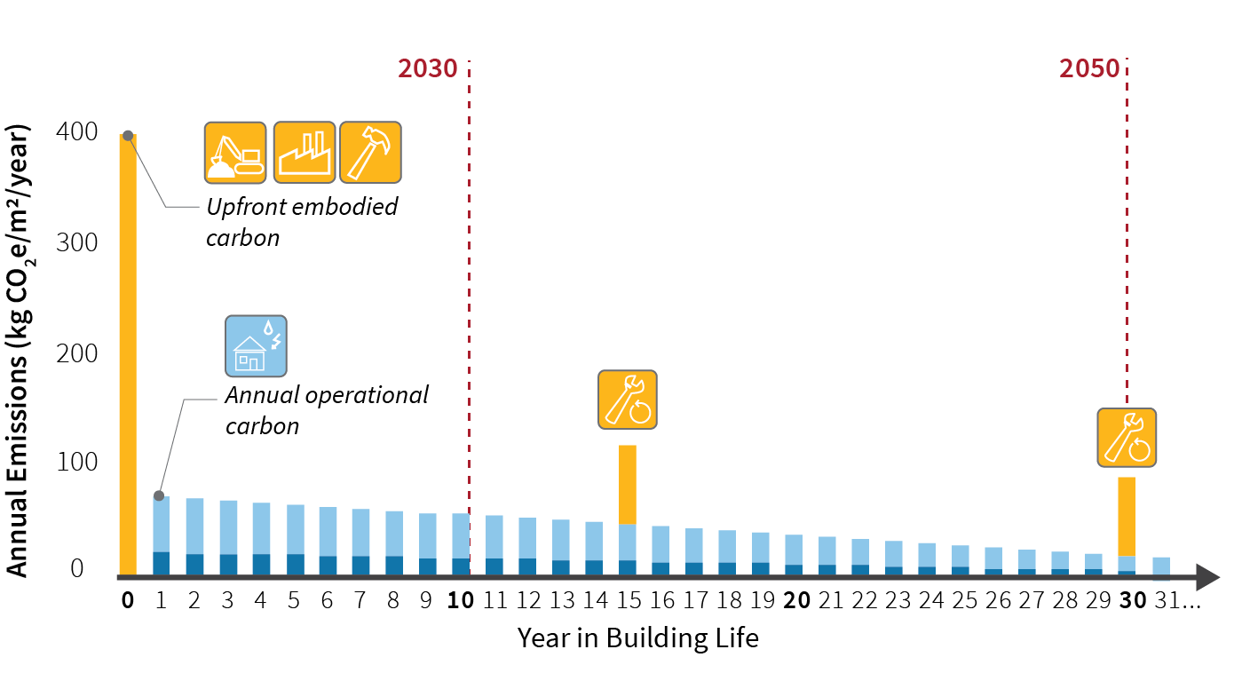
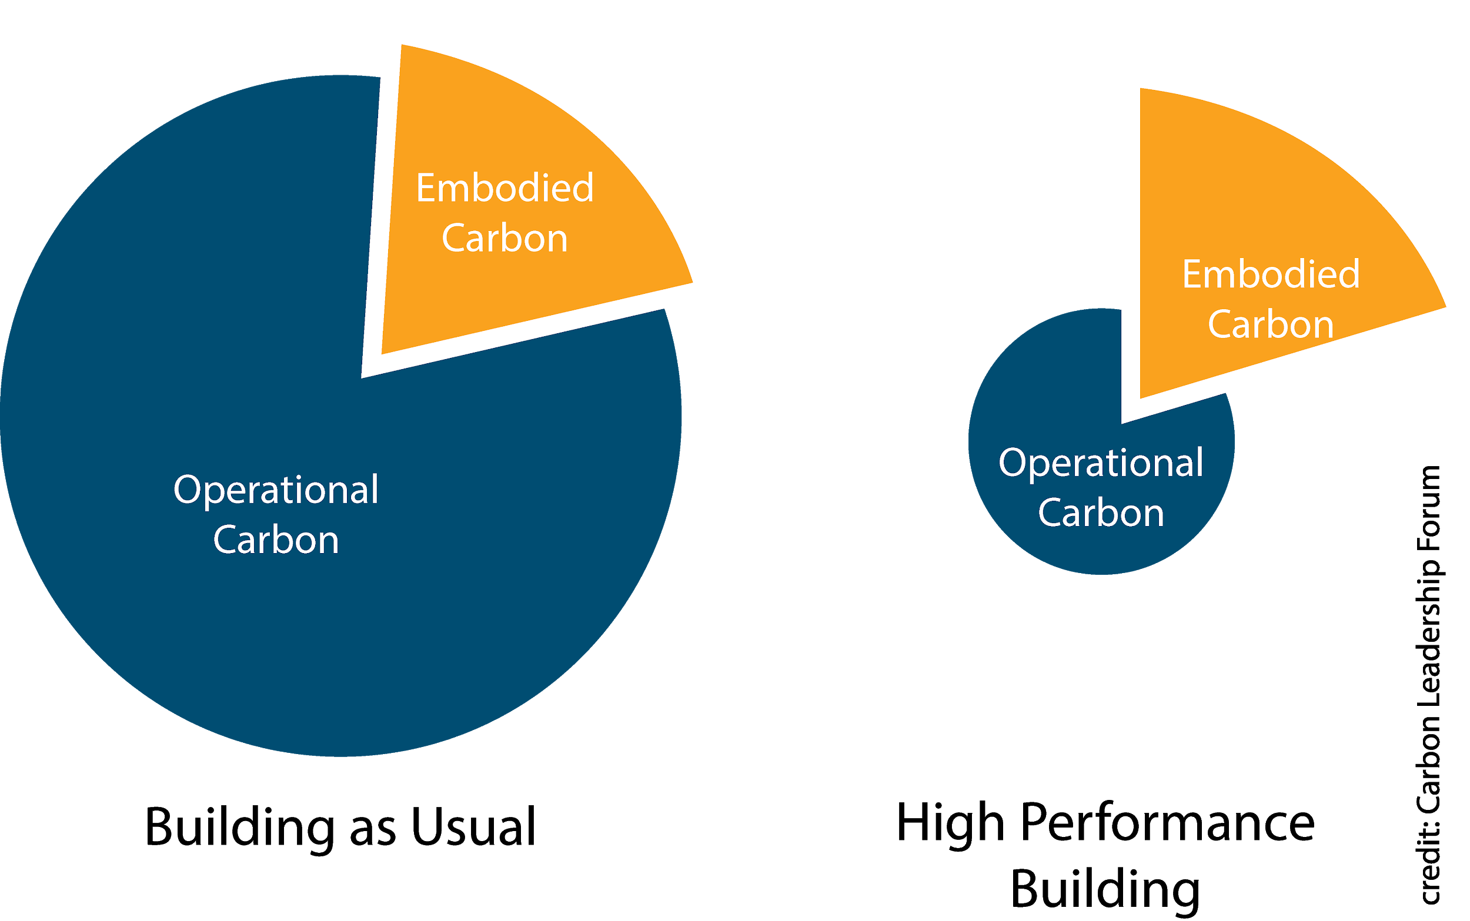
Embodied carbon is significant and urgent
High Performance Buildings
Building as Usual
Image Source: Carbon Leadership Forum, 2020
We are already reducing operational carbon. Embodied carbon contributes a higher proportion of life-cycle emissions in more energy-efficient buildings.
Embodied carbon is expended early in a building’s lifecycle, adding carbon to the atmosphere as we’re working to reduce emissions to meet 2050 goals.
Note: some content courtesy of Rebecca Esau of RMI

Slide 4
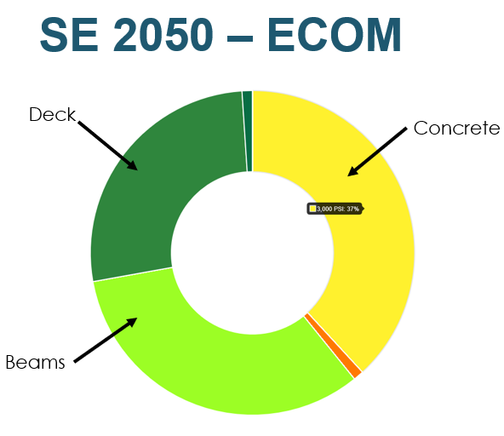
Embodied carbon estimation Tools
4

Slide 5
reducing embodied carbon in structural design
Design vs. Procurement Strategies
Design strategies relate to the form of the building:
Renovation vs. New Construction
Form: how tall, how deep into the ground, how many irregularities such as column offsets
Bay Size: widely spaced columns increase structural framing sizes significantly
Choice of Materials (e.g. steel vs. concrete vs. timber framing)
Designers can use embodied carbon tools to optimize these options
Procurement strategies relate to how the materials are specified after design:
Cement limits for concrete
Embodied carbon limits for materials
Certified wood

Slide 6
Local Policy
Town of Brookline: Town must use low carbon concrete (10% less than average) for town-owned projects and encourage developers to do the same.
City of Cambridge: On path to require measurement and reduction of embodied carbon through Zoning Ordinance.
City of Boston: Including embodied carbon as part of proposed Zero Net Carbon Building Zoning Initiative. Draft proposal includes both measurement and reduction.
Municipalities share goal of coordinating efforts.

Slide 7
Newton Background
Climate Action Plan, 2019
“Neither this Climate Action Plan nor the NCCE Plan directly addresses embodied energy. Embodied energy will need to be addressed in the future, as accounting methodologies and mitigation strategies continue to be developed.”
Sustainable Development Design, 2019
Section 5.13 of the Zoning Ordinance adopted
5.13.4.D: Embodied Carbon [reserved]
Formation of Working Group, Fall 2021
Mark Webster
Structural Engineer, SGH
Russel Feldman
Architect, President of AIA Massachusetts
Beverly Craig
Project Manager, MassCEC
Presentations with ZAP, EDC, Chamber Real Estate Group, Planning Board, Spring-Summer 2022

Slide 8
Draft ordinance Language: 5.13.4 Sustainable development requirements
D. Embodied Carbon A green building project must provide an analysis that estimates the embodied carbon of a project. The type of analysis is determined based on gross square footage of the green building project:
For projects under 50,000 sf, only structural materials must be evaluated using Life Cycle Analysis tools or Environmental Product Declarations.
For projects over 50,000 sf, the design team must use a Whole Building Life-Cycle Assessment tool to estimate the embodied carbon of both structural and enclosure materials, and the CO2e per square foot of the project compared to an average CO2e intensity (kg CO2e/unit floor area) for projects of comparable use, and provide justification for the building materials and systems chosen. This requirement may be met by using one of the following methods:
LEED Credit for Whole Building Life-Cycle Assessment
Green Building Initiative’s (GBI) Green Globes for New Construction (NC) Credit for Whole Building Life-Cycle Assessment
International Living Future Institute’s (ILFI) Zero Carbon Standard.
Another method approved by the Planning Director.
Projects where at least 50% of the floor area comprises re-use of a pre-existing structure are not subject to these provisions.

Slide 9
Draft ordinance Language: embodied carbon document submission
As part of the special permit submission: Specified procedure that will be used to analyze embodied carbon as part of the sustainability narrative.
As part of the building permit submission: Embodied carbon analysis as required by section 5.13.4.D and affidavit signed by a Registered Design Professional confirming the embodied carbon analysis follows the requirements committed to in the special permit submittal documents.

Slide 10
Details and next steps
Full draft language provided with meeting materials
FAQ document available
For discussion and, with council interest, schedule a public hearing

