Slide 1
Newton New EBeam Project
January 19, 2021

Slide 2
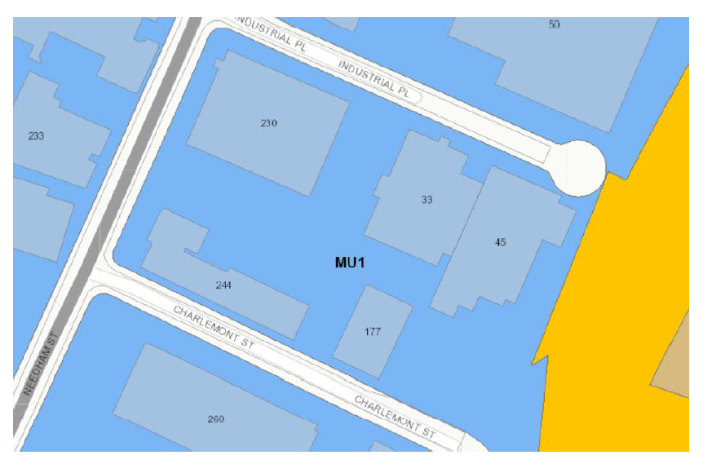
Site Zoning Overview
33 Industrial Place
Retail
Proposed Location

Slide 3
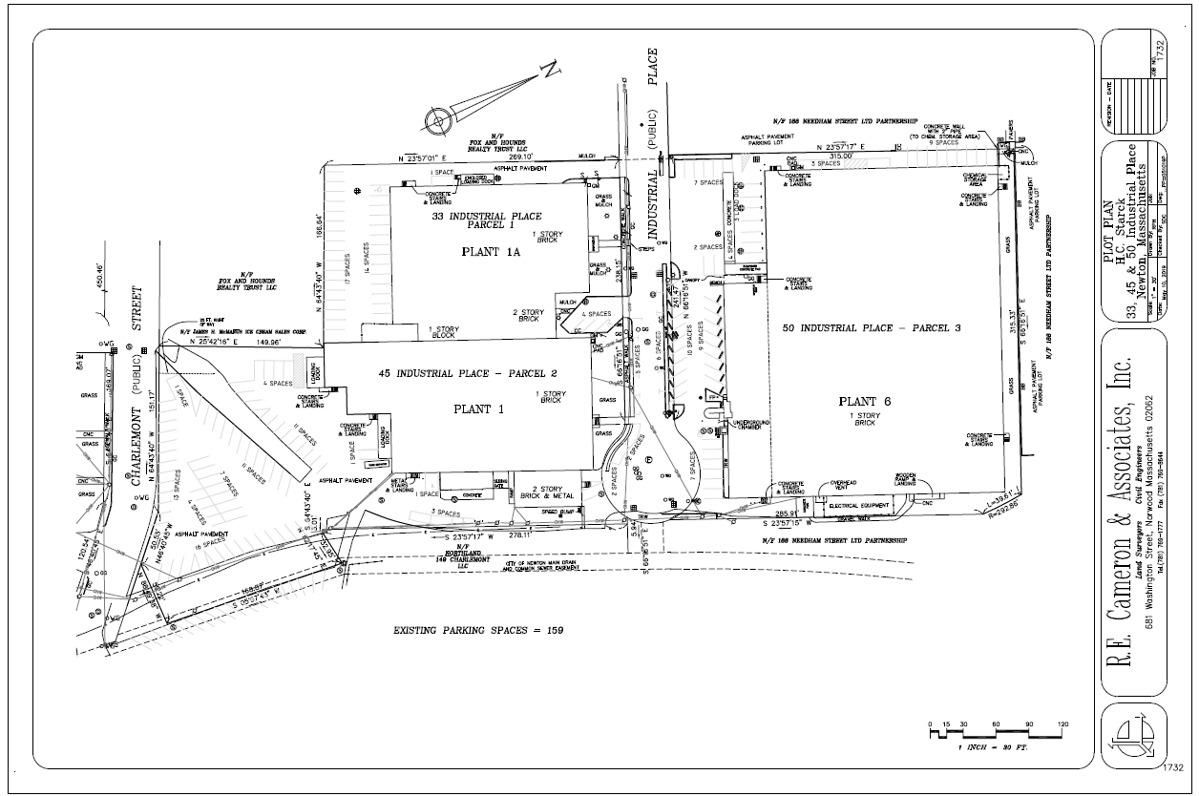
Site Plan View
Industrial Place
Existing EB1 – 38.7 ft. Height
Proposed
Location
MATERION SITE PLAN

Slide 4
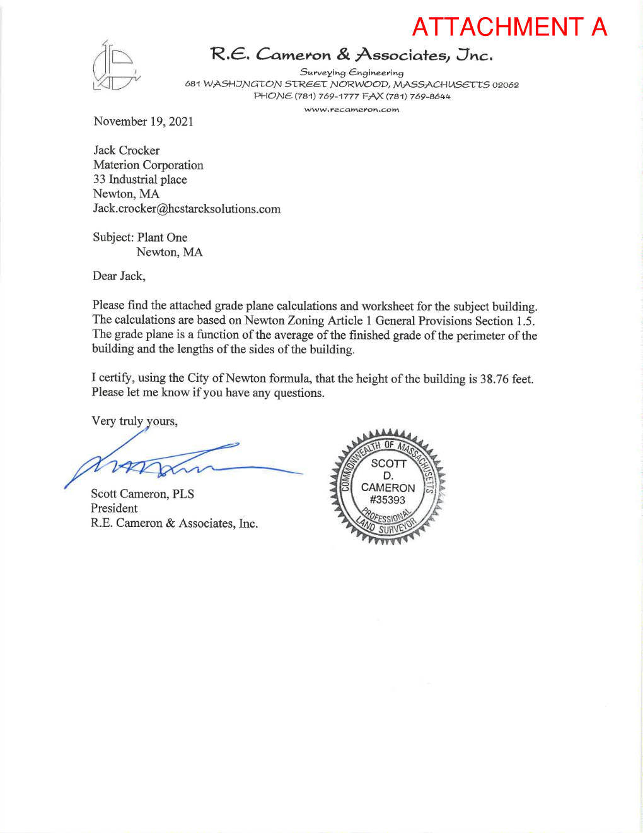
Existing Building Height Analysis

Slide 5
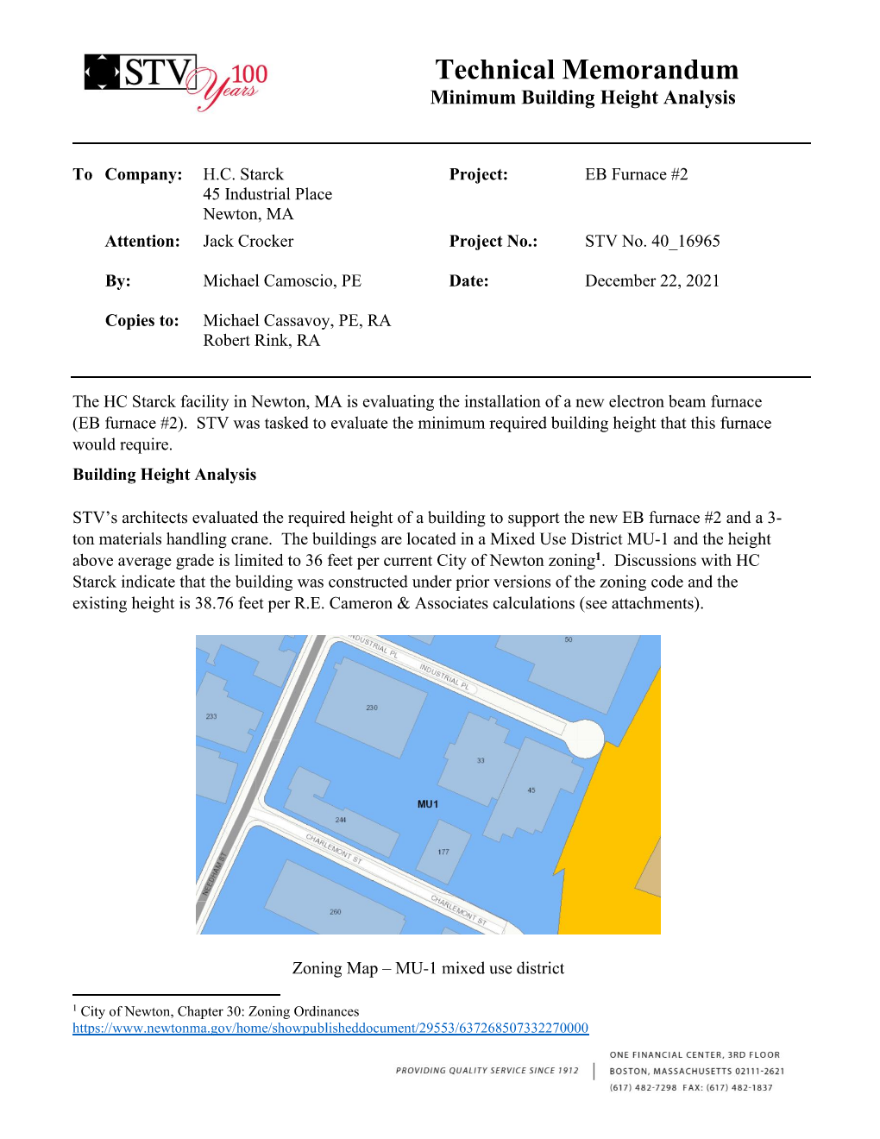
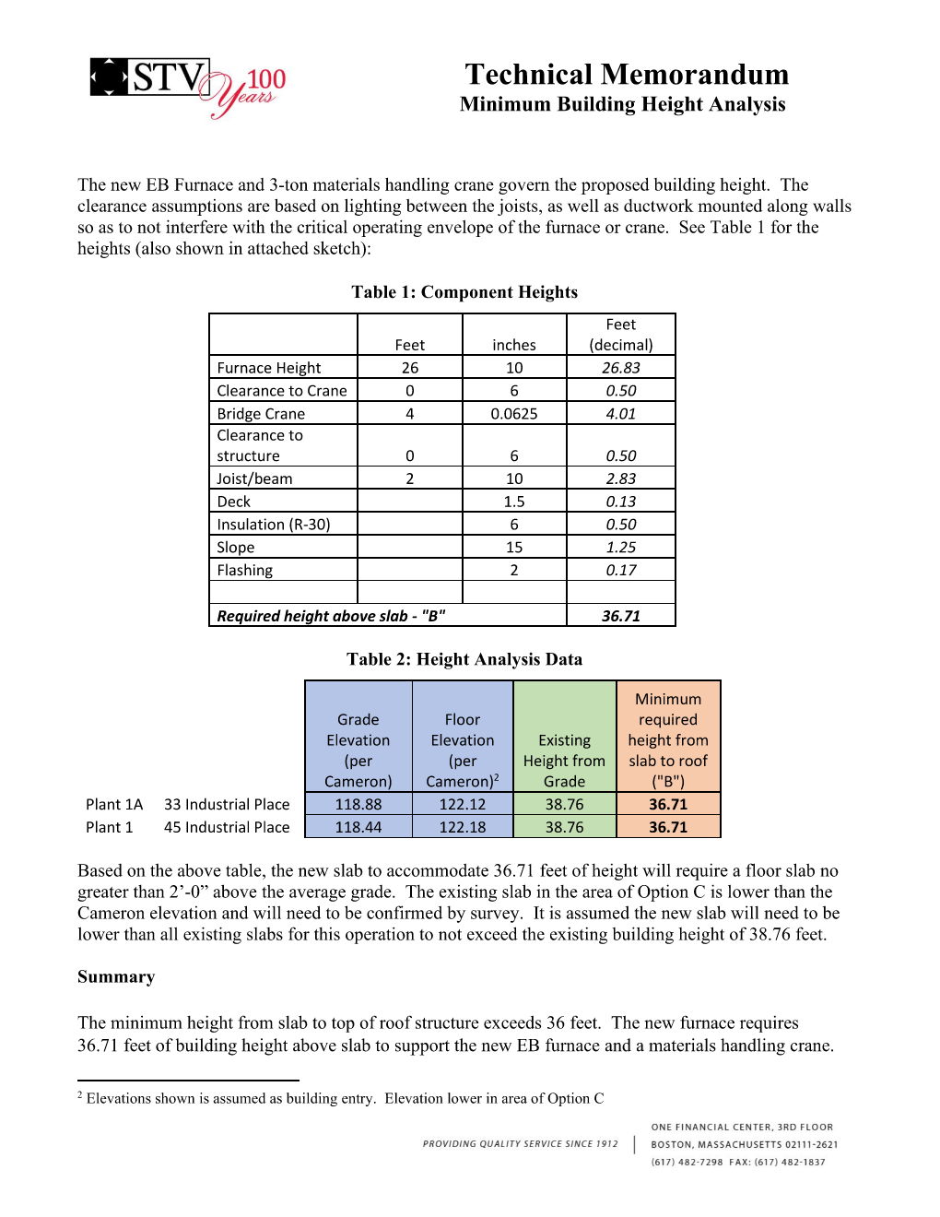
Existing Building Height Analysis

Slide 6
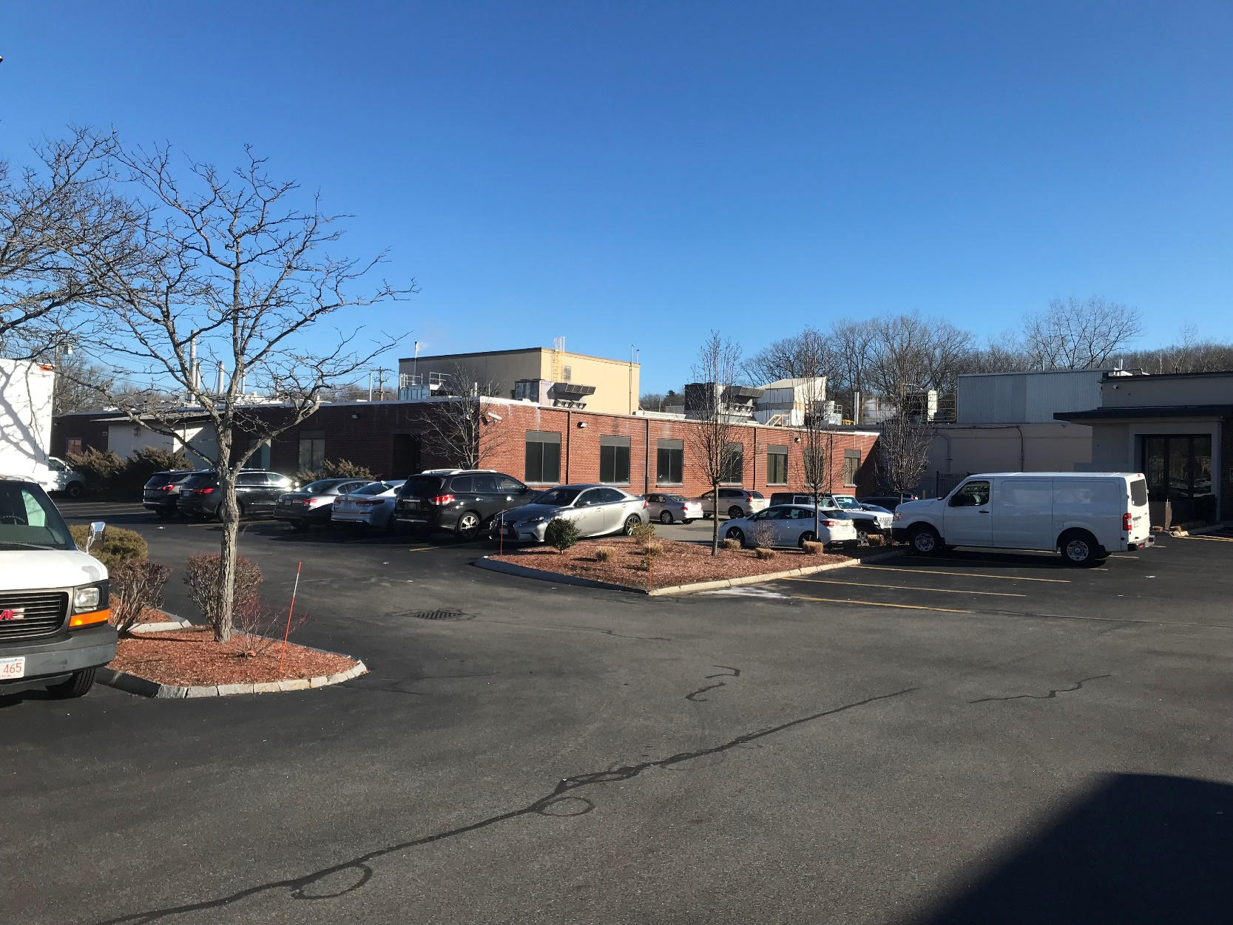
EB2 Proposed Location “View From Retail Parking Lot
Proposed Location
Plant 1A

Slide 7
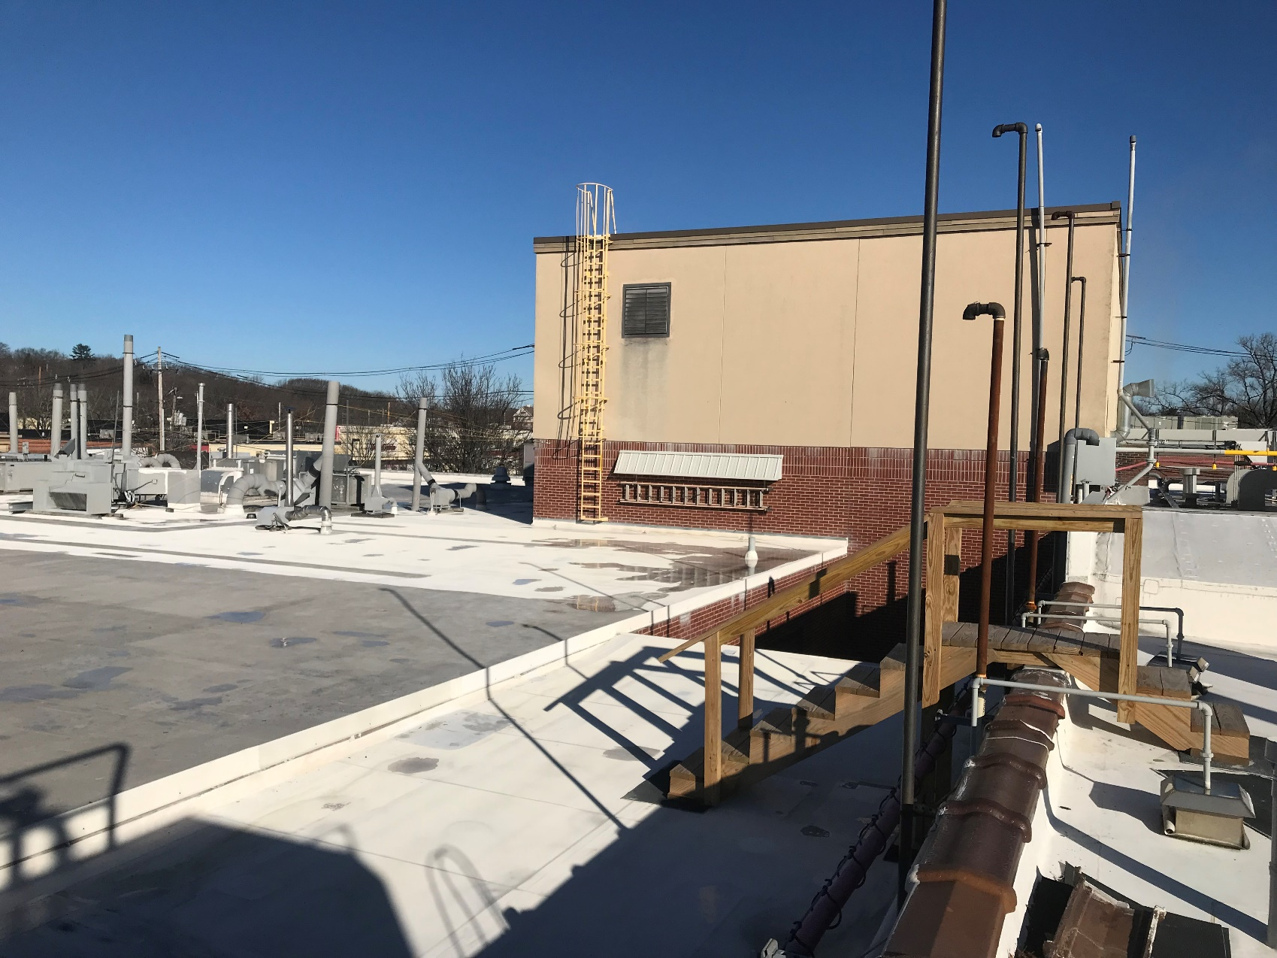
Proposed Location Newton Site
Existing EB1 Building
Roof Height 38.76 ft.
Option “C”
Proposed Location

Slide 8
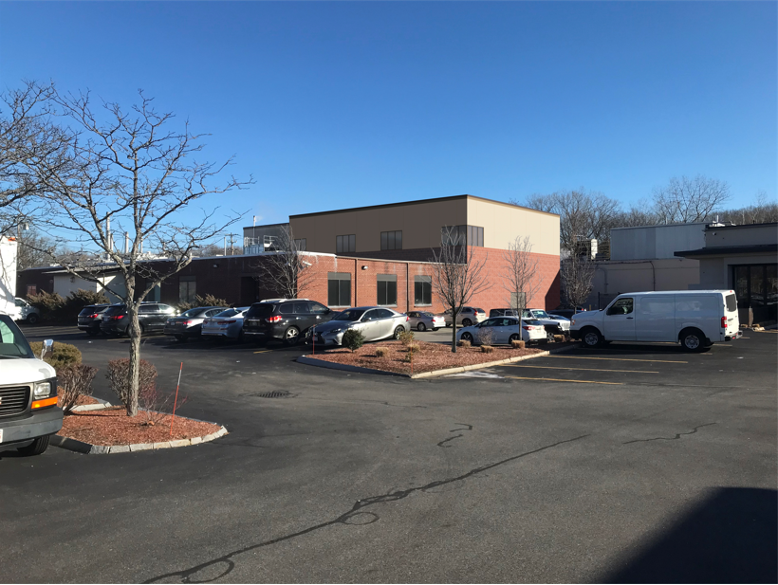
New EB2 Rendering View From Parking Lot

Slide 9
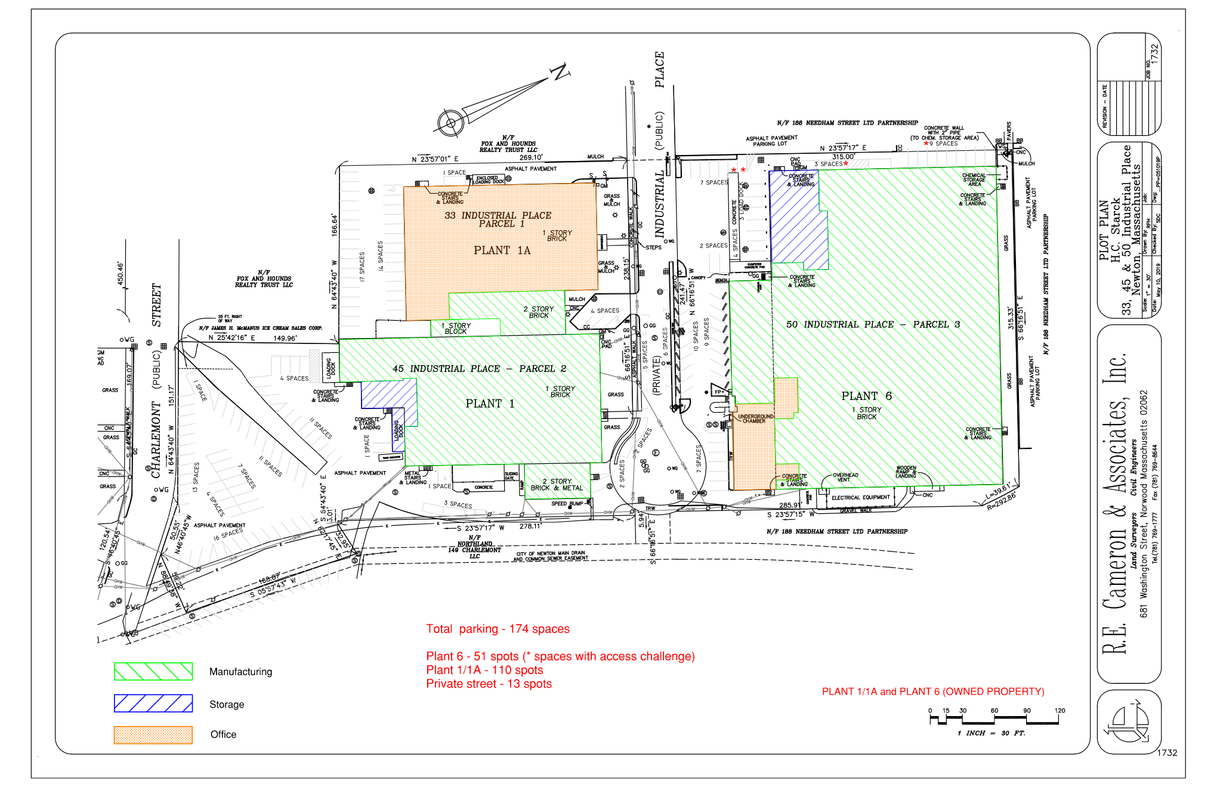
Plant 1/6 Parking
Proposed Location

Slide 10
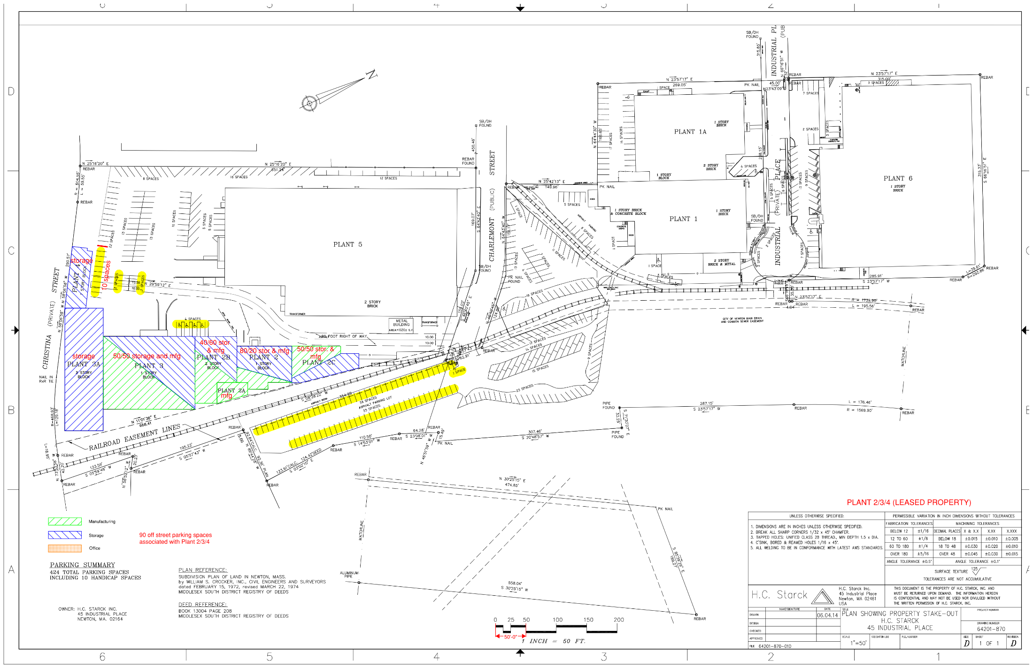
Plant 2/3/4 Parking

