Slide 1
Newton’s IZ Funds Cash Payment Recipient Proposed Amendments to Inclusionary Zoning Ordinance: Section 5.11.5(E) Public Hearing - ZAP Meeting September 12, 2022
The City of Newton Planning & Development Department

Slide 2
Purpose & Background
This proposed amendment seeks to assist the City’s newly created Affordable Housing Trust (AFT) to operate as efficiently and effectively as possible.
Section 5.11.5 (E) currently dictates that any and all cash payments made by a developer in lieu of providing inclusionary units within a project are made to the City’s Inclusionary Zoning Fund and then shared equally with the Newton Housing Authority (NHA).

Slide 3
Proposed Amendment
This proposal seeks to specify that the AHT be the entity that receives any and all cash payments made by a developer in lieu of creating affordable units in a project instead of the City’s IZ Zoning Fund.
The amendment does not propose to alter the provision that the NHA still receive an equal share of any cash payment. Any payments received will therefore be shared equally between the AHT and NHA.

Slide 4
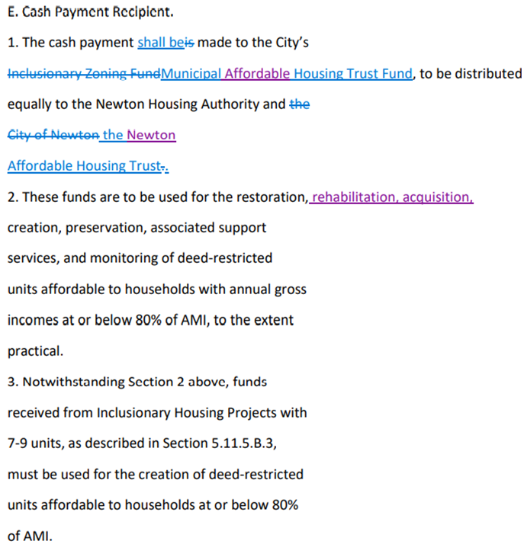
Proposed Text Revision to Section 5.11.5 (E)

Slide 5
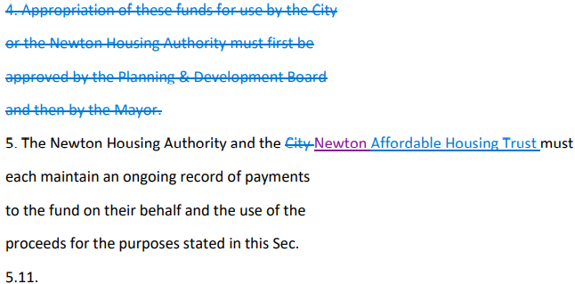
Proposed Text Revision to Section 5.11.5 (E)

Slide 6
Thank you
Questions / Comments?

