Slide 1
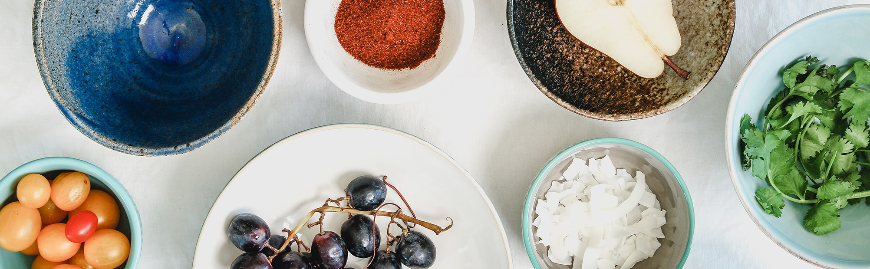
Outdoor dining policy update
City of Newton: Zoning & Planning Committee
Public Hearing on February 13, 2023

Slide 2
Changes to the Newton Ordinance
In January, City staff submitted proposed amending Newton Ordinance Sec. 12-70 to:
Enable outdoor dining areas in the public way, adding oversight of protected parking stalls to existing regulations about café furniture on public sidewalks,
Codify the City’s authority over an outdoor dining program, which will be necessary after the State’s emergency authorization expires on April 1, 2023, and
Extend the existing program for seasonal outdoor dining on a permanent basis.
The Public Safety & Transportation (PS&T) Committee voted unanimously to approve the amendments.

Slide 3
Amendments to the Zoning Ordinance
As part of this update, the City’s Law Department identified the need to separately amend three sections of the Zoning Ordinance cross-referencing Sec. 12-70.
These updates are needed to clarify that outdoor seating within the street will be regulated the same as sidewalk seating. Pertinent sections include:
5.1.4. Number of Parking Stalls (Restaurant, food, or beverage establishment)
6.4.29. Restaurant (B. Standards for Allowed Uses)
7.8.2. Nonconforming Buildings, Structures, or Uses

Slide 4
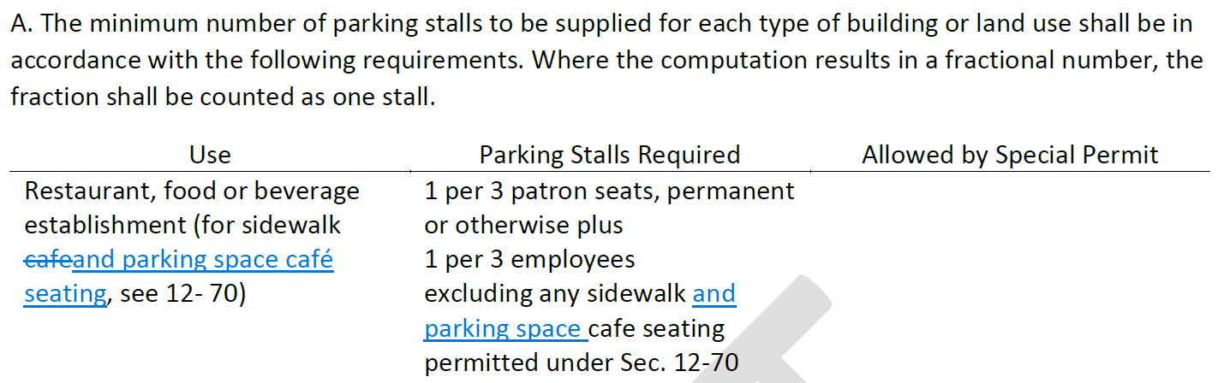
5.1.4. Number of Parking Stalls

Slide 5
6.4.29. Restaurant
B. Standards for Allowed Uses
[ … ]
  In all districts, outdoor sidewalk seats and parking space seats permitted under revised Ordinances Chapter 12, Section 12-70 shall be excluded from the total number of seats used to determine the review process.
[ … ]
C. Standards for Special Permit Uses
[ … ]
  In all districts, outdoor sidewalk and parking space seats permitted under revised Ordinances Chapter 12, Section 12-70 shall be excluded from the total number of seats used to determine the review process.
[ … ]

Slide 6
7.8.2. Nonconforming Buildings, Structures, or Uses
Special Permit Not Required.
  A special permit is not required from the City Council for nonconforming buildings or structures in the following cases:
[ … ]
    Additional outdoor sidewalk and parking space seats permitted under Revised Ordinances Chapter 12, Section 12-70 shall not be considered an increase in the nonconformity nor constitute an extension of use of a lawful nonconforming restaurant in any district; and
[ … ]

Slide 7
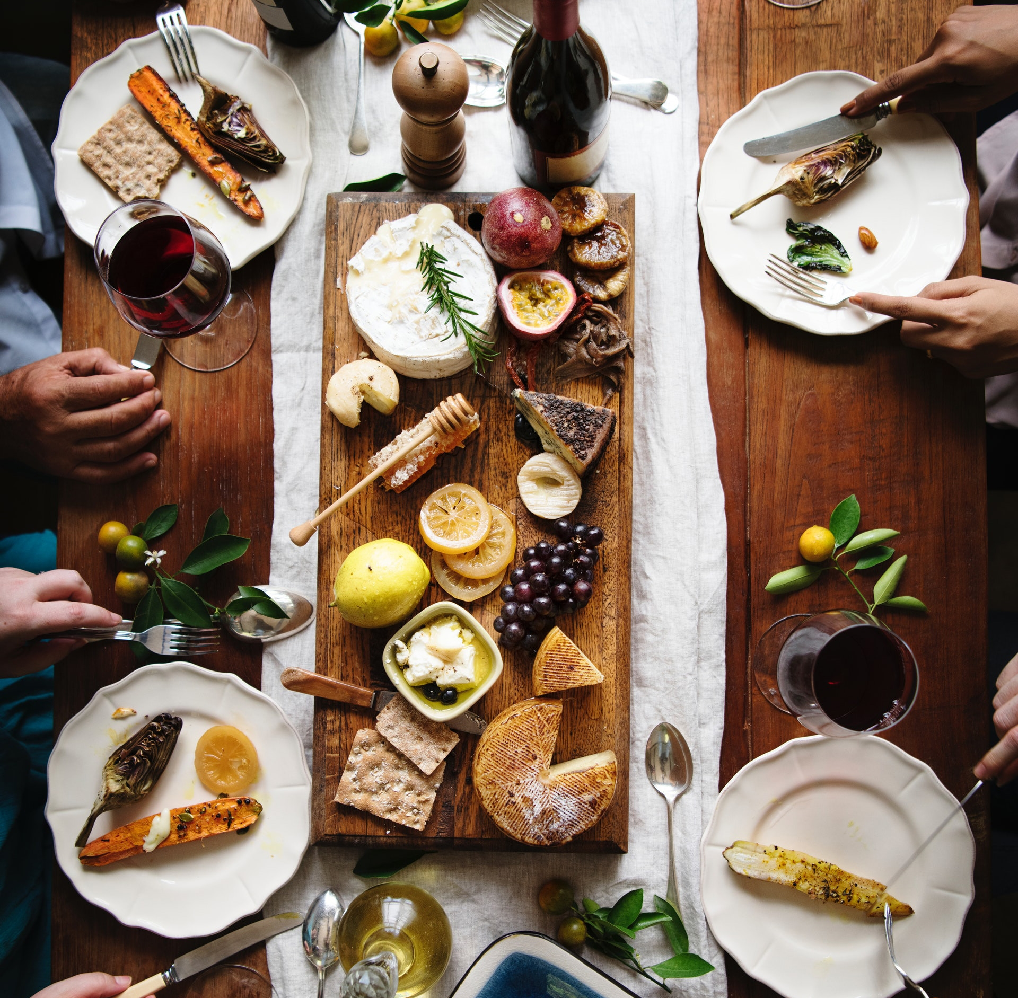
FUTURE PLANNING
Outdoor dining in the public way is a recent phenomenon in the U.S., and municipal policies will continue to evolve.
In 2023, City staff will continue studying comparable policies and implementations to provide analysis and recommendations to the City Council later this year.

