Slide 1
Update on Newton BERDO Michael Gevelber
Issues:
Overview
Case Study Overview: Apts at xxx Lexington St
Question: should electricity emissions be part of N-BERDO
Many slides taken from Philip Eash-Gates, PE, CEM, Principal Associate
Synapse Energy Economics, Inc.

Slide 2
Newtib BEERDO Building Counts, Area, Emissions
Tier | Description | Count of Buildings | Total GFA (Msq ft)/ emissions %
1 | Non-residential, ≥100,000 sq ft | 47 | 8.6M / 42%
2 | Non-residential, 50,000–99,999 sq ft | 71 | 5 M / 23%
3 | Non-residential, 35,000–49,999 sq ft Residential, ≥50,000 sq ft | 68 17 | 2.9M / 13% 2.1M / 6%
4 | Non-residential, 20,000–34,999 sq ft | 109 | 2.9M / 13%
5 | Residential, 20,000–49,999 sq ft | 44 | 1.2M /3 %
Total | All covered buildings | 356 | 22,724,984

Slide 3
206 Newton Building Owners
80 percent of owners have one covered building
4 percent of owners have non-residential condos
7 owners have 5 or more covered buildings:
Property Owner | Number of Covered Buildings
Trustees of Boston College | 40
City of Newton | 34
Lasell University | 20
Roman Catholic Archdiocese of Boston | 7
Chestnut Hill Shopping Center | 6
Newton Housing Authority | 5
Donato D. Capasso Trust | 5

Slide 4
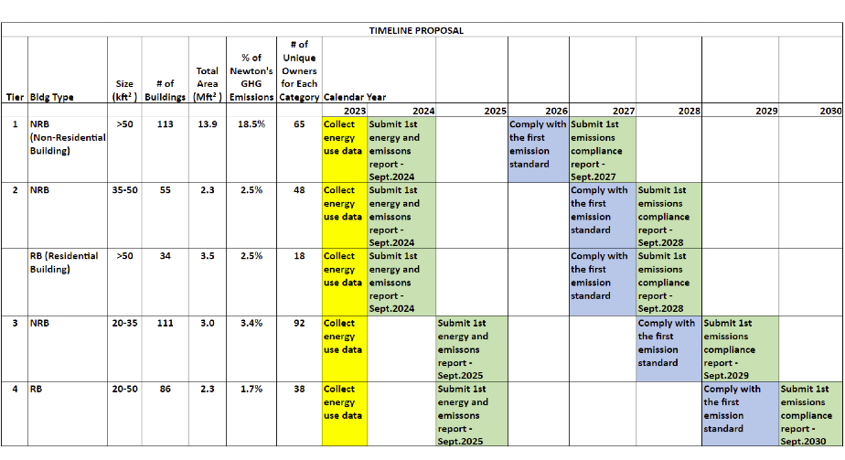
Proposed Newton BERDO Timeline
Notes:
Philip

Slide 5
Newton Emission Standard (v1.0)
Building typology | Emission standards (kgCO₂e/SF)
Year | Period 1 | Period 2 | Period 3 | Period 4 | Period 5 | Period 6 2050–
Assembly | 12.5 | 7.7 | 5.8 | 3.4 | 1.6 | 0.0
College/University | 18.4 | 10.5 | 6.9 | 3.9 | 1.9 | 0.0
Education | 4.9 | 3.8 | 2.9 | 1.9 | 0.9 | 0.0
Food Sales & Service | 34.4 | 18.2 | 13.7 | 8.3 | 4.2 | 0.0
Healthcare | 18.1 | 14.6 | 11.6 | 7.5 | 3.7 | 0.0
Lodging | 8.1 | 5.8 | 4.4 | 2.8 | 1.4 | 0.0
Manufacturing/Industrial | 27.8 | 23.2 | 18.7 | 11.6 | 5.1 | 0.0
Multifamily housing (residential buildings, RB) | 6.0 | 4.1 | 3.0 | 1.8 | 0.9 | 0.0
Office | 19.5 | 6.0 | 4.3 | 2.5 | 1.2 | 0.0
Retail | 14.6 | 9.2 | 6.0 | 2.7 | 1.2 | 0.0
Services | 13.2 | 7.6 | 5.5 | 3.4 | 1.7 | 0.0
Storage | 13.6 | 6.9 | 4.3 | 2.2 | 0.8 | 0.0
Technology/Science | 24.8 | 19.3 | 14.6 | 8.4 | 3.9 | 0.0
Individual compliance schedule (percent relative to baseline year) | 86.7% | 73.3% | 60% | 40% | 20% | 0%
Notes:
Philip

Slide 6
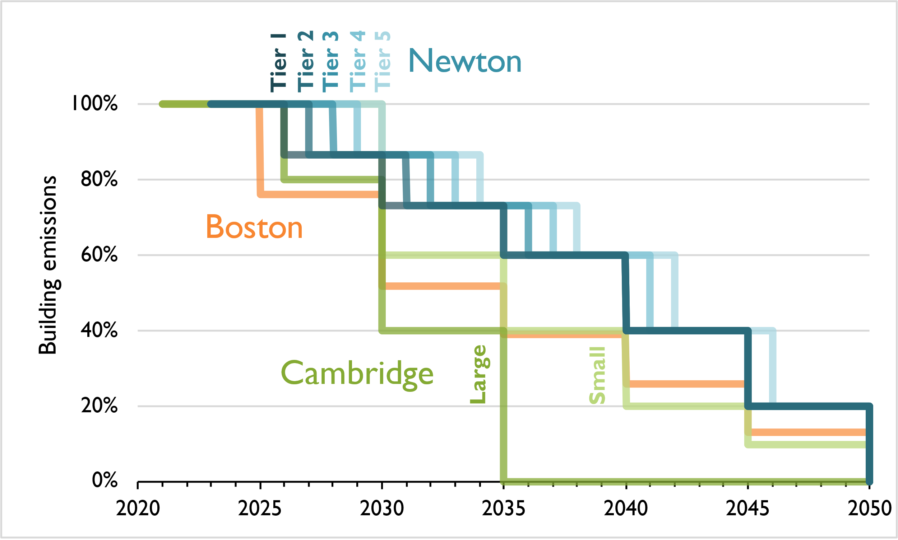
DRAFT Newton Emission Standard, Boston & PRC
Notes:
Explain steps for each city (Boston starts 2025, Cambridge 2026 (large) and 2030 (small), Newton 2026 for tier 1 (phase other tiers in gradually)
Cambridge allows use of carbon credits: 40% of baseline emissions in period 3 (2035-2039), less in other periods

Slide 7
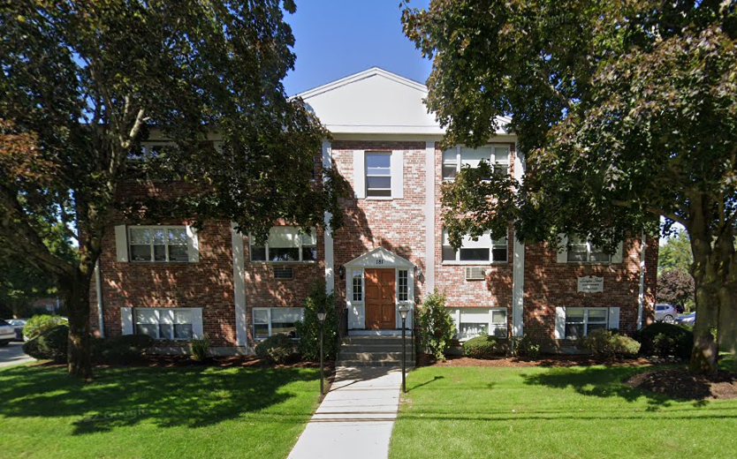
Case Study: Apts at 181 Lexington.
30-unit apartment building. Constructed in 1970 gross floor area of 24,570 square

Slide 8
Energy/Emissions Breakdown (estimate)
Table 1. Energy use and emissions at 181 Lexington Street, 2022
Energy source | Energy use | Energy use intensity | Emissions | Emissions intensity
 | kBtu | kBtu/sqft | kg CO2e | kg CO2e/sqft
Electricity | 293,000 | 11.9 | 9,000 | 0.37
Natural gas | 1,438,000 | 58.5 | 76,000 | 3.09
Total | 1,731,000 | 70.4 | 85,000 | 3.46
Over 2022, 16–20 units participated in Newton Power Choice.
All participants enrolled at the Standard level, 84 percent renewable power

Slide 9
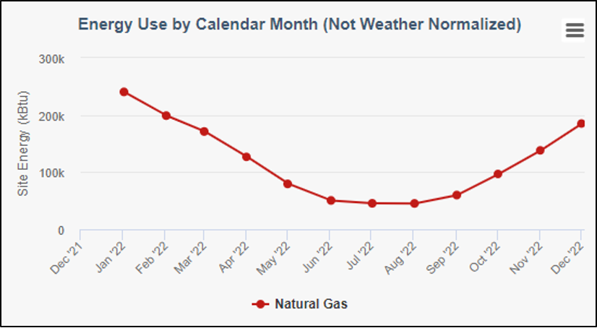
Natural Gas use:
3.1 kg CO2/sqft: 1.9 is for heating
38% of natural gas use is for DHW & Dryers. (1.2 kgCO2/sq ft)

Slide 10
Case study observations
3.46 kilograms of carbon dioxide equivalent (kgCO₂e) per square foot. .36 kgCO2/sq ft from electricity
3.1 kgCO2/sqft is from Natural Gas combustion. 38% from DHW & Dryers. (1.2 kgCO2/sq ft)
1.9 kgCO2/sqft is for heat
Proposed maximum emissions limits for apartment buildings less than 50,000 square feet are 4.8 kgCO₂e per square foot, beginning in 2030.
By 2038, the target would decrease to 2.6 kgCO₂e per square foot Buildings. 2042-45 is 1.6
Options for compliance: don’t need to replace all natural gas at once. DHW, Dryers, could
Use hybrid (natural gas-heat pump for heating hot water (50% of capacity)

Slide 11
Should we include electricity in Newton Berdo?
Massachusetts will get to nearly 90% by 2030.
If so, why should Newton BERDO include electricity emissions? Focus on the hard things that require large CapX

Slide 12
EIA data of MA Elec Generation: how replace 74% of gen capacity in 7 years & whats it going to cost???
Utility-Scale Net Electricity Generation (share of total) | Massachusetts | U.S. Average |  | Period
Petroleum-Fired | 0.1 % | 0.3 % |  | Jun-23 | find more
Natural Gas-Fired | 73.7 % | 45.3 % |  | Jun-23 | find more
Coal-Fired | 0.0 % | 16.2 % |  | Jun-23 | find more
Nuclear | 0.0 % | 18.2 % |  | Jun-23 | find more
Renewables | 23.4 % | 19.6 % |  | Jun-23

