Slide 1
Reflections on the Five Years at the Helm of Newton Citizens Commission on Energy and the Big Tasks Ahead By Halina Brown, October 25, 2023

Slide 2
My Vision 5 years ago Accomplished
Bold action in Newton on energy conservation and GHG emissions
NCCE the center of independent policy analysis and initiative
Creative and bold
Data-driven
Technically defensible
NCCE on the political map of Newton
Not so much
Go-to place on energy and environment policy: for the Mayor, the Administration and City Council
My personal hidden agenda: to put Newton on a course toward a transition toward less energy-intense lifestyles…i.e. cultural change (I am the co-founder of Sustainable Consumption Research and Action Initiative SCORAI.net)

Slide 3
Modus Operandi
We work for Newton as a community of people, not for its government
Focus on Newton-centered policy, not on state-level policy
Setting the agenda by doing the analysis and putting the recommendations on the Mayor’s desk. A Step Ahead.
Long-term priorities are determined by data on energy use and GHG emissions
Political considerations are the necessary means/tools, not the end

Slide 4
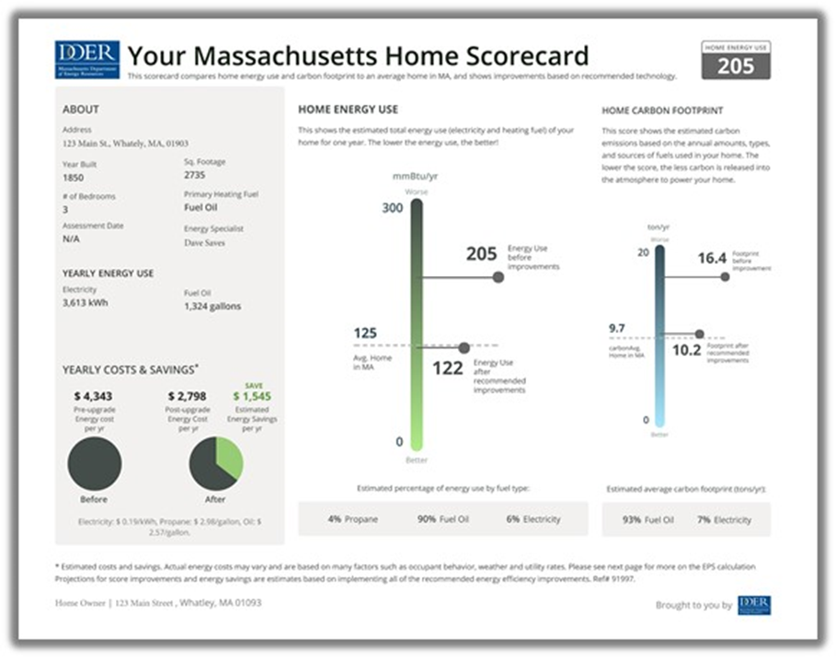
Big tasks ahead 1: Residential Sector
Partnership with GN to overcome technical barriers for interested homeowners
Lack of specific plan……generic for house types….customized for individual houses
Access to trusted contractors……….
Easy access to incentives
Overcoming inertia of those who are
not interested
2019-2020: Point-of-sale Scorecard
2021-2023: Reporting EUI by all homeowners
2023: Reporting EUI by landlords of rental properties – modelled on Burlington, Vt. (>50 kBtu/sf. weatherization trigger)
4OurFuture campaign?
Geographic clustering of outreach based on gas infrastructure

Slide 5
Big tasks 2:
BERDO a door to the residential sector
The importance of including residential buildings in BERDO(rentals + condo buildings with a shared heating system)
BERDO tracking and updates over time:
Put the tracking and progress report provision in the ordinance
NCCE design the tracking plan as soon as the ordinance passes
Testimony for public hearings (request special time slot; if necessary, propose an amendment)
*****
Creating partnerships with nearby leading communities
Streamlining City’s data collection and public posting

