Slide 1
Fair Housing 101:
Training for Real Estate Professionals
Kelly F. Vieira, Esq. – Director of Investigations & Outreach
Housing Discrimination Testing Program [HDTP]
January 17, 2024

Slide 2


The Suffolk University Law School Housing Discrimination Testing Program
(HDTP) is proud to be a HUD grantee.
Any opinion, findings, and conclusions or recommendations expressed in this material are those of the authors and do not necessarily reflect the views of the Department of Housing and Urban Development.

Slide 3
Presentation Outline
Overview of History, Laws, and Discriminatory Practices
Fair Housing 101
2020 Housing Discrimination Study
Best practices for real estate professionals
Q&A

Slide 4
Evolution of housing
Enslaving people
Emancipation Proclamation
Considered to be the starting point in the United States.
January 1, 1863 Abraham Lincoln issued the proclamation that gave people who were enslaved in the rebel states their freedom.
1808
1865
1619
1863
African Slave Trade Outlawed
13th Amendment
U.S. Congress outlawed the kidnapping and enslaving of people from Africa.
The Constitutionally mandated end to enslaving people in all of the United States.

Slide 5
Evolution of housing (cont.)
Civil Rights Act of 1866
Exclusionary Zoning Laws
Race-based discrimination in housing has been illegal since this law was passed; however, the law specifically excluded Native Americans.
Ordinances that prevented racial and ethnic minorities from moving into specific neighborhoods.
1890s -
866 | Early 1900s - 1917
1920s - 1948
1
Sundown Towns
Restrictive Covenants
Any jurisdiction that intentionally kept African Americans and other People of Color out and thus was all-White on purpose.
Forbade the sale of homes based on race.

Slide 6
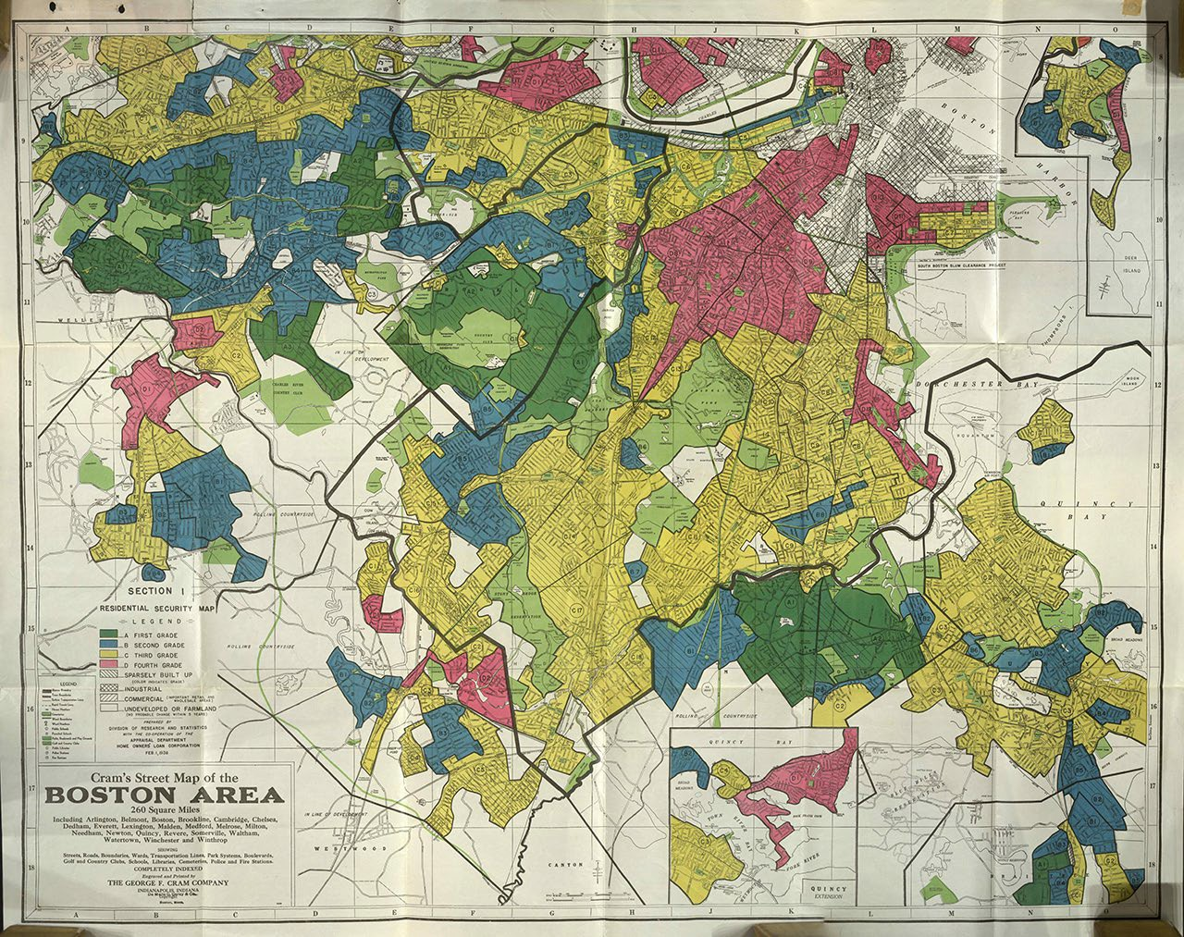
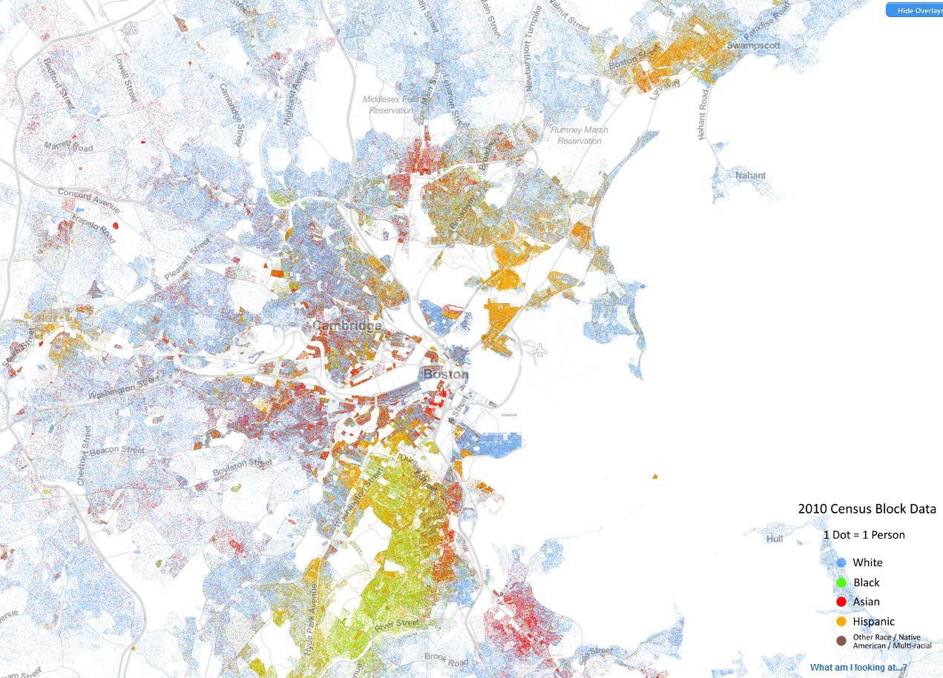

Slide 7

Dr. King’s last speech, April 3, 1968
1:20 – 2:35
https://www.youtube.com/watch?v=Oehry1JC9Rk
Notes:
From 1:22 to 2:36

Slide 8

April 4, 1968

Slide 9
February 29, 1968 – Kerner Report released
“Our nation is moving toward two societies, one black, one white—separate and unequal.” – Kerner Commission, federally appointed to examine the state of housing in the United States

Slide 10
The Fair Housing Act of 1968 (amended 1988)
FHA outlaws the following types of discrimination (based on 7 protected classes)
Refusal to rent, sell, or negotiate
Making housing unavailable or denying access
Setting different terms, conditions, or privileges
Providing different housing services or facilities
Falsely denying that housing is available for inspection, viewing, or rental

Slide 11
Fair Housing Act cont.
For profit, persuade, or try to persuade homeowners to sell by suggesting that people of a particular race, etc. have or are about to move into a neighborhood (blockbusting)
Denying access to or membership or participation in any org., facility, or service (such as Multiple Listing Service [MLS]) related to sale or rental of dwellings
To make, print, or publish any notice, statement, or advertisement that indicates a preference or limitation based on a protected class
Coerce, intimidate, threaten or interfere with the exercising of a fair housing right

Slide 12
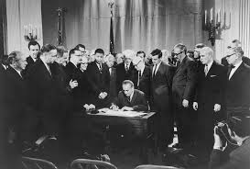
April 11, 1968 – FHA signed by President Johnson
“It is the policy of the United States to provide, within constitutional limitations, for fair housing throughout the United States.”
1.) Outlaws many types of housing discrimination
2.) Affirmatively Furthering Fair Housing (AFFH)
Communities which have benefitted from historical discrimination are REQUIRED take action to remediate it (many suburbs fall into this category)
Fair Housing Act, Sec. 801

Slide 13
The Landscape Today
Home ownership = the building of wealth
Net worth (sum of value of total assets - value of debts) White people: $247,500
Black people: $8 Dominicans: $0
Ana Patricia Muñoz et.al, The Color of Wealth in Boston, p. 20 Federal Reserve Bank of Boston (2015). Analysis is estimates of U.S. born people in the Boston Metropolitan Statistical Area.

Slide 14

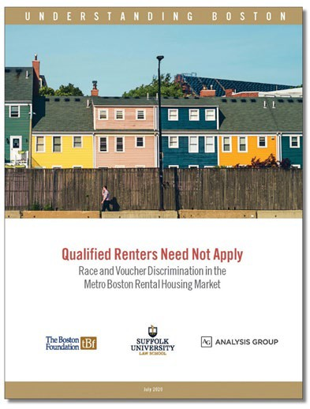
Measured level of race-based and voucher-based discrimination
Investigated if voucher-based
discrimination is a proxy for race-based discrimination
Testing took place between August 2018 – July 2019

Slide 15

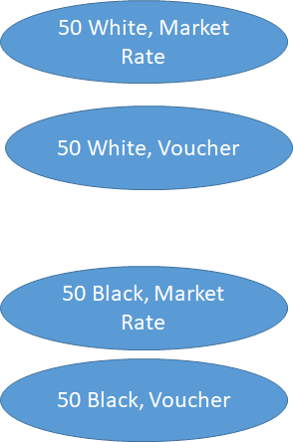
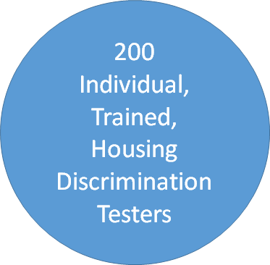

Study Design

Slide 16
Paired Testing
Similar as possible in all ways but for variable(s) being tested:
•All 4 testers for each test were same sex
•Same credit, same rental history
•Everyone could afford the apartment based on their total incomes
•Race was indicated over the phone by assigned names
All properties were accessible by public transportation, within voucher payment standards, and randomized.
Other protected classes were not introduced
•Everyone had same family size (single)
•Everyone presented as cisgender, no visible disabilities, accent considerations etc.

Slide 17
Typical Business Practices
Testers simulated a real housing search:
Contacted advertising person (a real estate professional in the majority of cases)
Expressed interest in setting up an appointment Introduced name and if relevant voucher
Gathered evidence as to what information was given, what was asked, and whether could make an appointment and view the unit

Slide 18
What we found: Discrimination with a smile
86% of Voucher Testers Experienced Discrimination 71% of Black Testers Experienced Discrimination
NUMBER OF UNITS AVAILABLE
ABILITY TO TOUR UNIT
GHOSTING

Slide 19
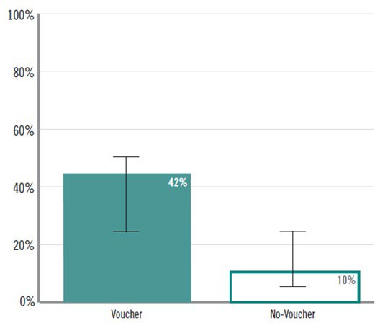
Ghosted by Housing Provider
Some voucher holders were expressly told that their voucher was not a barrier to renting the unit.
In 81% of those tests, evidence of discrimination was ultimately found.
In 56% of those cases, the real estate professional ceased all communication with the testers in spite of significant efforts on each testers’ part to make contact.

Slide 20
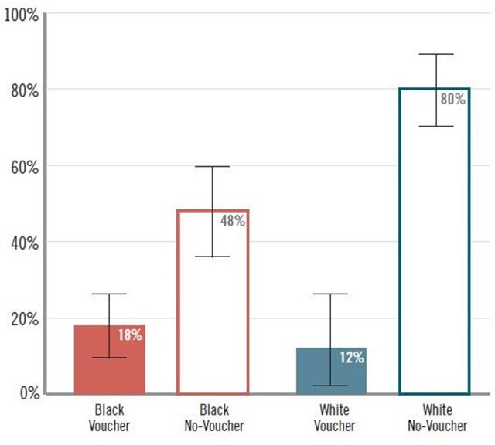
Touring the Unit
Real estate professionals did not return calls from testers with racially identifiable Black names.
Testers with racially identifiable white names were able to tour the unit (if they didn’t have a voucher).

Slide 21
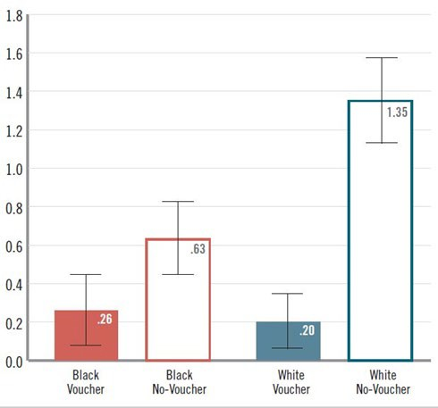
Units Housing Providers Said were Availabl
After "M.’s" tour, she was invited to join a “select group” to see another unit:
"They don’t advertise that apartment because then they would have to respond to everyone who inquires...“
"They were looking for people with quiet lifestyles who work, not CEOs necessarily, but people with good jobs."
The other three testers did not receive this offer.

Slide 22
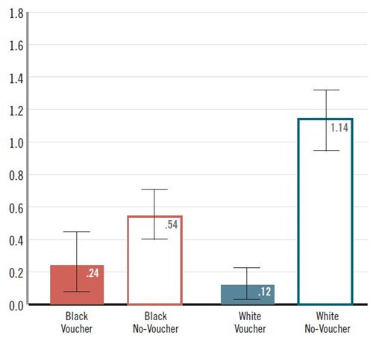
Units Shown to Testers
The White Market Rate tester was unable to tour a unit in only 10 tests out of 50.
In 5 of those tests, the unit had rented so no one could tour it.

Slide 23
Real Estate Professionals as Gatekeepers
187 testers interacted with a real estate professional
14 testers interacted with the property owner
4 testers interacted with property management personnel
On paper, all the testers were equally qualified to rent.
Many testers were never able to demonstrate their ability to rent the unit because they were screened out early in the process.

Slide 24

What is a protected class?
Characteristic of a person (defined by law) that cannot be targeted for discrimination
Prohibited conduct under law + Action being done based on a person’s protected class = fair housing violation

Slide 25
Protected Classes in Massachusetts
Fair Housing Act
(federal law)
Massachusetts
Anti-Discrimination Law (151B)
Race
Color
Religion
Sex
Disability
Familial Status
National Origin
Age
Military Status
Gender identity
Sexual Orientation
Marital Status
Receipt of public assistance
Genetic in formation
Ancestry

Slide 26
Protected Classes in Massachusetts
Fair Housing Act
(federal law)
Massachusetts
Anti-Discrimination Law (151B)
Race
Color
Religion
Sex
Disability
Familial Status
National Origin
Age
Military Status
Gender identity
Sexual Orientation
Marital Status
Receipt of public assistance
Genetic in formation
Ancestry

Slide 27

Who must follow fair housing laws?
Real estate professionals
Property owners/sellers
Housing authorities
Developers
Condo associations and homeowner associations
Housing employees such as property managers, clerical staff, maintenance and other housing personnel
Attorneys
Advertisement venues
Other residents in the building, development and neighborhood
Architects and contractors can be held liable under the accessible
Design and construction fair housing mandates
Short answer: Everyone!

Slide 28
Exemptions
There are limited, narrowly constructed exemptions to state and federal law, including some owner-occupied buildings.
No exemptions for source of income.
Exemptions do not apply to real estate professionals.
It is ALWAYS illegal to express d iscrim in atory preferences in
advertisem ents (even for owners who would otherwise be exempt).

Slide 29
Mass. Lead Law
Dwellings must be made lead safe if a child under the age of 6 resides or will reside there. This is a strict liability law.
A family with a child under the age of 6 cannot be denied a rental property because of the presence of lead paint (violation of multiple laws).
A lead law notification is not a waiver. An owner cannot avoid liability by asking tenants to sign an agreement that they accept the presence of lead paint.
A tenancy may be delayed to make a property lead safe (no longer than 30 days).

Slide 30
Disability : Reasonable Accommodations & Modification
Accommodation: A change or waiver to policies, practice, procedure, or service that is needed due to a disability
Modification: A physical alteration to provide greater accessibility and use of the premises for a person with a disability
A verbal request is accepted- no “magic words” are required and ALL requests must be considered
A provider can request information in order to evaluate if R.A. is necessary due to a disability - but not if the person’s disability is obvious, readily apparent, or already known to the provider

Slide 31
Housing Vouchers
In Massachusetts, source of income (state or federal housing vouchers like Section 8, SSI/SSDI etc) is a protected class.
No exemptions whatsoever, even if owner- occupied.
Discriminatory advertising is an additional and separate violation of fair housing laws.

Slide 32
Enforcement
Administrative Agencies
  Department of Housing and Urban Development HUD [federal]
  Massachusetts Commission Against Discrimination MCAD [state]
  Local (e.g., Newton Human Rights Commission, Boston Fair Housing Commission, Cambridge Human Rights Commission, etc.)
State and/or Federal Courts
18

Slide 33
Remember: Fair Housing is good for business!

Slide 34
Best Practices for Housing Providers
Establish a checklist and team plan.
    Checklists help you remain CONSISTENT.
    Make sure all employees are on the same page, so prospective tenants or home purchasers aren’t receiving different service based on which agent they speak to.
    Remember, an agency can be held liable for the actions of an individual agent, and often will be.

Slide 35
Best Practices cont.
Background and credit checks OK – as long as EVERY APPLICANT is asked for the same information.
Examples of what NOT to ask about:
1. If applicant has a disability or the nature or severity of disability
2. If the applicant has children or the age and genders of the children
3. The nature of the relationship between adult applicants, i.e., marital status
4. One’s sexual orientation
5. Age
6. Religion

Slide 36
Best Practices cont.
Use template emails or other correspondence (like text messages)
One form of discrimination we often observe is where members of a protected class are not told about special deals, receive less information about available units, or are told about fewer units.
Templates ensure that everyone is getting the same information.
Using a template also helps avoid mistakes, forgotten info, etc.
Be aware that discrimination can occur at all steps of the process (touring, application, appraisals, etc.)

Slide 37
Best Practices cont.
Maintain a call log for people you communicate with.
Be prepared to communicate about re levant laws (be knowledgeable about your obligations as a realtor)
Slow down. Engage in self-reflection.
Self-assessment - Project Implicit, take implicit association tests at (https://implicit.harvard.edu/implicit/)

Slide 38
Best Practices cont.
Provide and attend regular fair housing trainings to keep aware of your legal obligations.
Establish a monitoring plan which ensures all prospective home purchasers and tenants are treated similarly and fairly
Advocate for change!
Join with real state professionals to fight for fair housing, and for changes which would benefit both buyers and sellers
Fair housing is good business, it benefits EVERYONE!

Slide 39
Studies on Housing Discrimination
The full report, “Qualified Renters Need Not Apply” is on the Boston Foundation’s website
Additionally, researchers and policy advocates convened a discussion of the study results which can also be accessed on the Boston Foundation’s website (length: 60 min.)
Newsday’s study Long Island Divided, ava ilab le at
https://projects.newsda y.com /long-island/rea l-estate-investigation-videos/

Slide 40
What can I do if I witness discrimination?
You can REPORT discrimination and help join the fight!
Housing Discrimination Testing Program (HDTP) Boston Metro:​
Phone: 617-884-7568​ ​
Visit: suffolk.edu/law/academics-clinics/clinics-experiential-opportunities/housing-discrimination-testing-program​
Massachusetts Fair Housing Center (MFHC) Central MA:​
Phone: 413-539-9796 ​
Email: info@massfairhousing.org​
Visit: massfairhousing.org​
Community Legal Aid (CLA) Western MA:​
Phone: 855-252-5342​
Visit: communitylegal.org/get-help/report-housing-discrimination​
SouthCoast Fair Housing (SCFH) Southern MA/RI:​
Phone: 774-473-9994 ​
Visit: southcoastfairhousing.org

Slide 41
Questions?

