Slide 1
Inclusionary Zoning Ordinance Financial Feasibility Analysis
City of Newton, Massachusetts
March 12, 2018
Presented by:
Kyle Talente, Vice President & Principal
Jahangir Akbar, Market Analyst/Planner

Slide 2
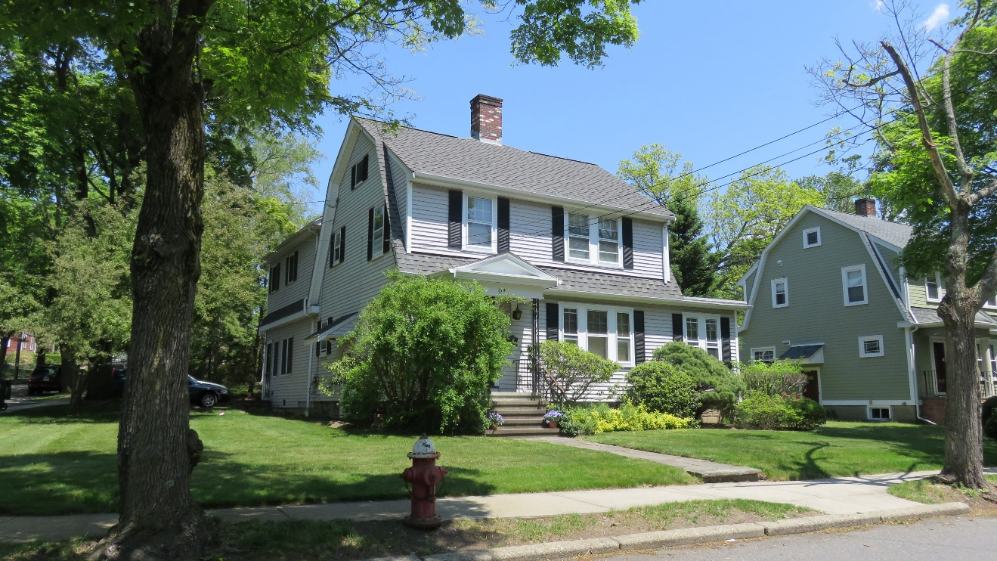
Study Goal
Help the City evaluate proposed changes to the inclusionary zoning Ordinance which will create more affordable housing while not having a detrimental impact on overall housing development.

Slide 3
Data Collection
Review Existing and Proposed Ordinance
Research Market Data
Model Building
Construct Pro Forma Model
Enter Raw Data
Analysis
Scenario Runs
Interpretation of Findings
Interview Real Estate Professionals
Calibrate
Recommendations

Slide 4
Model Elements

Slide 5
Model Inputs
Revenues
Expenses
Financials

Slide 6
Revenues
Rental income from apartments
Market driven
Sale income from ownership units
Market driven
Secondary income from development
Parking fees
Laundry
Vending machines
Reversion of rental property
Pro formas require assumption of sale at the end of the hold period

Slide 7
Expenditures
Rental properties
Vacancy and collection loss
Operating expenses
Management fees
Marketing
Maintenance
Insurance
Property taxes
Debt Service
All residential types
Equity Investments
Land acquisition
Development costs
Soft costs (i.e. permits)
Hard costs (i.e. buildings)
Cost of sale

Slide 8
Financials
Equity requirements
For sale and for rent properties
25% minimum
Construction (bridge) loans
Mortgage requirements
Origination fees
Interest rates
Term of loan
Capitalization rate
Valuation of cash flow
Market driven value
Currently 5.5% for rental properties

Slide 9
Model Outputs
Development profile
Unit Count
Affordable Units
Cash Contribution
Development value
Development cost
Land Cost
Construction Cost
Rate of return
Affordability gap
Is the development proposal financially viable?

