Slide 1
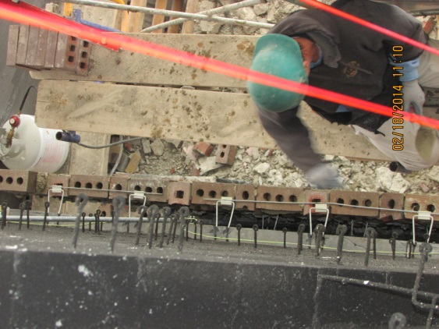
Carr School Update
3/5/14

Slide 2
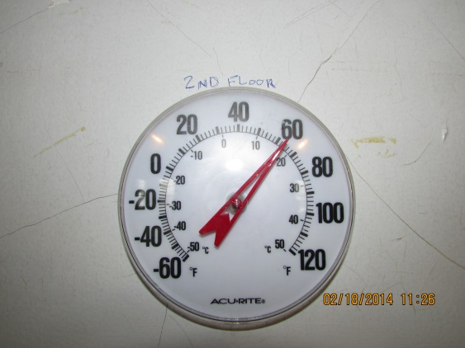
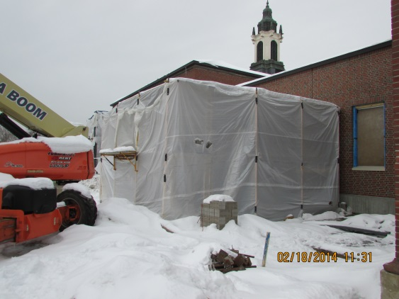
Elevator and Classroom Additions
Work is nearly complete. Containment to be removed in the coming weeks. Hourly checks on the space temperature have ensured proper environment for the masonry work. The elevator itself just arrived to the shop and will be on site within the week.

Slide 3
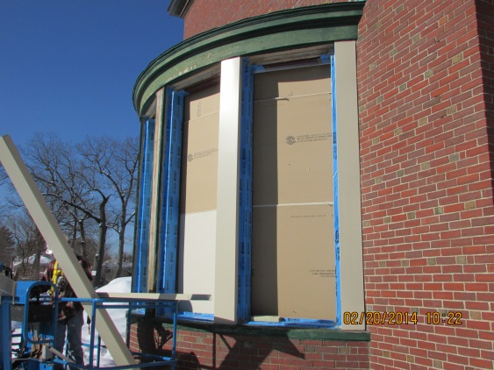
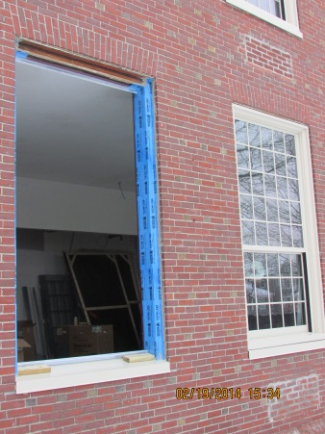
Windows
Windows are approximately 80% complete. Special care has been taken to ensure that the install is high quality, with an eye for air sealing and envelope integrity.

Slide 4
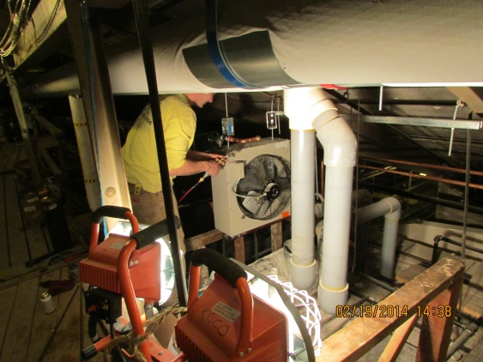
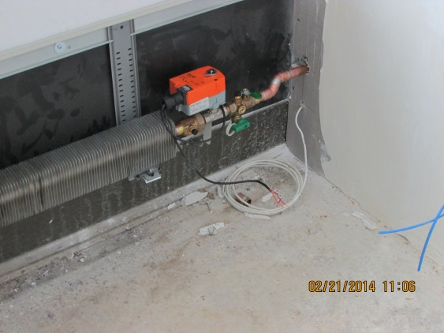
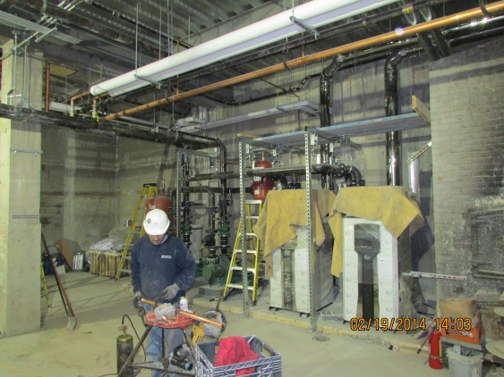
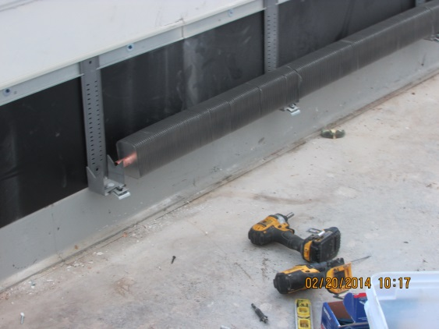
Mechanical Systems
Most of the HVAC work is complete. A few more air handlers to be installed, some small things to button up, and in about 4 weeks we’ll be firing up the new high efficiency condensing boilers.

Slide 5
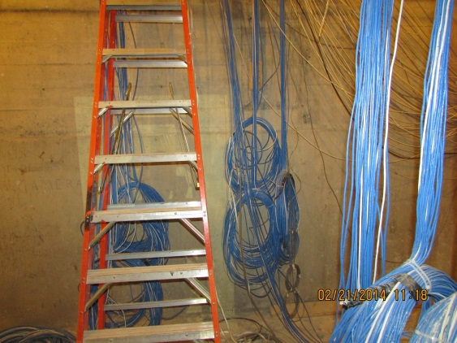
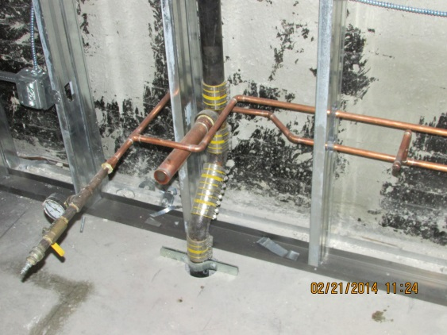
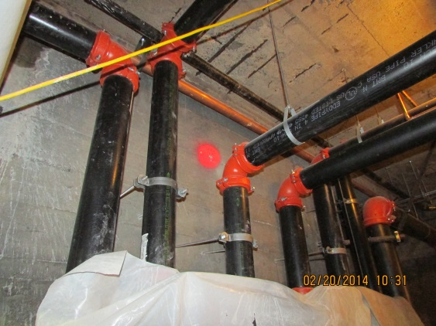
Electrical, Plumbing, Sprinkler, and Data
All interior trade work is moving along quickly. Systems are mostly installed, and things like pressure testing, safety checks, and final wiring are underway.

Slide 6
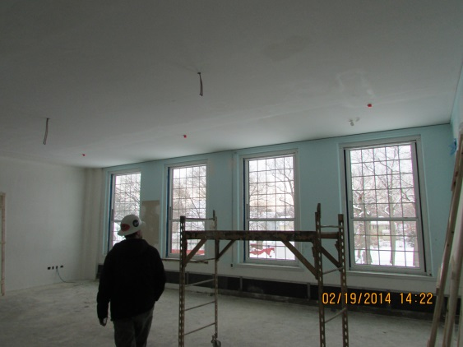
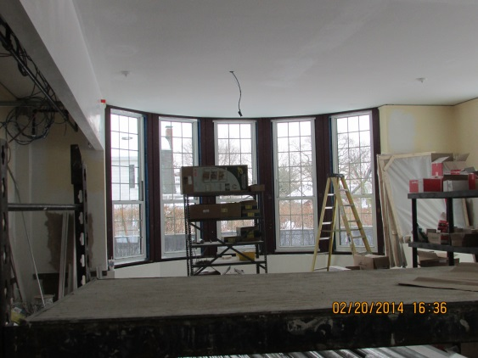
Interior Finishes
Almost all of the walls are closed up. Plastering is almost complete, and we’ve started painting.

