Slide 1
Newton Fire Station #10
Site Plan Review
8 May 2013
Jeff Shaw, AIA
Principal-in-charge
Notes:
1

Slide 2
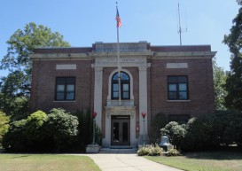
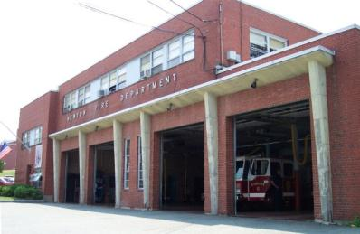
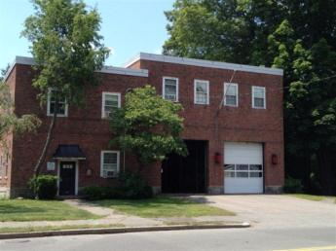
Feasibility Study Recap:
Study Goals:
The study was limited to the existing facilities: HQ, Station 3 & Wires Division (Newton Centre), Station 10 (Oak Hill).
Determine suitability of each Existing Station for modern firefighting needs
Review Code compliance
Study the Space Needs for each facility over the next 20 years
Headquarters
Station 3 & Wires Division
Station 10

Slide 3
Feasibility Study Recap:
Recommendations
Due to the significant costs incurred to renovate, replace all three buildings.
Relocate Wires Division to Station 10 property due to large lot size and use compatibility
Construct Station 10 first, then construct Wires Building behind
Construct a combined facility for Station 3 & HQ in phased operation

Slide 4
Fire Station Phase 1:
Fire Station #10 Space Needs
Current Needed
Personnel
Captain/Lieutenant 4 (1/shift) 4 (1/shift)
Firefighters 12 (3/shift) 12 (3/shift)
Parking, Public 0 1
Parking, Staff 20+ 8
(incl. shift change)
Front Line Apparatus 1 1
Reserve Apparatus 1 1
(ladder or engine)

Slide 5
Fire Station Phase 1:
Wire Division Space Needs
Current Needed
Personnel
Superintendent (at HQ) 1 1
Staff 3 4
Parking, Public 0 0
Parking, Staff 3 4
Vehicles Under Cover 1 5
Vehicles Outside 4 0

Slide 6
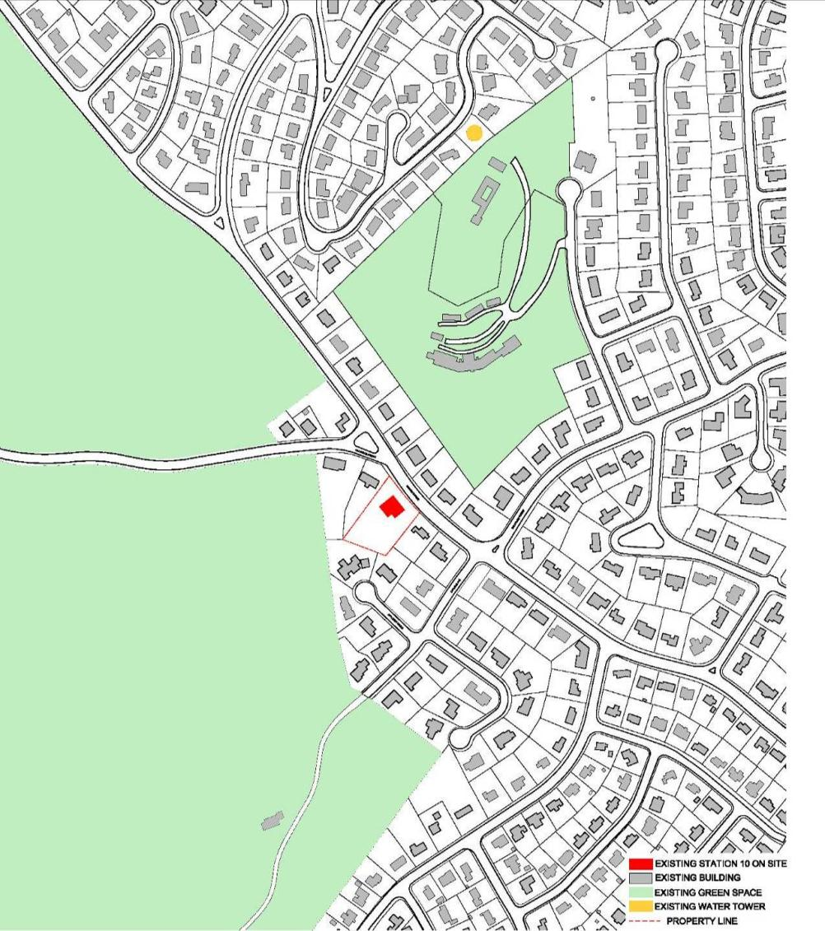
Oak Hill Neighborhood
NORTH

Slide 7
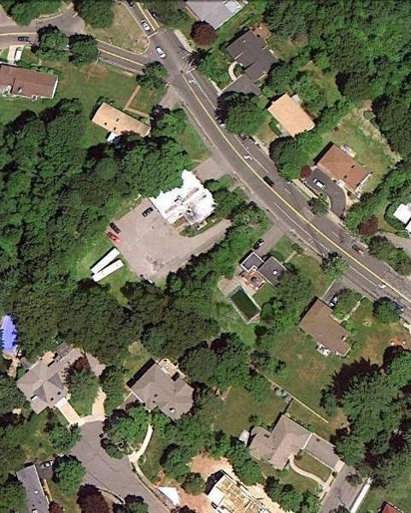
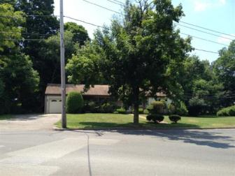
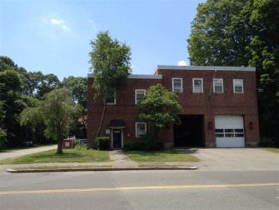
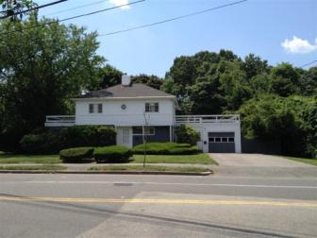
Existing Site
Notes:
7

Slide 8
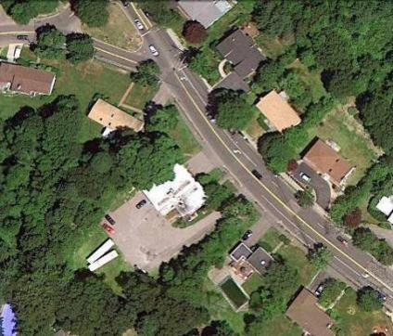
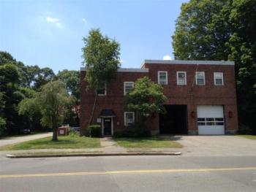
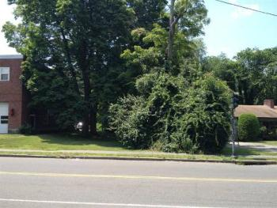
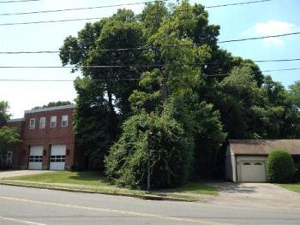
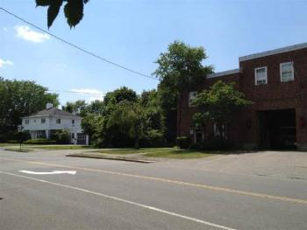
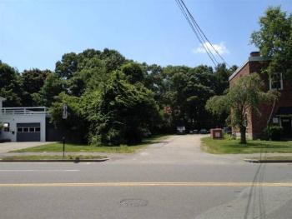
Dedham Street - West
Dedham Street - East

Slide 9
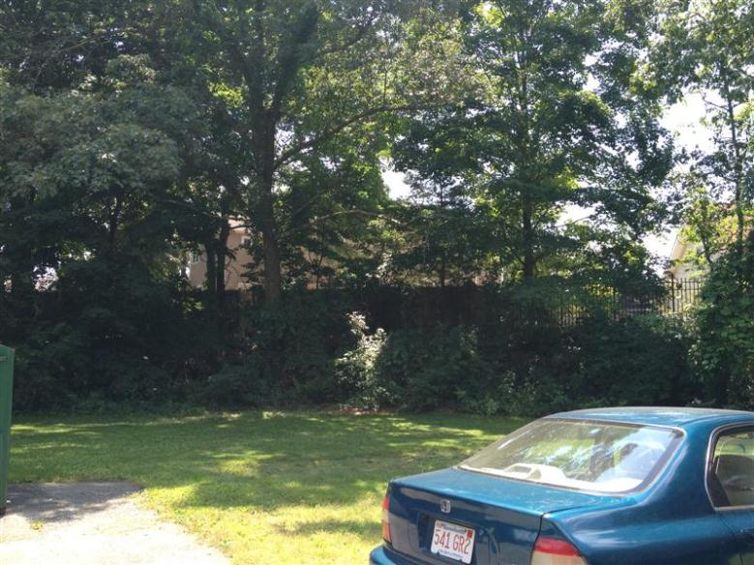
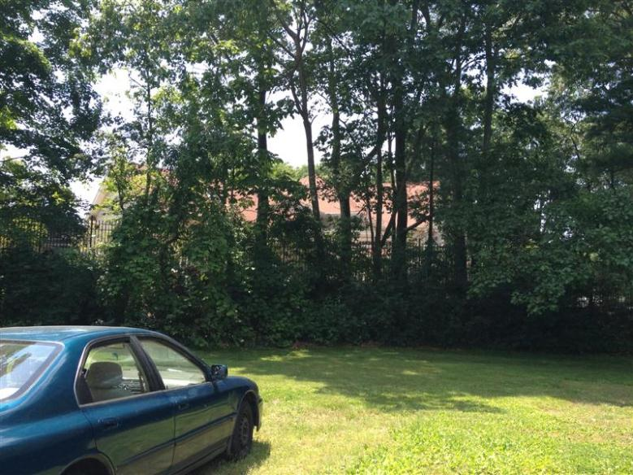
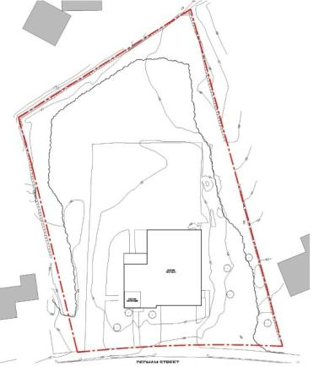
Back Property Line

Slide 10
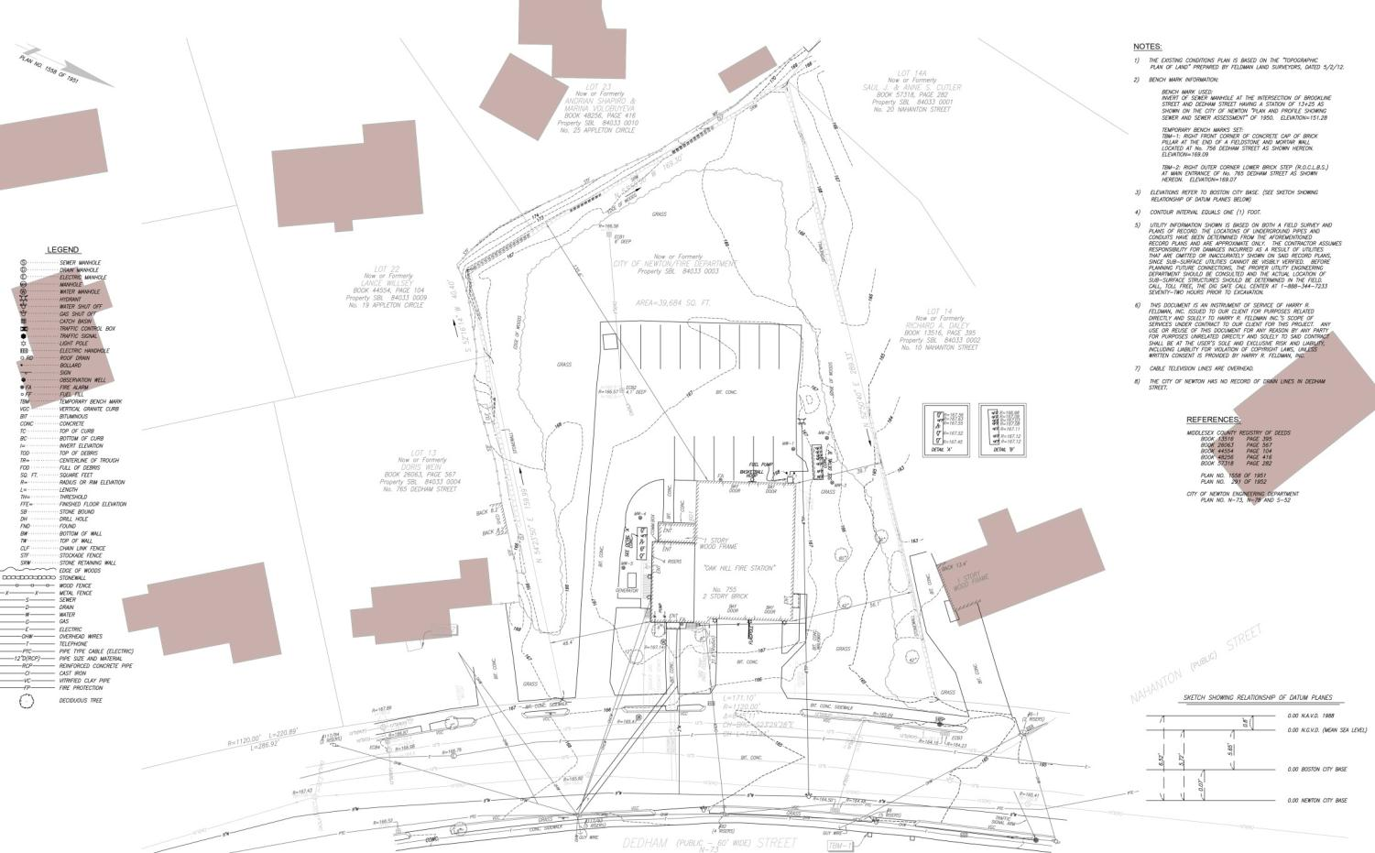
NORTH
STATION 10
EXISTING CONDITIONS

Slide 11
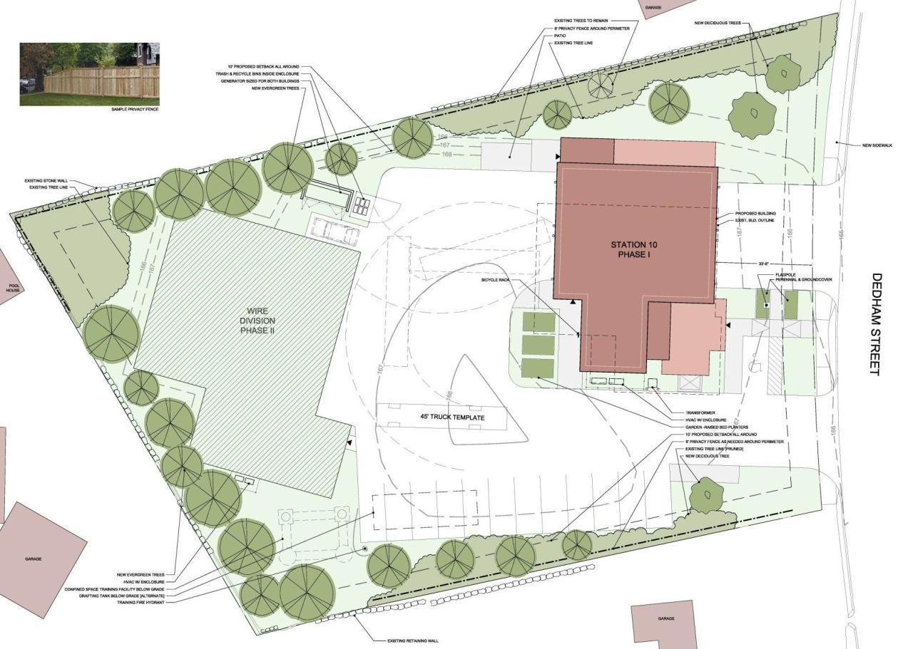
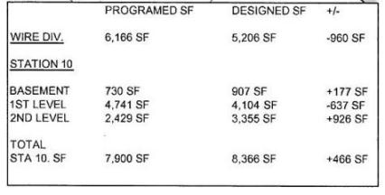
NORTH
STATION 10
Approved Proposal
DRC 10/18/2012
SITE PLAN

Slide 12
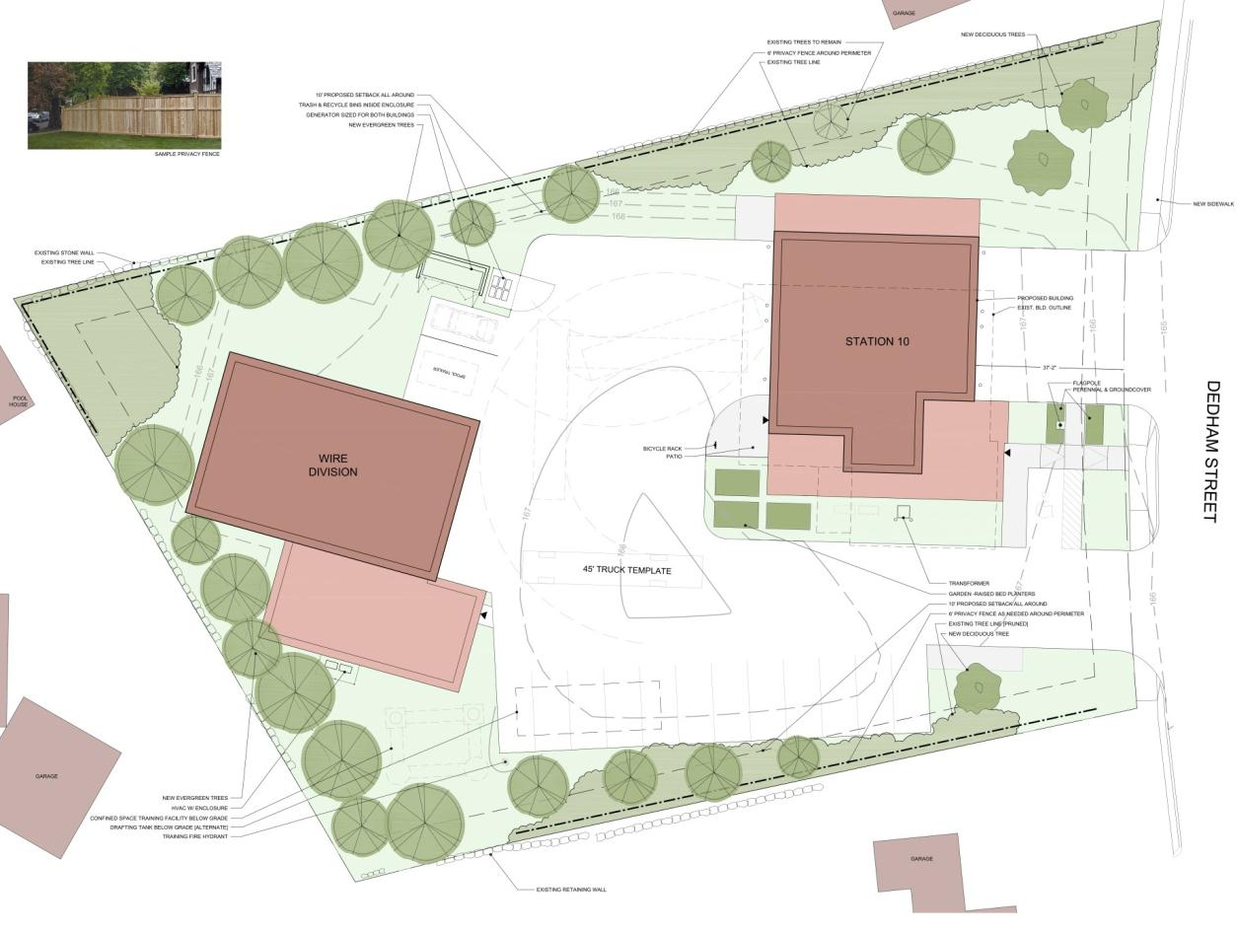
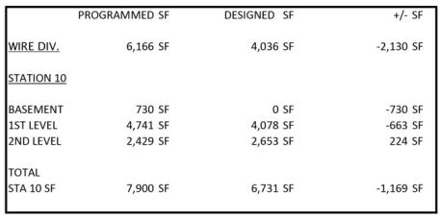
NORTH
STATION 10
Revised Proposal
SITE PLAN

Slide 13
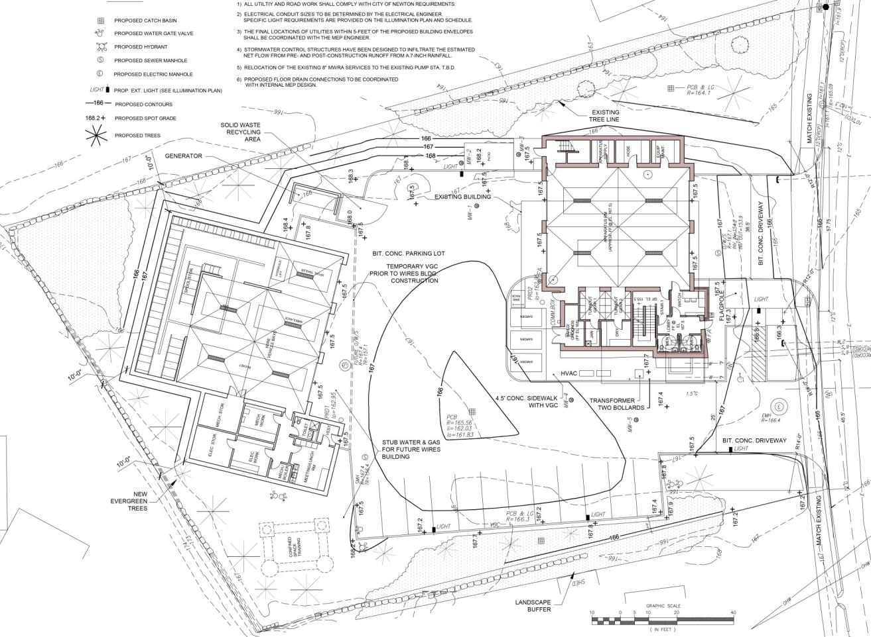
NORTH
STATION 10
Approved Proposal
DRC 10/18/2012
GRADING & PAVING

Slide 14
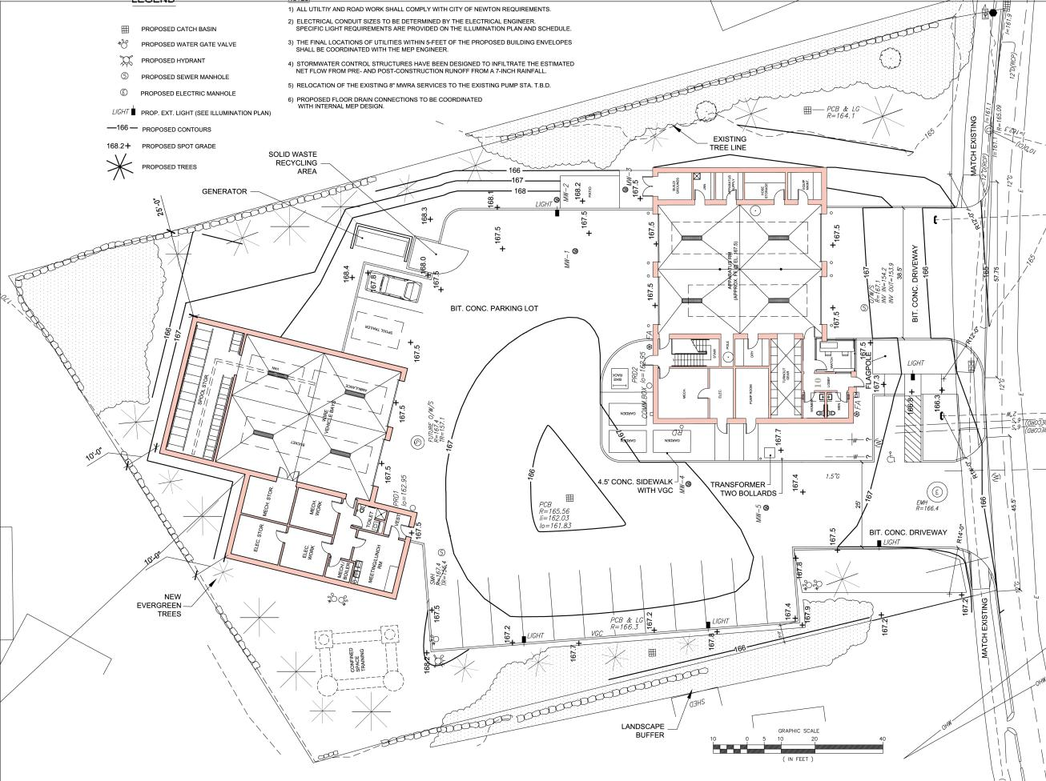
NORTH
STATION 10 & WIRES
Revised Proposal
GRADING & PAVING

Slide 15
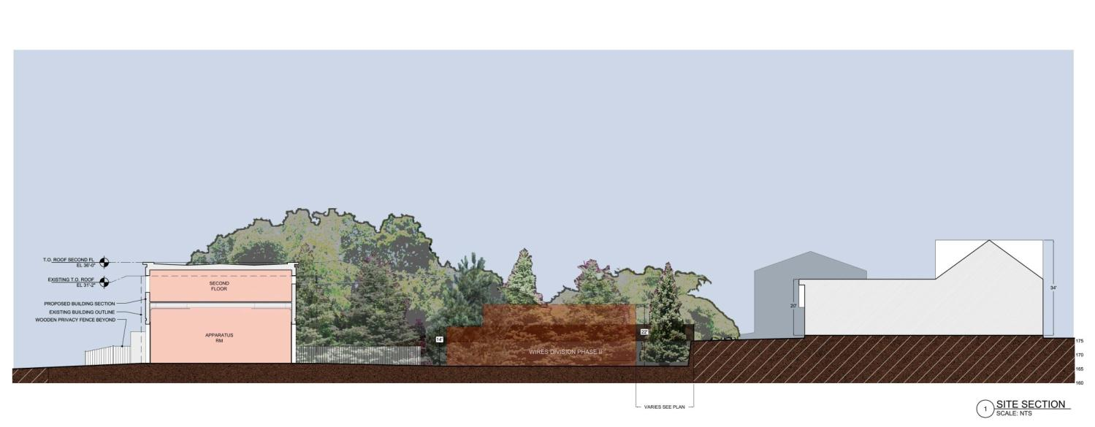
STATION 10
Approved Proposal
DRC 10/18/2012
SITE SECTION

Slide 16
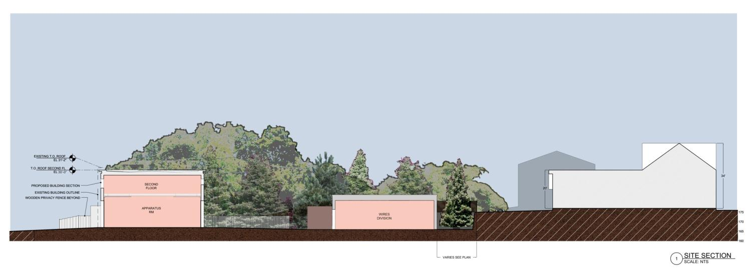
STATION 10
Revised Proposal
SITE SECTION

Slide 17
STATION 10
Approved Proposal
DRC 10/18/2012
SITE ELEVATIONS

Slide 18
STATION 10
Revised Proposal
SITE ELEVATIONS

