Slide 1
Transportation Management
1149-1151 Walnut Street

Slide 2
Existing Parking
The site currently features parking for 24 cars, accessible via two curb cuts on Walnut Street.
11 spaces are front-loaded along the façade of 1141 and 1151 Walnut, and another 13 spaces are in a parking lot in the rear of 1149 Walnut.
All spaces are non-conforming.

Slide 3
Vehicle Parking
The Project will feature 23 assigned parking spaces and two short-term parking spaces
All spaces will be charged separately from the apartments and retail rents
All parking to be covered, surface-level parking accessible via existing curb cut from Walnut Street
7 of the 23 assigned spaces are dimensioned for compact cars
1 of the spaces will be handicapped accessible and at least 1 will be electric car charge ready
The infill of one of the existing curb cuts on Walnut Street will create two additional street parking spaces

Slide 4
Bicycle Parking
The Project will feature a 228 square foot bicycle storage room adjacent to the covered parking level
This space should store approximately 25-30 bicycles.

Slide 5
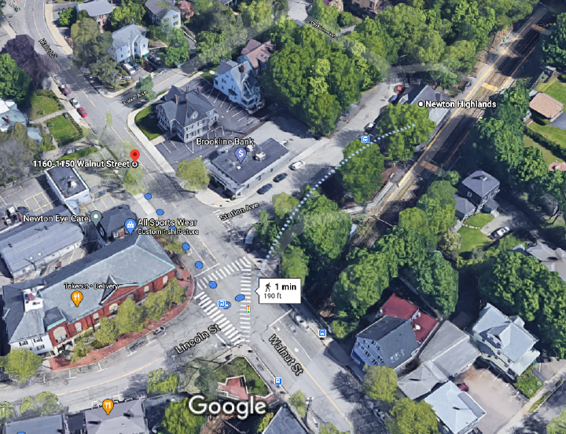
MBTA - Green Line
The entrance to the Newton Highlands stop of the Green Line D Train is approximately 190 feet from the Project’s residential entrance on Walnut Street.
The D Train runs eastbound to Downtown Boston and westbound to Riverside
Weekdays during peak service, trains arrive every 6 minutes, and off-peak or weekend service, every 8-13 minutes.
It is anticipated that many of the residents will utilize the Green Line as their primary means of commuting

Slide 6
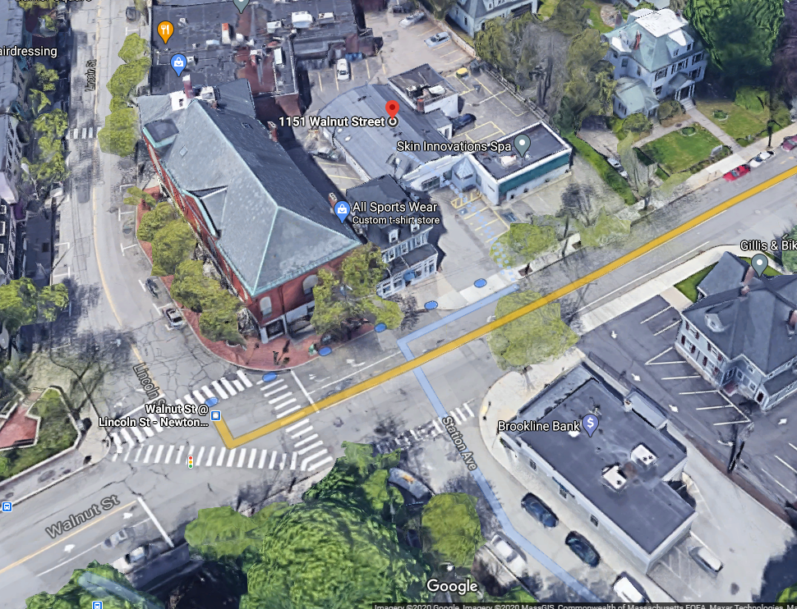
MBTA - Bus Route 59 AND SHUTTLES
The MBTA 59 bus runs from Needham Junction to Watertown Square
The 59 bus stop is located at the corner of Lincoln Street and Walnut Street, approximately 193 feet from the Projects residential entrance on Walnut Street.
Northland shuttle is anticipated to Needham Street
Wells Ave shuttle is anticipated.

Slide 7
Administrative Management
Upon project completion, the Property Management Company's (C. Talanian Realty) Property Manager will serve as Transportation Coordinator
A TDM disclosure, MBTA and rideshare information will be featured in a resident welcome packet to new residents
A management operated “ride board” featuring carpool and MBTA information will be presented in the residential lobby
Subsidizing MBTA passes for renters who don’t own a car is an option currently under review

