Slide 1
NEWTON PARKS, RECREATION & CULTURE
FIELD SUBCOMMITTEE MEETING
FIELD PERMIT FEE INFORMATION
DECEMBER 10, 2020

Slide 2
Current Tier Structure and Fees
Tier | Groups | Turf | Grass | Lights
1 | Newton Parks & Recreation, Newton Public Schools | $0 | $0 | $0
2 | Newton-based Youth Sports Leagues | $50 | $0 | * $50
3 | Adult Groups and Youth Leagues with more than 65% residents, Newton Private Schools, Newton Charitable organizations, Newton Public School PTO’s | $75 | $15 | $50
4 | Newton Businesses, non-Newton schools, Adult Groups and Youth Leagues with less than 65% Newton Residents, Newton non-profits; Newton Charitable organizations | $100 | $20 | $50
5 | Private for profit Camps and Clinics not affiliated with Newton, one-time Events/Tournaments, or other organizations running a business regardless of number of Newton residents associated with the program. 10% of program income OR | $100 | $25 | $50
* $35/hr Highlands Little League

Slide 3
Fee Benchmarks to Other Communities
A survey was done of 12 Communities to learn how each community handles their numerous requests for field use by residents and non-residents.
All Communities appear to have some form of Tier System, similar to Newton.
7 of the 12 communities surveyed charge a per person participant fee for youth leagues; two or three communities charge a PPF for adult programs; several charge a PPF for non-resident youth and adult programs.
Fees for grass field use range from $10/hour for a single use permit to as much as $40/hour. (fee reductions be given for groups who pay PPF)
Fees for turf field use range from $30 to $150 per hour depending on Tier. (fee reductions may be given for groups who pay PPF)
Communities appear to consistently charge higher fees to for-profit programs and non-resident programs. Some communities, however, do not permit to non-resident groups at all.
Newton’s field permit fees for grass are consistently lower than other communities. Turf field fees are middle of the road.
Community Survey data is located in Appendix – slides 11, 12 & 13

Slide 4
Newton Youth Sports Program: Hours & Participants
LEAGUE | TOTAL HOURS PERMITTED | TOTAL PARTICIPANTS
Newton Youth and Girls Soccer | 16,123 | 3,497
Newton Boys Lacrosse League | 802 | 300
Newton Girls Lacrosse League | 212 | 180
Newton Youth Football Mustangs (No 2020 program) | 0 | 0
BUDA youth Frisbee* | 53 | 163
Private LAX (Girls Lax Newton, Gorilla)* | 249 | 86
Zervas Kindergarten Soccer*. (No 2020 program) | 196 | 250
Newton Area Flag Football league* | 157 | 505
Newton Little League | 11,546 | 686
Newton South East Little League | 8,697 | 764
Newton Girls Softball | 7,462 | 289
Babe Ruth League | 734 | 82
Senior Youth Baseball. (No 2020 program) | 845 | 35
Private baseball leagues (Minuteman, Triple Crown, Prime)** | 0 | 256
TOTAL: | 46,864 | 7,093
* private league tier 3
** private league tier 4
Data from: April 1 – June 16, 2019, June 17, 2020 – December 2020
Permits not typically issued for “winter season”

Slide 5
Newton Youth Programs Registration Summary
Program | Cost | Last Fee Change | Registration | Expenses
Newton Youth Soccer | NO DATA | ? | ? | $125,000 Field Maintenance, Field lining, Field rentals, Goal maintenance, Toilet rentals, Lights: $50,000 NSHS Lights Purchase
Newton Girls Soccer | $180 - $210 | 2019 | Jun, Dec | $125,000 Field Maintenance, Field lining, Field rentals, Goal maintenance, Toilet rentals, Lights: $50,000 NSHS Lights Purchase
Newton Girls Lacrosse | $100 - $220 | 2012 | Nov | $1,450 Field Lining plus turf fees ($50/hour)
Newton Flag Football | $150 |  | Rolling | $10,000 field markings, use. $30K to invest in field renovations
BUDA youth Frisbee* | $90 - $130 | NONE | 1-2 months prior
Newton SE Little League | $150 - $225 | 2021 ($25) | May, Jul, Dec | $20,000 field maintenance
Babe Ruth League | $195 | 2019 | Feb | $15,000-$16,000 (umps., Equipment, insurance, etc.)
Boston Volleyball | $190 - $310 | NONE | Rolling
Newton Little League | $160 - $300 | none | ? | $53,470 Field prep, field maintenance, cleaning toilets, aeration, grass cutting, supplies
Newton Girls Softball | $75 - $135; Travel teams $125-$900 | 2015 spring; 2019 fall | Spring-Nov; Fall – July; Summer- prior August/Sept | $5,000 - $15,000 field maintenance $15,000 capital expenses in 2015
Newton Boys Lacrosse Newton Youth Football Private LAX (Girls lax, Gorilla) Zervas K Soccer Senior Youth Baseball Private Baseball Leagues | Data not available at this time

Slide 6
Turf Field Possible Permit Fee Proposals*
TIER 2019 Hours/Income NEW FEE ADDITIONAL INCOME GENERATED
ONE 750 est.($0.00) No change
TWO 339.5 ($16,975) No Change
(possible reduction if Per Participant fee instituted)
(NYS/NGS not charged for turf use – offset from league donations to turf projects)
THREE 215 ($16,125)
$100/hour +$5,375
$125/hour +$10,750
$150/HOUR +$16,125
FOUR 318 ($31,800)
$125/hour +$7,950
$150/hour +$15,900
$175/hour +$23,850
$200/hour +$31,800
FIVE n/a (hours charged as Tier 4 in 2020)
$200/hour
Daily rate for Tournaments/player expos
Daily rate for Camps/Clinics (plus per participant fee)*
*Hours/ Income listed and projections are based on 2019 turf field use, because spring 2020 was cancelled. The 2019 number represent a more “normal” year.

Slide 7
Grass Field Possible Permit Fee Proposals*
TIER 2020 Hours/Income NEW FEE ADDITIONAL INCOME GENERATED
ONE (3,895) $0.00 no charge $0.00
TWO (21,057 hours) $0.00
no charge $0.00
Per participant fee (slide 12)
Hourly fee per field ($1.00 -$5.00) + $21,057 - $105,285
THREE (861 hours) $12,915
$20/hour +$4,305
$25/hour +$8,610
$30/hour +$12,915
FOUR (1,167 hours) $23,340
$25/hour +$5,835
$30/hour +11,670
$35/hour +$17,505
$40/hour +$23,340
FIVE (68 hours) $1,700
$50/hour +$1,700
$75/hour +$3,400
$100/hour +$5,100
*Hours/Income listed and projections do not include Session 1 (April 1-Father’s Day, 2020) cancelled due to COVID. They are based on June 16 thru December17, 2020 permit numbers.

Slide 8
Possible Per Participant Fee Proposals Annual (based on 2019/2020) & League Financial Impact
LEAGUE | TOTAL PARTICIPANTS (spring 2019 & summer /fall 2020) | PPF@$10 | PPF@$15 | PPF@$20
Newton Youth and Girls Soccer League | 3,497 | 34,970 | 52,455 | 69,940
Newton Little League | 686 | 6,860 | 10,290 | 13,720
Newton South East Little League | 764 | 7,640 | 11,460 | 15,280
Zervas Kindergarten Soccer* | 250 | 2,500 | 3,750 | 5,000
Newton Girls Softball | 289 | 2,890 | 4,335 | 5,780
Newton Area Flag Football league* | 505 | 5,050 | 7,575 | 10,100
Newton Boys Lacrosse League | 300 | 3,000 | 4,500 | 6,000
Newton Girls Lacrosse League | 180 | 1,800 | 2,700 | 3,600
Gorilla Boys Lacrosse* | 25 | 250 | 375 | 500
Babe Ruth League (summer only) | 82 | 820 | 1,230 | 1,640
BUDA Youth Frisbee* | 163 | 1,630 | 2,445 | 3,260
Newton Youth Football (Mustangs) | 0 | 0 | 0 | 0
Girls Lacrosse Newton | 61 | 610 | 915 | 1,220
Senior Youth Baseball | 35 | 350 | 525 | 700
Boston UVC (volleyball)* | 570 | 5,700 | 8,550 | 11,400
TOTALS: | 7,663 | $76,630 | $114,945 | $153,260

Slide 9
Field Sub Committee Permit Fee Questions to discuss
Would adding a “Season Pass” option for adult groups and pick-up use of both grass and turf fields be a viable addition? If so, what might we charge?
What would a reasonable per day and/or per weekend fee be for a tournament or player “expo” on a turf or grass field?
What would a reasonable fee be for “for profit” camp or clinic using a turf or grass field daily during summer months?
If we were to assess a per participant fee to Newton Youth Organizations, should we also include a PPF for non-Newton Youth Leagues? If so, what fee is possible?
Should a dialogue be initiated between PRC and the School Athletic departments (Public Schools) to discuss fees for athletic field use & maintenance? Perhaps a PPF each outdoor season?
If a PPF is initiated can we split the fee (1/3 to administrative; 2/3 to field maintenance)?

Slide 10
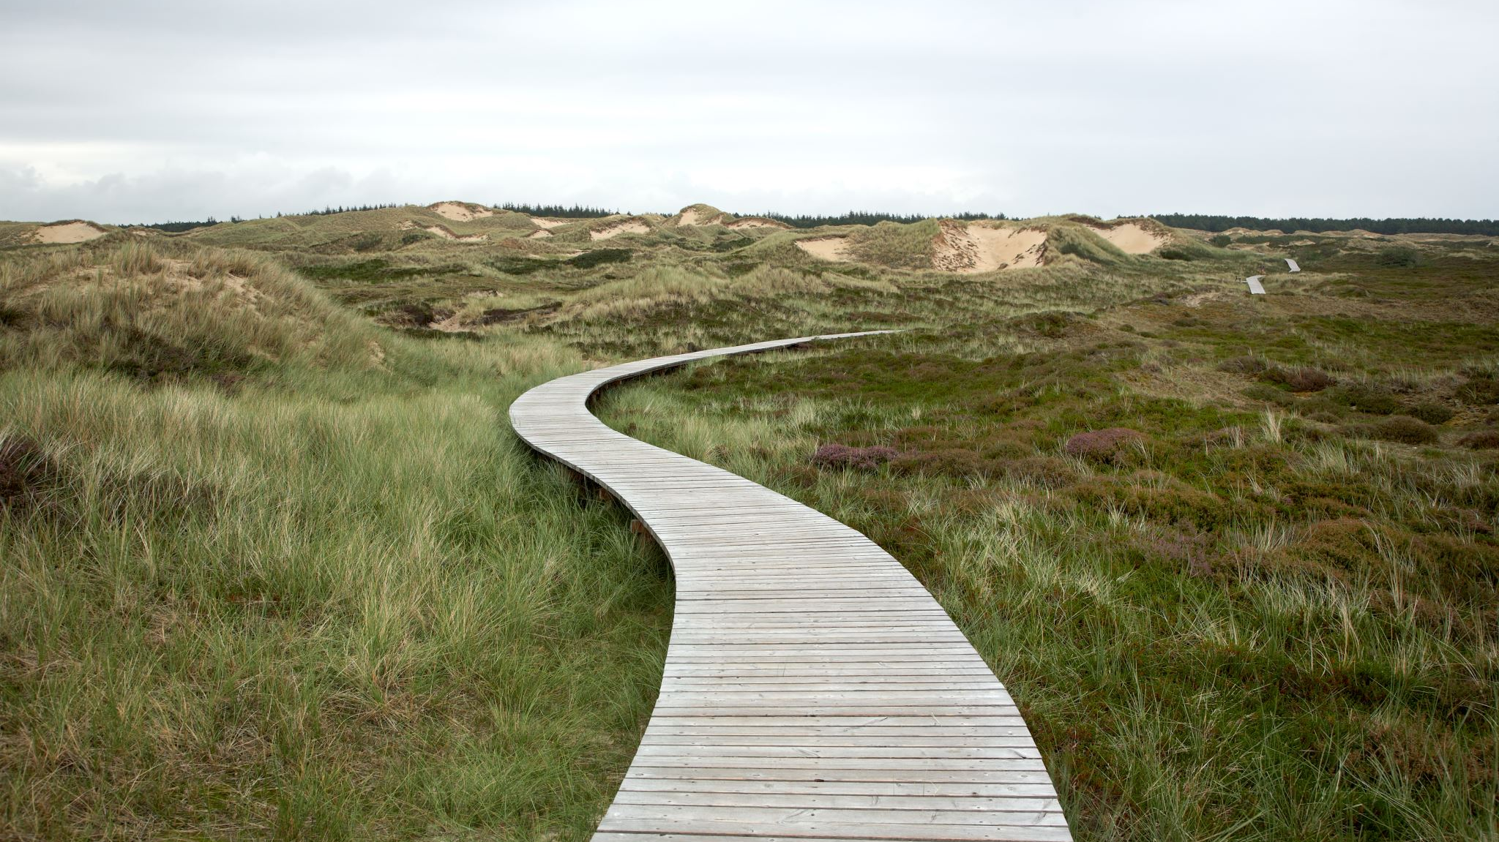
Field Sub Committee Permit Fees
NEXT STEPS
WHERE DO WE GO FROM HERE?

Slide 11
APPENDIX

Slide 12
Community survey
CITY/TOWN | Tier One | Tier Two | Tier Three | Tier Four | Tier Five
WELLESLEY (see attached) | 1) Town-wide Special Events: No fee, 2) School Use: No fee, 3) School Coach(es) Clinics: $15 per participant, 1.5 hours minimum | League$30 per participant per season; Clinic $15/participant1.5 hours minimum | Multi-Purpose Field (at Hunnewell) for Adult Softball: $40 per participant per season ($25 to Recreation lighting account); Wellesley Resident – One-Time Use: $50 for a grass field, including the Multi-Purpose Field (at Hunnewell), but $75 if using lights (incremental $25 to Recreation lighting account); $75 for a turf field, 1.5 hours minimum | Non-Resident (Adults and Youth): Grass field and Sprague turf field: $150; High School turf field: $375 (fee is for field use only; utilization of scoreboard and sound system is not allowed),1.5 hours minimum | Non-Recreation Department Camps: $35 per participant on a grass field; $50 per participant on a turf field. 1.5 hours minimum
TURF |  |  | $75
LIGHTS
BURLINGTON | no charge | 90% resident youth or adult $25/hour | 60% residents youth or adult $35/hour | under60% resident youth or adult, but must have at least 20% residents on roster $50/hour | $50/hour plus usage fee of $500 per day -weekdays; $800/day weekends
TURF
LIGHTS |  | going electrical rate | going electrical rate plus $15 admin fee | going electrical rate plus $15 admin fee | going electrical rate plus $50/admin fee
PLYMOUTH |  | Youth Leagues $5/pp per season | Adult Leagues $8/per adult | Resident single use $10/hour; NR single use $20/hour
TURF
LIGHTS |  | lights $15/hour | lights $15/hour | lights $15/hour
NORWOOD |  | Youth group/league $20/pp oer season | Resident Single use $10/hour | Non resident single use $25/hour | Norwood camp $50/hour; non Norwood camp $75/hour
TURF
LIGHTS
SUDBURY (see attached) |  | ResidentYouth group: $40/pp per season; Non Resident Youth group $85/pp per season | Resident Adult group $45 pp per season; Resident grass field $70/hour | Non Resident Adult group $85 pp/per season | Camps/Clinics $50/person
TURF |  | $70/per hour resident | $70/hour | $110/per hour
LIGHTS | seasonal: $35/hour One time; $75/hour
LINCOLN | Lincoln Community Group non profit - $5/hour | Lincoln Community Group for profit - $20/hour | Non resident Community Group Non Profit - $45/hour | Non Resident Community group For Profit - $75/hour
TURF
LIGHTS

Slide 13
Community survey
CITY/TOWN | Tier One | Tier Two | Tier Three | Tier Four | Tier Five
Brookine (minimum 2 hours) | no charge | $15 - $25/hour | $15 - $25/hour | $25 - $40/hour | $50/hour
TURF | no charge | $30 - $50/hour | $30 - $50/hour | $50 - $80/hour | $100/hour
LIGHTS
Lexington | no charge | no charge w/$15 per person participant fee | $40/hour | $55/hour | $75/hour
TURF | no charge | $35/hour | $80/hour | $110/hour | $150/hour
LIGHTS | $35/hour | $35/hour | $35/hour | $35/hour | $35/hour
Westwood | no charge | $50/hour
TURF | no charge | $150/hour
LIGHTS | $70/hour WHS; $25/hour Morrison | $70/hour WHS; $25/hour Morrison
Natick | no charge | $5/player/season | Natick Adult ORGS$125/team/ season | Natick residents$10/hour | $200/field/day
TURF | TBD | additional $5/player/season | TBD | TBD | $300/field/day
LIGHTS | TBD | TBD | TBD | TBD | TBD
Weston | no charge | no charge -$15/hour | $25/hour | $50/hour | $75/hour
TURF | n/a | n/a | n/a | n/a | n/a
LIGHTS | n/a | n/a | n/a | n/a | n/a

Slide 14
Community survey
CITY/TOWN | Tier One | Tier Two | Tier Three | Tier Four | Tier Five
NEEDHAM ) | Needham Non-Profit Youth organization § 100% “Needham residents”; Needham Public schools; Needham Park and Rec programs § Youth Legacy Organization § Game and Practice Schedules, only | Needham Non-Profit Adult organization § 100% “Needham residents” § Adult Legacy Organization § Game and Practice Schedules, only | Needham Non-Profit Adult organization ; 100% “Needham residents” (see definition) ;Adult Legacy Organization ;Game and Practice Schedules, only | Needham Non-Profit Youth or Adult organization;Less than 100% Needham residents; Regional Teams, based in Needham (Club, AAU) | Non Needham based Non profits; unlisted groups
 | $15 per participant per season, of which $10 is deposited as Field Maintenance Fee and $5 is deposited as Field Administration Fee § $5 per participant per season, if proof of residency cannot be provided § Fees are not charged to Needham Public Schools | $45 per day per block of time of four hours or less; $90 for more than 4 hour block of time, deposited as Field Administration Fee § $10 per participant per season, deposited as Field Maintenance Fee § $5 per participant per season, if proof of residency cannot be provided | Clinics/Camps § This fee is not charged when event is approved special event only for members of a permitted organization during its regular season § $5 per participant per day § $5 per participant per clinic/camp, if proof of residency cannot be provided § The majority of the fee will be deposited into a Trust Fund for Capital Improvements to Athletic Fields and Facilities. A small portion may be deposited into the Field Maintenance Fund to assist with repairs after the event. | Special Events § The Park and Recreation Commission and/or Trustees of Memorial Park will determine the events that fall under this fee structure, based on type of organization requesting and type of use. § $500 per day on natural grass field or other facility, for event scheduled for four hours or more of actual use. § $1,000 per day on synthetic turf field, for event scheduled for four hours or more of actual use.

Slide 15
Facility by Field Type/ User/Hours June 16, 2020 through December 17, 2020
Hours of Rectangular Use: 16,119.25
Newton Youth Soccer
Newton Girls Soccer
Newton Boys Lacrosse
Newton Girls Lacrosse
Girls Lacrosse Newton*
Gorilla Boys Lacrosse*
Prep Soccer Academy*
Surf Soccer *
XCEL Lacrosse*
Newton Area Flag Football*
Boston Ski & Sports*
NNHS
NSHS
Juventas*
Over the Hill Soccer League*
Newton Community Ed
Boston UVC (volleyball)*
Youth & Adult BUDA (frisbee)*
Neighborhood Adult soccer groups*
Hours of Diamond Use: 12,756.25
Newton South East Little League
Newton Little League
Newton Senior League
Newton Girls Softball
Babe Ruth League
Private Leagues (Prime, Minuteman, Pure Baseball, Triple Crown)
Early Risers – softball
Shul Softball League
Newton Brewers
Boston Ski & Sports
Spartans Cricket
Newton Traveling Baseball
Bay State Summer Teams
Extra Innings

