Slide 1
Special Permit Request
29 Wedgewood Road, West Newton
Peter and Denise Staubach

Slide 2
Agenda
Neighborhood
Mass
Historic review
Landscaping plan
Let’s stick to the facts. Opinions are like belly buttons: Everyone has one and they are all different.

Slide 3
Neighborhood
Wedgewood Road
16 homes
14 – 2 story colonials, most with walk up attic
2 - 1.75 story capes, with crawl space
Eliot Ave abutters
3 homes
2 – 2 story colonials, with walk up attic
1 – 1 story bungalow

Slide 4
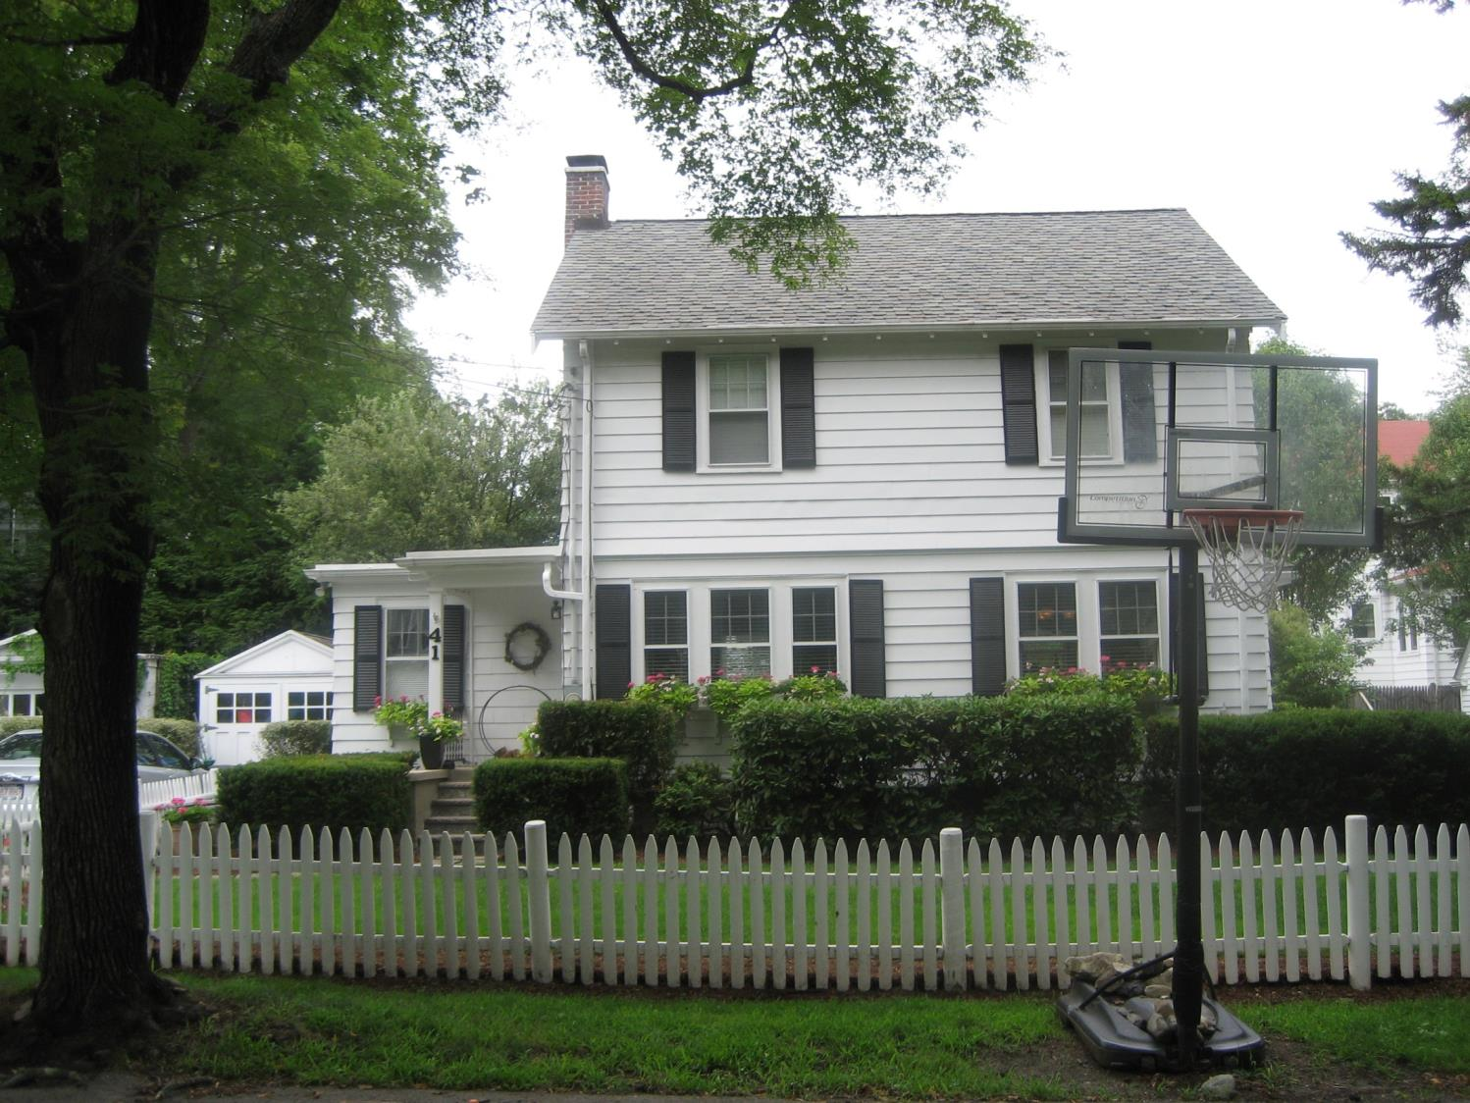
41 Wedgewood Road

Slide 5
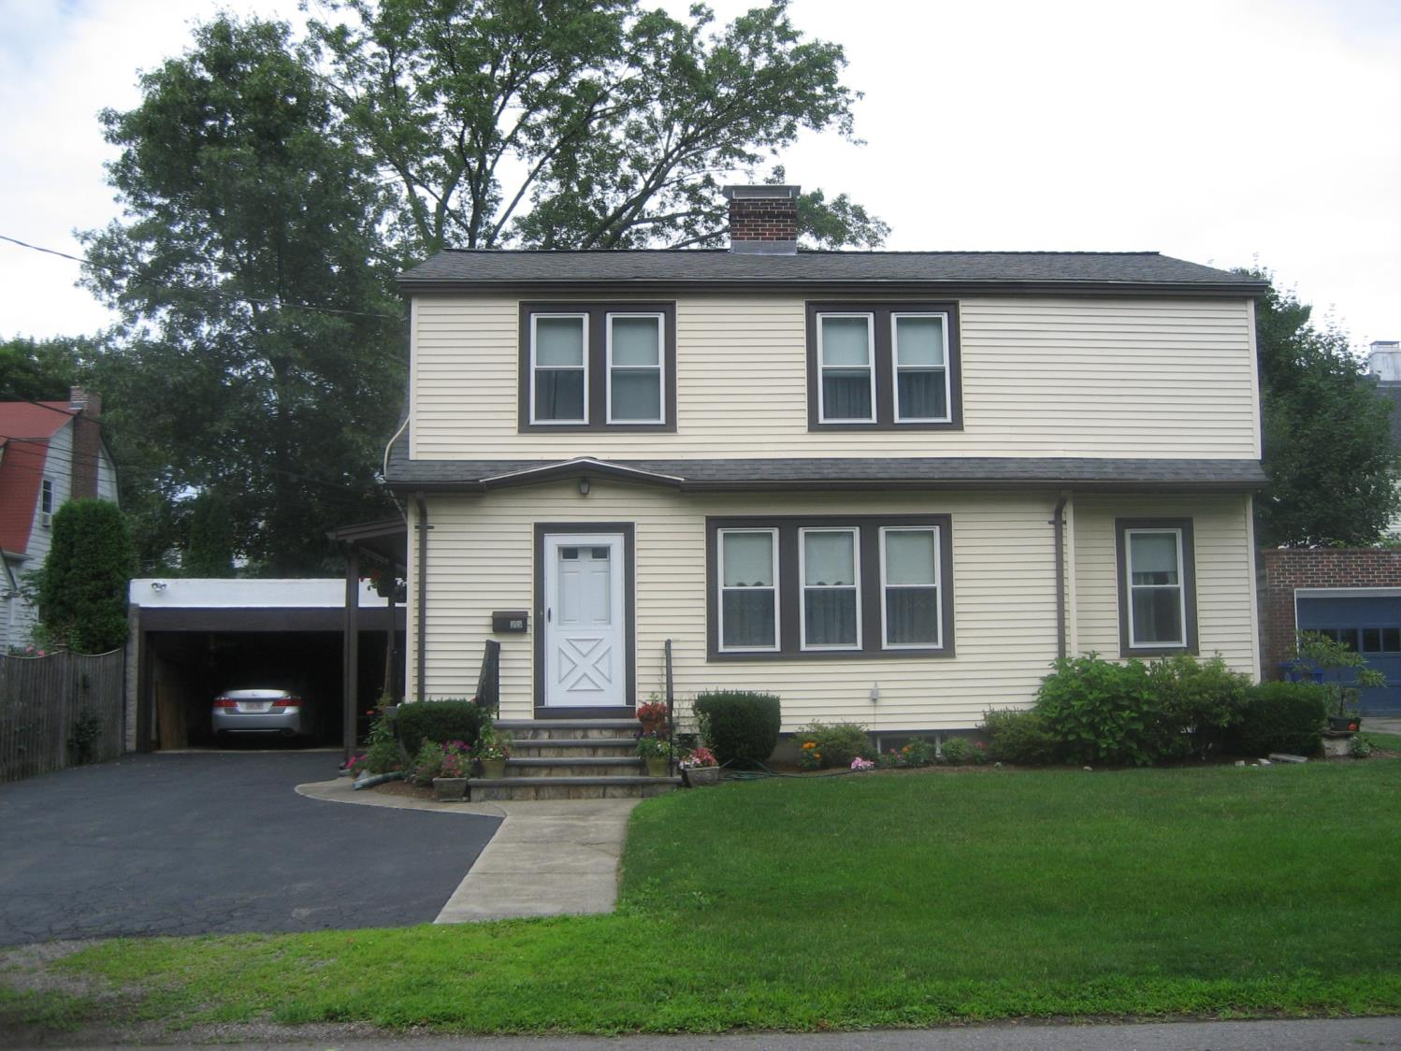
25 Wedgewood Road

Slide 6
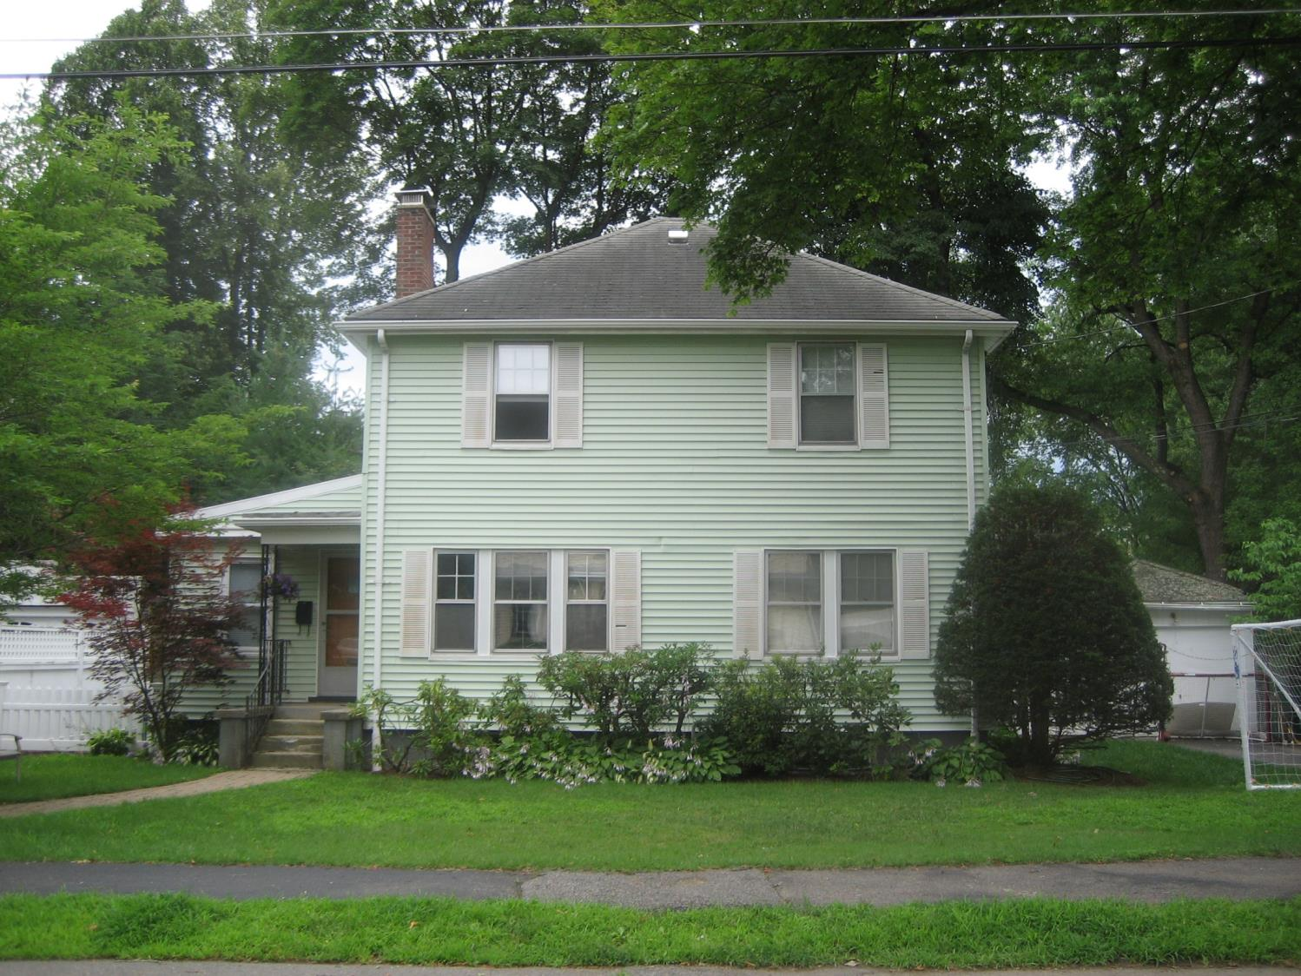
30 Wedgewood Road

Slide 7
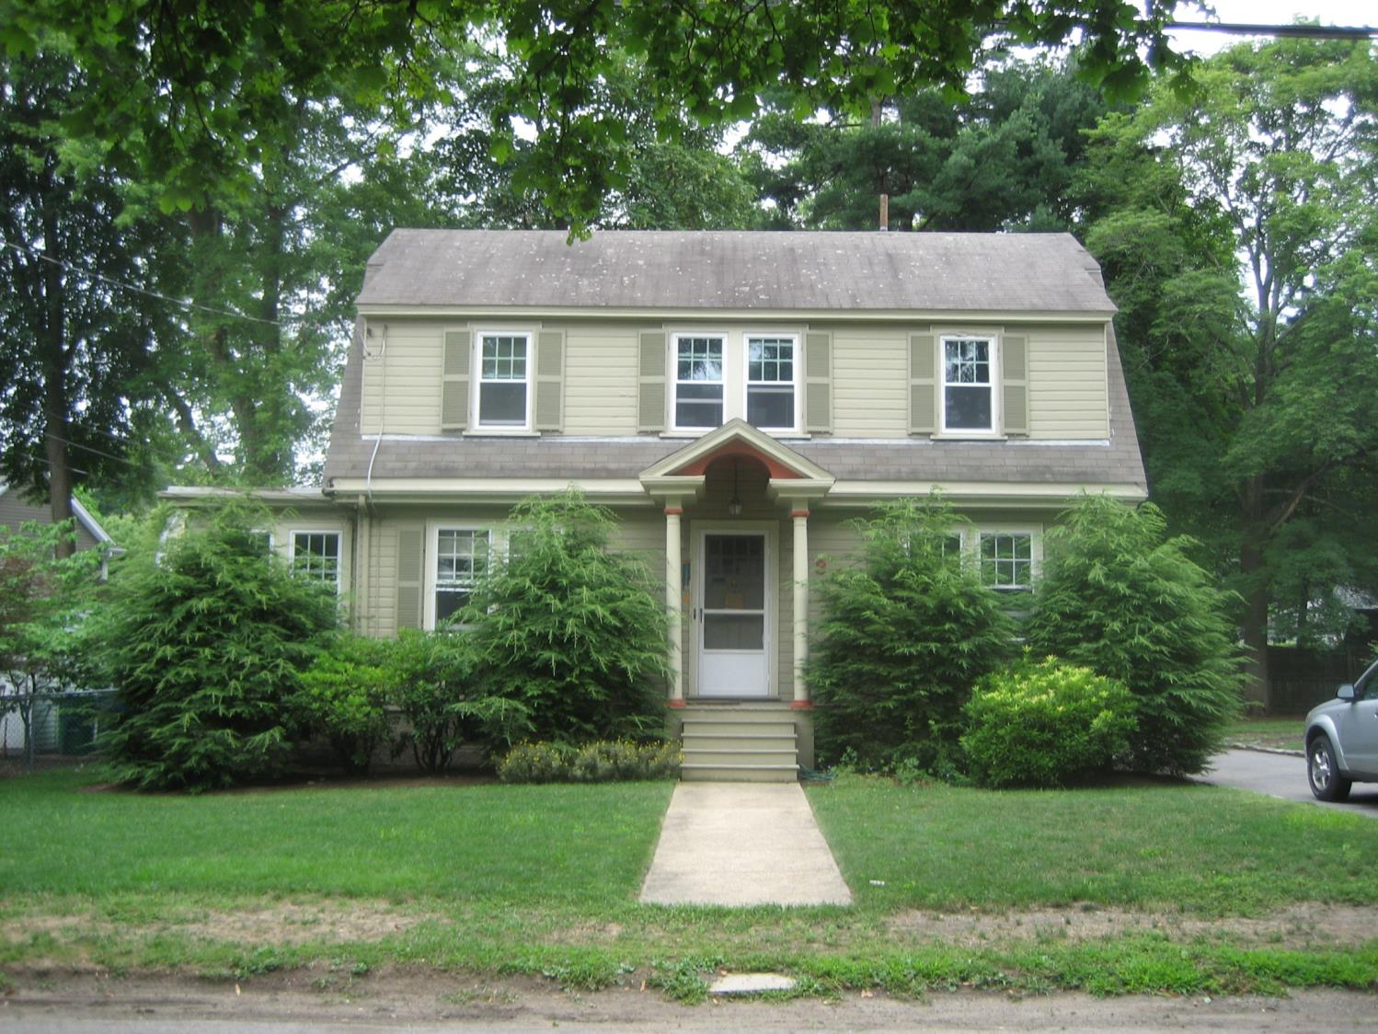
36 Wedgewood Road

Slide 8
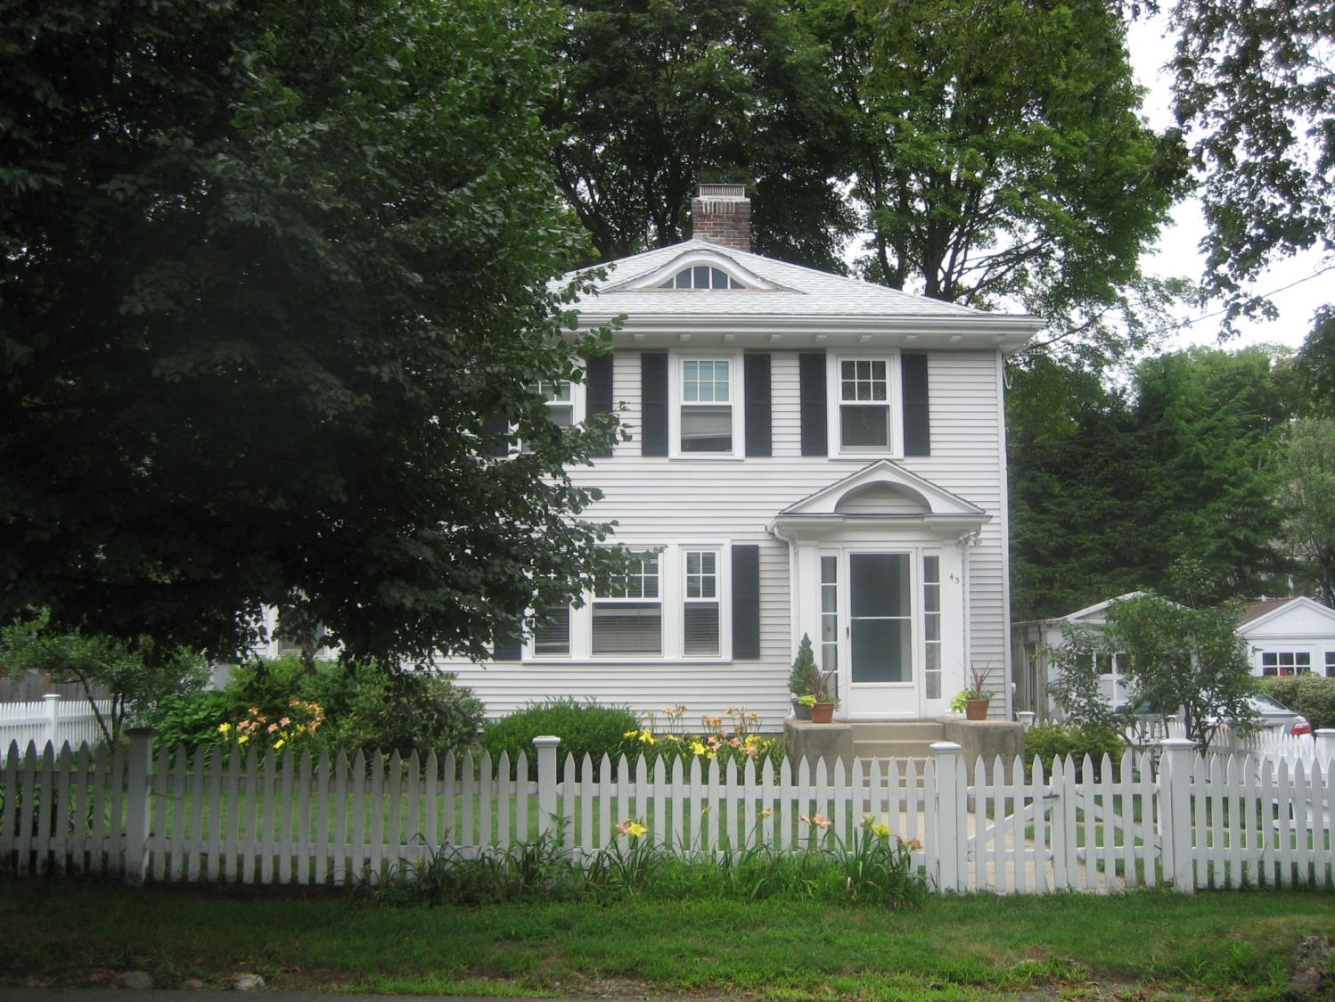
45 Wedgewood Road

Slide 9
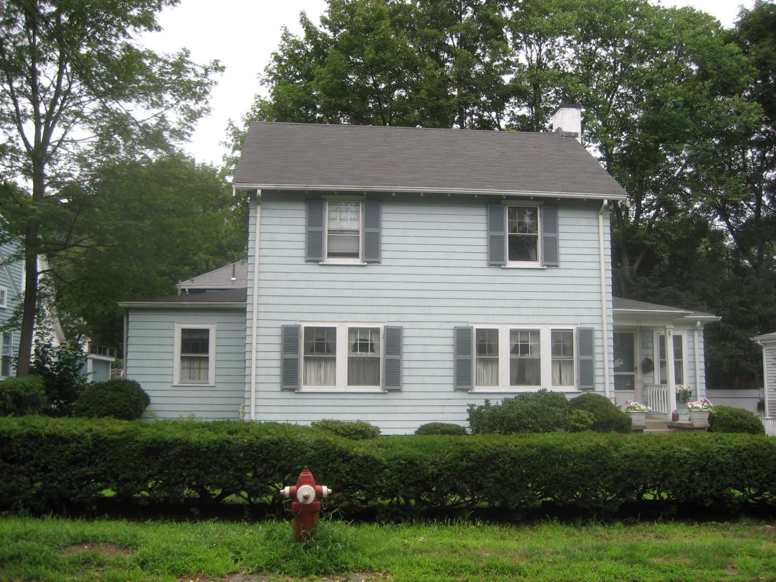
51 Wedgewood Road

Slide 10
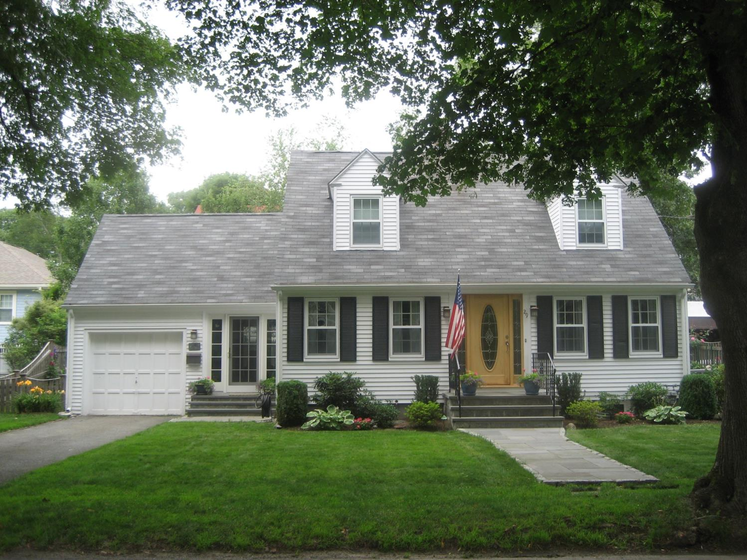
29 Wedgewood Road

Slide 11
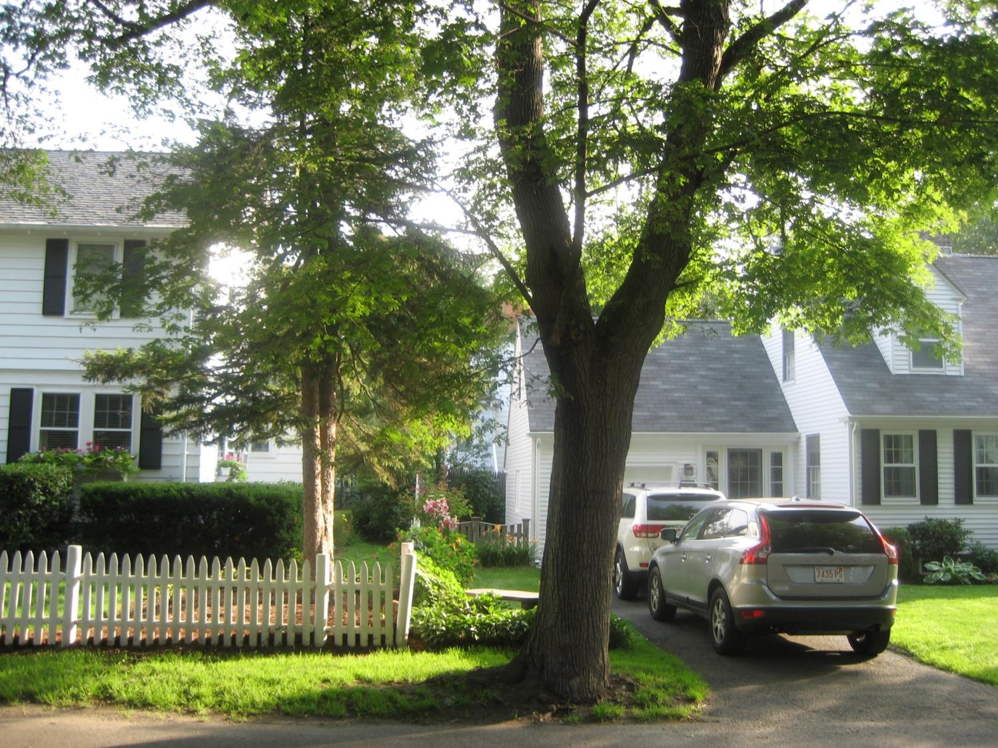
Even with addition, 29 Wedgewood will still be shorter!

Slide 12
Mass
Mass = Volume x Density
If all houses have equal density, then
Mass = Volume
Volume = Length x Width x Height
Total house height has not been factored into FAR calculations
50% of our 2nd floor (w/ addition) is at or under 7 feet ceiling height and we only have a crawl space above
29 Wedgewood is one of the smallest houses on the street!

Slide 13
Area on Sides of Houses
29 Wedgewood addition = 567 sq. ft.
41 Wedgewood = 612 sq. ft.
45 Wedgewood = 598 sq. ft.
Even with addition as designed, the side area of the 29 Wedgewood addition is smaller than the side area of other houses on the street!

Slide 14
Rear Gable vs. Shed Dormer
Ice damns with shallow shed dormer roof *
Ceiling height below 6’ with shed dormer
Furniture won’t fit with shed dormer (see updated plans with furniture)
Plan to add a second garage window and raise both garage windows on side of house
* Even with the best insulation available and new gutters, we still have major ice build up and ice damns with our existing shallow shed dormer roof.

Slide 15
Historic Review
At public hearing, front facing gable design with same ridgeline was rejected
At same hearing, current design (with higher ridgeline) was then proposed and approved
Minutes failed to reflect the different ridgeline on the approved proposal
Single gable dormer with 2 windows (twice width of existing single window dormers) was also approved

Slide 16
Why Different Ridgeline?
We and our neighbors (documented) like this design!
“I am an licensed architect and I have reviewed their plans and am confident that they are sensitive to the character and scale of our neighborhood” – Liz Minnis, 54 Wedgewood Road
Front house and garage gutters in same horizontal plane
Back left corner of house at setback
Needed depth/height for 2 bedrooms above garage (see updated plans with furniture)
Needed min 29.6’ depth to fit 2 car garage in front and mud/sunroom with pullout coach + ¾ bath in back (part-time bedroom today & potential full-time bedroom in future) (see updated plans with furniture)

Slide 17
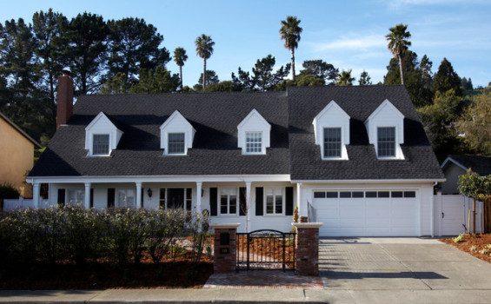
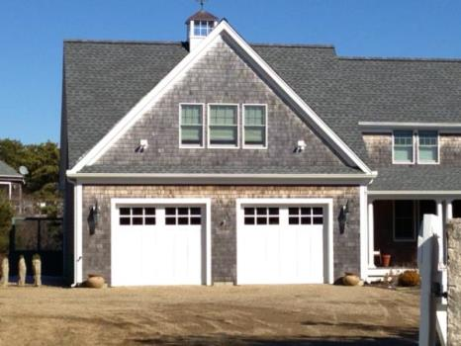
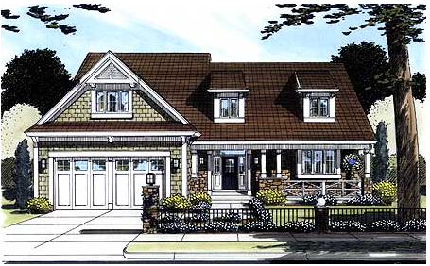
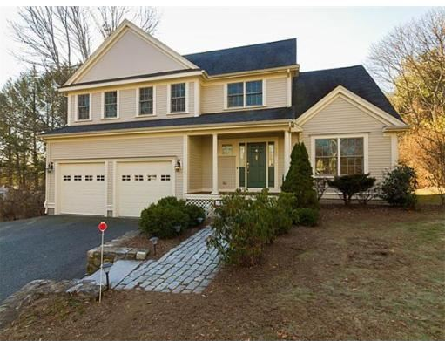
Examples of Capes with Different Ridgeline?
www.architecturaldesigns.com

Slide 18
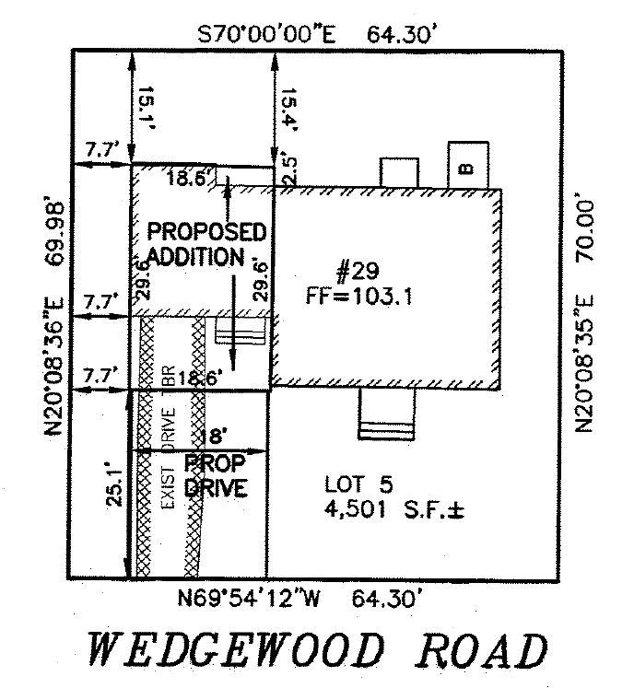
Landscaping plan
Key:
Trees
Hydrangea
Rose bush
Clematis
Day lilies
Rhododendron
Azalea
Mountain Laurel
Hasta
Evergreen shrub Rose of Sharon
Lilac Peony
Stone bench
Potted plants
Dahlias/annuals
Neighbor’s 6’ stockade fence
Patio benches
Blue stone patio
Neighbor’s Garage
B
Table + 6 chairs
Gas Grill
29 Wedgewood Road Residence
Fire wood
4ft high x 3ft wide lace-cap hydrangeas and double knock-out rose bushes along side of addition.
Driveway
Neighbor’s picket fence, 3ft for 25 ft.
Scalloped top fence, 6ft high for 18ft, sloping to 3ft for 9ft, 3ft high for 25 ft.
Blue stone walkway
Scalloped top fence, 6ft high for 18ft, sloping to 3ft for 9ft, 3ft high for 18 ft.

Slide 19
Summary
Documented support provided by 8 of the 16 Wedgewood Road residents and rear abutter on Eliot Ave.
“We are writing in support of Denise and Peter Staubach’s petition for Special Permit/ Site Plan Approval to improve their home at 29 Wedgewood Road, Newton. The proposed design is an attractive expansion that maintains the home’s traditional cape style while improving the livability and value of the home. The Floor Area Relief requested is nominal.” - Ann Houston and Henry Korman, 45 Wedgewood Road
Several neighbors contacted Aldermen directly on our behalf.
Only asking for 270 sq. ft. over FAR.
We need an accessible bath and sleeping accommodations on the 1st floor (today and future) and we would like 3 – 2nd flr. bedrooms so family/guests can sleep over.
Please approve our Special Permit request.

Slide 20
Appendix

Slide 21
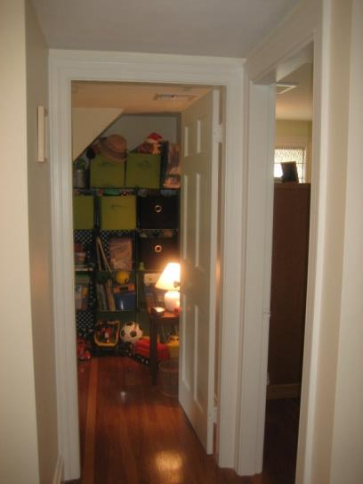
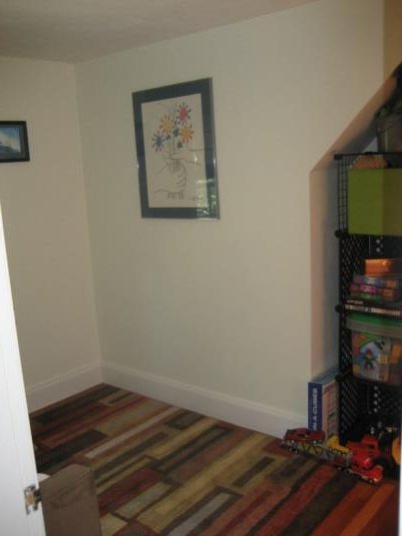
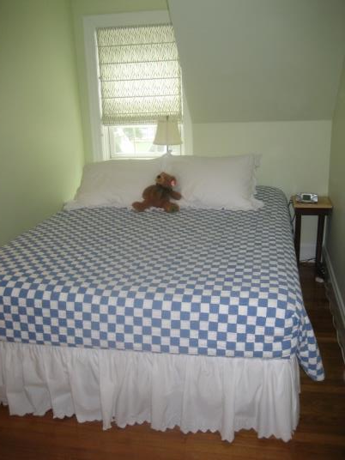
Existing Bedrooms
2 existing 2nd flr. bedrooms; trying to get 3 – 2nd flr. bedrooms
In 2002, previous owner split a bedroom, closet only in one half. Today, we use the tiny room (w/o closet) as a play room for kids. With addition, we plan to use tiny room as an office.

Slide 22
NEIGHBOR SUPPORT

Slide 23
Dear Ms. Finucane and Mr. Sexton,
I am writing in support of my neighbors, Denise and Peter Staubach, who are applying for a special permit to expand their small Cape on our wonderful Wedgewood Road. This is a very special street with a wonderful community, of which Denise and Peter are active members. They have a beautiful property that is extremely well maintained and tastefully landscaped and designed.
I wholeheartedly support their desire to add on to their property, as i know it will be well designed and maintained and a benefit to them and the neighborhood.
I am an licensed architect and I have reviewed their plans and am confident that they are sensitive to the character and scale of our neighborhood and will improve the value of their home, thereby having a positive impact on the surrounding homes.
Thank you.
Elizabeth Minnis, AIA
54 Wedgewood Road
Newton, MA 02465
617-291-4370

Slide 24
Dear Linda,
My husband and I are fortunate enough to live directly across the street (36 Wedgewood Road) from Denise and Peter Staubach, two of the most giving, caring people we have ever met.
Since they moved onto Wedgewood Road, the entire face of the street has improved. Their gardens, backyard and front, are worthy of a spread in House and Garden magazine. They have improved the house immensely every year, with a flagstone walkway, new shrubs, flowers and trees, new front door and numerous interior upgrades including a spectacular new kitchen. Now they are hoping to add a bedroom and a larger garage in order to accommodate their aging parents who are unable to walk stairs at this stage of life.
Their home, already beautiful, will be enhanced (but not physically altered in any significant way) by this change, meaning that eventually the selling price will be higher than it is now. That, obviously, will increase the value of all homes on the street. They have always been interested in improving the neighborhood. They are among the first to host wonderful parties to gather the neighbors around a festive table at Christmas time.
We would be the first to complain if this gracious Cape were to be compromised as we live directly across the street. Instead, we feel 29 Wedgewood will become even more attractive, given the excellent taste of Denise and Peter.
Please grant them this special permit which will allow them to continue to be good children and caretakers to parents who raised them so well.
Sincerely,
Joyce and Larry Eldridge
36 Wedgewood Road
W. Newton 02465-1918

Slide 25
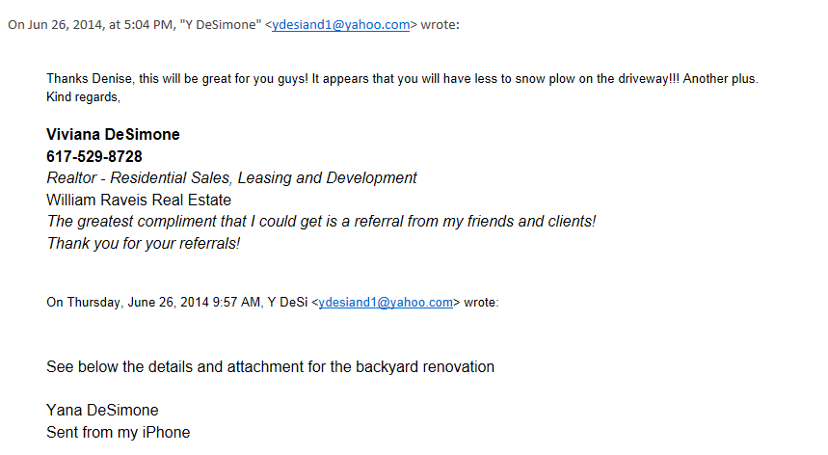
Correspondence with rear abutter about our home renovation project and special permit:
Yana DeSimone
64 Eliot Avenue
West Newton, MA

Slide 26
Dear James, Linda and Dan:
We are Wedgewood St. residents and share the neighborhood with Peter and Denise Staubach (29 Wedgewood Rd.). We are writing to express our full support of the proposed expansion of their house to accommodate the aging parents. They've taken very good care of the house over the years. It is a great looking cape house with a well maintained lawn and exterior. We are confident that both of those will be preserved after the expansion. This significant proposed investment in the house demonstrates their willingness to live in this neighborhood longer term. They are an integral part of this neighborhood and we would like to keep it that way for as long as possible.
Please consider this email as full approval and support of the proposed project from both of us.
Jugminder and Avideep Chawla 24 Wedgewood Rd. Newton, MA 02465

Slide 27
Ms. Finucane and Mr. Sexton:
We are writing in support of Denise and Peter Staubach’s petition for Special Permit/ Site Plan Approval to improve their home at 29 Wedgewood Road, Newton. We have owned our home at 45 Wedgewood Road, two doors down from the Staubach home, for 22 years. The proposed design is an attractive expansion that maintains the home’s traditional cape style while improving the livability and value of the home. The Floor Area Relief requested is nominal. The Staubach’s have demonstrated a deep commitment to maintaining their home and to high quality landscaping that is an asset to the entire neighborhood. The Wedgewood Road community is unusually close-knit; Peter and Denise are important members of our neighborhood and so this proposed investment in their home is welcomed evidence of their long-term commitment to our community.
Ann Houston and Henry Korman
45 Wedgewood Road
Newton, Massachusetts

Slide 28
Dear Ms. Finucane,
I am Robert M. Bloom of 51 Wedgewood Rd where I have lived since 1975. I am writing in support of my neighbors Denise and Peter Staubach's request for a special permit. They have been wonderful caring neighbors who have contributed greatly to our close knit Wedgewood community. Their house is very well maintained and their improvements have contributed to the overall beauty of the street. I am certain that there proposed improvement which will maintain the cape style design will further enhance our neighborhood. On a personal note I have observed how wonderfully caring they are to their parents and I know the proposed project will better enable them to care for their parents within their home. I think this project will ensure their commitment to stay in our Wedgewood community and we all benefit from this.
Sincerely, Robert M. Bloom 51 Wedgewood Rd. West Newton Ma. 617 965 4380

Slide 29
Dear Ms. Finucane, Mr. Sexton, and Newton City Officials, I am writing this letter to convey my wholehearted support for the proposed renovation of the Staubach residence. I live several houses down from Denise and Peter Staubach at 73 Wedgewood Rd.
I have reviewed the proposed renovation drawings/plans which Denise and Peter have shared with the neighborhood and I am pleased that the renovations maintain the same beautiful cape style of their home which they have meticulously maintained. Their renovation plans highlight their commitment to stay in the neighborhood and invest in our community. I understand the rationale for regulations on renovations, but I also know that the spirit behind these regulations is to maintain the beauty, character and value of neighborhoods. Wedgewood Rd has many beautiful homes situated relatively close to each other on relatively small plots of land. Many of the homes front yards are larger than their backyards. While this may mean that one neighbors kitchen window can directly face another's living room window and most of our backyards are too small to play catch with a baseball, it also means that neighbors are out in the fronts of their houses and on the street more. It means we see each other more frequently. We talk. We share gardening tips. We borrow tools and books. We organize neighborhood card games and impromptu neighborhood picnics at the park on nice days. We have annual block parties and goodbye parties when neighbors move away. It means the kids run from house to house and play games on the street. In short, it helps create a close-knit, vibrant and welcoming community that takes pride not only in the beauty of the homes on the street but the character and qualities of the neighbors who dwell in them.
When our family moved into the neighborhood 4 years ago nearly every day of the first week we arrived was accompanied with a new neighbor introducing themselves at our door with homemade treats and meals to welcome us. It is neighbors like Denise and Peter who not only take pride in the care of their home but also take interest in the lives of their neighbors that brings the most value to our neighborhood. The few inches of setback that may be lost in renovation are undoubtedly overshadowed by allowing them the space in their home needed to stay in and contribute to our wonderful Wedgewood community. Sincerely, Peter Ngo 73 Wedgewood Rd West Newton, MA

Slide 30
Hello,
I am a neighbor of Peter and Denise Staubach, I live a few doors down the street on Wedgewood road. I am writing in support of Peter and Denise Staubach's request to get a variance to the the land use zoning ratios as part of their house improvements. I have looked through the plans and I support their request to get the variance they have requested. Sincerely,
Andrew Wardly
Andrew Wardly 50 Wedgewood Road West Newton, MA 02465

