Slide 1

Department of
Planning and Development
Petition #92-18
37 Westbourne Road
SPECIAL PERMIT/SITE PLAN APPROVAL to Amend Special Permit #131-16 to alter existing nonconforming front and side setbacks.
March 6, 2018

Slide 2
Requested Relief
  Grant a one-year extension to May 17, 2018
  Special Permit per §7.3 to alter nonconforming front and side setbacks. §3.1.3, §7.8.2.C.2

Slide 3
Criteria to Consider
When reviewing this request, the Council should consider whether:
The proposed nonconforming front and side setbacks are substantially more detrimental than the existing nonconforming front and side setbacks are to the neighborhood. § 3.1.3, §7.8.2.C.2

Slide 4
Special Permit #131-16
Approved an extension of nonconforming FAR for the construction of an addition to include a new attached single-car garage, additional kitchen space, an interior stairway with a chair lift, and a one-car carport
The new garage would be accessed from Francis Street and the carport would be accessed from Westbourne Road
The existing detached garage became noncompliant in 1985 when a deck was added between the garage and house, making the detached garage an attached garage and the front and side setbacks of 4.8 feet and 2.5 feet noncompliant for an attached structure

Slide 5
Special Permit #131-16
When Special Permit #131-16 was granted in May 2016, variances were required from the Zoning Board of Appeals for the front and side setbacks
The recent change to M.G.L. ch. 40A, section 7 allows for those noncompliant setbacks to be legitimized by a Section 6 finding as extension of pre-existing nonconformities
Petitioner seeks an amendment to the Special Permit to include a finding that the proposed front setback of 5.4 feet and side setback of 2.1 feet are not more detrimental than the existing setbacks of 4.8 feet and 2.5 feet

Slide 6
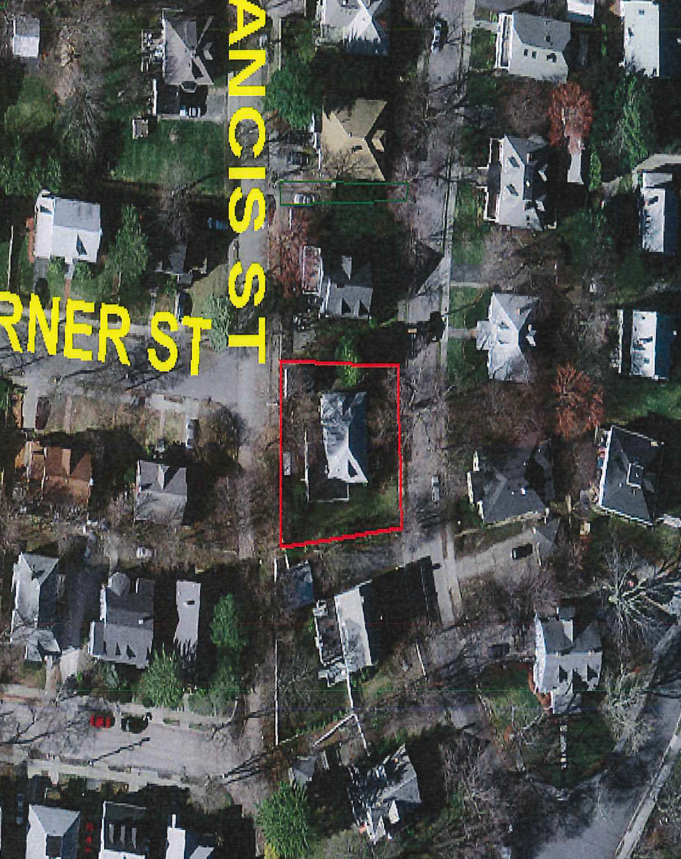
AERIAL/GIS MAP

Slide 7
Site Plan
Notes:
There have been no changes to the plans from the 2016 special permit. The existing garage is accessed via a driveway from Westbourne. The proposed one car garage would be accessed by a new driveway from Francis Street. The proposed carport would be accessed from Westbourne.

Slide 8
Elevations (existing)

Slide 9
Elevations (proposed)

Slide 10
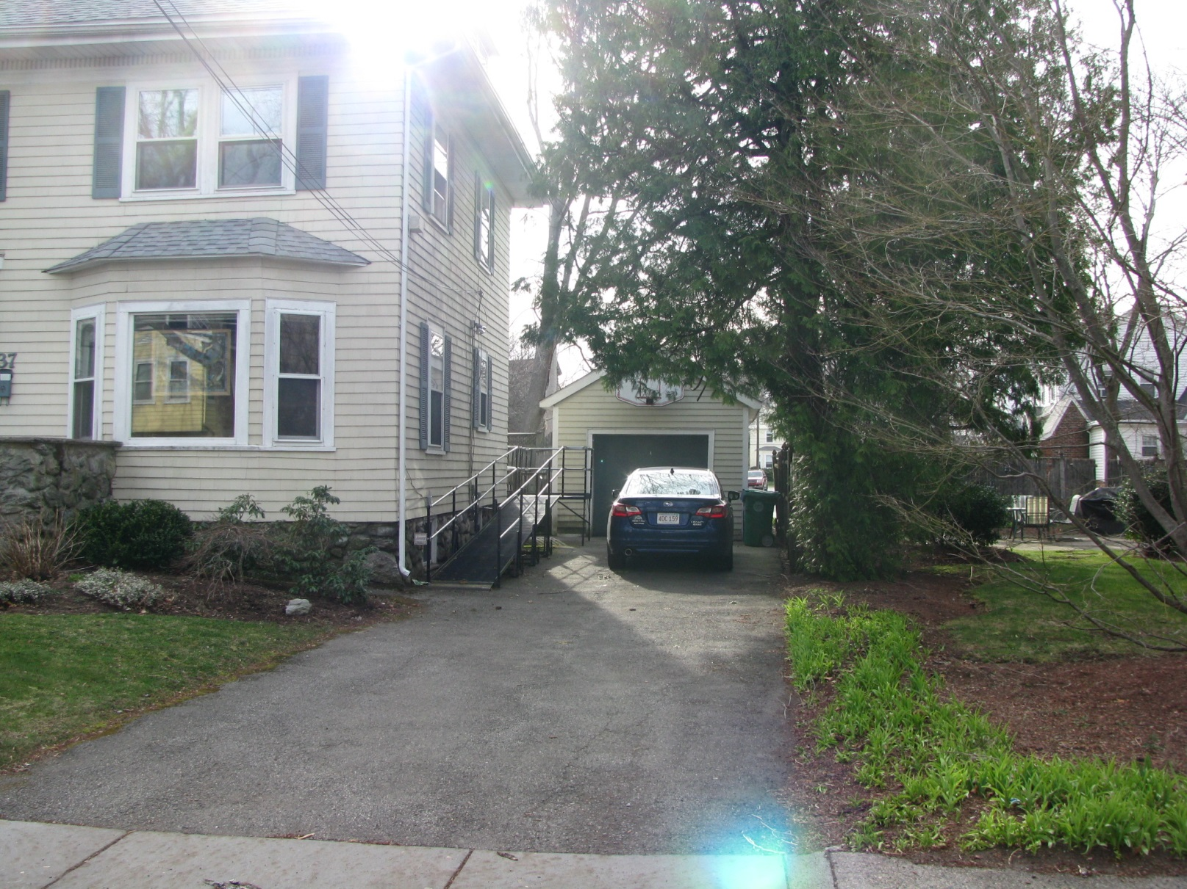
Photos
Notes:
View from Westbourne Road

Slide 11
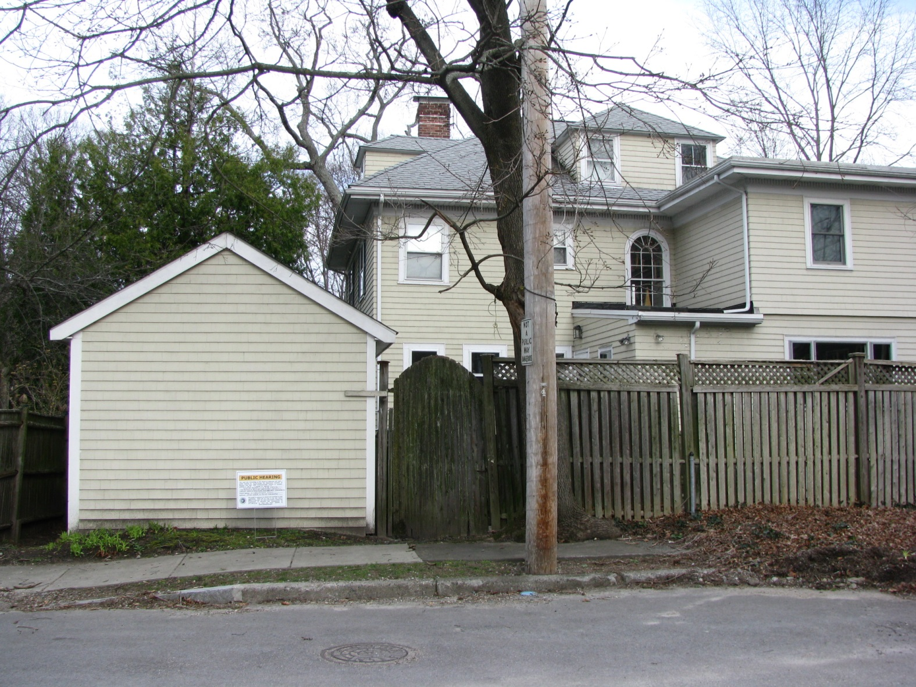
Photos
Notes:
View from Francis Street of the existing garage which would be replaced by a new garage and curb cut. The new garage would be set back slightly more from the street.

Slide 12
Proposed Findings
The extension of the nonconforming structure with the proposed addition will not be substantially more detrimental than the existing nonconforming structure as it will largely occupy the location of the existing similarly sized garage. §3.1.3, § 7.8.2.C.2

Slide 13
Proposed Conditions
This petition consolidates prior special permits.
Plan Referencing Condition.
Standard Building Permit Condition.
Standard Final Inspection/Certificate of Occupancy Condition.
Notes:
The proposed conditions remain the same, except the condition requiring approval of variances is removed

