Slide 1

Department of
Planning and Development
Petition #131-16
37 Westbourne Road
SPECIAL PERMIT/SITE PLAN APPROVAL to construct addition with garage to single family dwelling increasing non-conforming FAR
May 10, 2016

Slide 2
Requested Relief
Special Permits per §7.3.3 of the NZO to:
  Increase nonconforming Floor Area Ratio (FAR) from 0.52 to 0.59 where 0.41 is the maximum allowed by right (§3.1.9)

Slide 3
Criteria to Consider
When reviewing this request, the Council should consider whether:
The proposed addition will not be substantially more detrimental than the existing nonconforming structure is to the neighborhood. (§7.8.2.C.2).
The proposed increase in FAR from 0.52 to 0.59, where 0.41 is the maximum allowed by right, is consistent with and not in derogation of the size, scale, and design of other structures in the neighborhood. (§3.1.9.A.2 and §7.8.2.C.2)

Slide 4
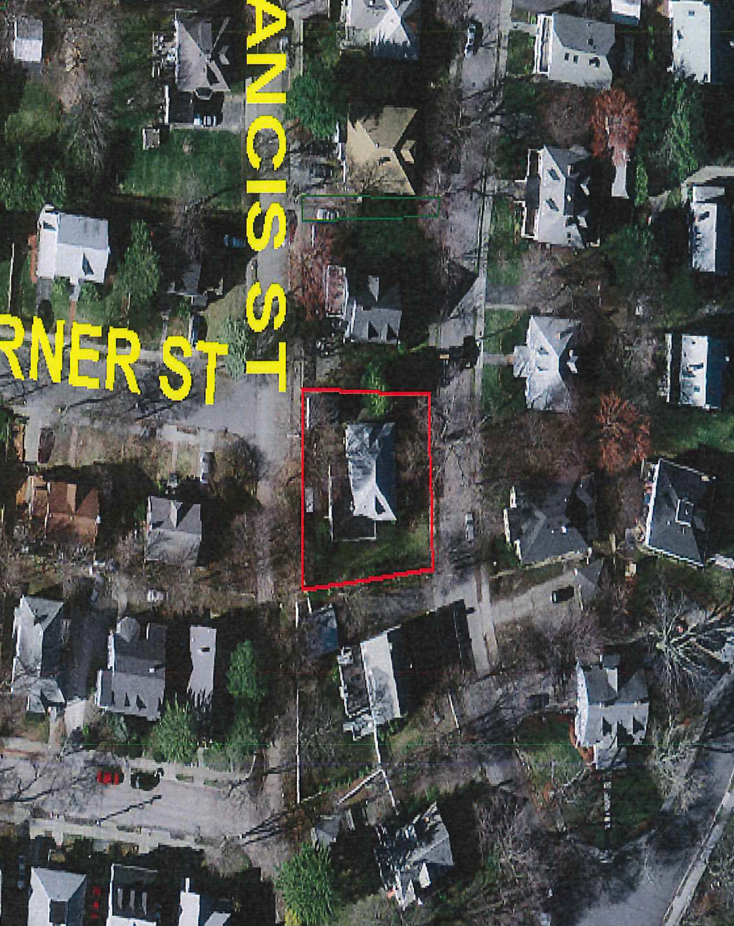
AERIAL/GIS MAP

Slide 5
Site Plan

Slide 6
Floor plan (existing)

Slide 7
Floor plan (proposed)

Slide 8
Elevations (existing)

Slide 9
Elevations (proposed)

Slide 10
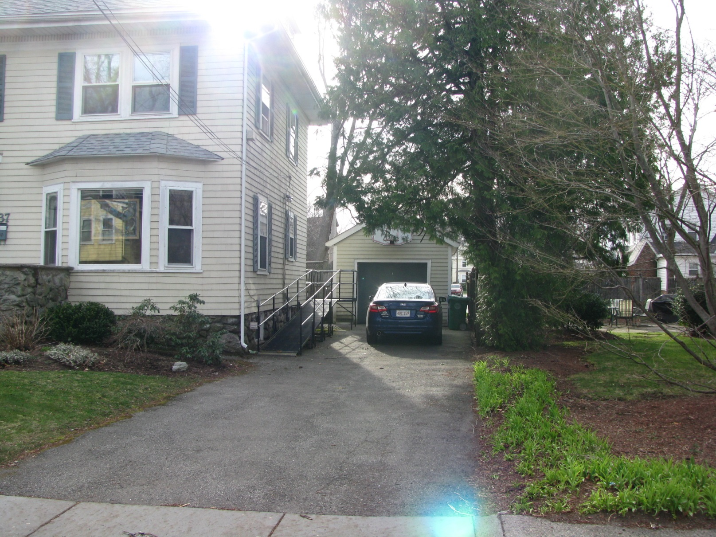
Photos

Slide 11
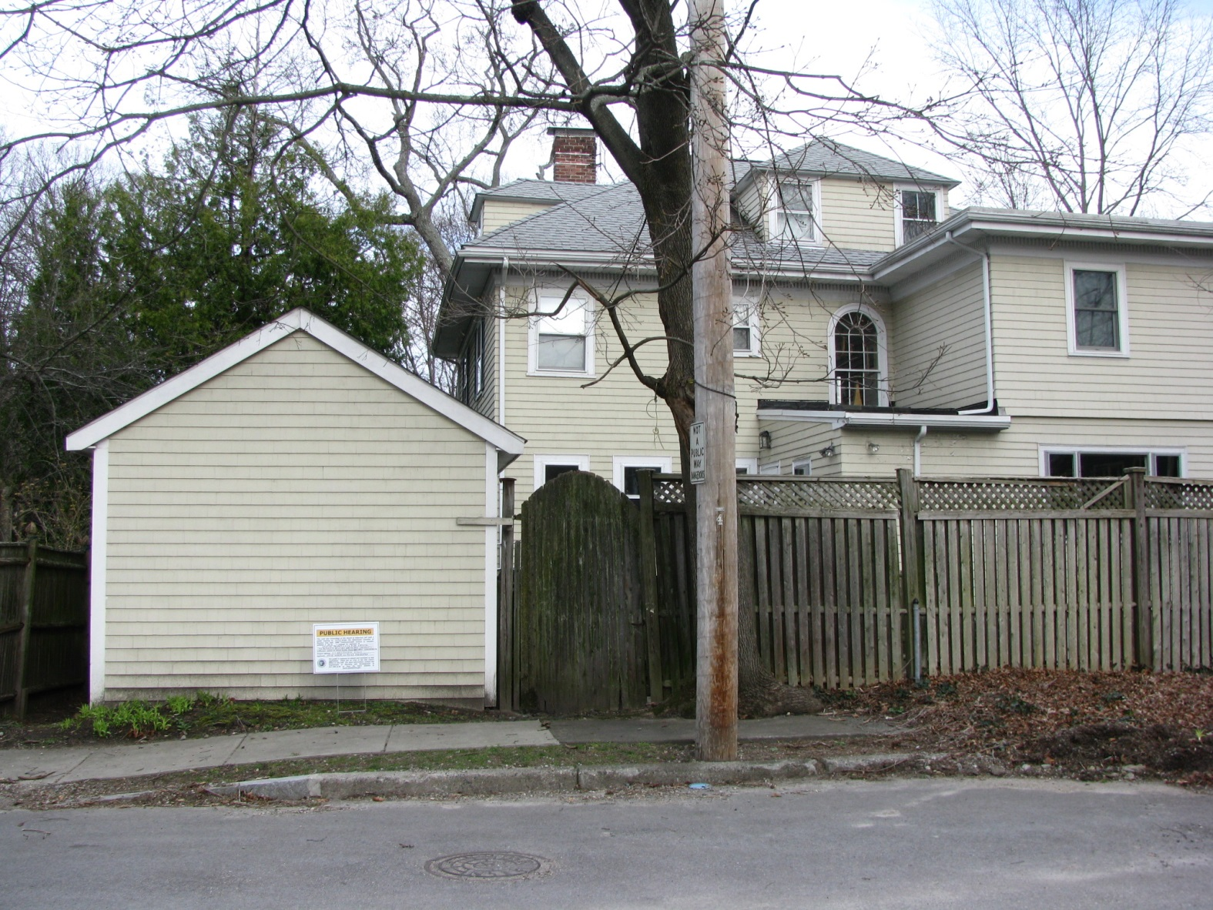
Photos

Slide 12
Proposed Findings
The extension of the nonconforming structure with the proposed addition will not be substantially more detrimental than the existing nonconforming structure as it will largely occupy the location of an existing, similarly sized garage. (§3.2.3. and 7.8.2.C.2.)
The proposed Floor Area Ratio (FAR) of 0.59, where 0.41 is the maximum allowed by right and 0.52 exists, is consistent with and not in derogation of the size, scale and design of other structures in the neighborhood. The addition and carport will increase the gross floor area by only approximately 558 square feet on a lot of 8,090 square feet and the addition will be located largely where an existing garage and an outdoor deck will be removed. (§3.1.9.A.2 and §7.8.2.C.2)

Slide 13
Proposed Findings
The site in a Single Residence 2 zoning district is an appropriate location for the proposed addition and carport as they are consistent with the residential use of the property. (§7.3.3.C.1)
The expanded structure will not adversely affect the neighborhood as the addition will be located largely at the location of an existing garage and outdoor deck which shall be removed and the carport will be setback approximately 40 feet from Westbourne Road and be largely shielded by existing fencing and vegetation. (§7.3.3.C.2)
Neither the addition nor the carport will create a nuisance or serious hazard to vehicles or pedestrians (§7.3.3.C.3).

Slide 14
Proposed Conditions
Plan Referencing Condition.
Petitioners receive required variances from the Zoning Board of Appeals from front lot setback and side lot setback dimensional regulations.
Standard Building Permit Condition.
Standard Final Inspection/Certificate of Occupancy Condition.

