Slide 1
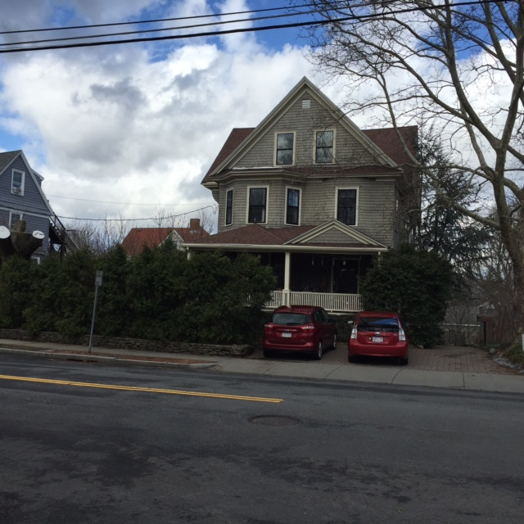
Department of Planning and Development
Petition #97-16
27 Waverly Ave.
SPECIAL PERMIT/SITE PLAN APPROVAL to allow an association of persons in a common dwelling where inhabitants will share common living spaces and for waivers to the parking requirements
May 3, 2016

Slide 2
Requested Relief
Special Permits per §7.3.3 of the NZO to:
To allow an association of persons in a common dwelling (§3.4.1.)
To waive up to 15 parking stalls (§5.1.4 and 5.1.13)
To allow parking within five feet of the street (§5.1.7.A and §5.1.13)

Slide 3
Criteria to Consider
When reviewing this request, the Council should consider whether:
The site is an appropriate location for the proposed association of persons in a common dwelling. (§3.4.1. and §7.3.3.C.1.)
The proposed waiver of up to 15 parking stalls and to allow parking within five feet of the street is appropriate as literal compliance is impracticable due to the nature of the use, or the location, size, width, depth, shape, or grade of the lot, or that such exceptions would be in the public interest, or in the interest of safety, or protection of environmental features. (§5.1.4., §5.1.7.A., and §5.1.13.)

Slide 4
AERIAL/GIS MAP

Slide 5
Site Plan (proposed)

Slide 6
Proposed Findings
The site is an appropriate location for the proposed two unit association of persons in a common dwelling and encompassing the entire property as the proposed use is located in a multi-residence zone and the use will not alter the exterior of the structure which has a large number of existing bedrooms. (§3.4.1. and §7.3.3.C.1.)
The proposed waiver of up to 15 parking stalls and to allow parking within five feet of the street is appropriate as literal compliance is impracticable due to the nature of the use, or the location, size, width, depth, shape, or grade of the lot, or that such exceptions would be in the public interest, or in the interest of safety, or protection of environmental features. The waiver as to the number of stalls required is appropriate as the site is well located with respect to transportation options and the cooperative living association intends to seek residents that choose to live without a car. Three of the stalls that are located in the front setback have existed for many years with no known hazards to vehicles or pedestrians. (§5.1.4., §5.1.7.A., and §5.1.13.)

Slide 7
Proposed Findings
The association of persons at the site is organizing as a not-for-profit corporation and submitted drafts of their Articles of Organization, Mission Statement, Membership Criteria and Occupancy Agreement. The Council finds that the association intends to live together as a family sharing common living and kitchen facilities. Members of the association participate in weekly meetings, contribute to house and property related chores and activities, and share ownership interests in the association.
The proposed association of persons will diversify the City’s housing stock in keeping with the Newton Comprehensive Plan without significant changes to the site and without disruption to the neighborhood. The majority of immediate abutters submitted letters to the Council in support of this petition.

Slide 8
Proposed Conditions
Plan Referencing Condition.
No more than 14 adult residents shall reside in the structure at any one time.
There shall be no more than five parking stalls on the property.
Prior to the issuance of a building permit the petitioner shall submit a revised parking layout plan and planting plan to the Director of Planning and Development for review and approval.
Standard Building Permit Condition.
Standard Final Inspection/Certificate of Occupancy Condition.

