Slide 1

Department of
Planning and Development
Petition #128-16
9-11 Bridge Street
SPECIAL PERMIT/SITE PLAN APPROVAL to create a accessory apartment in a Two-family dwelling
May 10, 2016

Slide 2
Requested Relief
Special Permits per §7.3.3 of the NZO to:
  allow the creation of an accessory apartment in a two-family dwelling in the MR1 district (§6.7.1.D).

Slide 3
Criteria to Consider
When reviewing this request, the Council should consider whether:
The site is an appropriate location for an accessory apartment within a two-family dwelling in a MR-1 district. (§7.3.3.C.1)
The accessory apartment will not adversely affect the neighborhood. (§7.3.3.C.2)
The accessory apartment will not create a nuisance or serious hazard to vehicles or pedestrians (§7.3.3.C.3)
Access to the site over streets is appropriate for the types and numbers of vehicles involved. (§7.3.3.C.4)

Slide 4
AERIAL/GIS MAP

Slide 5
Site Plan (existing)

Slide 6
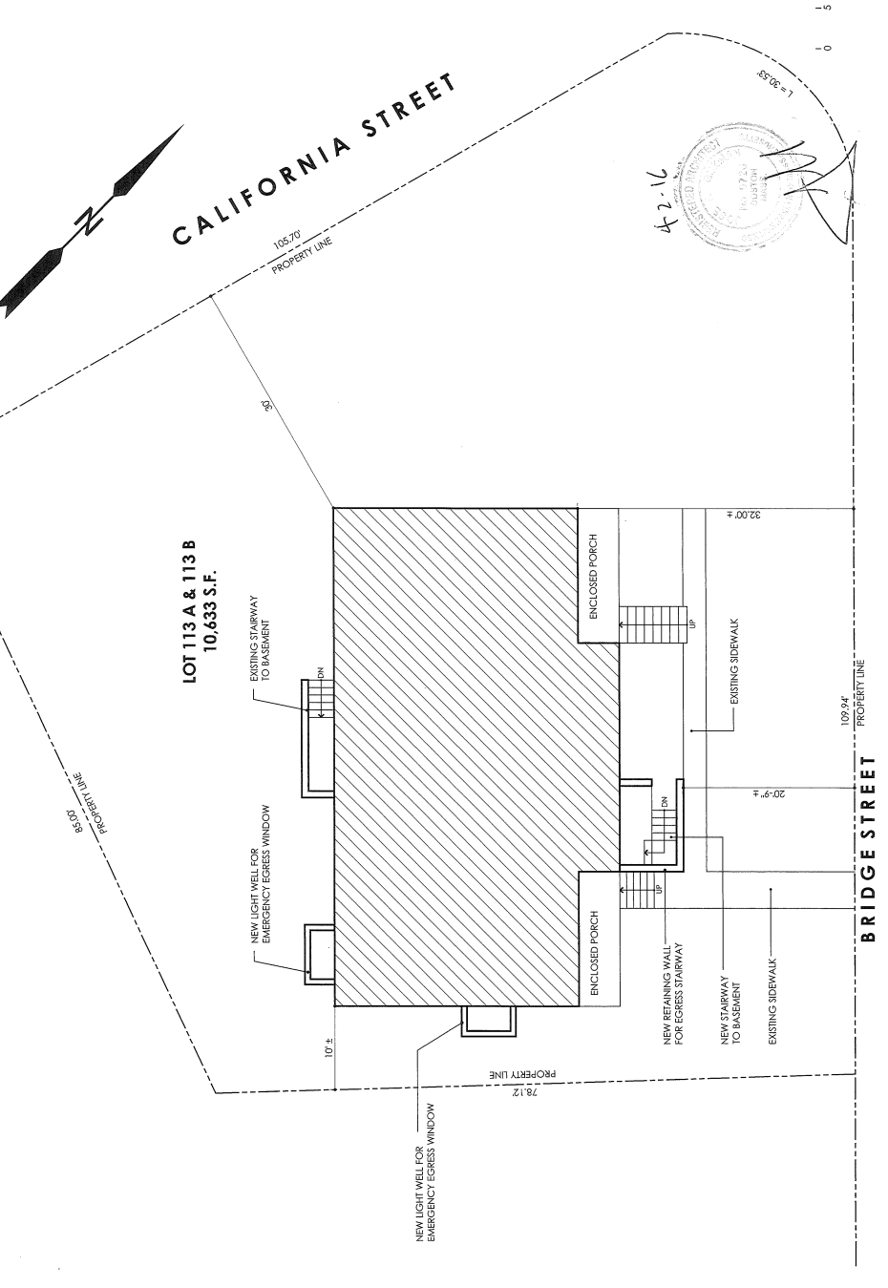
Site Plan (proposed)

Slide 7
Floor plan

Slide 8
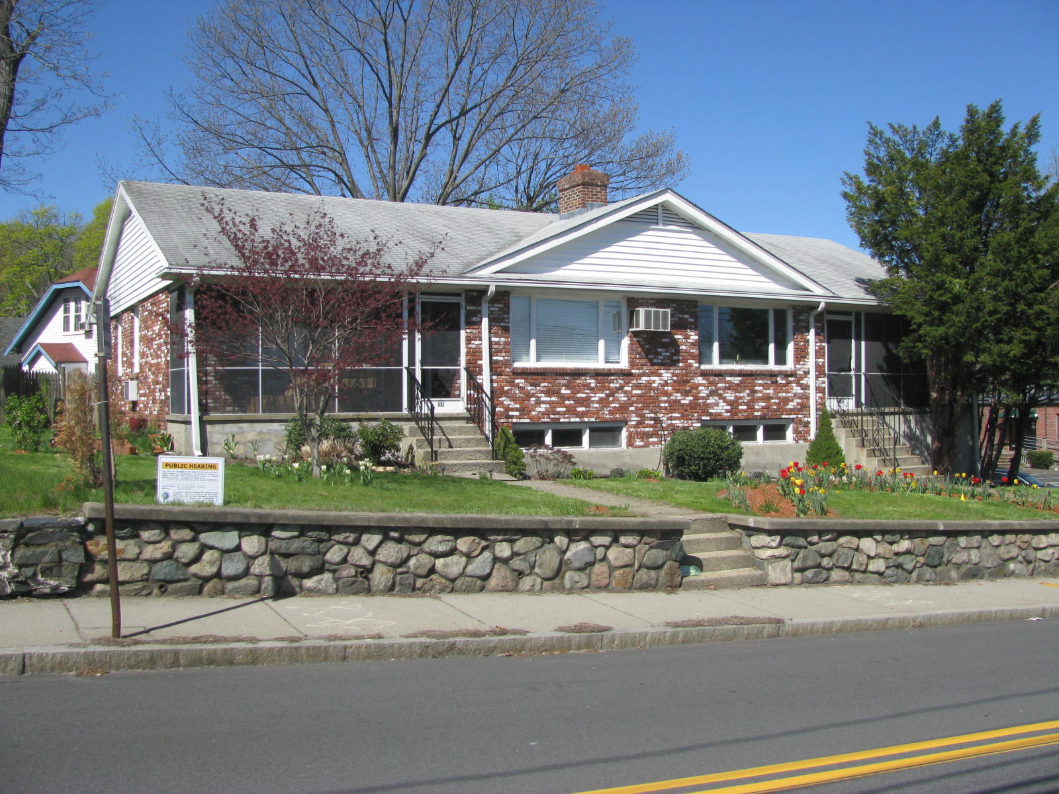
Photos

Slide 9
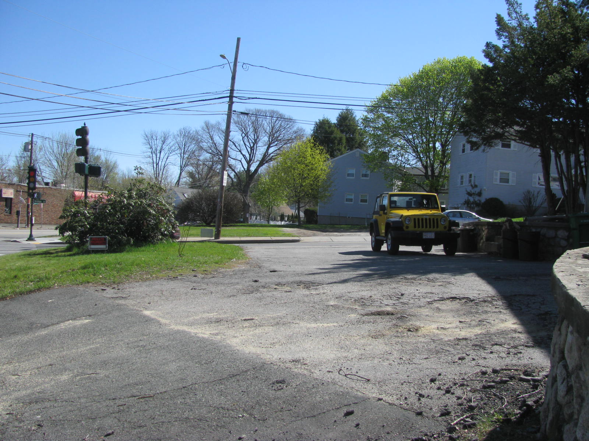
Photos

Slide 10
Issues
Paving in poor shape, petitioner has agreed to repave
Existing wide curb cuts
Consider low screening adjacent to driveway/parking area away from corner so as not to interfere with site lines

Slide 11
Proposed Findings
The site is an appropriate location for an accessory apartment within a two-family dwelling in a Multi-Residence 1 (MR-1) district as the existing dwelling, which is consistent in scale with adjacent residential properties, can accommodate the accessory apartment without any increase to the footprint. (§6.7.1.D.1 and §7.3.3.C.1)
The accessory apartment will not adversely affect the neighborhood as it will be constructed in existing space within a two-family dwelling on a property that has sufficient interior and exterior capacity to accommodate the required additional parking stall. (§7.3.3.C.2)
There will be no nuisance or serious hazard to vehicles or pedestrians, as the property has a large driveway area with ample curb cuts located on two public ways, California Street and Bridge Street, that allow for adequate sight lines for drivers and pedestrians passing, entering or leaving the property. (§7.3.3.C.3)

Slide 12
Proposed Findings (con’t)
Access to the site is appropriate for the number of vehicles related to the residential use of the site as it is served by a driveway with access to both California Street and Bridge Street, dispersing any impacts on two public ways. (§7.3.3.C.4)
The creation of an accessory apartment will help to diversify Newton’s housing stock consistent with Newton’s Comprehensive Plan.

Slide 13
Proposed Conditions
Plan Referencing Condition.
Final landscape plan to be reviewed and approved by the Director of Planning.
Standard Building Permit Condition.
Standard Final Inspection/Certificate of Occupancy Condition.
The accessory apartment may not be held in separate ownership from the two-family dwelling in which it is located.
The owner of the two-family dwelling shall occupy either one of the main dwelling units or the accessory apartment, and annually attest to this.
Upon any ownership change the new owner shall notify ISD for determination of compliance with this decision and all applicable codes.

