Slide 1
Department of Planning and Development
Permit #279-98(3)
14 Roland street
Ostrovskaya residence
Expansion of nonconforming structure within the front setback

Slide 2
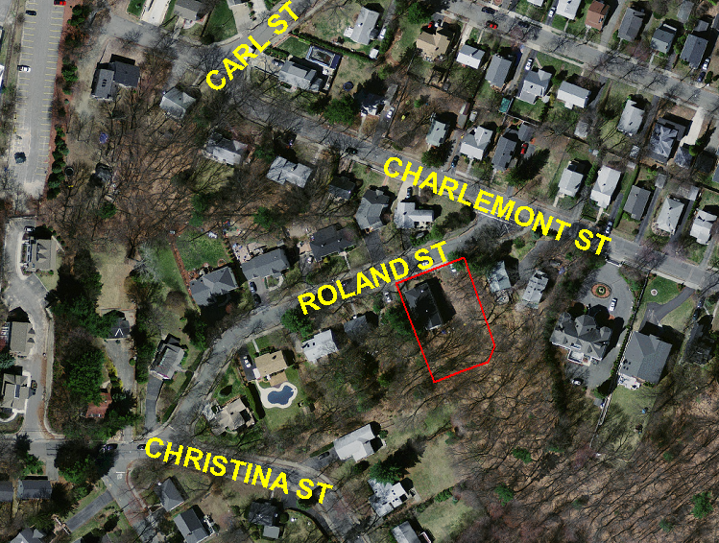
Site:
14,819 square foot site slopes towards the rear
Existing two story house within front setback
S.P. # 279-98(2) authorized expansion to add a garage and breezeway connector
Garage is under construction

Slide 3
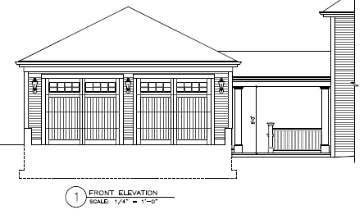
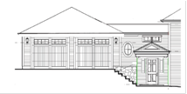
Project Description:
Due to the grade of the site, project could not be built as approved
Connector is now being proposed as fully-enclosed space
Represents additional expansion within the front setback

Slide 4
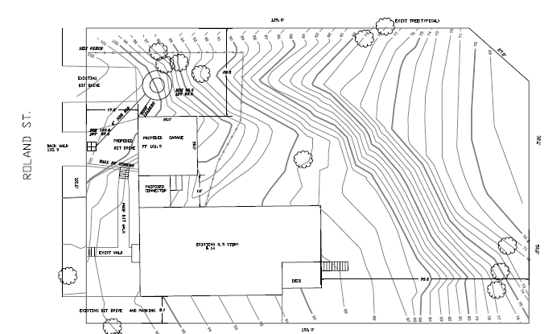
Project Description:

Slide 5
Relief Requested:
30-21(a)(2)(b) and 30-21(b) to extend a structure that is legally nonconforming with regard to front setback

Slide 6
Proposed Findings:
The extension of a nonconforming structure is not substantially more detrimental to the neighborhood than the existing nonconforming structure for the following reasons:
Many of the other homes in the neighborhood are legally nonconforming with respect to front lot line setback.
A mature wooded area provides natural screening between the site of the proposed expansion and the nearest neighboring property to the west.
Due to the severe slope of the property towards the rear, expansion of the structure within the front setback requires less disturbance of the natural topography of the site.
The repair of the deteriorating sidewalk as part of this proposal will improve the safety of pedestrians and is consistent with the conditions of the prior special permit on the property.

Slide 7
Proposed Conditions:
The petitioner shall close the curb cut closest to the western property line and replace the sidewalk along the entire frontage of the property.
No building permit shall be issued pursuant to this special permit/site plan approval until the petitioner has submitted a construction management plan
No occupancy permit for the use covered by this special permit/site plan approval shall be issued until the petitioners have closed the curb cut closest to the western property line and replaced the sidewalk
Bond for 135%
Standard filings and conditions

