Slide 1
Department of
Planning and Development
LAND USE Committee
Working Session, May 21, 2013
#258-12 BH NORMANDY RIVERSIDE, LLC/MASSACHUSETTS BAY TRANSPORTATION AUTHORITY petition for a change of zone to Mixed Use 3/Transit Oriented District for a portion of land located at 327 Grove Street, also identified as Section 42, Block 11, Lot 3A, currently zoned Public Use.
#258-12(2) BH NORMANDY RIVERSIDE, LLC/MASSACHUSETTS BAY TRANSPORTATION AUTHORITY petition for a SPECIAL PERMIT/SITE PLAN APPROVAL to construct a mixed use, transit-oriented development including an office building of approximately 225,000 sq. ft., a residential building containing 290 apartments with 5,000 sq. ft. of retail space, a three story building containing approximately 15,000 sq. ft. of retail space and approximately 8,000 sq. ft. of community space, and related site improvements; to permit office use on the ground floor, medical office use, retail and personal establishments of more than 5,000 sq. ft., eating and drinking establishments of more than 5,000 sq. ft., retail banking and financial services, and health club establishments on the ground floor; and reduced minimum setbacks of side setback of office building, and front setback of retail/community building; parking facility design standards including stall width, stall depth, maneuvering space for end stalls, minimum width for entrance and exit driveways, tandem stalls, number of required off-street loading facilities and design standards of same, landscape screening requirements, surfacing and curbing requirements and one foot candle lighting at 327 GROVE STREET, Ward 4, on land known as SBL 42, 11, 3A containing approx. 9.4 acres of land in a proposed Mixed Use 3 Transit Oriented Zoned district. Ref: Sec 30-13(f), Table A Footnote; 30-13(g); 30-15(v)(1); 30-15, Table 3; 30-19(d)(22); 30-19(h); 30-19(h)(2)a); 30-19(h)(2)b); 30-19(h)(2)e); 30-19(h)(4)a); 30-19(h)(5)a); 30-19(i); 30-19(i)(1)a); 30-19(j); 30-19(j)(1)a); 30-19(j)(2)d); 30-19(l); 30-19(l)(2); 30-19(l)(3); 30-19(m); 30-23; 30-24; 30-24(i)(7) of the City of Newton Revised Zoning Ordinance, 2012.

Slide 2
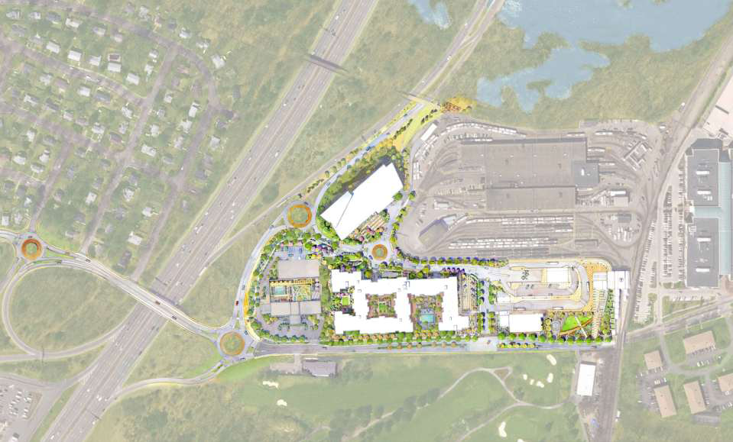

Slide 3
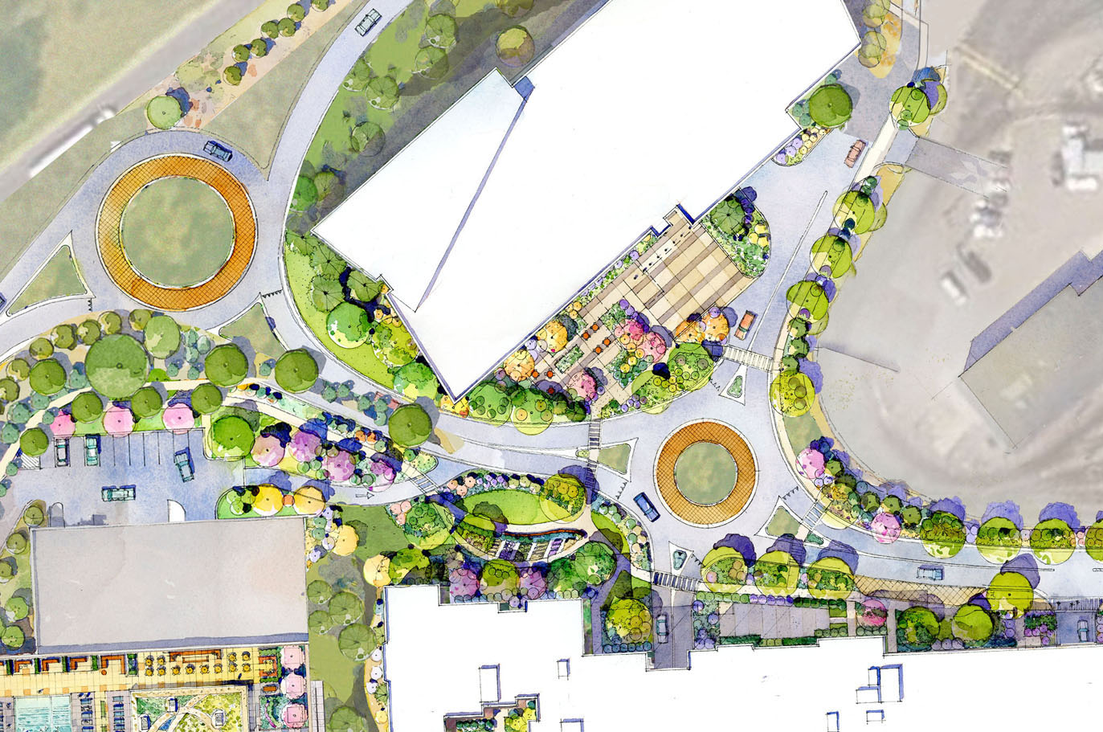

Slide 4
Traffic and Circulation
Intersections recommended for further study
  Grove Street at Woodland Road
  Grove Street at Auburn Street
  Grove Street at Riverside Office Park (north entrance)
  Commonwealth Avenue at Auburn Street
  Washington Street at Woodland Road
Based on Criteria
  Severity of traffic operations
  Crash frequencies
  Relative impact from traffic generated by project

Slide 5
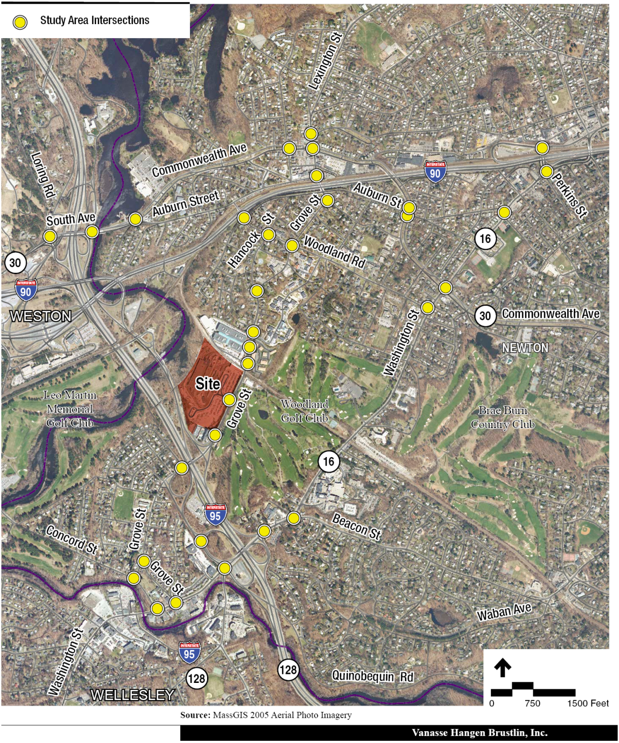

Six Study Area
Not Mitigated Intersections
Suggested
For Further
Study (AM LOS)
NM
NM
NM
NM
NM
NM
NM
NM
NM
NM
NM
NM
NM
NM
NM
NM
NM
NM
NM
Legend
LOS A-C
LOS D
LOS E
LOS F
Mitigated
Build
No-Build
NM
NM
NM
NM
NM
NM
NM
NM – No Mitigation Proposed
Prepared for: City of Newton

Slide 6
Six Study Area
Not Mitigated Intersections
Suggested
For Further
Study (PM LOS)
NM
NM
NM
NM
NM
NM
NM
NM
NM
NM
NM
NM
NM
NM
NM
NM
NM
NM
NM
Legend
LOS A-C
LOS D
LOS E
LOS F
Mitigated
Build
No-Build
NM
NM
NM
NM
NM
NM
NM
NM – No Mitigation Proposed
Prepared for: City of Newton

Slide 7
Traffic and Circulation
Roundabout design and review
  Several months or more
  If not approved per plan, SP cannot be executed
  Can tie construction to approvals
  Require reconsideration by BOA
Riverside Business Center/Equity Office/Stantec Concerns
  Secure access on westerly side (Option B-2)
  Traffic signal will add delays – Request review of signal timing
  Queuing at traffic signal to Business Center
  Peak hour conditions at Williams School
  Final design of roundabout

Slide 8
Weave Study

Slide 9
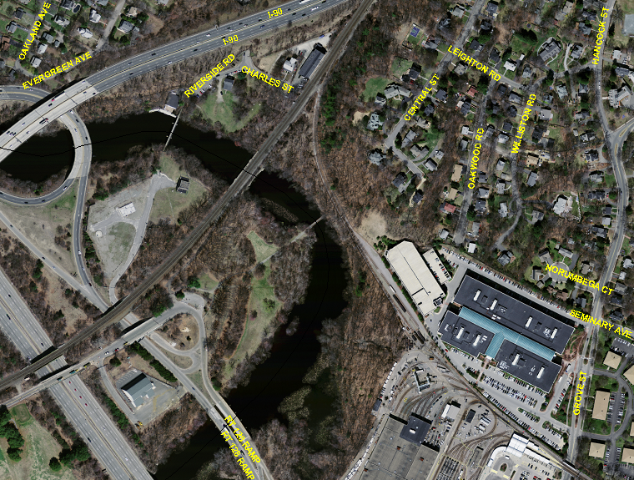

Slide 10
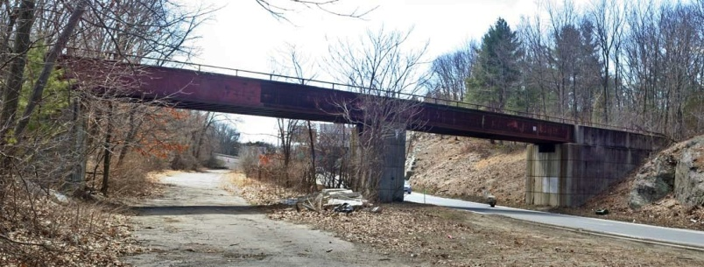
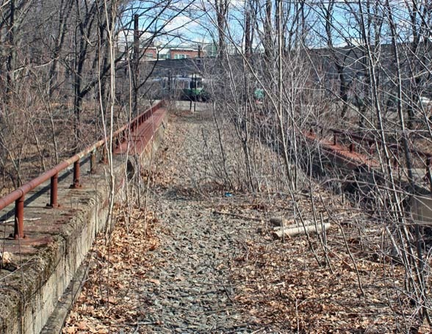
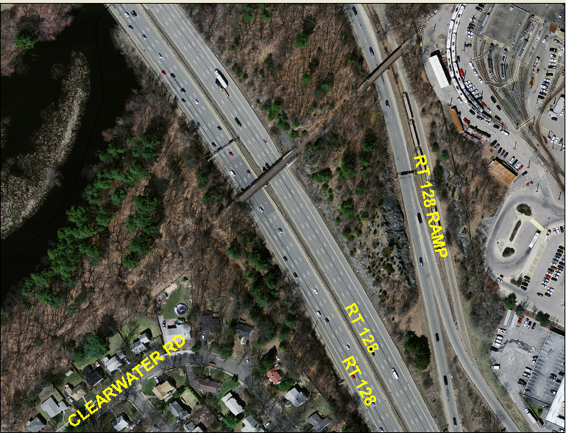

Slide 11
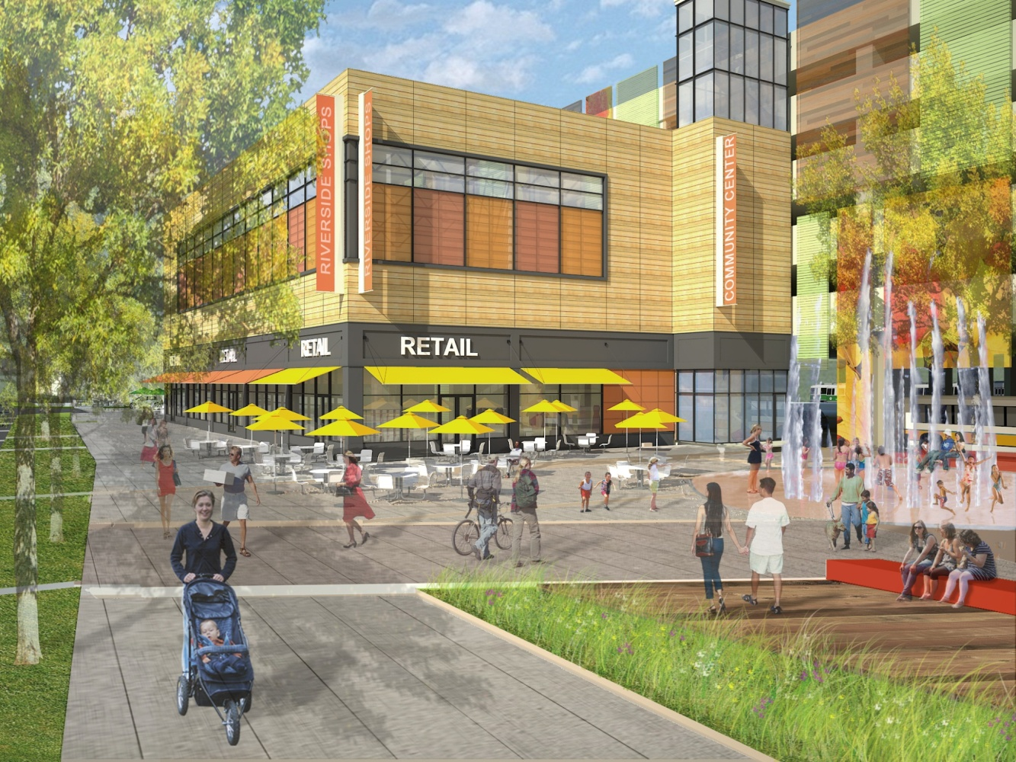
Other issues
Scenic Roads
  Held by P&D Board
Community Space
  Nonprofit structure
  Self-sustaining
  Steering Committee
Fiscal Impacts
  School impacts
  Property taxes
  One-time benefits
  Fiscally positive

Slide 12
Other issues
Building Design
  Residential detailing – Next meeting
Construction Management Plan
  Phasing
  Timing
  Management of impacts and disturbances
  Parking management on Red Sox game days

Slide 13
Station at Riverside
What’s Next?
Working session(s)
Outstanding Issues
    Hotel Indigo
    Residential Details
    Internal Signs
    I&I
    Mitigations
Close Public Hearing on Map Change
Board Order

Slide 14
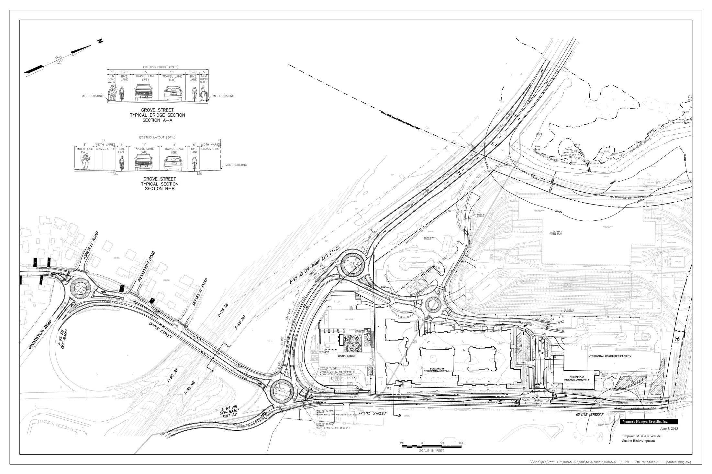

Slide 15
