Slide 1

Riverside Station
Peer Review Findings Summary
Traffic Impact and Access Study (TIAS)
2/12 Report and Subsequent Revisions
Prepared for: City of Newton, Massachusetts
By: Fay, Spofford & Thorndike
December 18, 2012

Slide 2
Peer Review Findings Summary - Overview
TIAS generally well prepared, thorough, most assumptions reasonable
TIAS trip generation, regional Trip Distribution, and Existing and No-Build analyses acceptable
Grove Street route choice traffic impacts identified in the TIAS was an issue that was addressed
Roundabouts with Options B-2 or A are expected operate better than and with fewer crashes than the No-Build Exit 22 and reduce ramp delays compared to the No-Build
Site parking still needs further clarification. Peak parking demands will be satisfied sufficiently assuming a sound shared parking arrangement is created
Prepared for: City of Newton

Slide 3
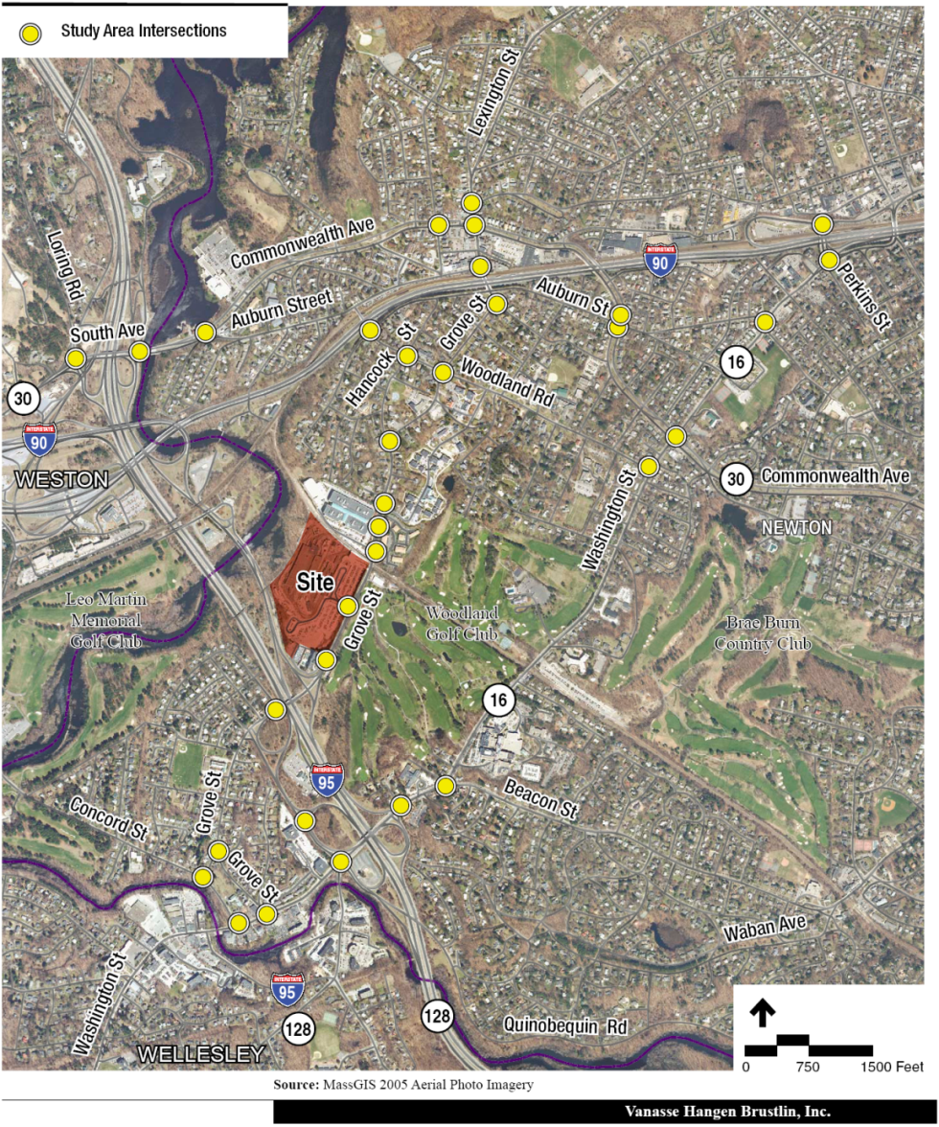
TIAS Study Area
Key Finding:
Adequate
Prepared for: City of Newton

Slide 4
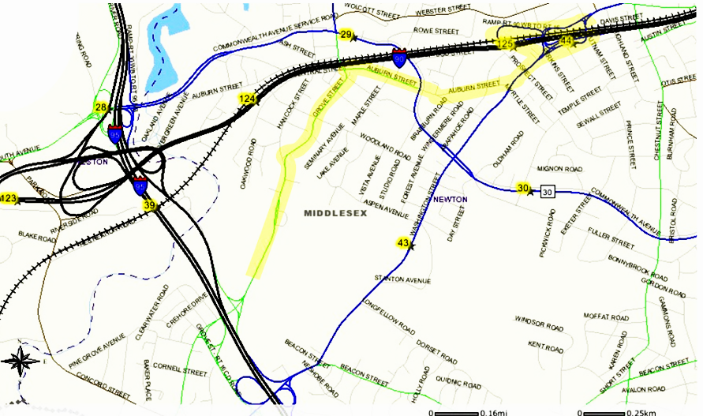
Trip Distribution Adjustment
Key Finding: Regional Distribution adequate, local Grove Street distribution needed adjustment
Original TIAS projected
a maximum of 80-85
(14-16%) of
site-generated
trips/hour use Grove/
Auburn/Washington
corridor to and from
I-90 east. Greater use
of this corridor expected
Redistribution at measured 29% level represents 65 to 80 additional peak hour trips over the 80-85 assumed & would still be consistent with TIAS’s regional distribution pattern.
Applicant re-distributed and checked impacts to see if additional mitigation is warranted; non-structural preferred
Signal timing adjustments required at three locations.
Concurrently reduces C-D Road and Exit 22 ramp volumes by up to 65 to 80 trips per hour
Riverside
Prepared for: City of Newton

Slide 5

Study Area Comparisons
2022 AM Peak Hour Mitigated Build vs. No-Build LOS’s
W/Redistribution
NM
NM
NM
NM
NM
NM
NM
NM
NM
NM
NM
NM
NM
NM
NM
NM
NM
Legend
LOS A-C
LOS D
LOS E
LOS F
NM
Mitigated
Build
No-Build
NM
NM
NM
NM
NM
NM
NM
NM – No Mitigation Proposed
Prepared for: City of Newton

Slide 6
Study Area Comparisons
2022 PM Peak Hour Mitigated Build vs. No-Build LOS’s
W/Redistribution
NM
NM
NM
NM
NM
NM
NM
NM
NM
NM
NM
NM
NM
NM
NM
NM
NM
NM
Legend
LOS A-C
LOS D
LOS E
LOS F
NM
Mitigated
Build
No-Build
NM
NM
NM
NM
NM
NM
NM
NM – No Mitigation Proposed
Prepared for: City of Newton

Slide 7
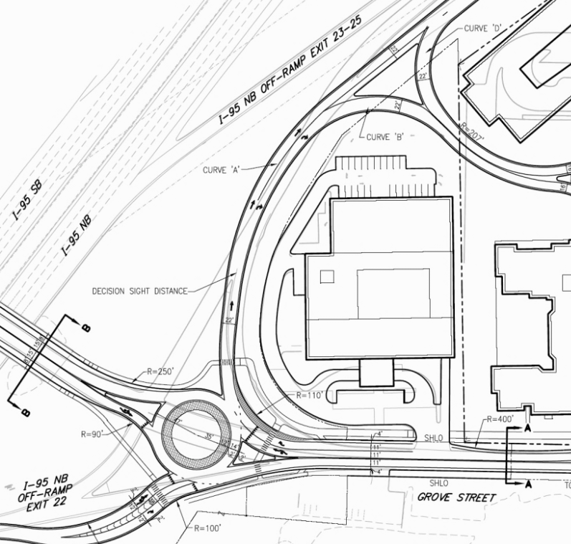
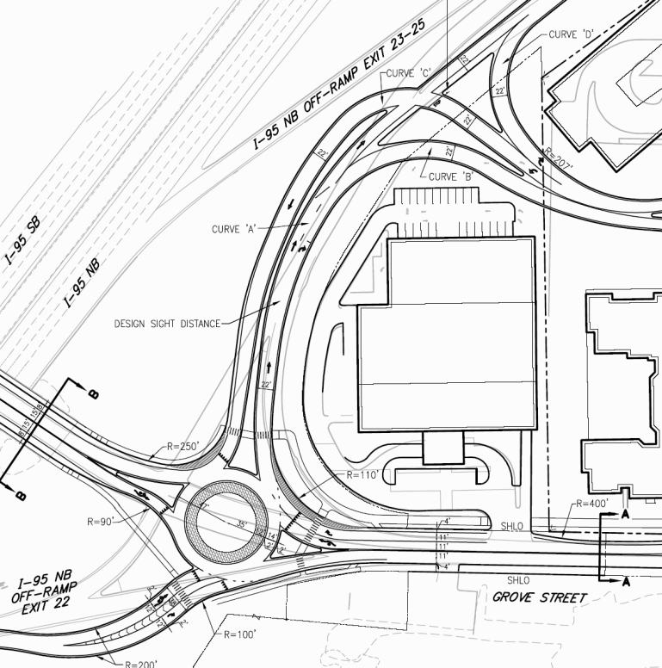
Options B-2 and A – Key Difference
Option A
Option B-2
Prepared for: City of Newton

Slide 8
Peer Review Findings Summary - Options
Option B-2 has potential sight line/ramp conflicts issues but results in best east roundabout traffic operations and slightly better operations on Grove Street between Exit 22 and MBTA Site Drive
Option A is best from an overall traffic safety perspective
Compared to the No-Build, Option B-2 and A both reduce traffic volumes on Grove Street between the T entrance and Exit 22 – Option B-2 by nearly 2,300 vpd; and Option A by 700 vpd
Refinements to Options A or B-2 should be made to accommodate pedestrians and bikes better during design
The MBTA Site Drive approach to Grove Street should be two lanes to accommodate peak queuing demands
Prepared for: City of Newton

Slide 9
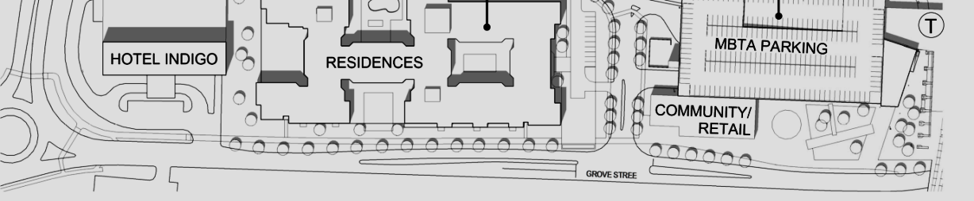
Peak Hour Grove Street Traffic w/North Re-distribution
N

Slide 10
Daily Grove Street Traffic w/North Re-distribution
N
Prepared for: City of Newton

Slide 11
Buildings/Parking Overview
Existing
  Riverside Intermodal facility with Green Line/bus service and 963 surface commuter parking spaces
Future Development
  Office space – 225,000 gsf
  290 apartments – 320,000 gsf
  Retail space – 15,000 gsf
  Community space – 8,000 gsf
Future Parking
  Total 2014 spaces – net increase of 1, 051 spaces
  MBTA Commuter Spaces– 1,005 spaces
  Development Spaces – 1,009 spaces
      Offices – 563 spaces (2.5/1,000 gsf)
      Apartments – 435 spaces (1.5/unit)
      Surface – 11 spaces (Residential/retail building short term)
Prepared for: City of Newton

Slide 12
Shared Parking Review
2,014 total spaces; 1,009 private/free? – 1,005 public (MBTA)/pay
From 46-232 spaces in MBTA garage may need to accommodate non-commuter site users
How much non-commuter users will pay for site parking at MBTA is an issue, must be same rate for all users
Prepared for: City of Newton

Slide 13
Shared Parking Potential
by Type of Use
100%
80%
60%
Retail
40%
20%
0%
12M 12N 12M
100%
80%
60%
Office
40%
20%
0%
12M 12N 12M
100%
80%
60%
Apartments
40%
20%
0%
12M 12N 12M
Shared parking need
Shared parking potential spaces
Prepared for: City of Newton

Slide 14
Shared Parking Conclusions
With clarifications, shared parking strategy as presented should reduce traffic demands
Vast majority of typical weekdays, the MBTA should be able to satisfy its commuter parking demands
From 46-232 spaces in MBTA garage may need to accommodate non-commuter site users
Community space parking should be worked out with Building A
Prepared for: City of Newton

Slide 15
Trip Generation
Key finding: Adequate
Total New Trips:
  Daily – 5,088 (2,544 in and out)
  AM Peak Hour – 496 (356 in and 140 out)
  PM Peak Hour – 575 (198 in and 377 out)
  Community building trip generation assumed as office space
Assumes:
  Office –365 AM / 321 PM Peak Hour New vehicle trips
  Retail– 39 AM/139 PM Peak Hour New vehicle trips
  Residential– 104 AM/115 PM New vehicle trips
  MBTA intermodal facility - ‘neutral’ (i.e., ‘0’ New) generator depends on funding/operations service policies
  Fewer than 3 vehicles on average per minute estimated added to Grove Street to and from the north during peak hours
Prepared for: City of Newton

Slide 16
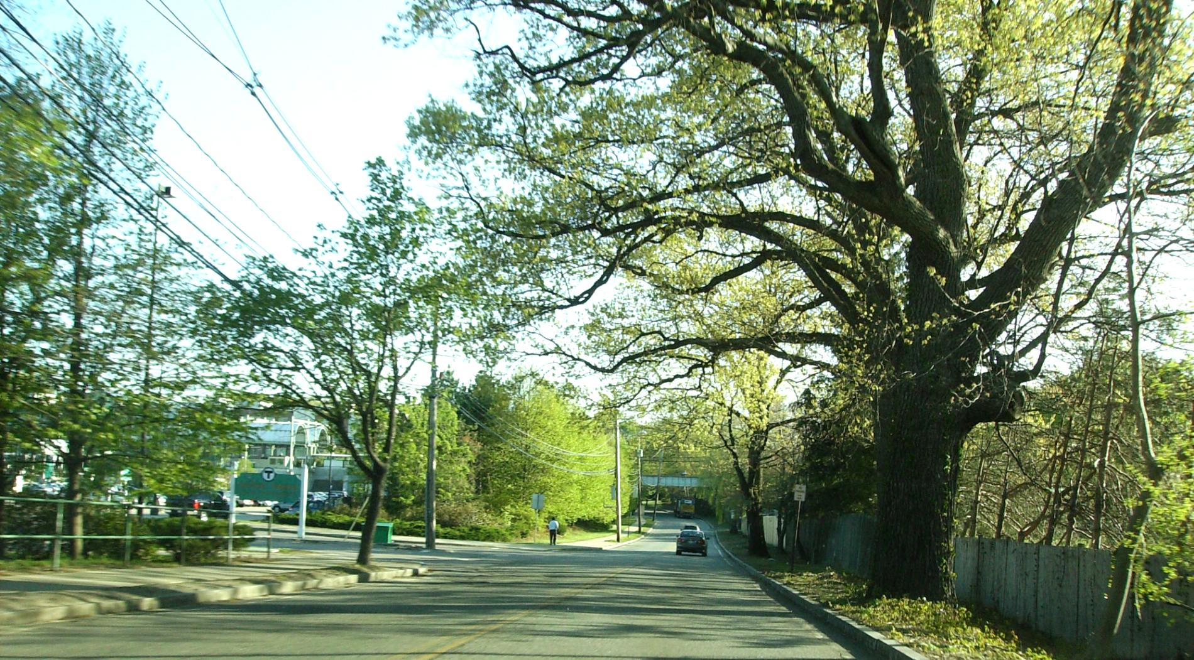
Grove Street:
Looking North the MBTA Entrance
Prepared for: City of Newton

Slide 17
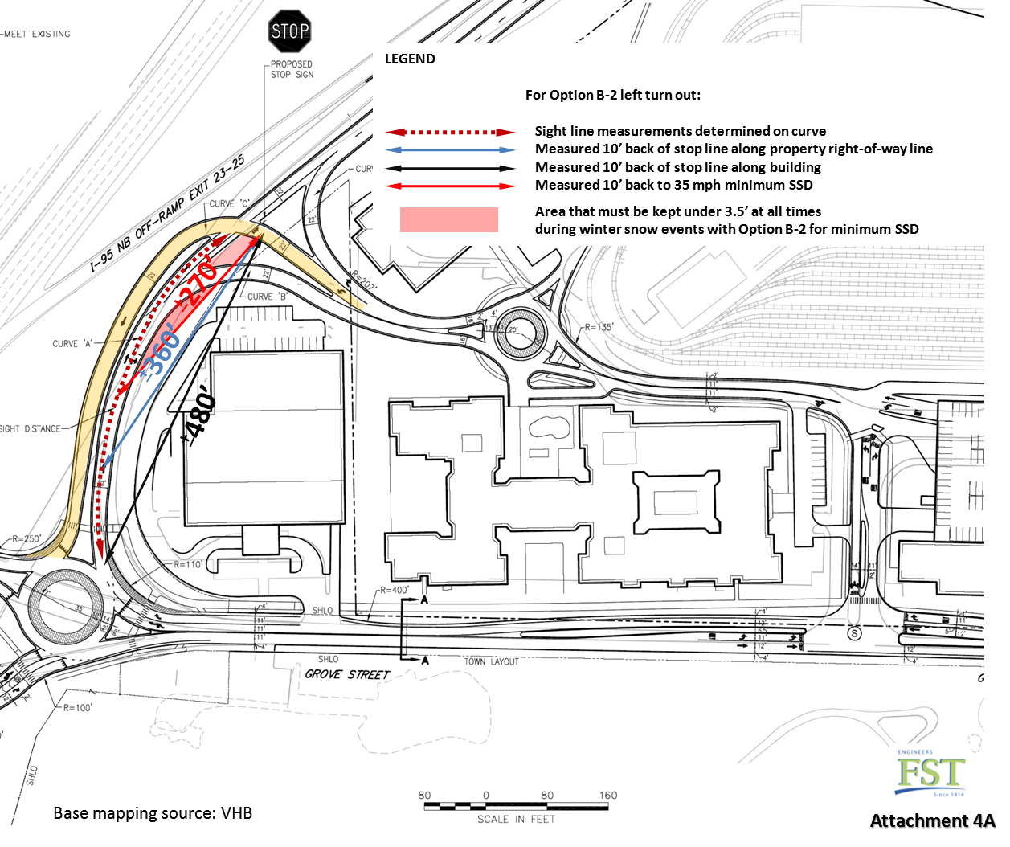
Key Finding: Option B-2 has superior vehicle traffic operations but a potential sight line & conflicts safety issue not associated with Option A
Prepared for: City of Newton

Slide 18
Grove Street roundabouts
Far lower crash experience expected than with signals or the current interchange configuration
Operate best with Option B-2, acceptably with Option A
Consider focusing most Exit 22 pedestrian crossings to the north side of interchange roundabouts where best environment can be created
Prepared for: City of Newton

Slide 19
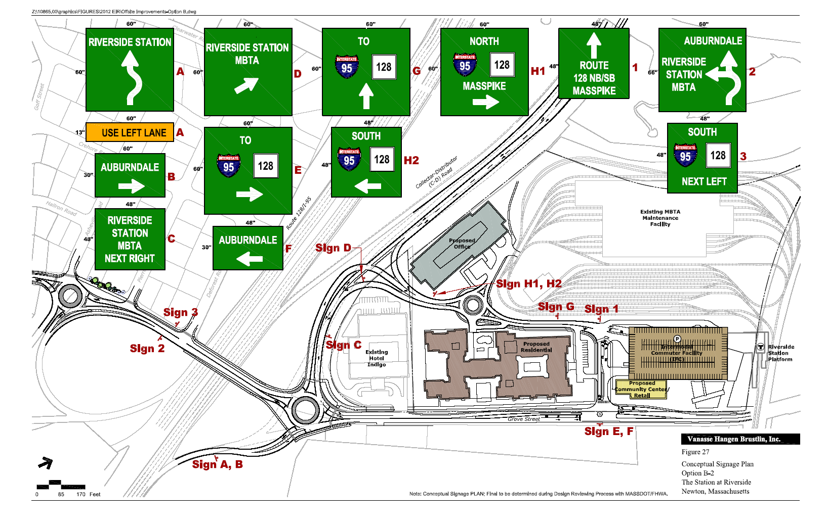
Potential Grove Street Pedestrian/Bike Enhancements
Consider eliminating free right and maximizing deflection; change SB I-95 merge to Grove Street to yield to crossing traffic & bikes & focus pedestrian crossings on north side of the interchange
2 Buffer bridge bike
lane and one create crossing for bus stop users at 1 lane roundabout crossing
Consider maximizing deflection for NB merge to enhance bike & Grove Street NB merges; no ‘free’ right turn movements
Consider using raised medians with deflection between the two Grove Street lanes for1-lane pedestrian crossings at a time
5 Consider 5-foot bike lanes rather than 4-foot bike accommodations to new T entrance
1
2
3
4
5
Prepared for: City of Newton

Slide 20
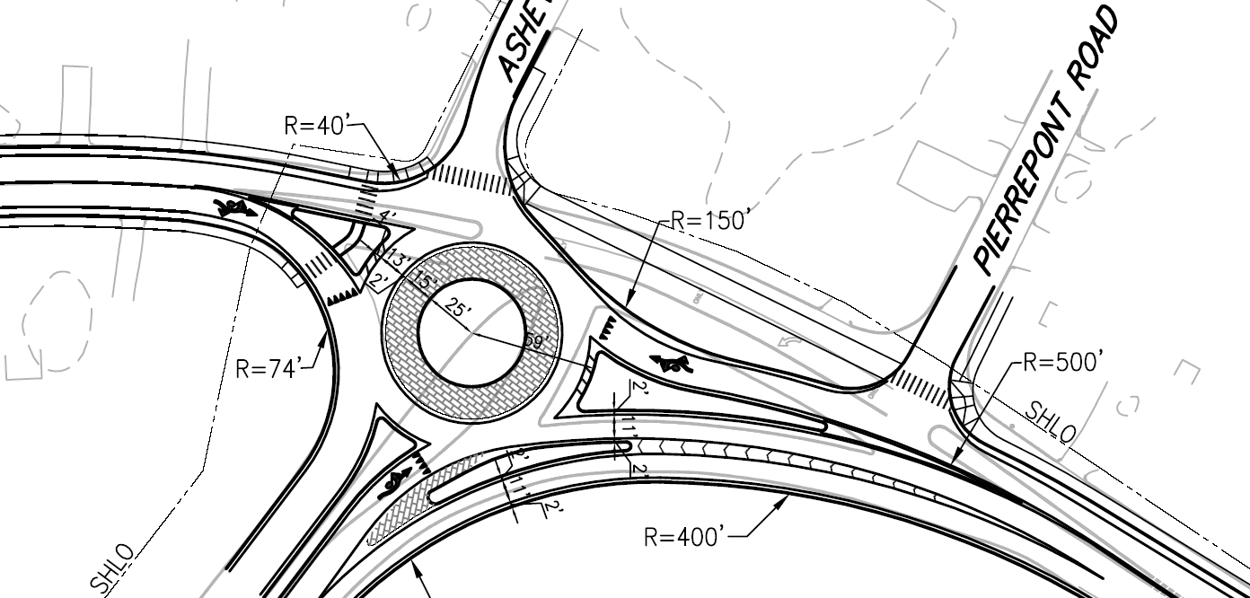
Grove Street – West Roundabout
Measures to Consider
1 - 2
Asheville
Road
Pierrepoint Road
Grove Street

Slide 21
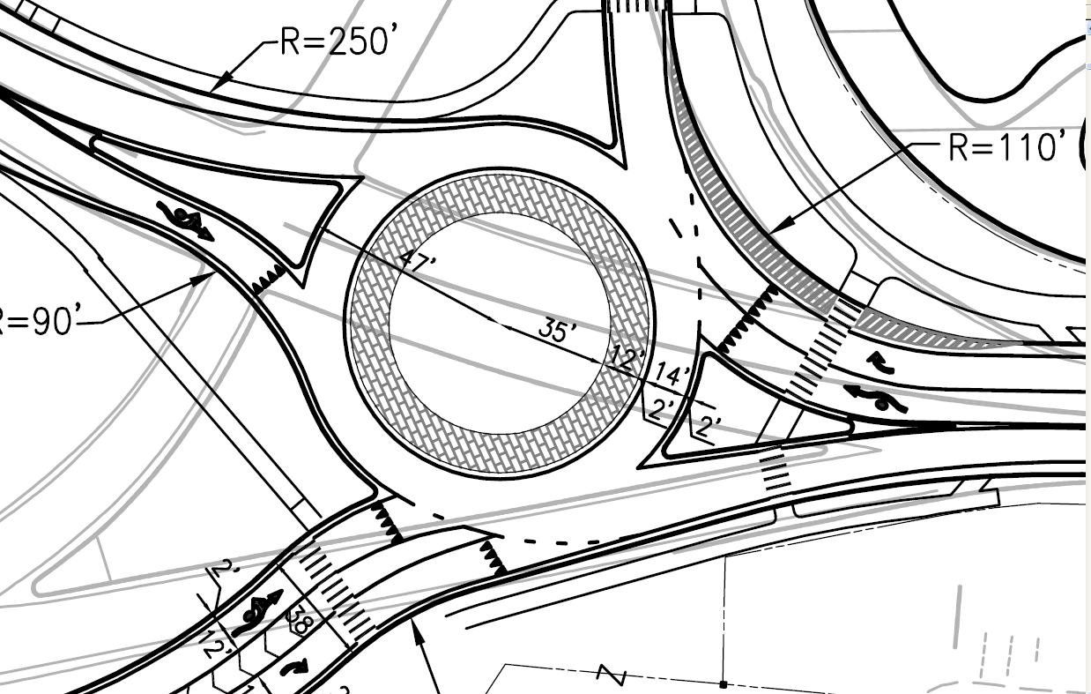
Grove Street – East Roundabout
Consider Modified Pedestrian Crossing
3 - 4
Grove Street

Slide 22
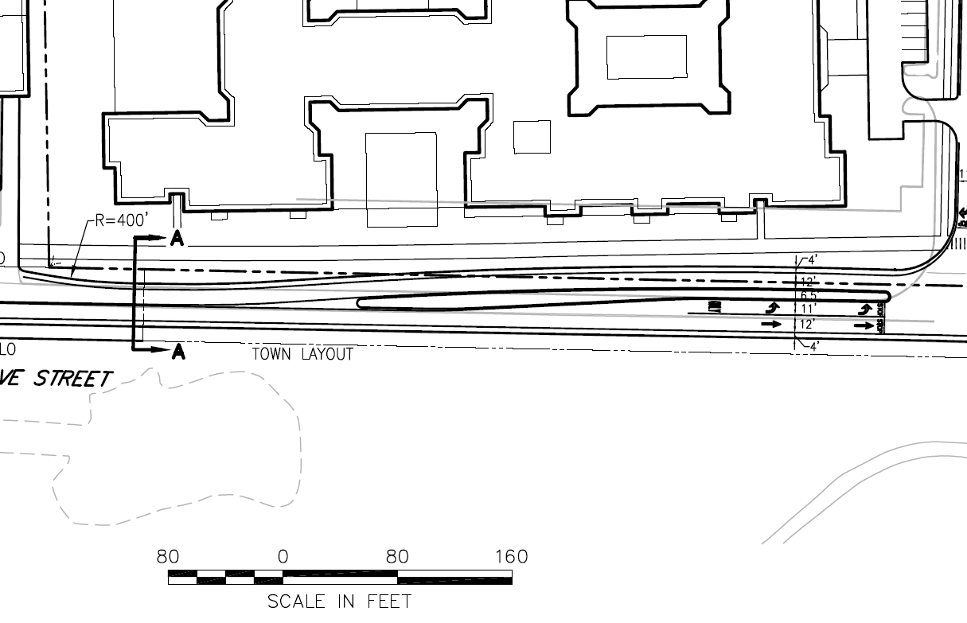
Grove Street – 5-foot bike lane vs. 4-foot accommodation
5
Grove Street
Use 11’ lanes rather than 12’ lanes for 5’ bike lanes
Prepared for: City of Newton

Slide 23
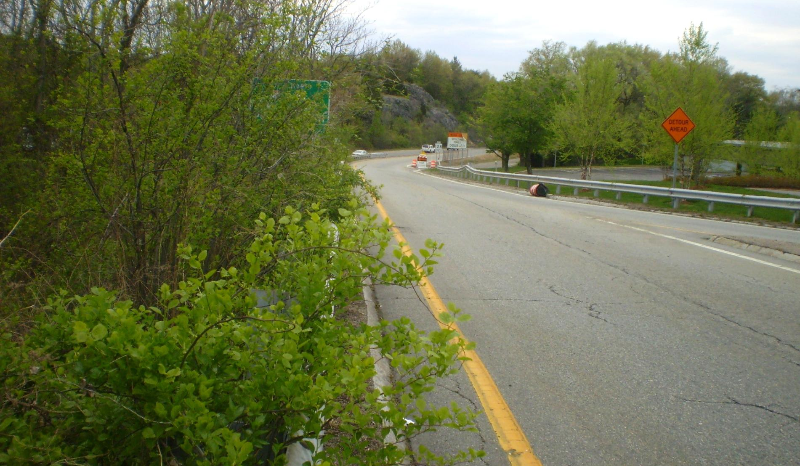
I-95 Northbound C-D Road
Looking north to future site ramps vicinity
Potential snow bank area that could impede winter sight lines inside horizontal curve
Vicinity of proposed left turn out
Prepared for: City of Newton

Slide 24
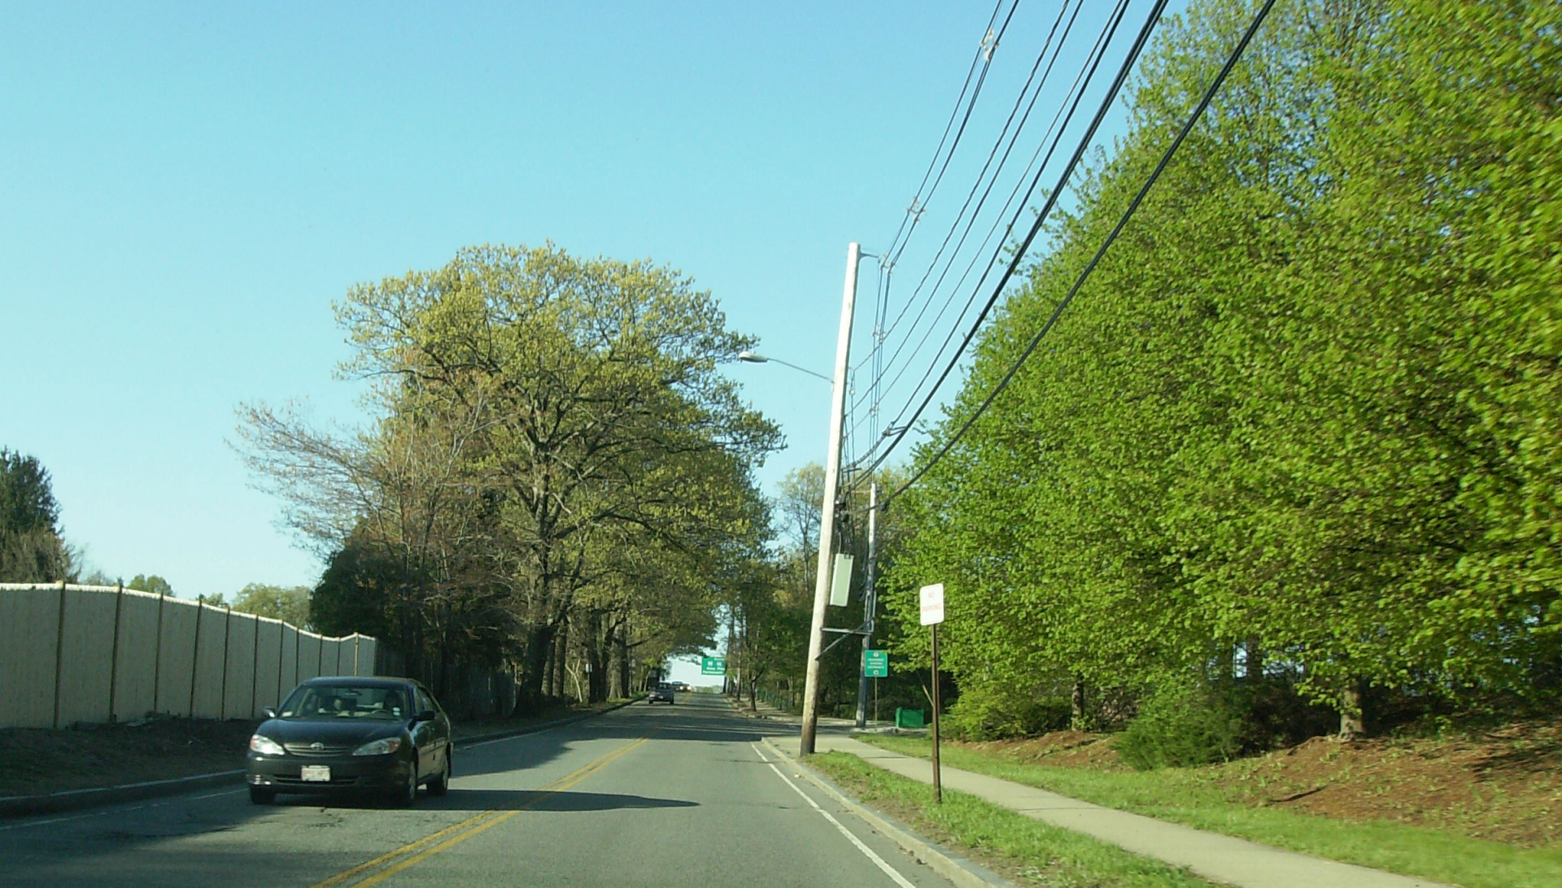
Grove Street:
Looking south to MBTA Entrance
Prepared for: City of Newton

Slide 25
Key Traffic Peer Review Findings: Mitigation
  Option A has better traffic and pedestrian safety features, but Option B-2 provides better traffic operations. If Option B-2 sight line/CD Road conflicts issue cannot be resolved, FST prefers Option A for safety reasons – FHWA will ultimately decide
  Necessary Grove Street physical modifications are similar with Options A and B-2 access options
  Grove Street traffic projection re-distribution was performed acceptably; implementation of additional mitigation measures is appropriate for those locations that worsen traffic operations compared to the No-Build Alternative
  Proposed TDM measures are reasonable, but need to be continuously applied/reinforced in the context of post implementation counts
  Consider Grove Street alternate measures from TIAS for pedestrian/bicycle/environmental enhancements as they pertain to roundabouts and the T entrance traffic signal
  Post-implementation measures are appropriate and should include a review of pre- and post-implementation neighborhood parking assessment as well as follow up counts.
Prepared for: City of Newton

Slide 26
Key Peer Review Findings:
Responsiveness of TIAS to Expressed City and Neighborhood Concerns
Reduces build from DEIR as requested
Itemized TDM measures as requested
Analyzed alternate site distribution pattern to and from I-90 to the east was evaluated and
Addresses Fenway event day traffic volumes, but not event day parking demands
Prepared for: City of Newton

Slide 27
Based on Peer Review Findings, the Applicant:
    Redistributed peak hour traffic on Grove Street corridor by assuming a maximum of approximately 29% of total site generated traffic will travel to and from the north vs. 14-16% as presented in the TIAS and addressed mitigation
    Should commit that site-generated volumes on Grove Street corridor will not exceed projected TIAS volumes by more than 10% based on future count program and maximize site TDM measures.
    Needs to confirm retail/community building parking assumptions
Prepared for: City of Newton

Slide 28
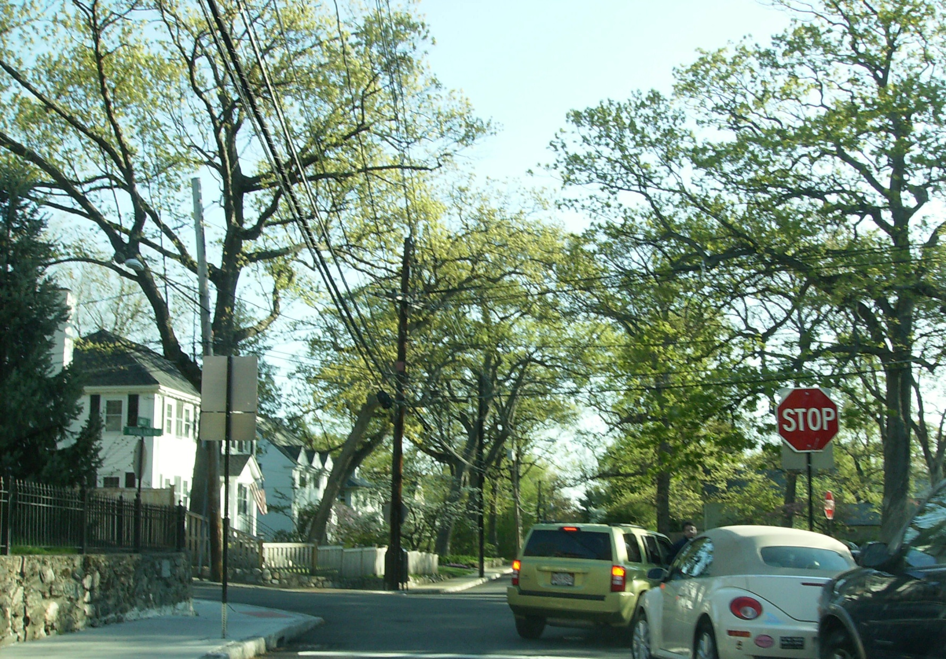
- Thanks
Questions?
Prepared for: City of Newton

