Slide 1
Department of Planning and Development
Permit #93-12
35 Norwood Avenue
Request to exceed FAR for a new single family dwelling

Slide 2
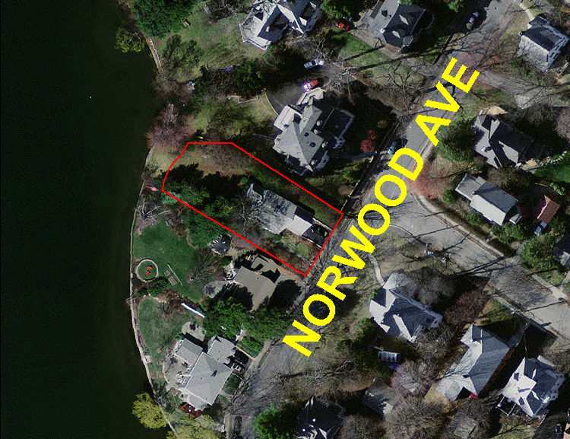
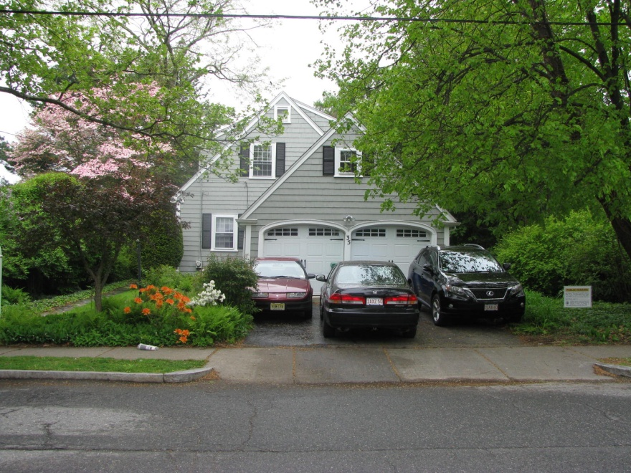
Site:
9,573 square foot lot
Zoned SR 2
Abuts Crystal Lake
Newton Centre
Existing 1930’s cape ~ 2,400 SF
Located in eclectic neighborhood with a variety of sizes/styles/vintages

Slide 3
Project Description/Relief Requested:
Demolish existing house and construct new 4,282 SF house
Section 30-15(u)(2), to allow an FAR of .45 where .39 is allowed by right

Slide 4
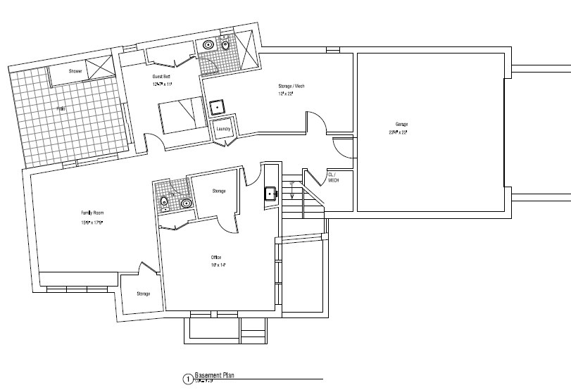
Proposed Basement:
Basement Area = 2,147 SF
Eligible FAR = 515 SF

Slide 5
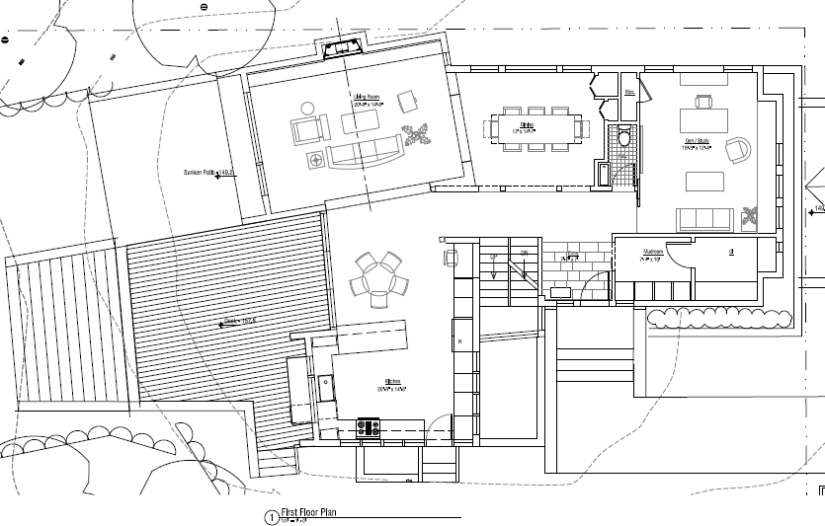
Proposed First Floor:
1st Floor FAR Area = 1,655 SF

Slide 6
Proposed Second Floor :
2nd Floor FAR Area = 1,574 SF

Slide 7
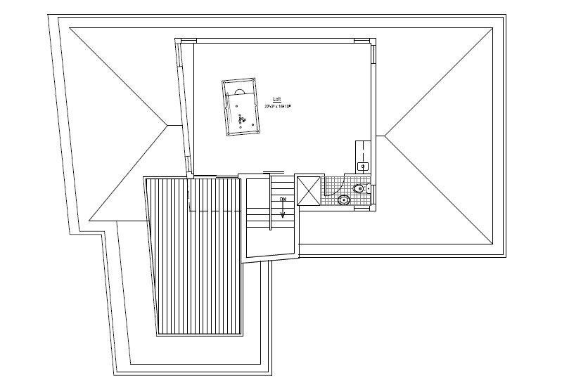
Proposed Third Floor:
3rd Floor FAR Area = 538 SF

Slide 8
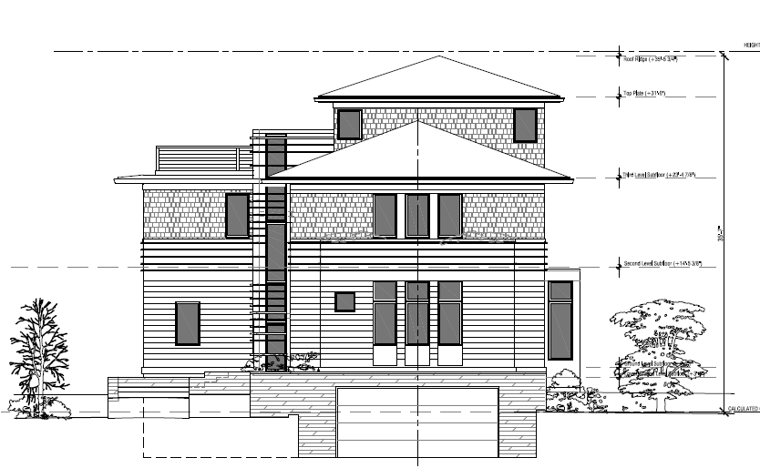
Proposed Front Elevation:
Raising house ~ 4 ft. to accommodate full basement

Slide 9
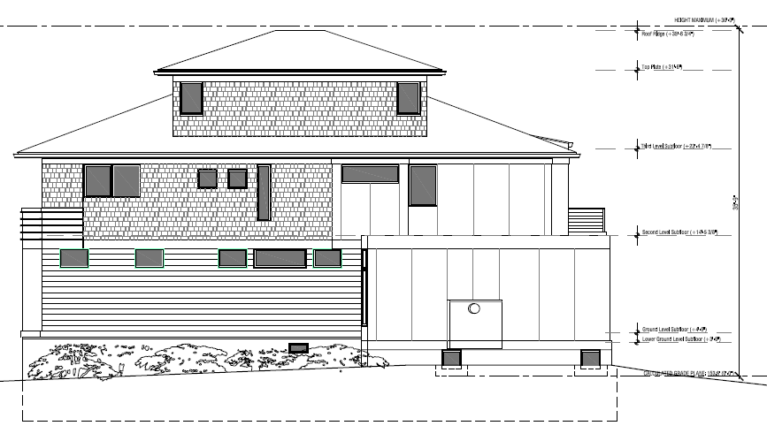
Proposed North Elevation:

Slide 10
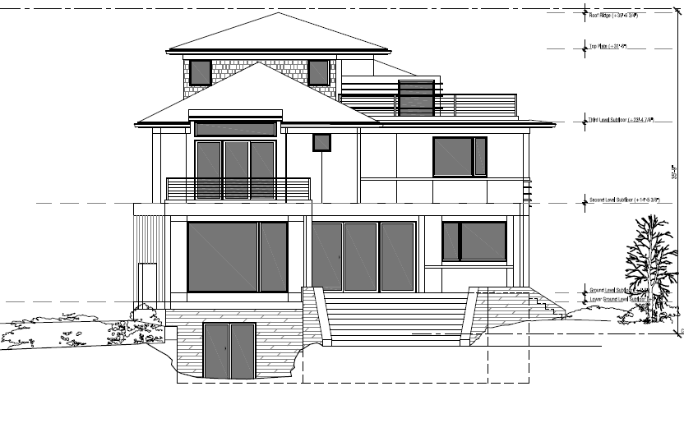
Proposed Rear Elevation:

Slide 11
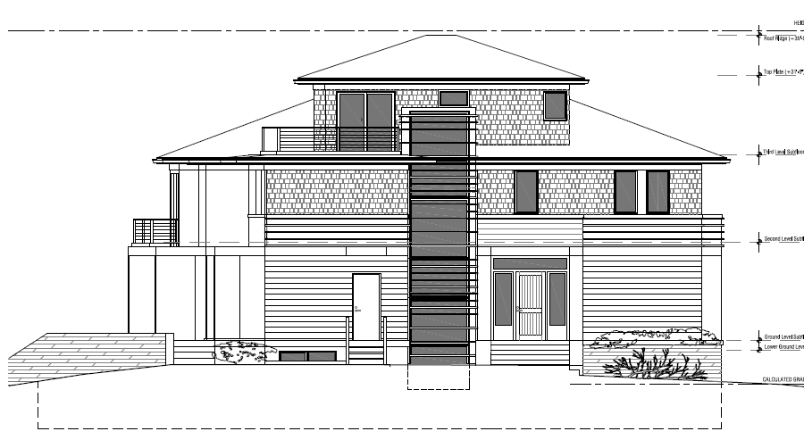
Proposed South Elevation:

Slide 12
FAR Calculation:
Total FAR GFA = 4,282 SF
Actual GFA = 5,914 SF (includes basement)
Max FAR GFA Allowed =
.39 * Lot Area = .39 * 9,570 = 3,732 SF
Proposed FAR = 4,282 / 9570 = .45
Exceeds Max .39 FAR by 550 SF
Neighborhood Average FAR = .34
Neighborhood Median FAR = .31

Slide 14
FAR Concerns:
First completely new house to exceed FAR requirements
Exceeds neighborhood average house size
Although there are two homes that exceed the allowed FAR in immediate neighborhood do we want to add another?
If Board continues to allow FAR to creep up, neighborhood average will increase
If we continue to waive FAR why do we have it?
Environmentally sensitive site deserves “right-sized” house
9,573 SF lot not constrained in any way

Slide 15
Additional Issues of Concern:
Preservation of existing mature trees bordering property
Proposed new house and rear deck projects into 100-foot wetland buffer zone – must get Con Com review and approval to build house as proposed
Need Construction Management Plan and Tree Preservation Plan (including trees on abutting properties) prior to building permit

