Slide 1

Department of
Planning and Development
Petition #141-13(2)
74 Newtonville Avenue
Construction of a Retaining Wall Exceeding four feet in Height and to locate two parking stalls in the front yard Setback

Slide 2
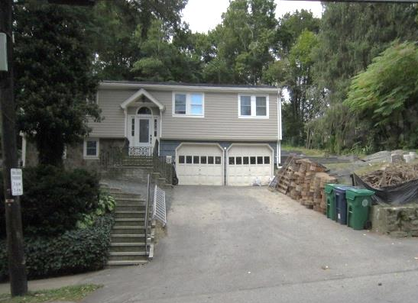
Project Description
SR3 zoning district
10,021 sq. ft. Lot
Residence w/attached garage was constructed in 1973
A proposed retaining wall with a maximum height of 12 feet and two parking stalls will be located in the front setback
Rendering existing two-car garage useless
Requested Relief From:
§30-5(b)(4) Locate a retaining wall of four feet or more within a setback, §30-19(g)(1) and §30-19(m) Allow two parking spaces within the front setback

Slide 4
Retaining Wall Drawings – Side Details
A four foot high iron rod railing will extend above the 12-foot high wall.
End of wall height will vary due to the existing slope of the sidewalk and adjacent grade.

Slide 5
Retaining Wall Drawings – Side Details

Slide 6
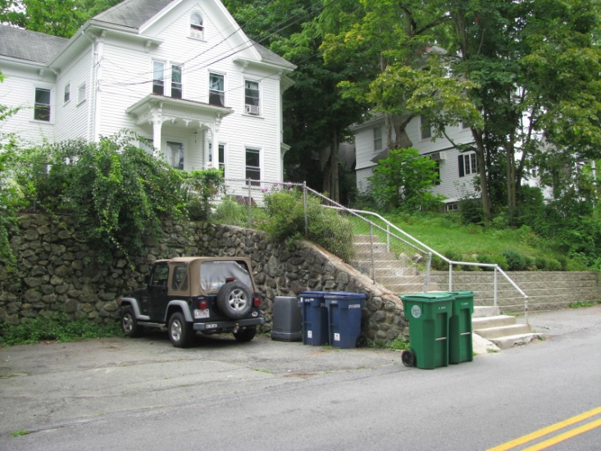
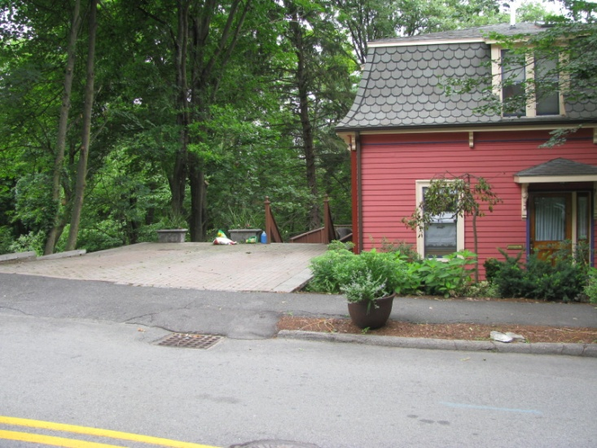
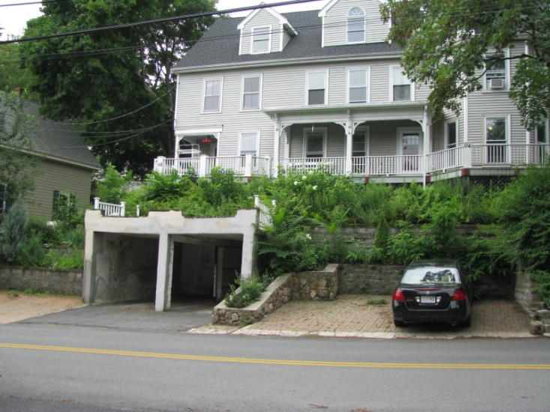
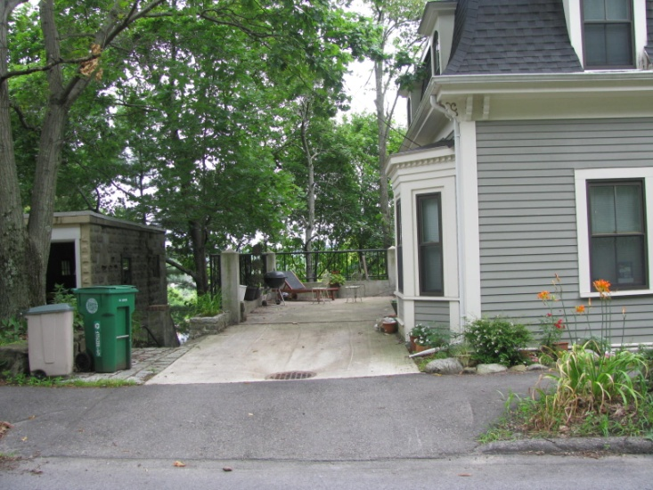
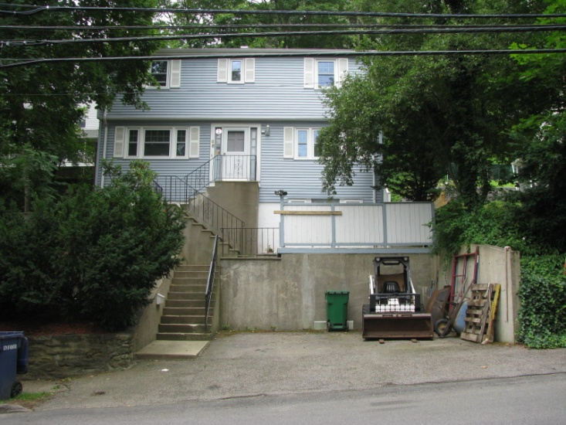
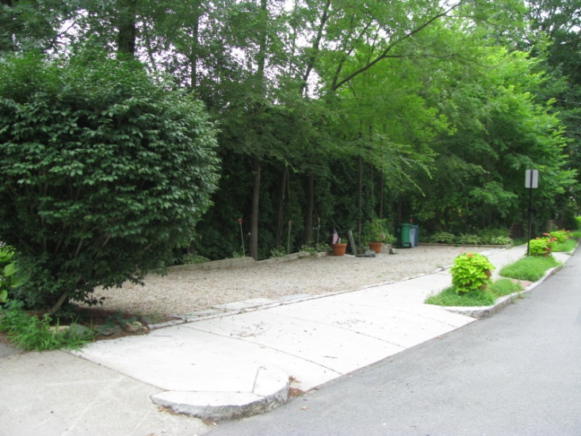
Neighborhood Context

Slide 7
Proposed Findings
The constraints present on the property, specifically the significant grade of the lot and seasonal drainage conditions, make the use of the existing two-car garage unfeasible for the current owners.
The proposed relief for retaining walls greater than four feet in height and located in the front setback will not adversely affect the neighborhood, and all runoff will be contained on-site.
The proposed parking stalls in the front yard setback will not create a nuisance or be a serious hazard to vehicles or pedestrians in the neighborhood and literal compliance with the parking requirements is impracticable due to the grade of the lot

Slide 8
Proposed Conditions
Standard Plan Condition
Prior to the issuance of any building permit, the petitioner shall have repaired the fence on the rear lot line to the satisfaction of the Inspectional Services Department.
The petitioner shall stucco the surface of the retaining walls to improve the streetscape.
Upon the issuance of any building permit, the petitioner shall provide engineering reports twice a month documenting the progress of the project to the Engineering Division of Public Works, Inspectional Services Department and Department of Planning and Development.

Slide 9
Proposed Conditions
Prior to the issuance of any building permit, the petitioner shall submit a final Construction Management Plan (CMP) to the Commissioner of Inspectional Services, the Engineering Division of Public Works, the Director of the Department of Planning and Development, and Newton Police Department. The CMP shall be consistent and not in conflict with relevant conditions of this Board Order and shall include, but not be limited to, the provisions of the draft CMP on file with the Department of Planning and Development, dated October 1, 2013.
Standard Building Permit Condition
Standard Certificate of Occupancy Condition

Slide 10
Enforcement/Permit History Assessment

