Slide 1
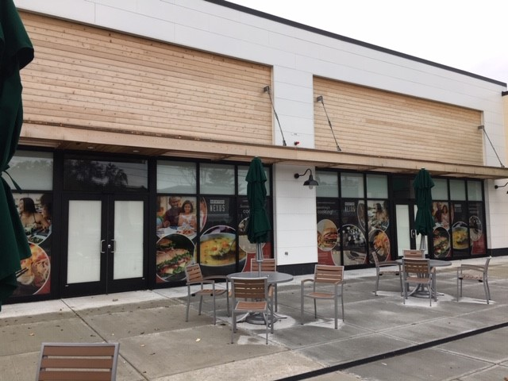
Department of Planning and Development
Petition #496-18
131-181 Needham Street
SPECIAL PERMIT/SITE PLAN APPROVAL to amend council order #19-15 and to allow A veterinary Hospital in a Mixed use-1 District
November 8, 2018
Notes:
Petition #496-18 for 131-181 Needham Street which is a SPECIAL PERMIT/SITE PLAN APPROVAL to allow a veterinary Hospital in a Mixed Use 1 District

Slide 2
Requested Relief
Amend Council Order #19-15
Allow a veterinary hospital in the Mixed Use 1 (MU-1) zoning district (§4.4.1 and §7.3.3)
Notes:
The petitioner is seeking relief to:
Amend Council Order #19-15
Allow a veterinary hospital in the Mixed Use 1 (MU-1) zoning district (§4.4.1 and §7.3.3)
The petitioner is an emergency veterinary clinic. Their core operations of emergency veterinary services is overnight during the week and 24 hours on the weekends. The petitioner will be occupying 2,700 square feet of space in the existing building.

Slide 3
Criteria to Consider
When reviewing this request, the Council should consider whether:
The site is an appropriate location for veterinary hospital (§7.3.3.C.1);
The proposed veterinary hospital will adversely affect the neighborhood (§7.3.3.C.2);
The proposed veterinary hospital will create a nuisance or serious hazard to vehicles or pedestrians (§7.3.3.C.3);
Access to the site over streets is appropriate for the types and numbers of vehicles involved (§7.3.3.C.4).
Notes:
When reviewing this request, the Council should consider whether:
The site is an appropriate location for veterinary hospital (§7.3.3.C.1);
The proposed veterinary hospital will adversely affect the neighborhood (§7.3.3.C.2);
The proposed veterinary hospital will create a nuisance or serious hazard to vehicles or pedestrians (§7.3.3.C.3);
Access to the site over streets is appropriate for the types and numbers of vehicles involved (§7.3.3.C.4).

Slide 4
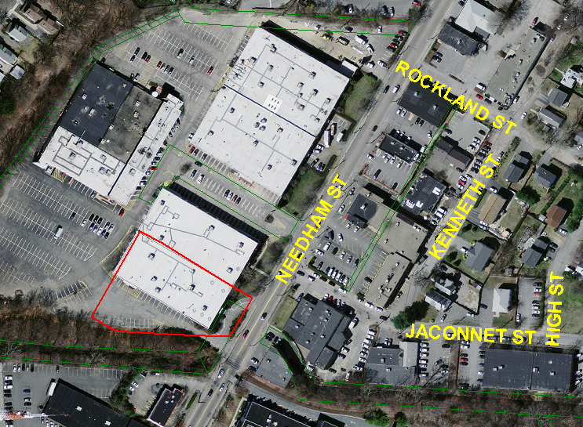
AERIAL/GIS MAP
Notes:
The site is located on Needham Street and is part of Newton Nexus. The site was found to be an appropriate location for mixed use development with office, service, retail, and restaurant uses per Council Order #19-15.
The vet will be located in the southernmost building occupying the tenant space on the left side when facing the building.

Slide 5
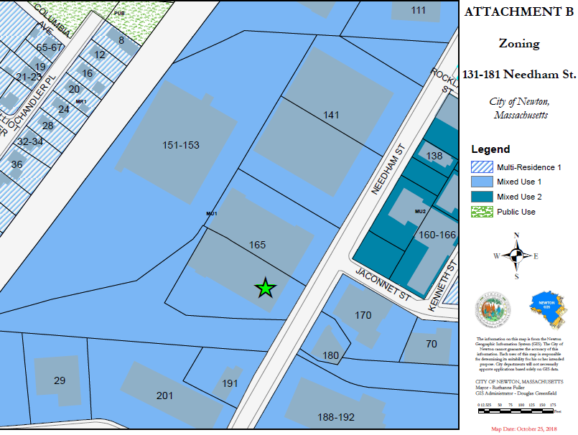
Notes:
Zoning
The surrounding zoning is mostly mixed use 1 zone with a smaller section of mixed use 2 on the east side of Needham St. The Upper Falls greenway separates the site from multi residence 1 zones and public space.

Slide 6
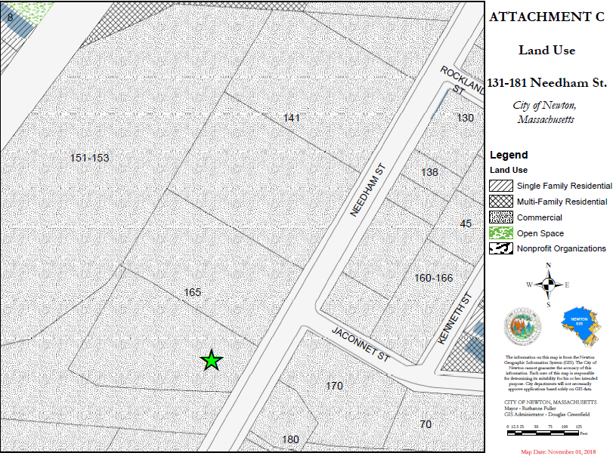
Notes:
Land Use
The surrounding land use is commercial.

Slide 7
Photos
Notes:
The veterinary clinic will be occupying the space on the left side.

Slide 8
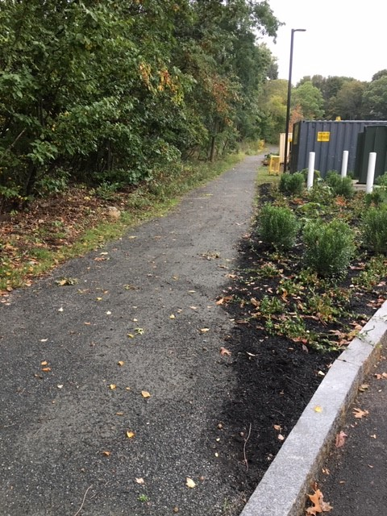
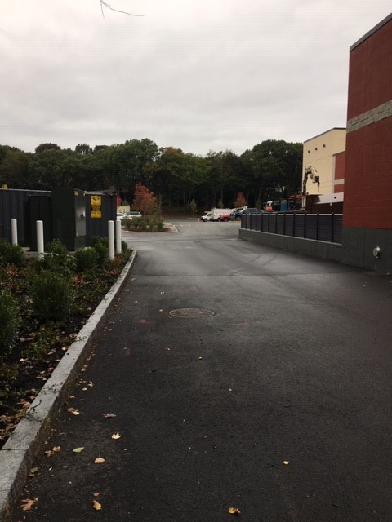
Notes:
The image on the left shows the trail to the upper falls greenway which can be accessed along the left side of the site.
The image on the right shows the driveway to the left of the building leading back to the larger shared parking facility.

Slide 9
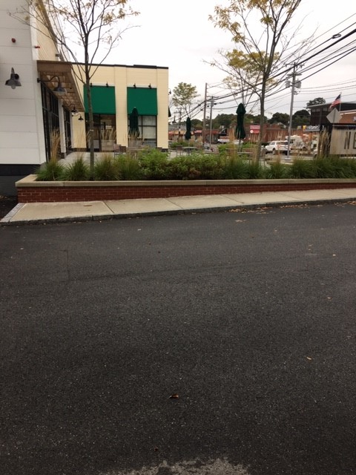
Notes:
This image shows the side of the building that the vet will be occupying from the driveway

Slide 10
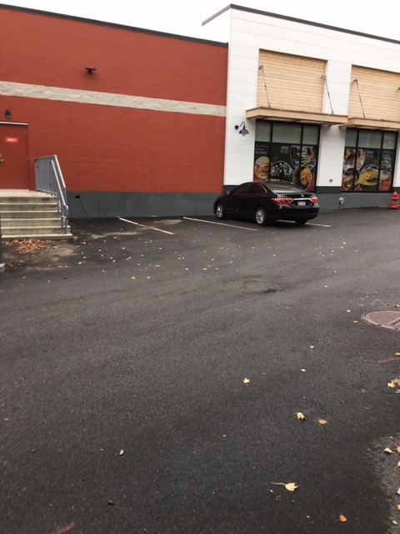
Notes:
There are a few additional parking spaces adjacent to the veterinary clinic

Slide 11
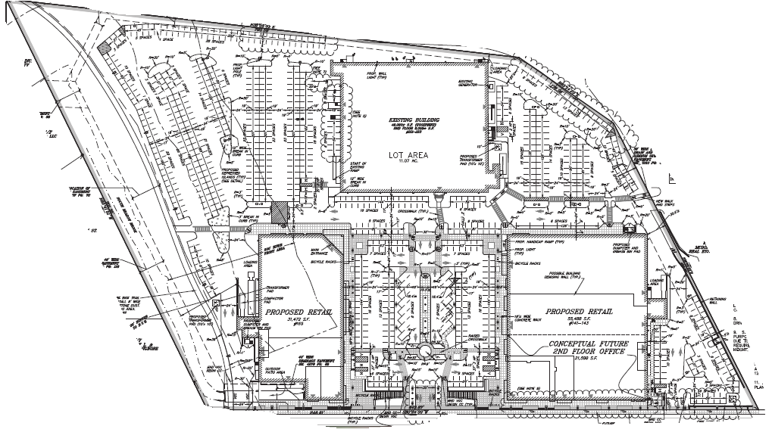
Site Plan
Notes:
The approved site plan for Newton Nexus shows the proposed veterinary clinic location with a red star over it. Entrances to the site are represented by the 3 blue circles to the bottom of the plan and primary parking closest to the tenant space is represented by the large yellow rectangle. This parking area has been observed to be underutilized. Secondary parking is located at the center of the site, outlined by the green rectangle.
The proposed veterinary space was anticipated by Council Order #19-15 as a personal service use, which is the same parking requirement as the veterinary use therefore we do not anticipate any new parking or traffic impacts.
That’s all I have and we are happy to answer any questions.
STOP

Slide 12
Proposed Findings
The specific site is an appropriate location for the proposed veterinary hospital because the site is located in an area containing a mix of uses and the proposed use is compatible with that mix. (§7.3.3.C.1.)
The proposed veterinary hospital will not adversely affect the neighborhood given the mixed use nature of the area. (§7.3.3.C.2)
The proposed veterinary hospital will not create a nuisance or serious hazard to vehicles or pedestrians because the use does not require any alterations to the site. (§7.3.3.C.3.)
Access to the site over streets is appropriate for the types and numbers of vehicles involved. (§7.3.3.C.4)

Slide 13
Proposed Conditions
Standard plan referencing condition
Standard building permit condition
Standard Certificate of Occupancy condition
The petitioner shall adhere to the following hours of operation: 6:00 p.m. to 8:00 a.m. Monday through Thursday and 24 hours from Friday at 6:00 p.m. through Monday at 8:00 a.m.
The petitioner shall not board animals overnight nor provide outdoor space for said animals.
All signage shall be reviewed and approved by the Urban Design Commission.
Notes:
Standard plan referencing condition
Standard building permit condition
Standard Certificate of Occupancy condition
The petitioner shall adhere to the following hours of operation: 6:00 p.m. to 8:00 a.m. Monday through Thursday and 24 hours from Friday at 6:00 p.m. through Monday at 8:00 a.m.
The petitioner shall not board animals overnight nor provide outdoor space for said animals.
All signage shall be reviewed and approved by the Urban Design Commission.
Frank is going to speak to the hours of operation condition

