Slide 1
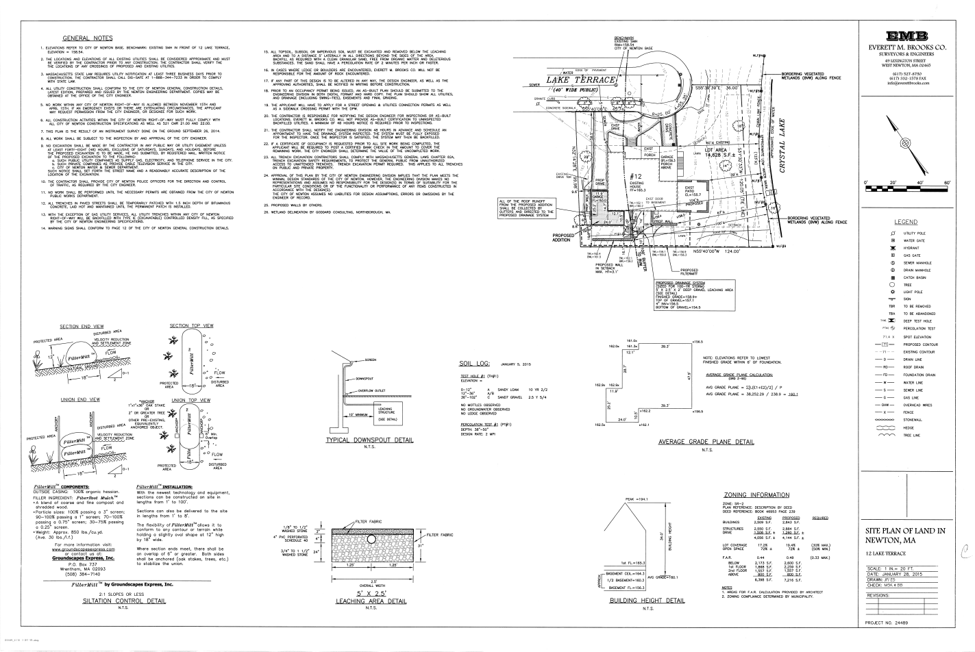

Slide 2
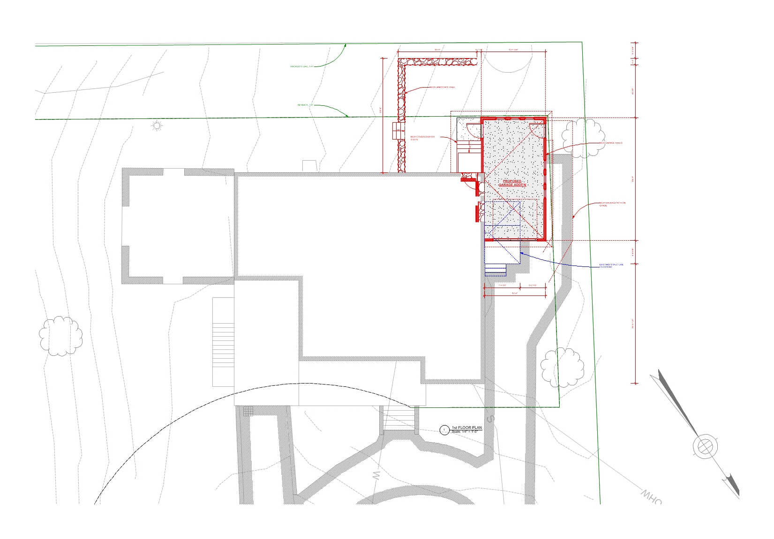
Garage Addition Project for Amanda Mahoney
12 Lake Terrace
Newton, MA 02459

Slide 3
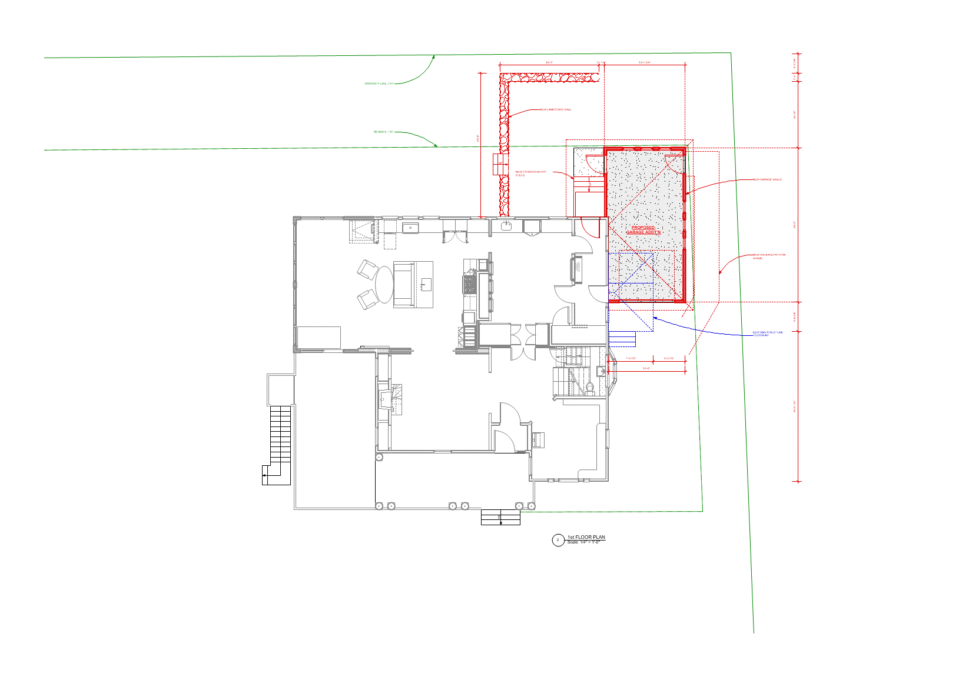
Garage Addition Project for Amanda Mahoney
12 Lake Terrace
Newton, MA 02459

Slide 4
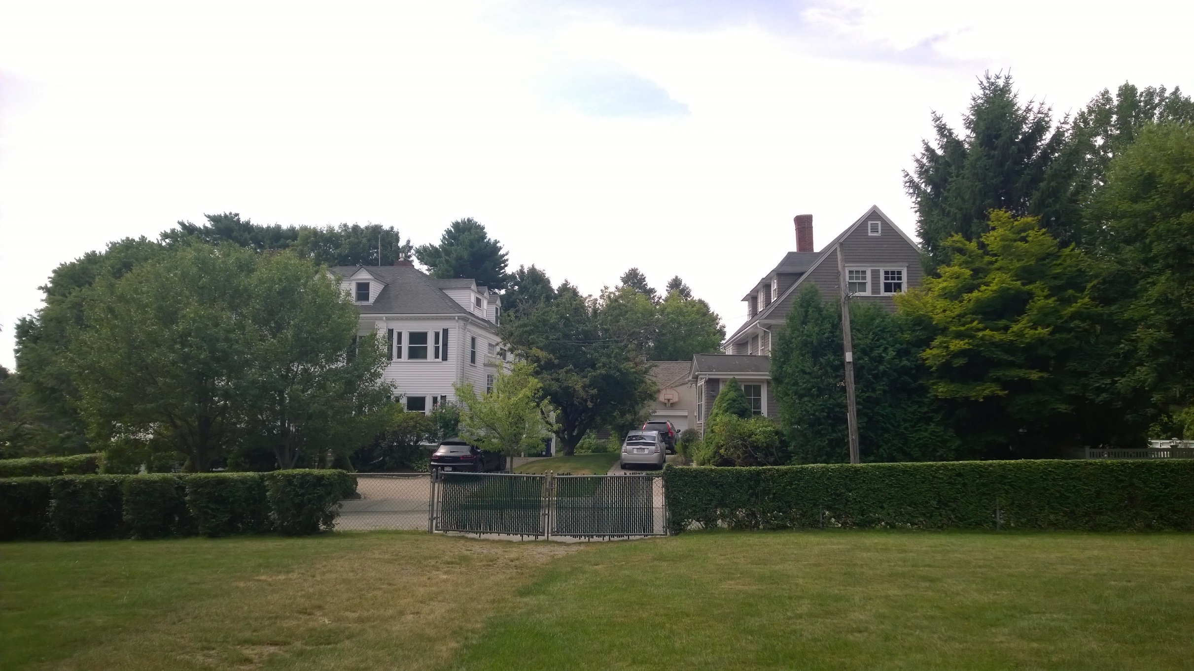
Existing Structure
View From Lake Terrace

Slide 5
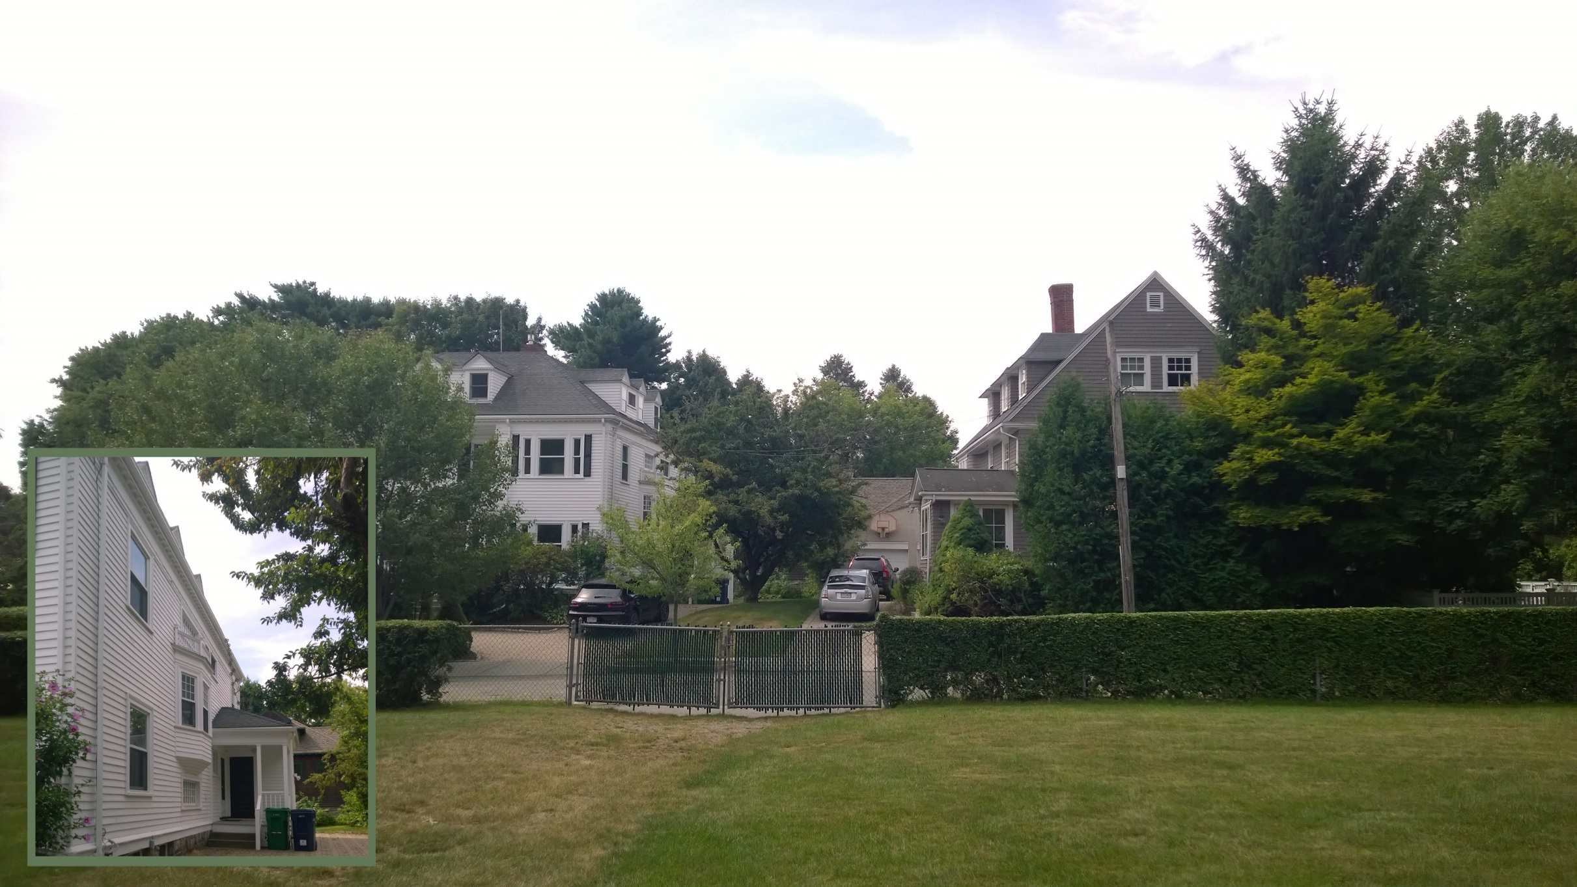
Existing Structure
View From Lake Terrace

Slide 6
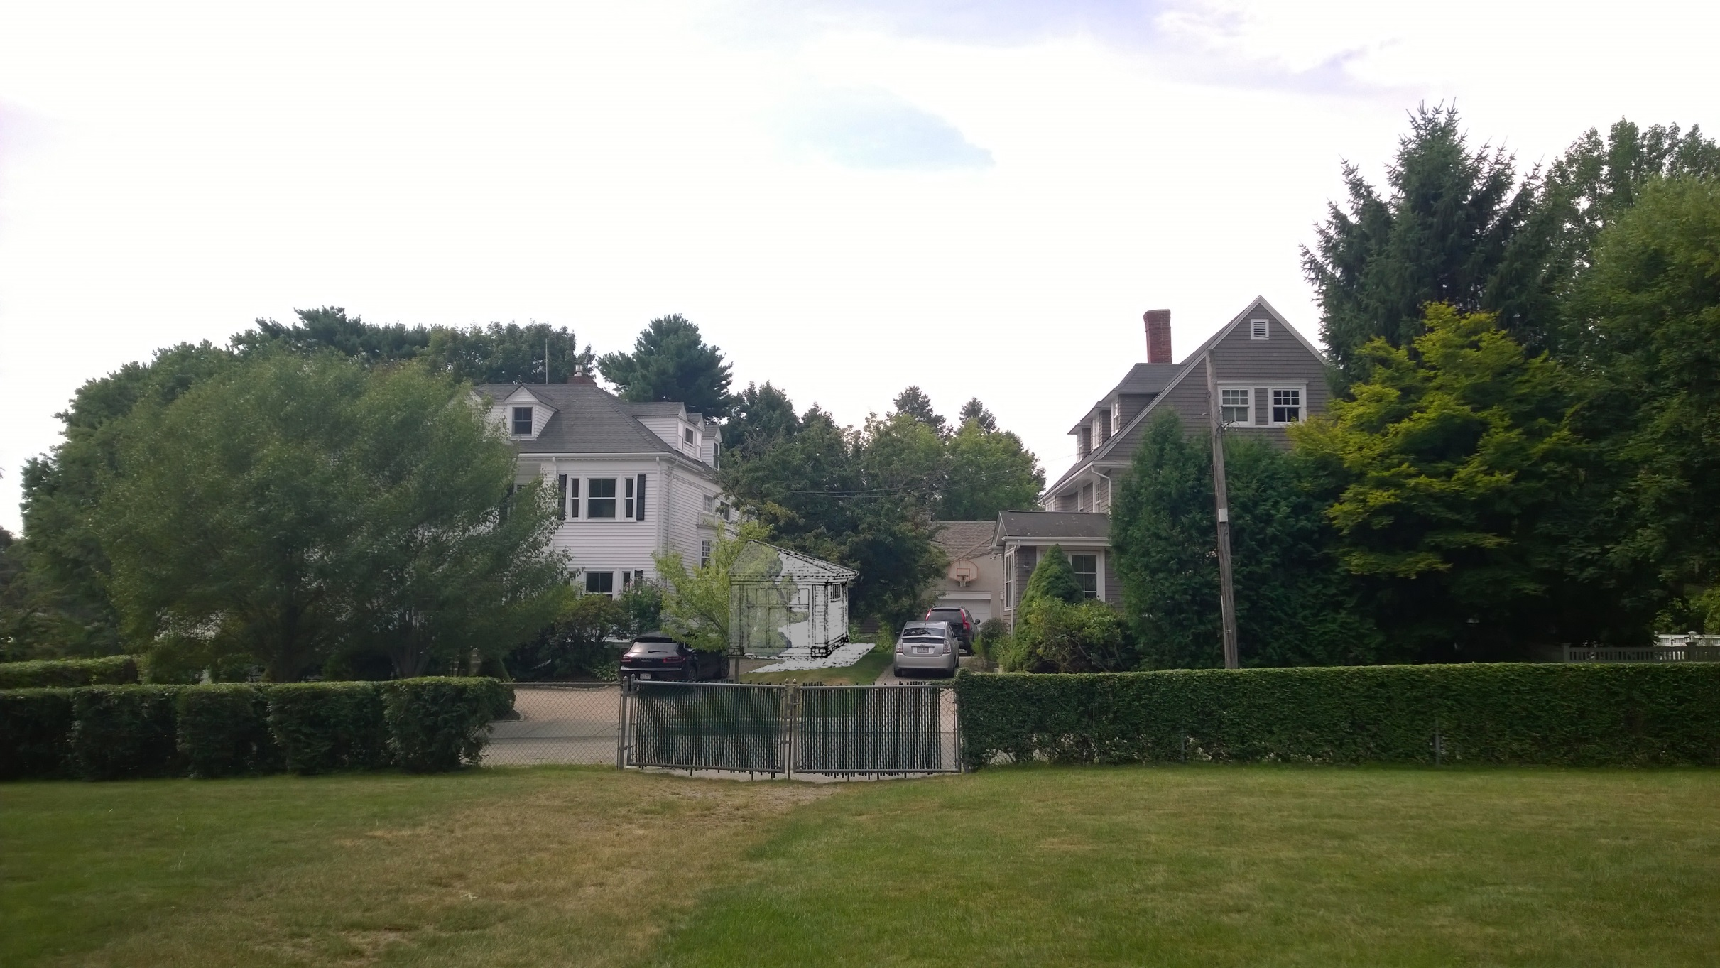
Proposed New Structure
View From 160 Lake Avenue

Slide 7
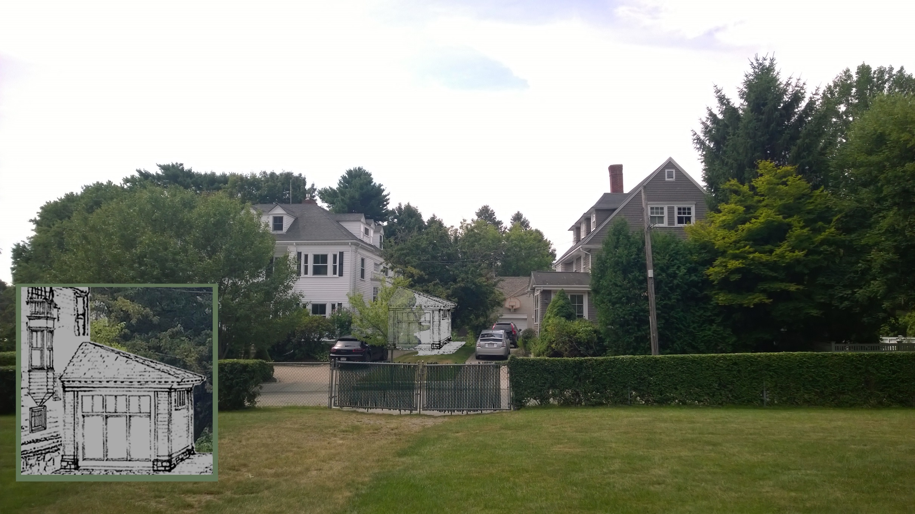
Proposed New Structure
View From Lake Terrace

Slide 8
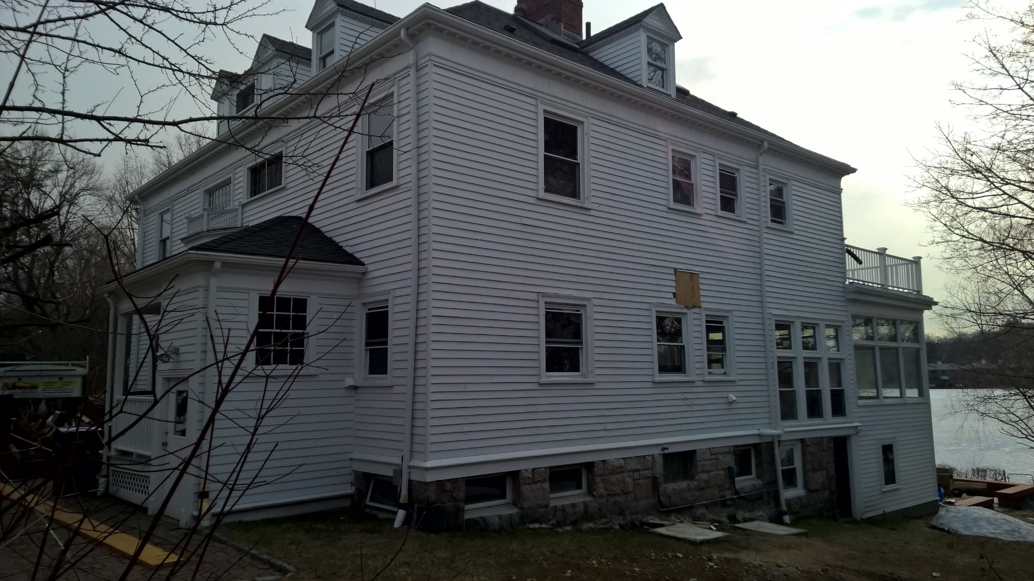
Existing Structure
View From 160 Lake Avenue

Slide 9
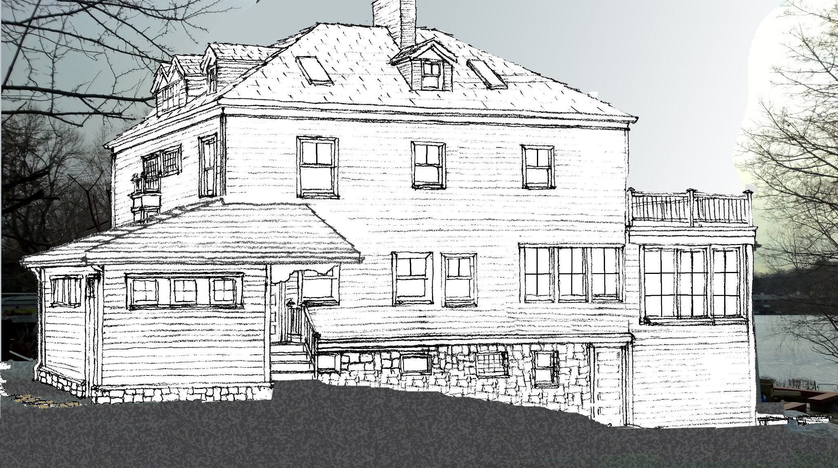
Proposed New Structure
View From 160 Lake Avenue

