Slide 1
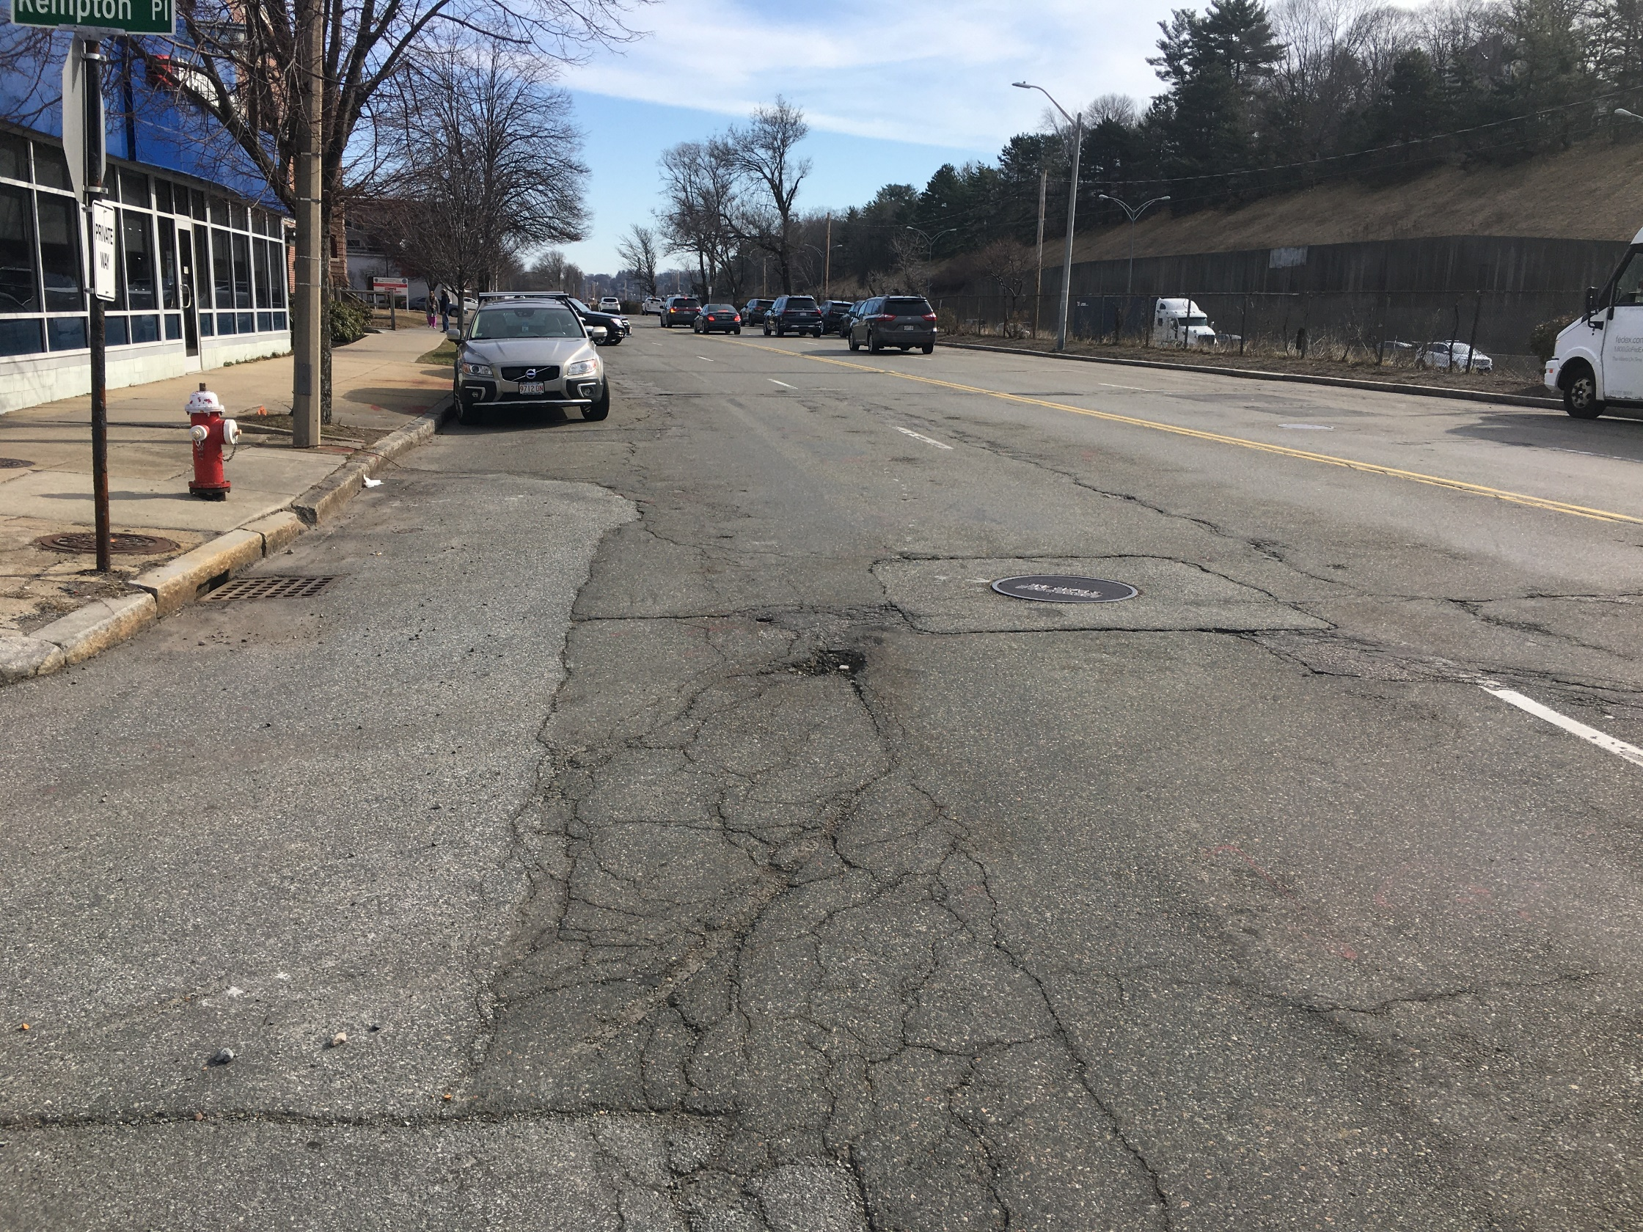
The Dunstan Residences
West Newton Redevelopment
Transportation
Peer Review
City of Newton
Newton City Hall
June 28, 2021

Slide 2
Peer Review Presenter
Jeff Maxtutis, Project Manager, Transportation Planner, BETA Group, Inc.

Slide 3
Peer Review Process
Reviewed:
Transportation Impact and Access Study – April 2021, VHB, Inc.
Site Plans – April 8, 2021, VHB, Inc.
Program Modification Trip Generation Memo – June 3, 2021, VHB, Inc.
Focus of review is on proposed Building #3
Presentation on outstanding comments

Slide 4
Peer Review Process
Review included:
Traffic data/analysis
Pedestrian & Bicycle
Transit
Parking
Internal Circulation
Loading & curbside activity
Transportation Demand Management (TDM)
Consistency with Zoning and Newton Street Design Guide
Overall, the study met state and industry professional practice standards

Slide 5
Project Program Changes
Proposed Changes in Building Program
Land Use | Approved Building Programª | April 2021 Updated Building Program | Change in Building Program
Residential | 234 units | 302 units | +68 units
Retail | 8,318 sf | 5,821 sf | -3,823 sf
Parking | 294 spaces | 338 spaces | +44 spaces
ª Building Program approved in July 2020.

Slide 6
Traffic

Slide 7
Trip Generation Changes
Net New Vehicle Trips
Net New Project-Generated Trips | Weekday AM Peak Hour | Weekday PM Peak Hour | Saturday Midday Peak Hour
2020 Building Program | 167 | 82 | 53
Revised Building Program | 181 | 88 | 56
Difference | +14 | +6 | +3

Slide 8
Traffic
Proposed Signal Timing Adjustments
Washington Street/Prospect Street – Weekday Evening
Washington Street/I-90 Eastbound On-Ramp – Weekday Evening
Washington Street/Elm Street – Weekday Morning
Washington Street/Lowell Avenue – Weekday Evening
Washington Street/Walnut Street – Weekday Morning
Watertown Street/Albemarle Street Southbound – Weekday Morning
Watertown Street/Albemarle Street Northbound – Weekday Evening
Provide Signal Timing adjustments for both the AM and PM peak periods for the seven intersections listed above and the intersection of Washington Street and Auburn Street which experiences an overall LOS F during the weekday evening peak.

Slide 9
Retail Sensitivity Analysis Conditions
June 21, 2021 Memorandum by Applicant
Proposed increase in retail from 5,821 SF to 7,771 SF (+1,950 SF)
No more than 8 additional vehicle trips during peak hours
No significant impact

Slide 10
Parking, Access, Circulation & Loading

Slide 11
Project Parking
Project Parking Summary
Project Element | Garage Spaces | Surface Spaces | Total
302 Residential Units | 302 (70 Building 3) | 0 | 302
Commercial and Residential Visitor | 20 | 16 | 36
Total | 322 | 16 | 338

Slide 12
Project Parking
Proposed 1.0 space per dwelling unit consistent with MBTA/MassDOT TOD guidelines and MAPC Metro Boston Perfect Fit Parking Initiative recommendations
Commercial Use: 113 parking spaces required per Newton Zoning Ordinance; 36 spaces proposed
Waiver of 77 spaces required, Applicant to update with additional 1,950 SF retail

Slide 13
Project Parking
Need additional information on parking:
Will 36 spaces for commercial use be shared with residential visitor use? Where, when and how?
Will proposed increase in retail space by 1,950 SF require additional parking spaces?
Will 16 parking spaces on Kempton Place be available for both retail and visitor use?
Need to designate one of the spaces as handicapped parking.

Slide 14
Parking
Provide dimensions and number of Compact parking spaces
Dimensional waivers required for:
Parking aisle width of 22 feet (24 required)
Parking stalls are 18 feet long (19 feet required)

Slide 15
Site Access, Circulation, Loading
How and where will loading and deliveries be handled for Building 3 from both Kempton Place and Washington Street?

Slide 16
Pedestrians, Bicycles, and TDM

Slide 17
Pedestrians and Bicyclists
Provide detectable warning panels across project driveways on Dunstan Street and Kempton Place
Confirm number of bicycle parking spaces in garages and on-street
Applicant should construct the sidewalk on the north side of Washington St. along project frontage with bicycle facilities consistent with Washington Street Vision as directed by the City Engineer

Slide 18
Potential TDM Mitigation
Transportation Demand Management (TDM) Program Elements
TDM Coordinator
Rideshare options
Information center
Hosting events
Monitor TDM effectiveness through surveys and counts
Report results to City
Indoor/outdoor bike parking
Bike-sharing
EV charging and parking
Unbundling parking costs from leases

Slide 19
Potential TDM Mitigation
Additional TDM Measures to Consider:
Will car-sharing be provided in Building 3?
Is a public transportation reimbursement included in the TDM plan for Building 3 residents?
Are bike racks proposed on Washington Street along the Building 3 frontage?
Will a bike share station be provided?
How many EV charging stations will be provided in Building 3? ..

Slide 20
Thank You

