Slide 1

Existing Conditions
Multiple business and residents
Multiple Curb-cuts; 8 on Washington today along property
On-street parking along north and south sides of Washington street in this area
Sidewalk along North Side of Washington Street along entire frontage but in poor condition in places
Watertown Street
The Barn
Trader Joe’s
Washington Street
Armory

Slide 2
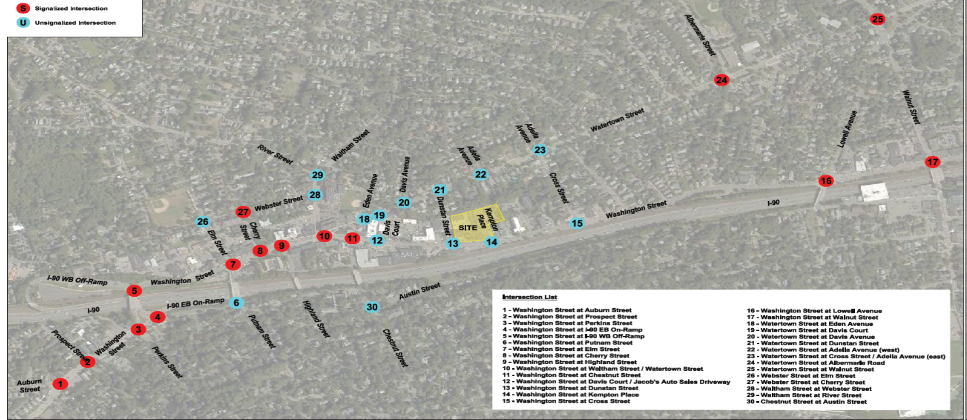
Project Study Area
30 Study area intersections
15 Signalized (red)
15 Unsignalized (blue)
Multiple business and residents
Multiple Driveways 8 on Washington today along property
On-street parking along north and south sides of Washington street in this area
Sidewalk along North Side of Washington Street along entire frontage but in poor condition in places
Watertown Street
The Barn
Trader Joe’s
Washington Street
Armory

Slide 3
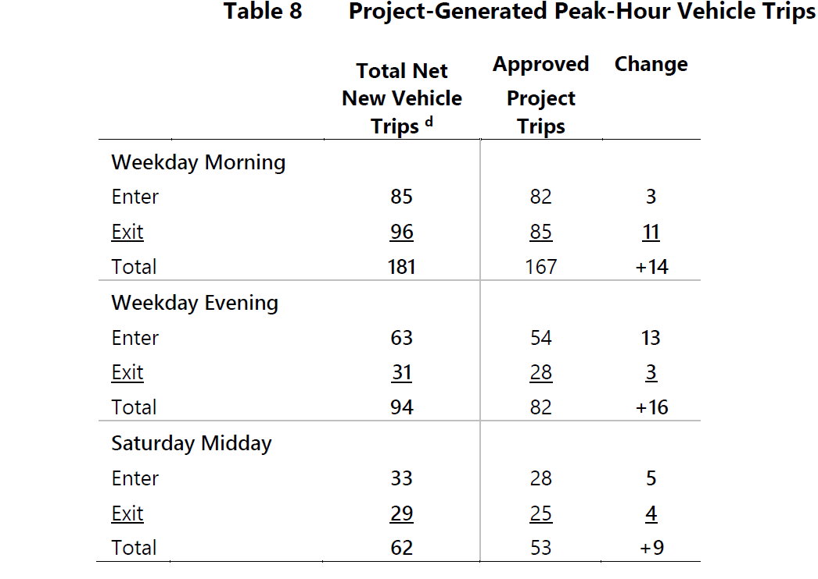



Traffic Generation
Based on Standard Procedures of the Institute of Transportation Engineers, ITE Trip Generation Manual (10th Edition)
LUC 221 (Mid rise residential 302 units)
LUC 820 (Shopping Center for 7,771 sf)
Use of LUC 820 Shopping Center for retail is a highly conservative approach likely overstating actual traffic generation
Watertown Street
The Barn
Trader Joe’s
Washington Street
Armory

Slide 4
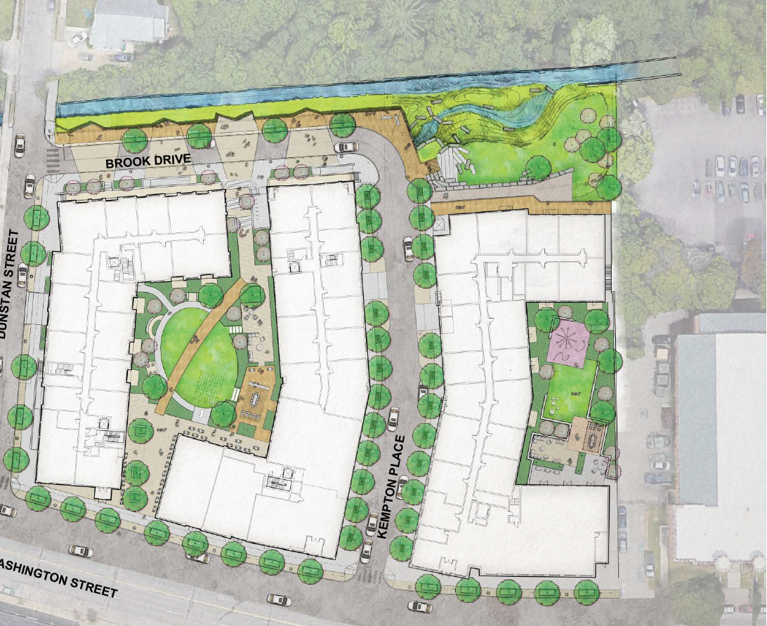
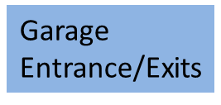
Proposed Conditions
Curb cut Consolidation from 8 along Washington Street to 2 roadways (Dunstan/Kempton)
Improved sidewalk along Washington Street frontage with ADA compliant crosswalks.
Three Garage access Points; 2 on Kempton and 1 on Dunstan
On-Street parking along Kempton Place
340 Parking Spaces on site with additional unmetered parking along both sides of Wash Street
Multiple business and residents
Multiple Driveways 8 on Washington today along property
On-street parking along north and south sides of Washington street in this area
Sidewalk along North Side of Washington Street along entire frontage but in poor condition in places
Watertown Street
The Barn
Trader Joe’s
Garage Entrance/Exits
Washington Street
Armory

Slide 5
Proposed Improvements
Multiple business and residents
Multiple Driveways 8 on Washington today along property
On-street parking along north and south sides of Washington street in this area
Sidewalk along North Side of Washington Street along entire frontage but in poor condition in places
Watertown Street
The Barn
Trader Joe’s
Washington Street
Armory

Slide 6
Traffic Demand Management (TDM)
Transportation Coordinator; Coordinates and Manages program
Bus and Commuter Rail available in the immediate area and use will be encouraged
Bike and Pedestrian environment enhancements are proposed to encourage activity
Care pool/Rideshare with guaranteed ride home
Shared parking for all uses
Bicycle storage with fix-it station for residents
Consistent with Washington Street Vision Plan which focuses on converting Wash Street corridor into a “dense, walkable neighborhood and transferring the roadway from high-speed throughway into local neighborhood street”.
Watertown Street
Trader Joe’s
Washington Street
Armory

