Slide 1
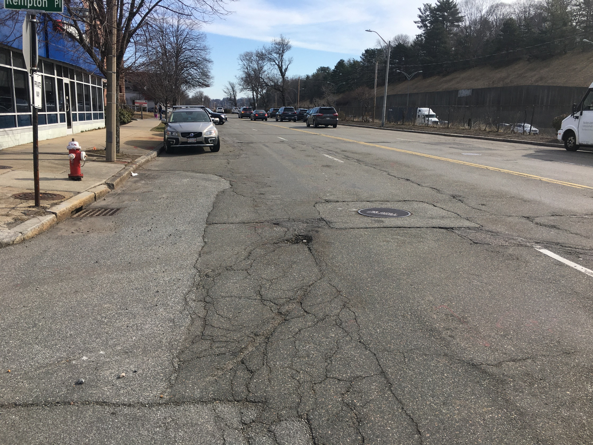
The Dunstan Residences
West Newton Redevelopment
Transportation
Peer Review
City of Newton
Newton City Hall
August 9, 2021

Slide 2
Peer Review Presenter
Jeff Maxtutis, Project Manager, Transportation Planner, BETA Group, Inc.

Slide 3
Peer Review Process
Reviewed:
Response to Comments Memo – July 15, 2021, VHB, Inc.
Transportation Demand Management Memo – July 16, 2021, VHB, Inc.
Revised Site Plans – July 20, 2021, VHB, Inc.
Revised Commercial Use Parking Calculations – July 21, 2021, Applicant
BETA submitted Memo - August 2021

Slide 4
Remaining Issues

Slide 5
Bicycle Parking
Comment 5.5
The number of parking spaces noted in the response to comments does not match those shown in the site plan. Please clarify
The project proposes 44 outdoor bike parking spaces for visitors along Washington Street. These spaces should be weatherproof and secure.

Slide 6
Washington Street Bicycle Lane Parking
Comment 5.6
Will the Applicant commit to construction of a protected bicycle lane if the City’s Washington Street design is approved before construction of the proposed project?

Slide 7
Washington Street Loading/Delivery
Comment 5.10
The Applicant should provide all accessible spaces and loading areas on their site to ensure that sufficient accessible spaces and loading areas will be provided on site regardless of the Washington Street design

Slide 8
Project Parking
Comment 5.12
Recommend the 38 commercial/visitor spaces be combined for shared use parking (27/11)
Provide shared parking information based on other comparable site(s) that demonstrate the amount of proposed parking for commercial and visitors is adequate
Proposed 16 on-street spaces on Kempton Place. 22 spaces will need to be designated in the garage for commercial/visitor use (38-16)
Indicate locations and access/management of these spaces. Provide wayfinding signage

Slide 9
Project Parking
Comment 5.12 Continued
Employee parking should be marked by signs and shown in the plans
The proposed pick-up/drop-off zone should not be shared with parking during off-hours; and therefore, should not be included as part of the parking supply
Show areas on the plan where residents would park to move-in/move-out

Slide 10
Project Parking
Comment 5.18
The revised site plan shows two proposed accessible spaces on Washington Street which would be pending until final design of Washington Street is completed. Recommend that the Applicant provide all accessible spaces and loading areas on their site. The accessible spaces should be located on Kempton Place.

Slide 11
Thank You

Slide 12
Project Parking
Project Parking Summary
Project Element | Garage Spaces | Surface Spaces | Total
302 Residential Units | 302 (70 Building 3) | 0 | 302
Commercial and Residential Visitor | 22 | 16 | 38
Total | 324 | 16 | 340

Slide 13
Potential TDM Mitigation
Transportation Demand Management (TDM) Program Elements
TDM Coordinator
Rideshare options
Information center
Hosting events
Monitor TDM effectiveness through surveys and counts
Report results to City
Indoor/outdoor bike parking
Bike-sharing
EV charging and parking
Unbundling parking costs from leases

