Slide 1
Building 3: 2021 Modifications
Footprint of Building 3 expanded to Washington Street.
Sixth story added for a portion of the structure.
Private courtyard for Building 3 has expanded, open to residents only.
35 Feet of Building 3 frontage converted to retail on Washington Street.
Retail space is amenity driven – café, small scale fitness.
Richmond
Square
Dunstan East Peer Review
August 9, 2021

Slide 2
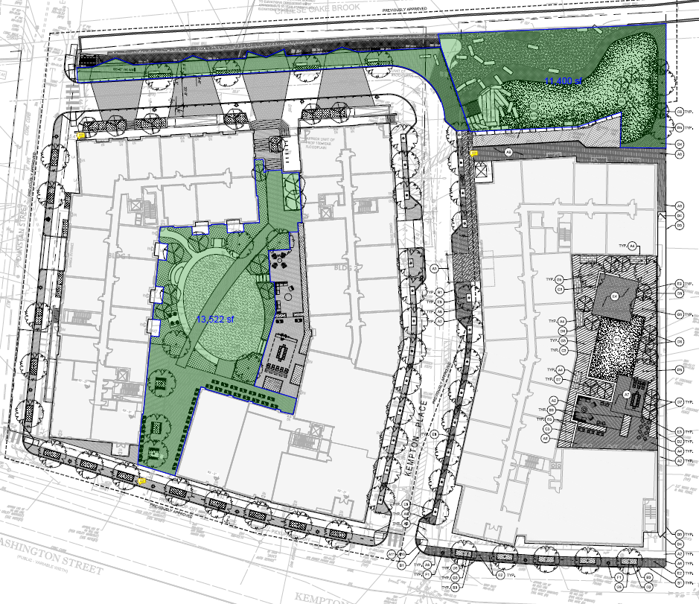
Site Plan & Open Space
Site Plan, massing, and building heights are generally consistent with the Vision Plan principles:
Project within “Medium Heights – Village Character” on Vision Plan.
Proposed buildings generate sense of enclosure and comfortable pedestrian environment.
Richmond
Square
Dunstan East Peer Review
August 9, 2021

Slide 3
Building 3: 2021 Modifications
Latest May 27, 2021 plans include:
6th level extended 122 feet towards Cheesecake Brook.
Portions of 5th and 6th levels set back from Kempton Place.
6th level steps back 30 feet at Cheesecake Brook.
Washington Street massing to step down from 6 levels to 4 levels at east property line.
Additional massing variations provided along Kempton Place.
Richmond
Square
Dunstan East Peer Review
August 9, 2021

Slide 4
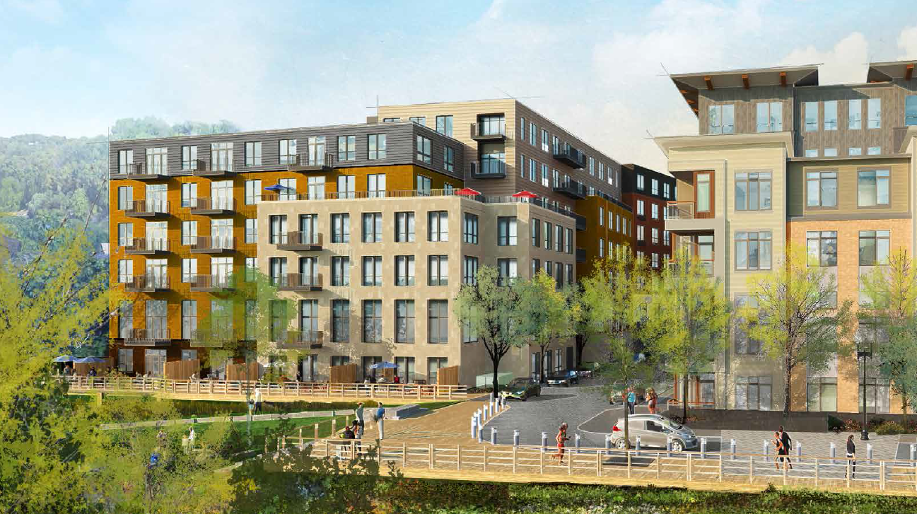
Proposed Building 3 and Brook Drive
Richmond
Square
Dunstan East Peer Review
August 9, 2021

Slide 5
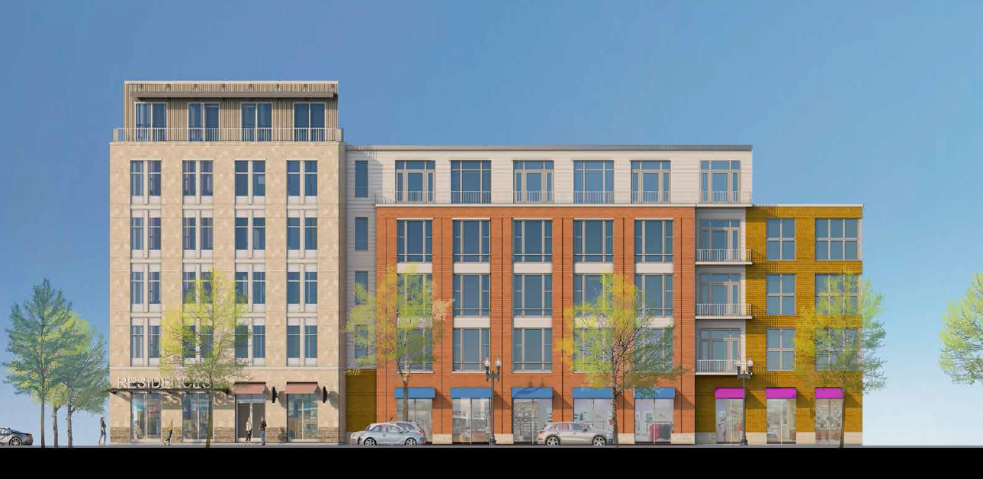
Proposed Building 3 and Washington Street
Richmond
Square
Dunstan East Peer Review
August 9, 2021

Slide 6
Site Plan & Open Space
Design includes public passage between Buildings 1 and 2 and via Kempton Place and Brook Drive - promotes small blocks.
Changes to building 3 shift massing from Washington Street edge down Kempton Place. Strategically incorporates setbacks to reduce
building height at street level. Consistent with Vision Plan and an improvement over previous design.
Transition from 6 levels to 4 levels at east property line provides gradual transition to adjacent neighborhood.
The Petitioner continues to incorporate strategies to breakdown the massing.
Richmond
Square
Dunstan East Peer Review
August 9, 2021

Slide 7
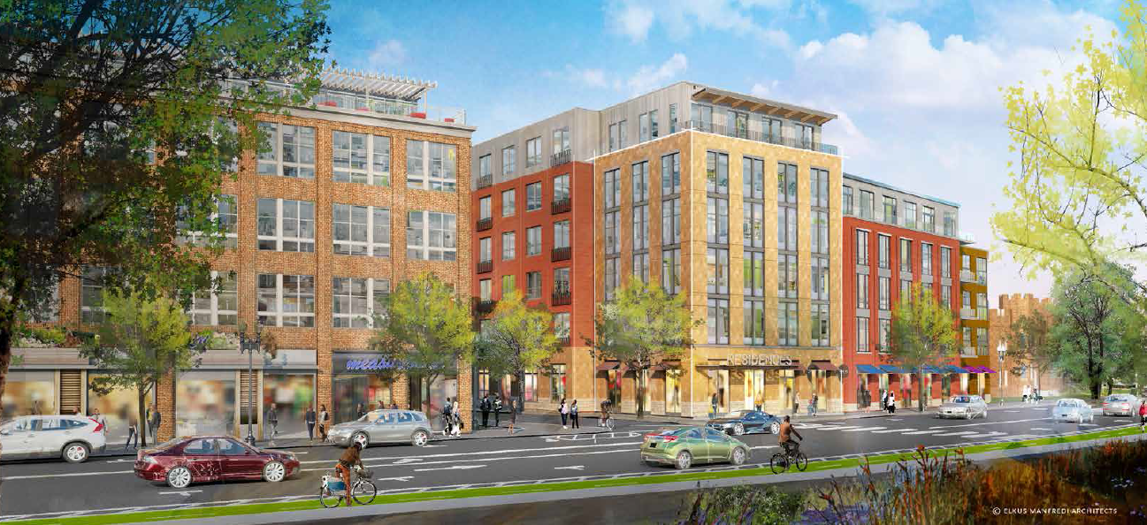
Proposed Building 3 and Washington Street
Richmond
Square
Dunstan East Peer Review
August 9, 2021

Slide 8
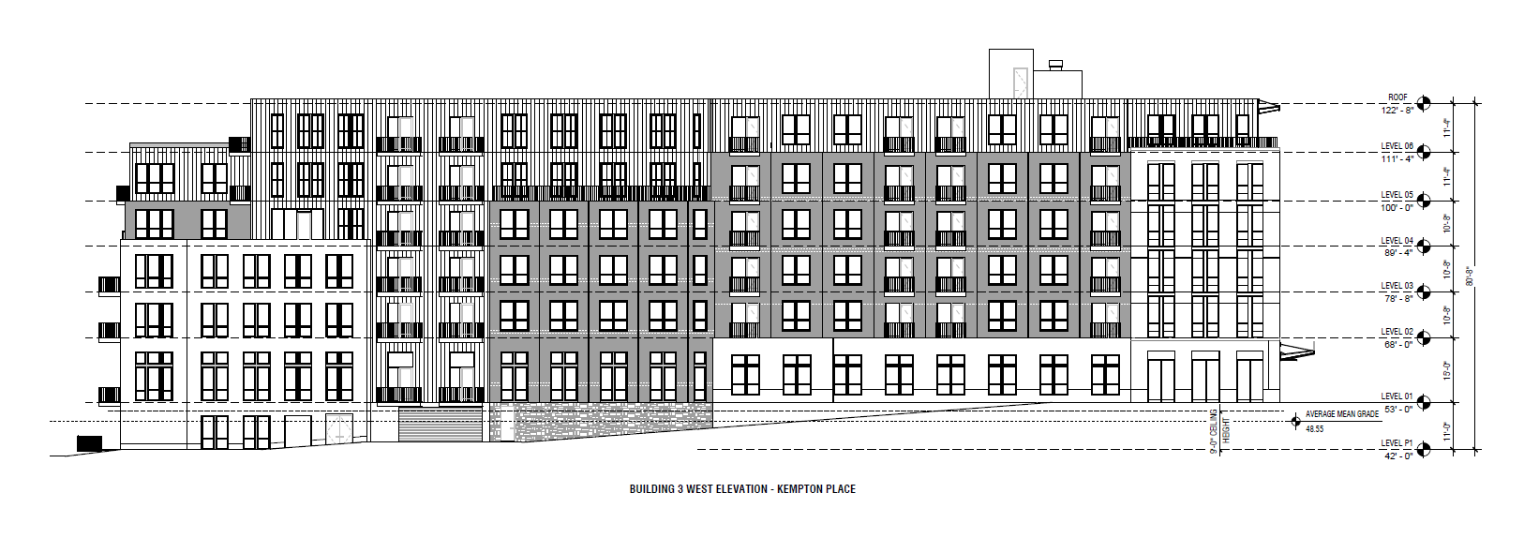
Building 3 Elevation – Kempton Place
Richmond
Square
Cheesecake
Brook
Washington St.
Dunstan East Peer Review
August 9, 2021

Slide 9
Shadow Study
March 21st and September 21st
Impacts of new shadows minimal to adjacent properties.
Morning shadow Dunstan Street until ~ 10:30.
Afternoon shadow Armory property beginning ~ 2:30.
Cheesecake Brook open space in shadow much of day.
December 21st
Impacts on adjacent properties within accepted tolerances.
Building 3 Courtyard in full shadow majority of day.
If buildings or open space change mitigating factors should be reviewed:
Setbacks upper stories
Building alignment
Richmond
Square
Dunstan East Peer Review
August 9, 2021

