Slide 1
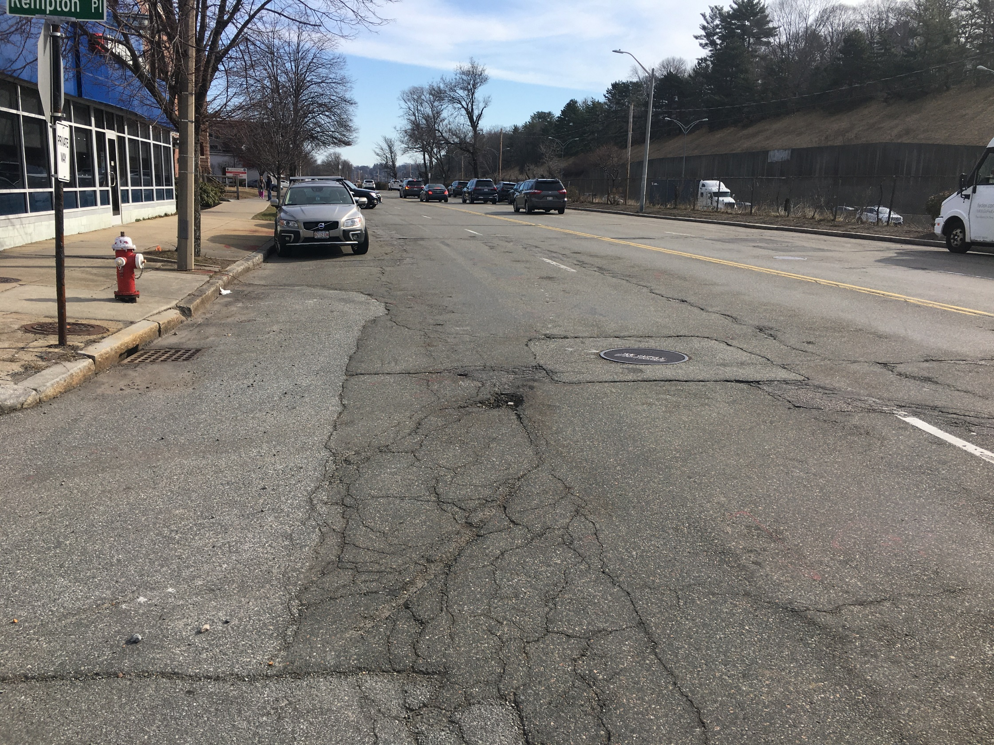
The Dunstan Residences
West Newton Redevelopment
Transportation
Peer Review
City of Newton
Newton City Hall
September 9, 2021

Slide 2
Peer Review Process
Reviewed:
Response to Comments Memo – August 17, 2021, VHB, Inc.
Response to Comments Memo – August 30, 2021, Applicant
BETA submitted Memo - September 2021

Slide 3
Remaining Issues

Slide 4
Loading/Delivery and Accessible Spaces
Comments 5.10 & 5.18
The Applicant should provide accessible spaces and loading areas on their site to ensure that sufficient accessible spaces and loading areas will be provided on site regardless of the Washington Street design
Consider relocating loading zone on the west side of Kempton Place to the east side near Washington Street to better serve Building 3
Applicant to coordinate with AAB if request for accessible parking on Washington Street is not approved by Traffic Council

Slide 5
Project Parking
Comment 5.12
Provide shared parking information based on other comparable site(s) that demonstrate the amount of proposed parking for commercial and visitors is adequate
Trio and The Merc (Waltham) developments reviewed

Slide 6
Parking
Parking Comparison
Project | Residential Ratio | Commercial Ratio
Dunstan 302 DUs 7.7 KSK Commercial | 1 space/DU | 3.5 spaces/KSF
Trio 131 DUs 41.9 KSF Commercial | .94 space/DU | 3.2 spaces/KSF
The MERC (Waltham) 269 DUs 27.6 KSF Commercial | 1.1 spaces/DU | 3.3 spaces/KSF

Slide 7
Thank You

Slide 8
Project Parking
Project Parking Summary
Project Element | Garage Spaces | Surface Spaces | Total
302 Residential Units | 302 (70 Building 3) | 0 | 302
Commercial and Residential Visitor | 22 | 16 | 38
Total | 324 | 16 | 340

Slide 9
Potential TDM Mitigation
Transportation Demand Management (TDM) Program Elements
TDM Coordinator
Rideshare options
Information center
Hosting events
Monitor TDM effectiveness through surveys and counts
Report results to City
Indoor/outdoor bike parking
Bike-sharing
EV charging and parking
Unbundling parking costs from leases

