Slide 1
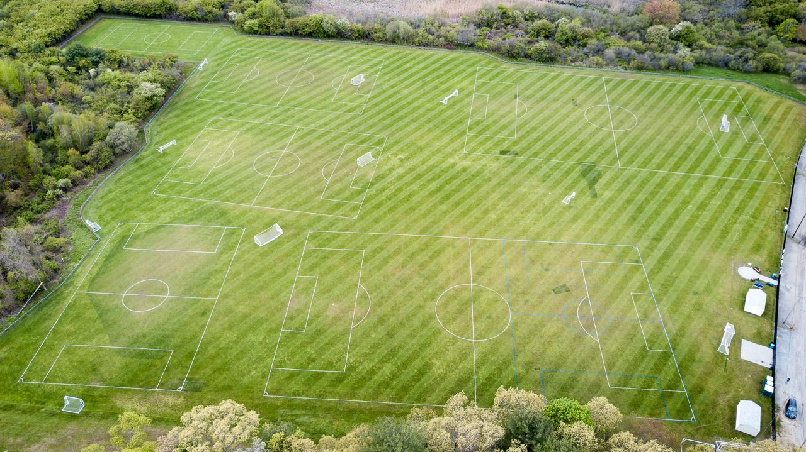
Newton Parks, Recreation & Culture Department
Athletic Fields Improvement Plan
Community Meeting # 1
McGrath Park @ Warren House +
Albemarle Park
October 20th, 2021
athleticfields@newtonma.gov
Merchant Road Fields, Framingham – Example of quality grass turf fields

Slide 2
AGENDA
1
Athletic Fields Projects Overview
2
McGrath Park @ Warren House Presentation
3
McGrath Park @ Warren House Listening + Discussion
4
Albemarle Park Presentation
5
Albemarle Park Listening + Discussion
Notes:
Agenda slide

Slide 3
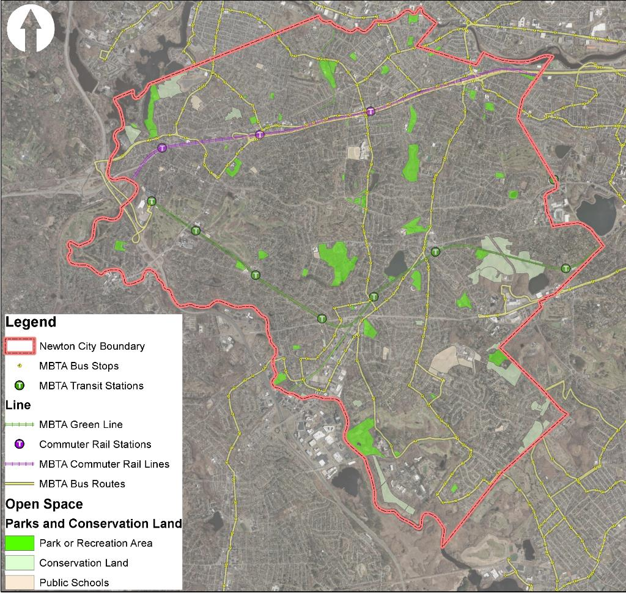
Newton Parks, Recreation and Culture Department
Athletic Fields Capital Improvement Plan
Parks, Recreation & Culture Overview:
Manage and oversee nearly 600 Acres of park land with varying recreational interests including:
  Aquatic facilities
  Tracks + fields
  Trails, pathways + safe routes to schools
  Playgrounds + tot Lots
  Field houses + community centers
  Hard courts
  Passive areas
  Outdoor exercise equipment
  Wooded areas
  Outdoor challenge courses
  Dog parks
  Splash pads
  Historic significance
  Wetlands and waterways
Spread across all Villages, Wards + School zones
Charles River.
Charles River.
Mass Pike/Washington St.
Walnut St.
Centre St.
Comm. Ave.
Beacon St.
Rt. 9
City of Newton Park Land Distribution

Slide 4
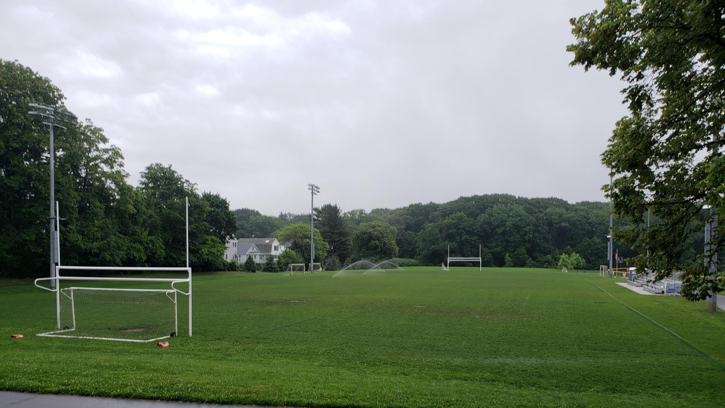
Why improve athletic fields?
Notes:
Here’s the agenda for today’s discussion

Slide 5
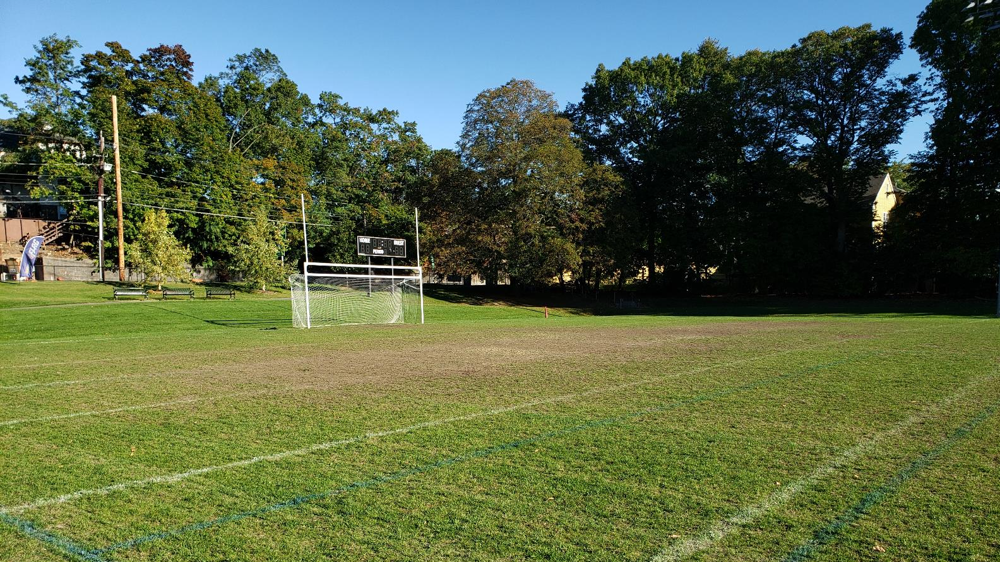
Current facilities experience little to no rest time and are overused
Notes:
Here’s the agenda for today’s discussion

Slide 6
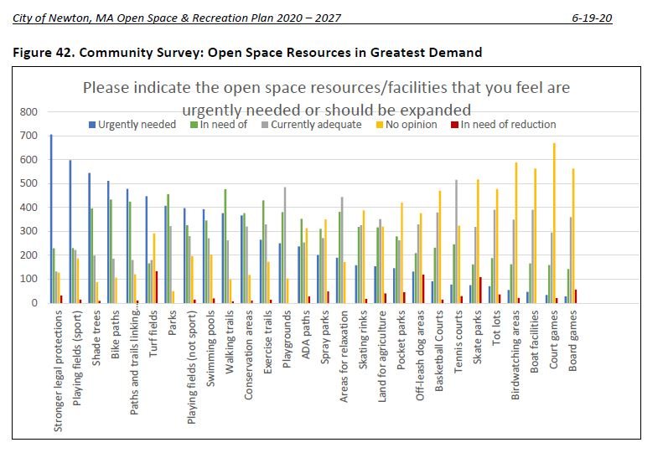
Community Survey (Open Space + Recreation Plan)

Slide 7
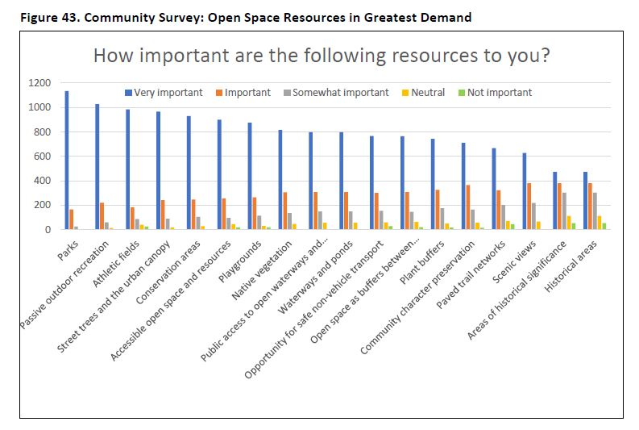
Community Survey (Open Space + Recreation Plan)

Slide 8
    Field + Park Improvement Goals
      Improve quality and quantity of usable multiuse/multipurpose fields
      Improve accessibility in park and field amenities
      Establish standardized park CONSTRUCTION details to better manage operation & maintenance POST CONSTRUCTION
      Invest equitably in Newton’s Athletic Fields + Parks across the city

Slide 9
How did we prioritize field improvements?
Notes:
Here’s the agenda for today’s discussion

Slide 10
    Prioritization Criteria
      Open Space & Recreation Plan
      City of Newton Capital Improvement Plan (CIP)
      Potential for greatest city-wide benefit
      Project sequencing: prioritize new fields being brought online first
      Potential for expansion of multiuse fields
      Expanding evening play (light improvements/ additions)
      Player safety
      Integrated with other projects in a park area (e.g., path at McGrath, Gath Pool Project)

Slide 11
How do we arrive at a viable project design?
Notes:
Here’s the agenda for today’s discussion

Slide 12
Safety +
Regulatory
Guidelines
Project
Goals
Community
Input
Parks, Recreation
& Culture
Goals
Notes:
Here’s the agenda for today’s discussion

Slide 13
Newton Parks, Recreation and Culture Department
Athletic Fields Capital Improvement Plan
Phase 1 Capital Project Distribution:
Albemarle Park/ Russ Halloran Sports and Recreation Complex
Forte Park
Burr School
Brown/Oak Hill Fields
McGrath Park
Bobby Braceland
TOTAL: 6 Sites
Forte
Albemarle
Burr
School
Mass Pike/Washington St.
McGrath
Walnut St.
Centre St.
Comm. Ave.
Beacon St.
Rt. 9
BOH
Braceland
Athletic Field Capital Project Distribution

Slide 14
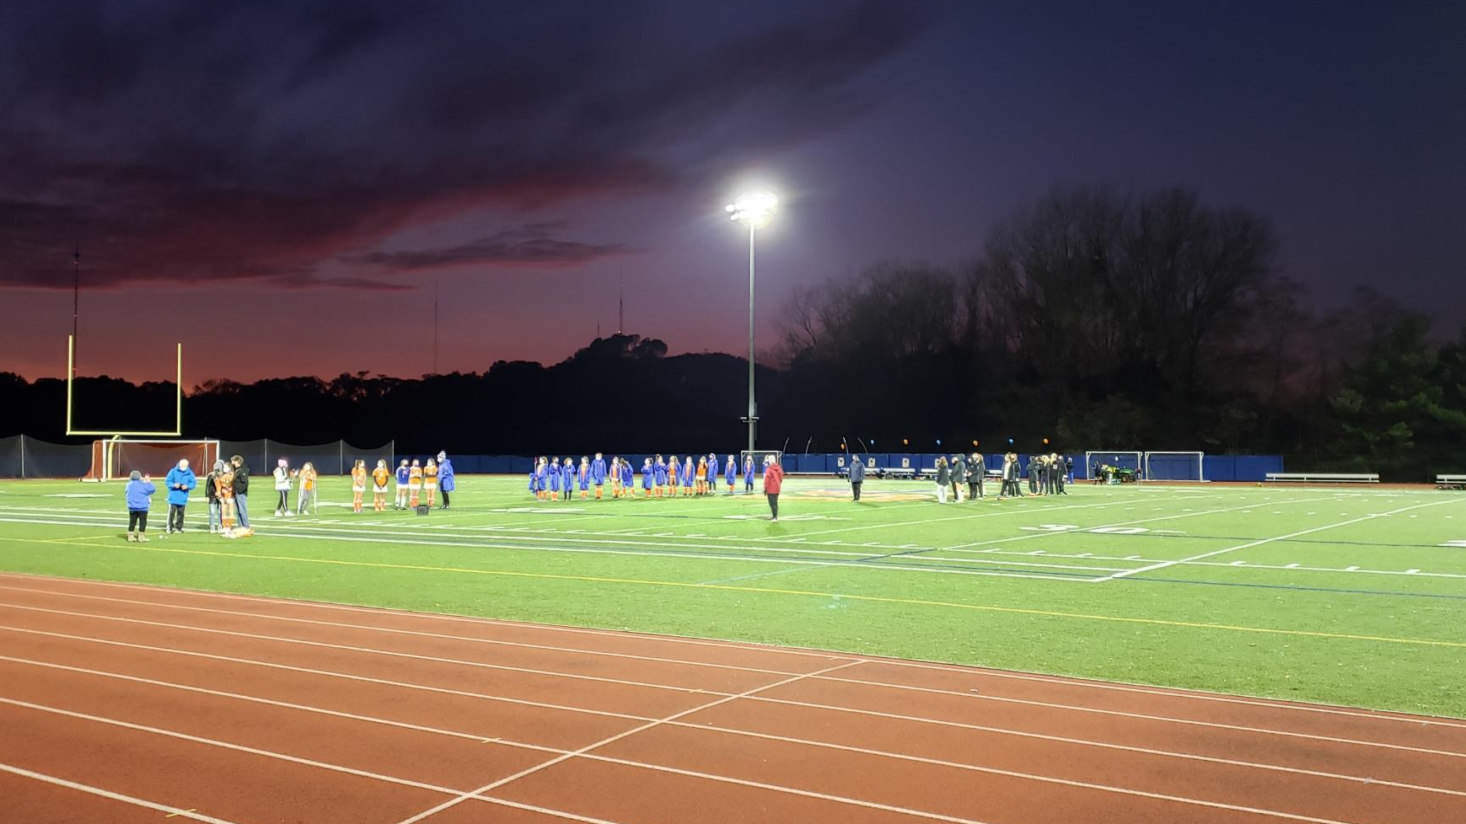
Additional Athletic Field Projects in the works:
  NNHS Tiger Stadium: High efficiency, low spillage Sports Lighting project (FY 23)
  NSHS Winkler Stadium & Brandeis Rd. Field: Artificial turf carpet replacement (FY 23)
  NSHS Brandeis Road Field: High efficiency, low spillage Sports Lighting project (FY 23)
  NNHS: Tiger Stadium: Artificial turf carpet replacement (FY 25)
  Forte Park: Developer-funded sports relighting (TBD)
  Increased Maintenance: additional seeding, fertilizing, and aeration, etc.

Slide 15
CITY OF NEWTON ATHLETIC FIELDS MAINTENANCE BUDGET IMPROVEMENTS
      Increase athletic field maintenance capabilities
      Increase scope of contractual maintenance work
      Significantly increase turf management capabilities

Slide 16
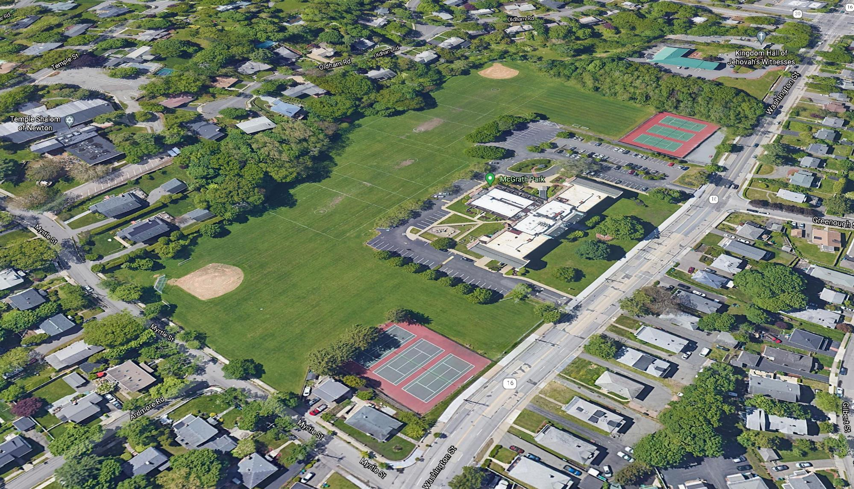
McGrath Park @ Warren House

Slide 17
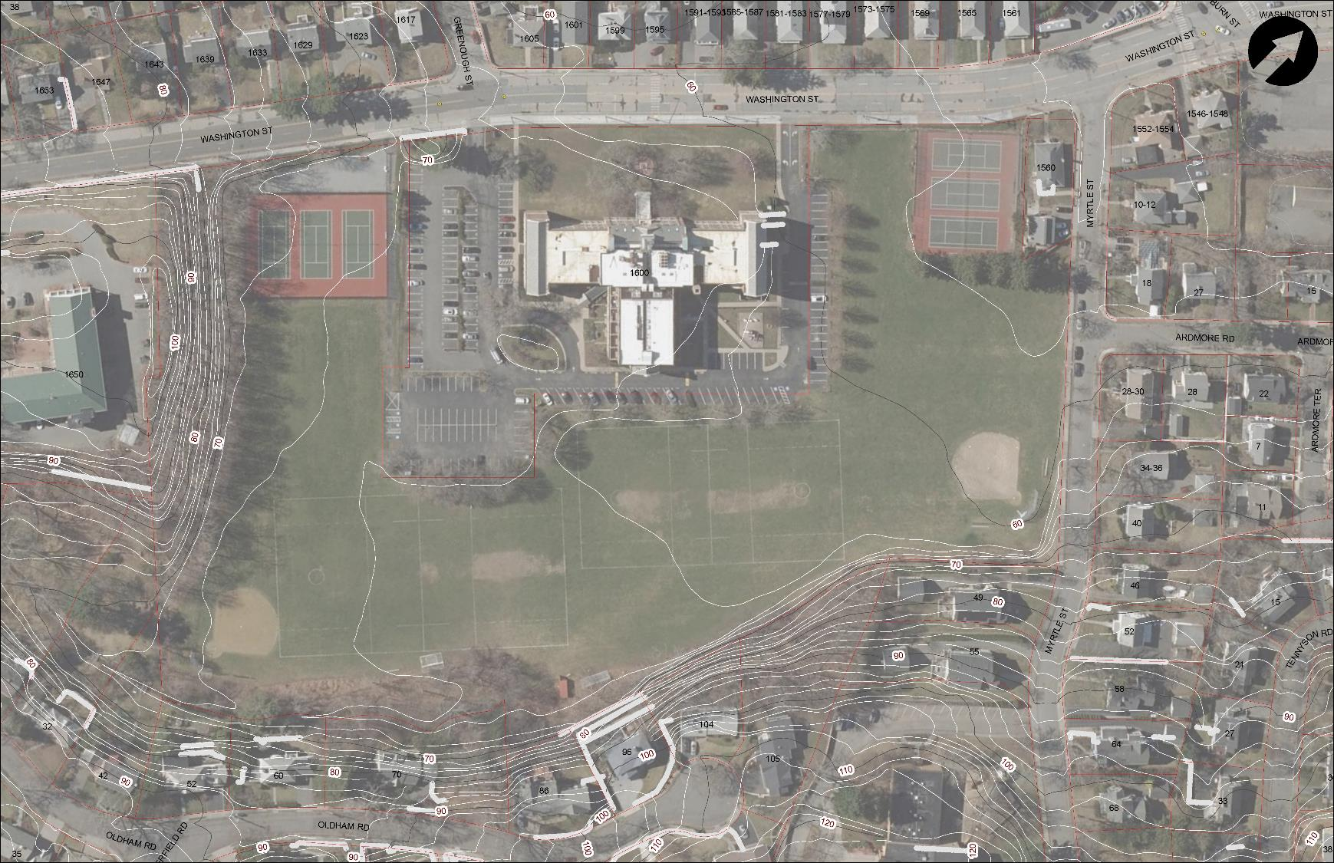
  Richard J. McGrath Park
  10.1 ACRES
  Ward: 3
  Village: West Newton
Existing Amenities
2 softball diamonds
59 Parking spaces (3 ADA)
6 tennis courts
off leash dog area
irrigated
1 - Boys Lacrosse (with safety conflicts due to topography)
1 – Intermediate rectangular fields per site allows
Unusable field area
Parking
Player safety issues
Use Conflict
  McGrath
  Park

Slide 18
McGrath Park Fields Key Athletic and Facility Stake Holder Data
Athletic Stake Holder Groups highlighted in Bold hold the most field permit hours per recent data

Slide 19
  Richard J. McGrath Park
Improvement Ideas/Goals
New accessible perimeter path and seating
Removed or reconfigured courts to increase multi purpose athletic field space (Myrtle St. Side only)
Removed underutilized backstop and infield
Expanded irrigation system to areas where ballfield has been removed
Improved irrigation efficiency and remote access
Properly located and designed lacrosse practice wall (Wall construction cost to be privately funded)
Improved athletic equipment storage
Improved field perimeter fence (and netting)
Scoreboards
Designated area for seasonal restrooms
Caliper inch replacement for any trees removed
Increased tree canopy where possible
Approximate Construction Budget: $1,000,000

Slide 20
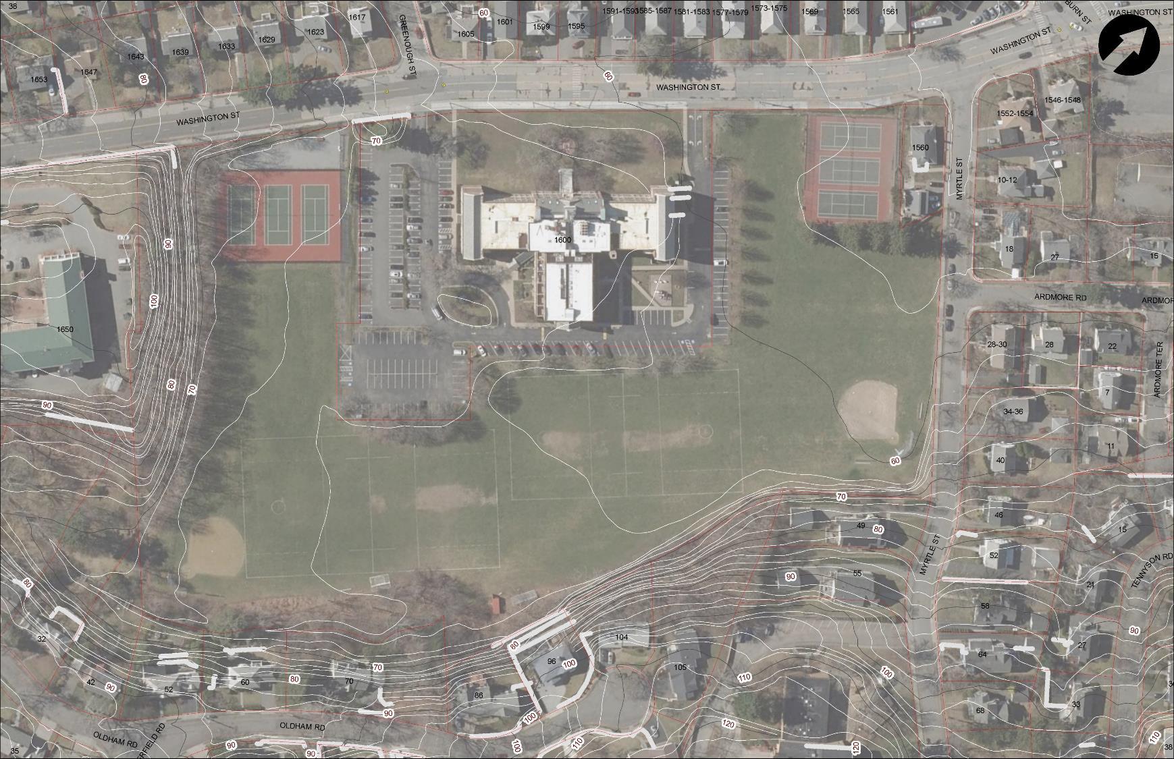
  McGrath
  Park

Slide 21
Completed Steps
Attained Community Preservation Act funding for design/engineering work
Prepared Request for Qualifications and advertised bid for designer
Next Steps
Designer Selection Committee chooses design firm
Preliminary field design/ layout developed based on community input
Share field project concepts with public

Slide 22
Questions and Discussion
For additional questions and input please contact: athleticfields@newtonma.gov
Newton Highlands Playground, Newton

Slide 23
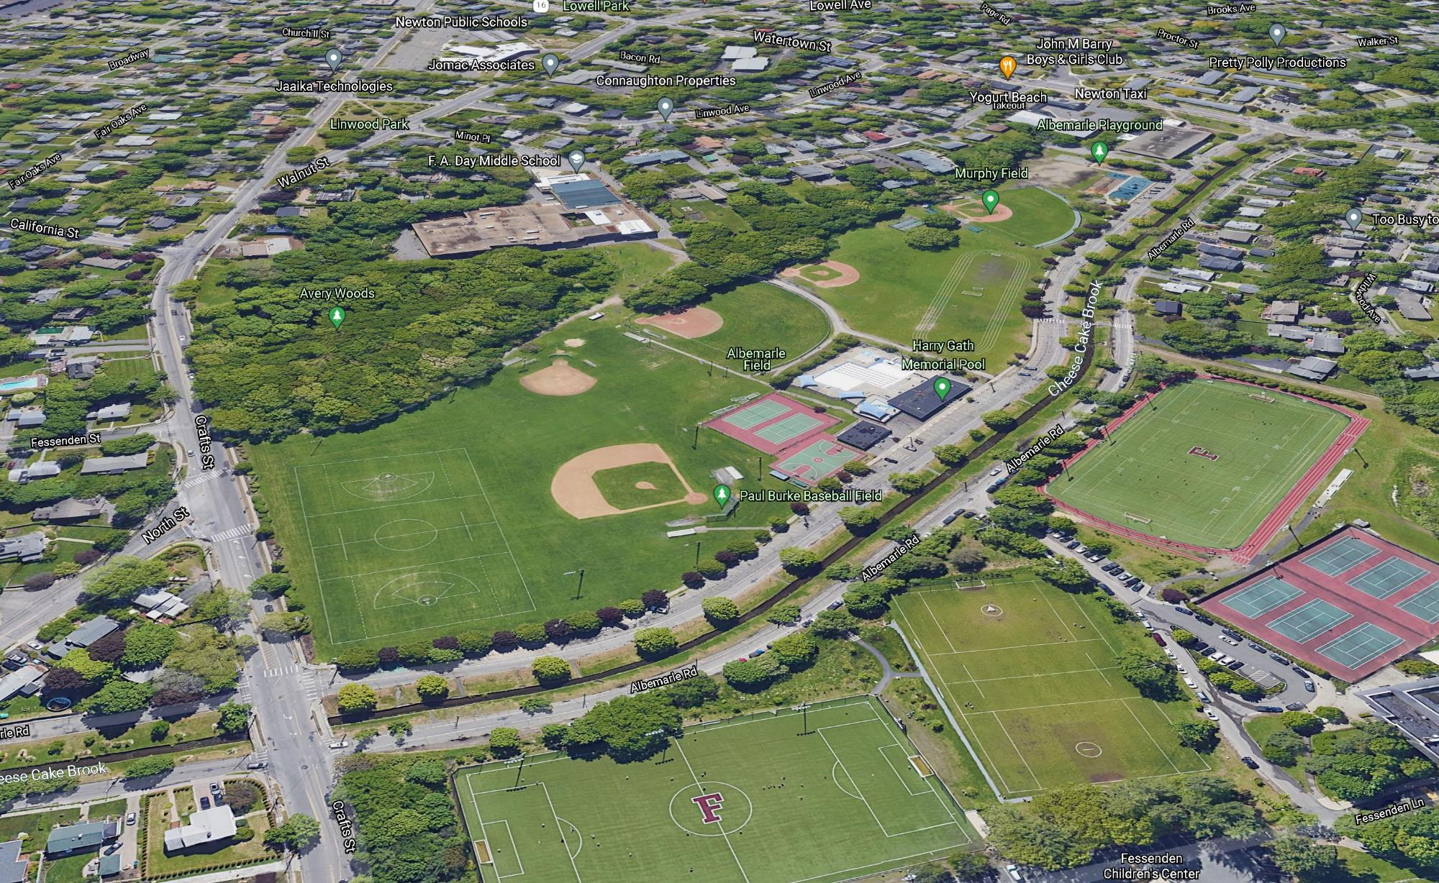
Albemarle Park

Slide 24
Newton Parks, Recreation and Culture Department
Athletic Fields Capital Improvement Plan
Parks, Recreation & Culture Overview:
Manage and oversee nearly 600 Acres of park land with varying recreational interests including:
  Aquatic facilities
  Tracks + fields
  Trails, pathways + safe routes to schools
  Playgrounds + tot Lots
  Field houses + community centers
  Hard courts
  Passive areas
  Outdoor exercise equipment
  Wooded areas
  Outdoor challenge courses
  Dog parks
  Splash pads
  Historic significance
  Wetlands and waterways
Spread across all Villages, Wards + School zones
Charles River.
Charles River.
Mass Pike/Washington St.
Walnut St.
Centre St.
Comm. Ave.
Beacon St.
Rt. 9
City of Newton Park Land Distribution

Slide 25
Why improve athletic fields?
Notes:
Here’s the agenda for today’s discussion

Slide 26
Current facilities experience little to no rest time and are overused
Notes:
Here’s the agenda for today’s discussion

Slide 27
Community Survey (Open Space + Recreation Plan)

Slide 28
Community Survey (Open Space + Recreation Plan)

Slide 29
    Field + Park Improvement Goals
      Improve quality and quantity of usable multiuse/multipurpose fields
      Improve accessibility in park and field amenities
      Establish standardized park CONSTRUCTION details to better manage operation & maintenance POST CONSTRUCTION
      Invest equitably in Newton’s Athletic Fields + Parks across the city

Slide 30
How did we prioritize field improvements?
Notes:
Here’s the agenda for today’s discussion

Slide 31
    Prioritization Criteria
      Open Space & Recreation Plan
      City of Newton Capital Improvement Plan (CIP)
      Potential for greatest city-wide benefit
      Project sequencing: prioritize new fields being brought online first
      Potential for expansion of multiuse fields
      Expanding evening play (light improvements/ additions)
      Player safety
      Integrated with other projects in a park area (e.g., path at McGrath, Gath Pool Project)

Slide 32
How do we arrive at a viable project design?
Notes:
Here’s the agenda for today’s discussion

Slide 33
Safety +
Regulatory
Guidelines
Project
Goals
Community
Input
Parks, Recreation
& Culture
Goals
Notes:
Here’s the agenda for today’s discussion

Slide 34
Newton Parks, Recreation and Culture Department
Athletic Fields Capital Improvement Plan
Phase 1 Capital Project Distribution:
Albemarle Park/ Russ Halloran Sports and Recreation Complex
Forte Park
Burr School
Brown/Oak Hill Fields
McGrath Park
Bobby Braceland
TOTAL: 6 Sites
Forte
Albemarle
Burr
School
Mass Pike/Washington St.
McGrath
Walnut St.
Centre St.
Comm. Ave.
Beacon St.
Rt. 9
BOH
Braceland
Athletic Field Capital Project Distribution

Slide 35
Additional Athletic Field Projects in the works:
  NNHS Tiger Stadium: High efficiency, low spillage Sports Lighting project (FY 23)
  NSHS Winkler Stadium & Brandeis Rd. Field: Artificial turf carpet replacement (FY 23)
  NSHS Brandeis Road Field: High efficiency, low spillage Sports Lighting project (FY 23)
  NNHS: Tiger Stadium: Artificial turf carpet replacement (FY 25)
  Forte Park: Developer-funded sports relighting (TBD)
  Increased Maintenance: additional seeding, fertilizing, and aeration, etc.

Slide 36
CITY OF NEWTON ATHLETIC FIELDS MAINTENANCE BUDGET IMPROVEMENTS
      Increase athletic field maintenance capabilities
      Increase scope of contractual maintenance work
      Significantly increase turf management capabilities

Slide 37
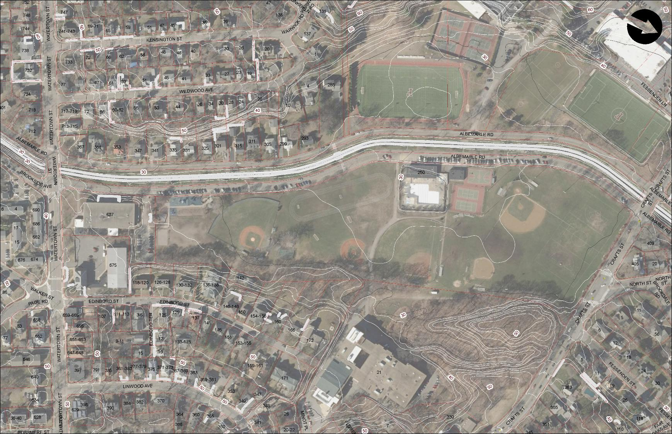
  Russ Halloran Sports & Recreation Complex at Albemarle
  24.9 ACRES
  Ward: 2
  Village: Newtonville/ West Newton
Existing Amenities
playgrounds
gazebo
Gath pool
community garden
2 little league fields
1 baseball field
1 t-ball field
2 softball fields
2 multipurpose fields
middle school track
2 intermediate soccer fields
basketball
tennis
field house
irrigated
lighted
walking paths, Avery woods
4th of July Fireworks
Snack shack/ticket booth
180 parking Spaces (10 ADA)
Gath Pool
Unusable field area
NECP
Unusable area
  Albemarle
  Park
Use Conflict
Unusable field area
F.A. Day Middle School

Slide 38
Albemarle Park Fields Key Athletic and Facility Stake Holder Data
Athletic Stake Holder Groups highlighted in Bold hold the most field permit hours per recent data

Slide 39
  Russ Halloran Sports & Recreation Complex at Albemarle
Improvement Ideas/Goals
  Developed multi-phased, multi-year improvement plans
  Some reconfigured amenities to increase multi purpose athletic field space
  Improved accessibility
  Replaced existing sports lighting at end-of-life
  Assessed park program and use needs, including:
    Gath Pool footprint
    school uses
    cultural events
  Improved safe routes to schools
  Improved shade and tree canopy coverage where possible
  Improved athletic field amenities i.e dugouts, batting cages, scoreboards (with some private funding)
  Assessed feasibility of artificial turf
Approximate Construction Budget for Phase 1: 3.2M

Slide 40
  Albemarle
  Park

Slide 41
Completed Steps
Attained Community Preservation Act funding for design/engineering work
Prepared Request for Qualifications and advertised bid for designer
Next Steps
Designer Selection Committee chooses design firm
Coordinate with Pool Project Leadership Team
Preliminary field design/ layout developed based on community input
Share field project concepts with the public

Slide 42
Questions and Discussion
For additional questions and input please contact: athleticfields@newtonma.gov
Newton Highlands Playground, Newton

