Slide 1
GATH POOL PROJECT
City of Newton
Parks & Recreation Commission
December 19, 2022

Slide 2
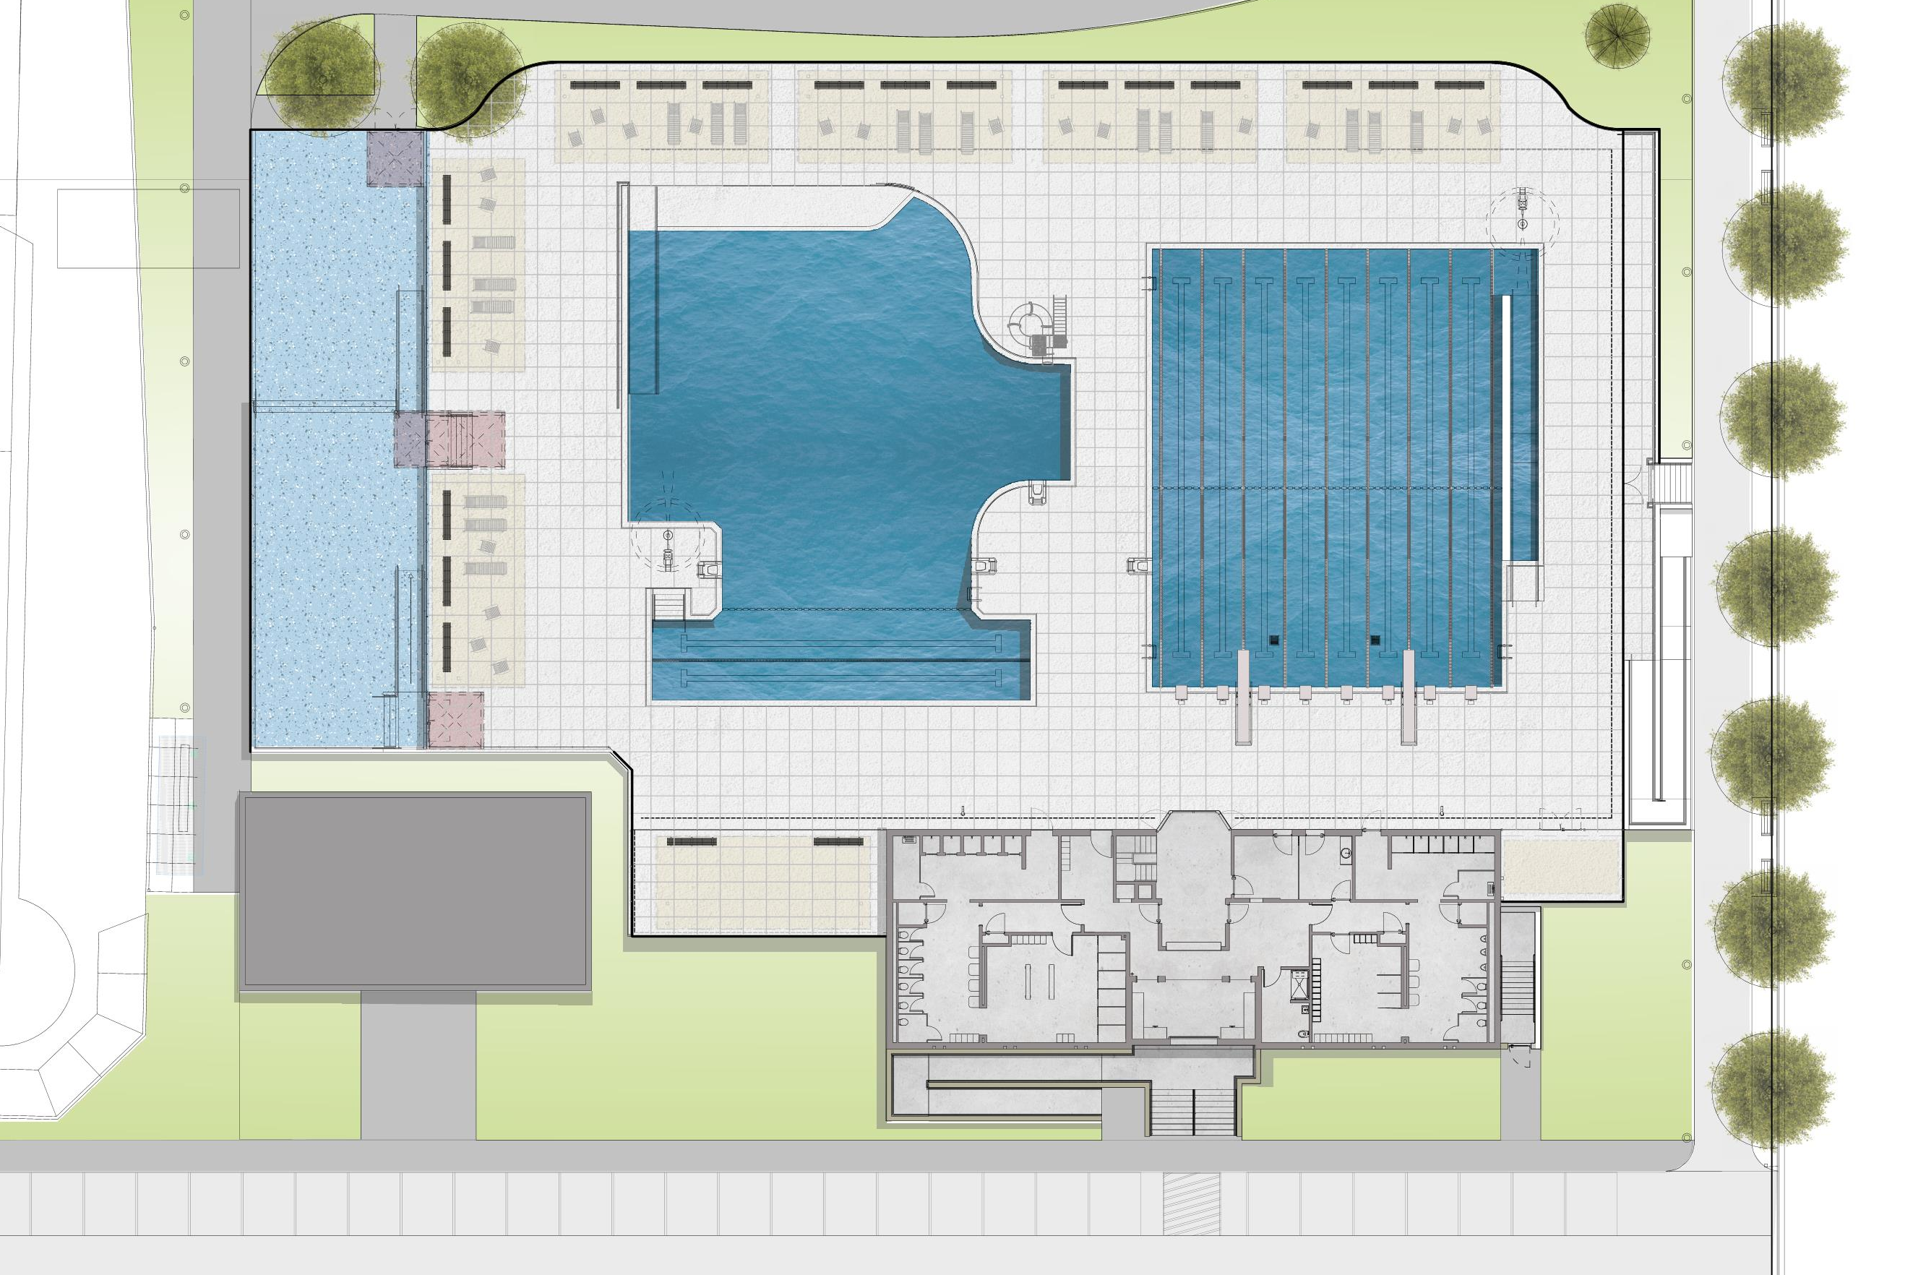
Overall Plan

Slide 3
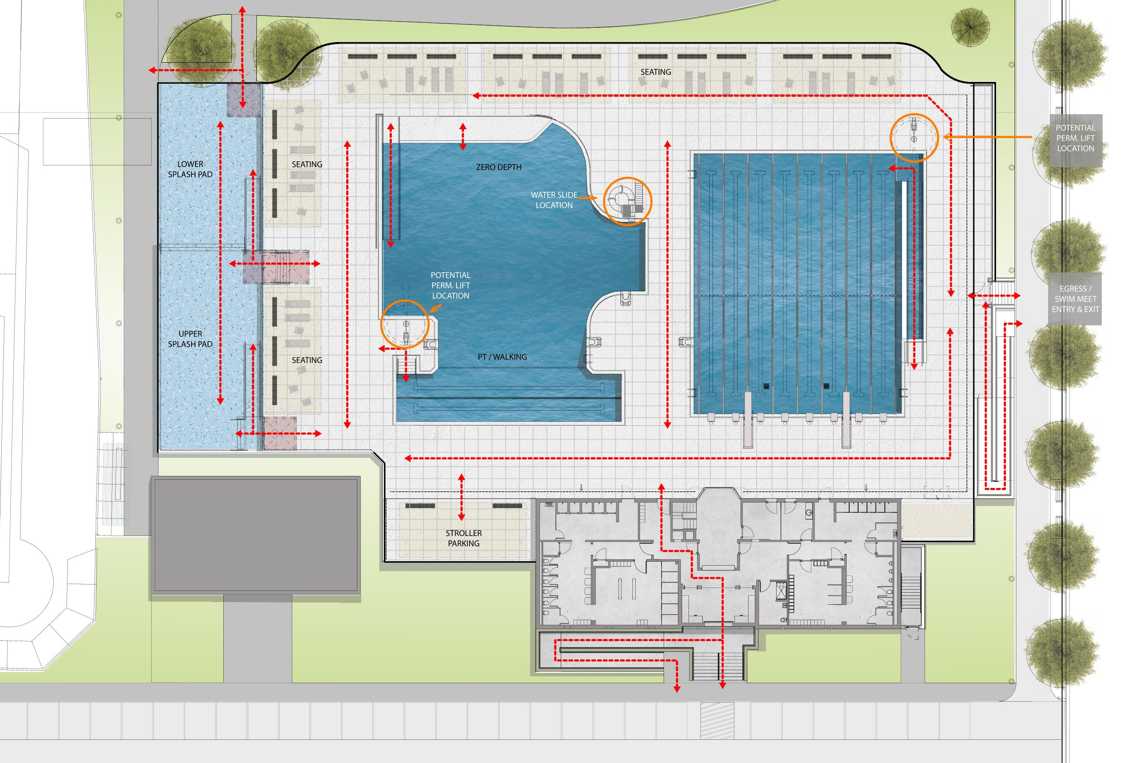
Circulation

Slide 4
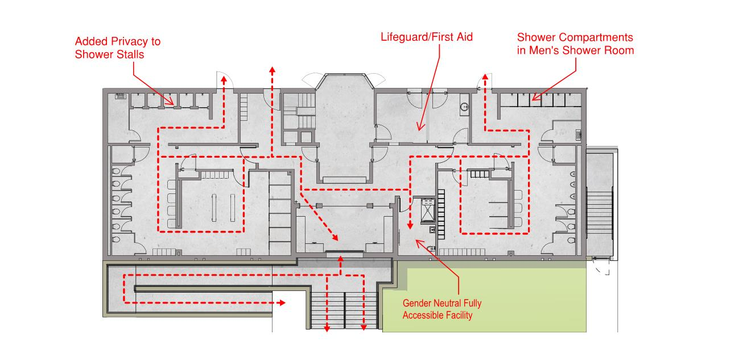
BATH HOUSE

Slide 5
QUESTIONS & COMMENTS
We welcome your thoughts and comments. Please feel free to email us at:
Project email: gathpool@newtonma.gov
Alejandro M. Valcarce, AIA: avalcarce@newtonma.gov
Luis Perez Demorizi: lpdemorizi@newtonma.gov
You can also visit the project website at:
www.newtonma.gov/gathpoolproject

