Slide 1
Polling Location Change for Ward 2 precinct 3
From
Newton Senior Center
To
Cabot Elementary School
Notes:
Thank you Chairman, and the members of the committing for having us at tonight’s meeting. I will now talk about (say docket number) the temporary polling location change for W2P3

Slide 2
#27‐23 Request to move Ward 2, Precinct 3 Polling Location
THE CITY CLERK requesting that the Ward 2, Precinct 3 polling location, currently located at the Newton Senior Center at 345 Walnut Street be temporarily relocated to Cabot Elementary School on 229 Cabot Street as the Senior Center is being rebuilt. Programs & Services Committee Agenda Wednesday, January 18, 2023
Notes:
The Senior Center will be under construction until Summer/Fall 2024
We propose that that W2P3 temporarily vote in the Gymnasium of Cabot elementary as Cabot has enough space, and resources (tables, chairs, outlets) to accommodate two precincts

Slide 3
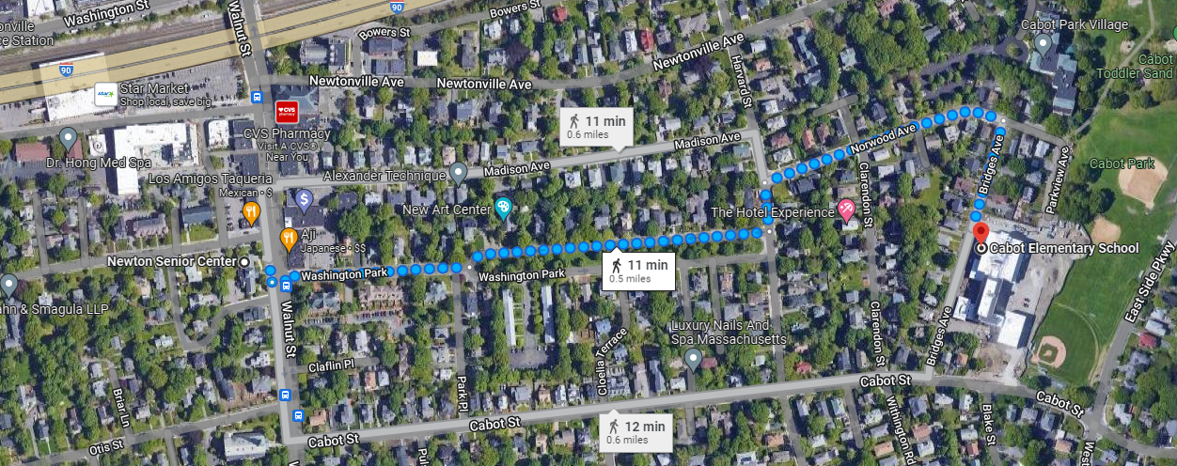
Location
Notes:
If you drive to voting, it is an additional 3-5 minute ride (.6 miles)
If you walk it is an additional 10 minute walk at most (.4 miles)
If you take the 59 bus you still can get off at the Senior Center stop, and then you just have that additional 10 minute walk as well. But it does not chance what transportation you need to take

Slide 4
Any Questions?
Notes:
Yes it can, the gym is quite spacious and offers enough resources

